Slide 1
Institute for Pure and Applied Mathematics, UCLA
2012 Program on Materials Defects
Workshop II: Quantum and Atomistic Modeling of Materials Defects
October 5, 2012
Slow Dynamics: A Case Study
Problems in Atomistic Modeling of Materials Aging
Sidney Yip
Nuclear Science and Engineering/Materials Science and Engineering
MIT

Slide 2
Solve one “grand challenge” problem to illustrate the accessibility to multiscale modeling of problems in materials aging
Account for experimental T - variations of viscosities of glasses
TSP sampling using a metadynamics algorithm
Heuristic model of activation barrier Q(T) and linear response (G-K) theory
Predictions of fragile and strong behavior observed in glasses

Slide 3
collaborators
Akihiro Kushima (MIT/UPenn)
Xi Lin (BU)
Ju Li (UPenn/MIT)
John Mauro (Corning Research Center)
Jacob Eapen (NCSU)
Xiaofeng Qian (MIT)
Phong Diep (Corning Research Center)

Slide 4
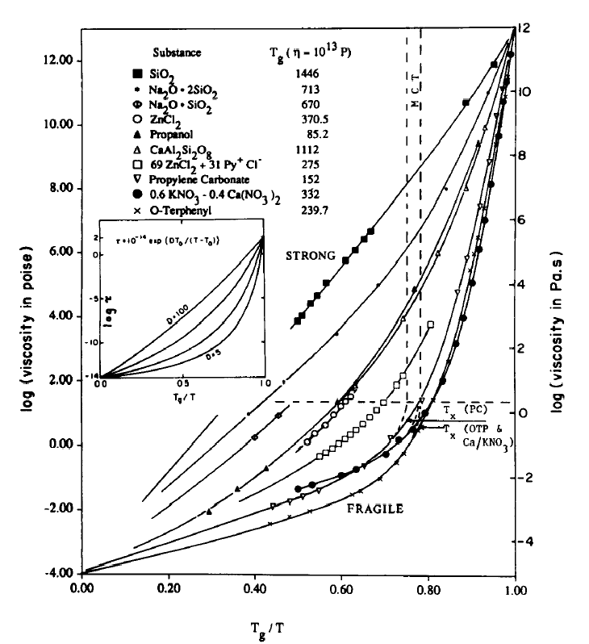
Can atomistic modeling account for the behavior of fragile and strong glasses?
fragile vs. strong
C. A. Angell, J. Phys. Chem. Solids 49 (1988)

Slide 5
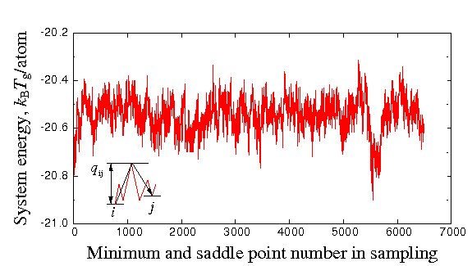
Atomistic input to modeling the fragile behavior
(obtained by sampling method ABC,BLJ potential)

Slide 6
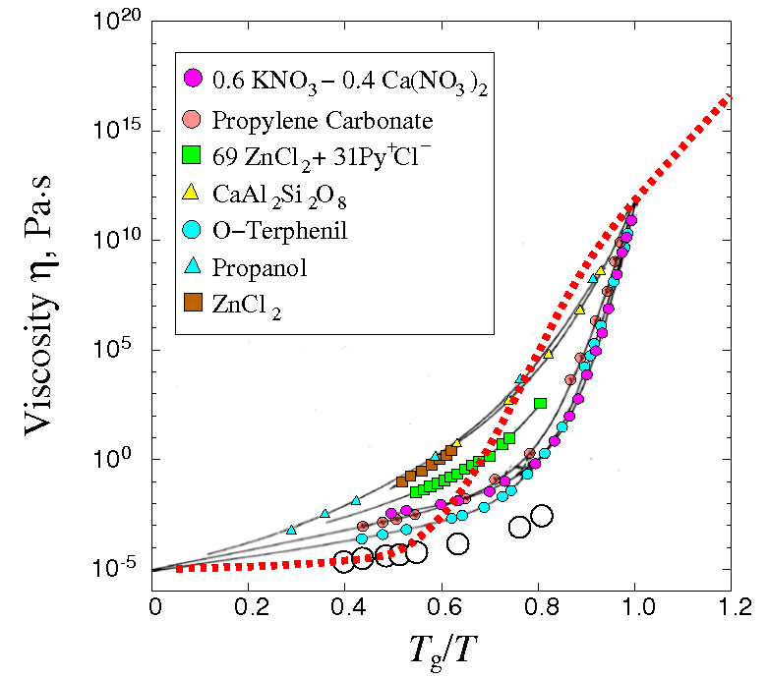
Heuristic Model prediction
A. Kushima et al, JCP.130 (2009)

Slide 7
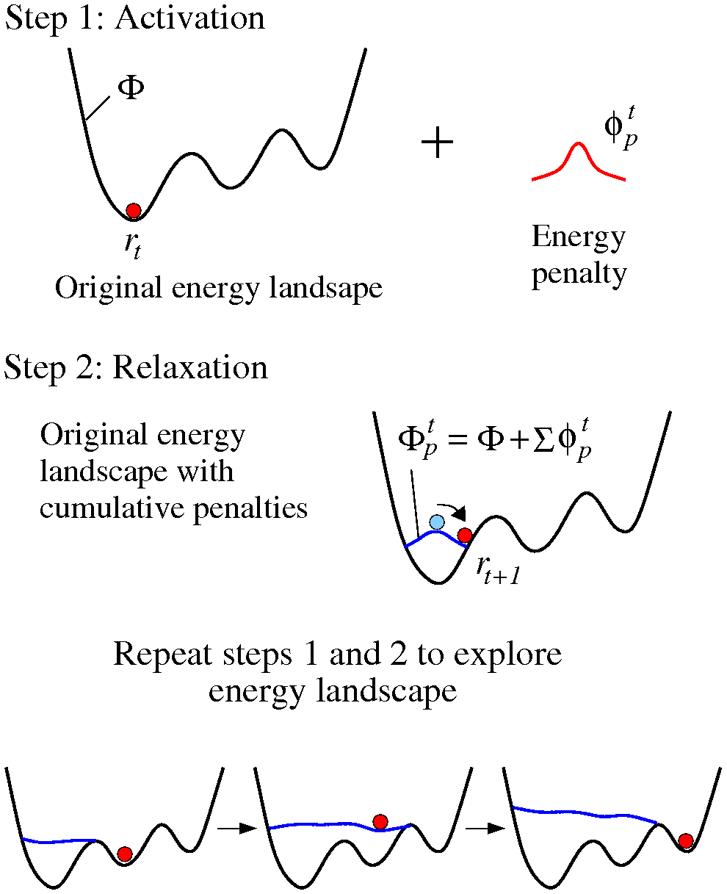
A metadynamics algorithm : Autonomous Basin Climbing
A. Kushima et al, J CP130 (2009)

Slide 8
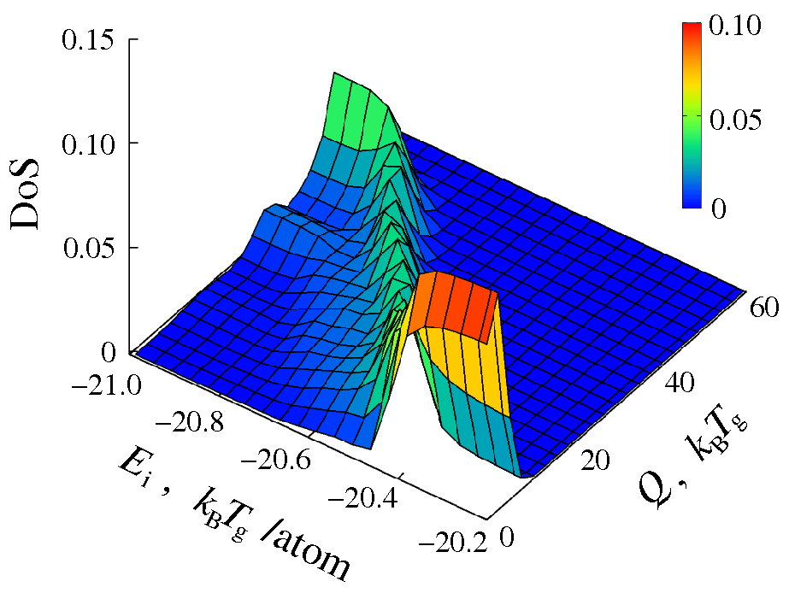
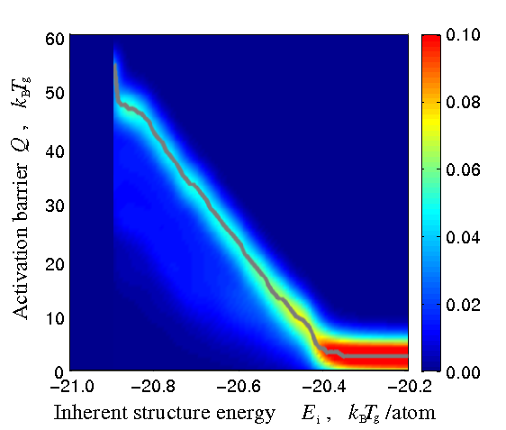
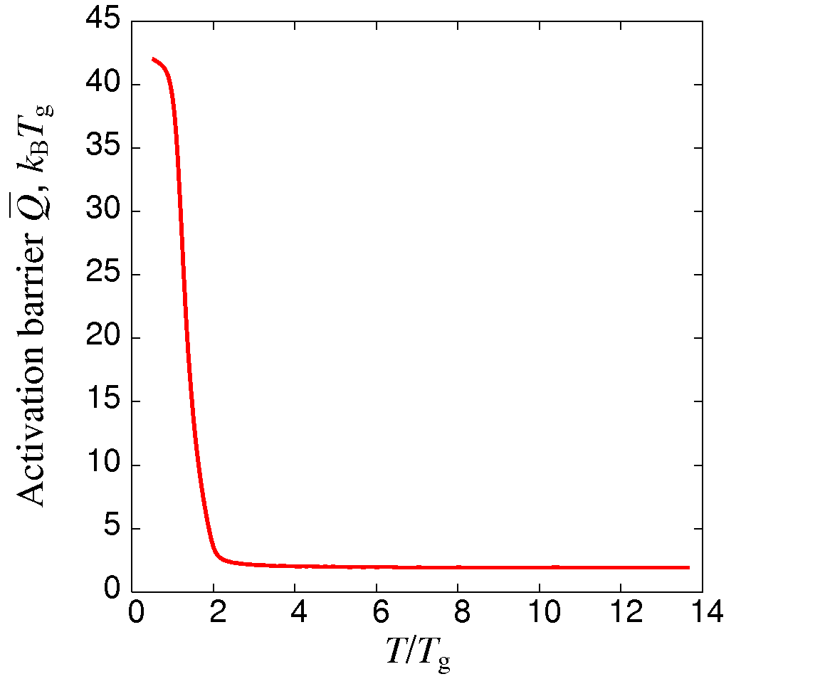
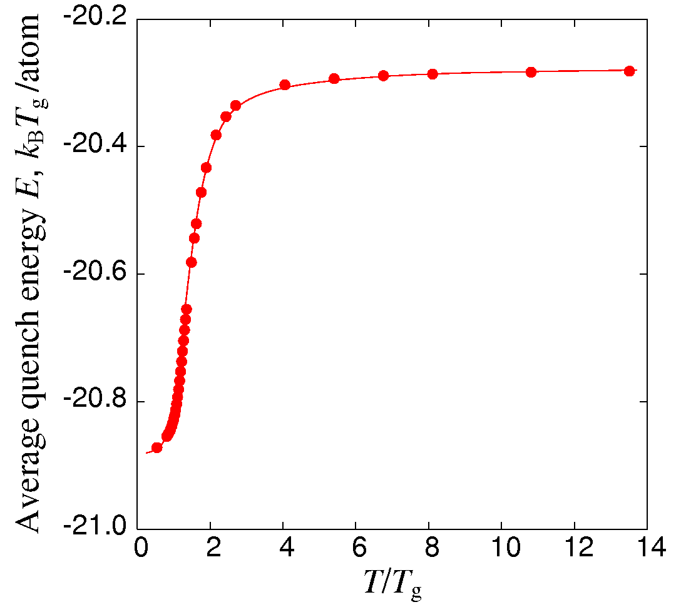
TSP trajectory analysis to obtain effective activation barrier Q(T)
A. Kushima et al, J. Chem. Phys.130 (2009)

Slide 9
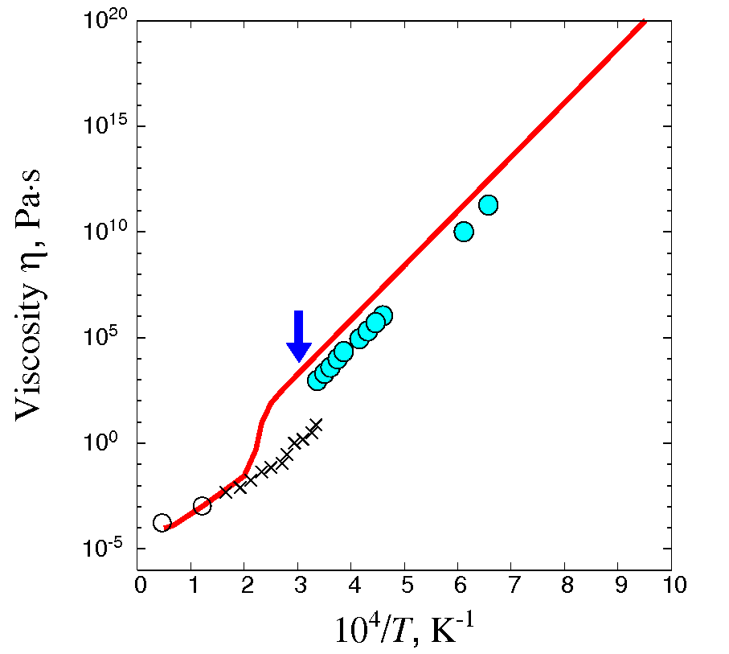
Heuristic Model prediction for SiO₂
SiO₂
Potential: Feuston and Garofalini, JCP (1988)
Saika-Voivid et al,
Nature (2001)
Horbach and Kob, PRB (1999)
A. Kushima et al, JCP.131 (2009)

Slide 10
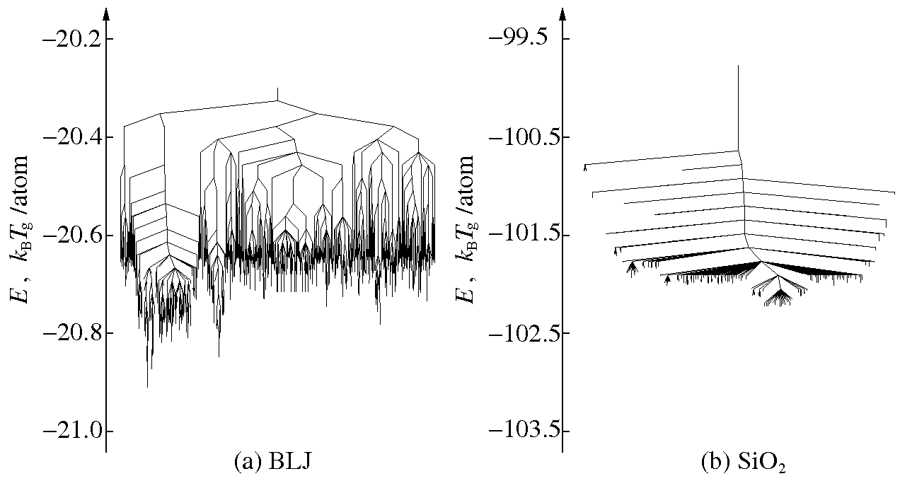
Disconnectivity Graphs of a fragile and strong glass former
A. Kushima, JCP 131 (2009)
Becker and Karplus, JCP 106 (1977), D. Wales (2006)

Slide 11
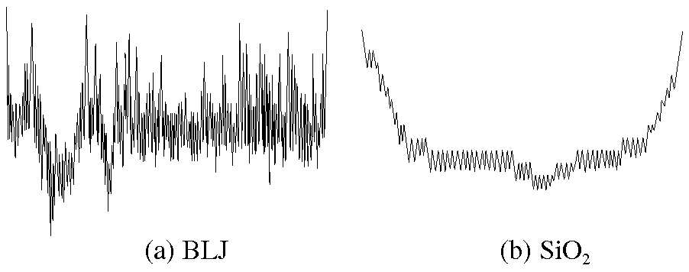
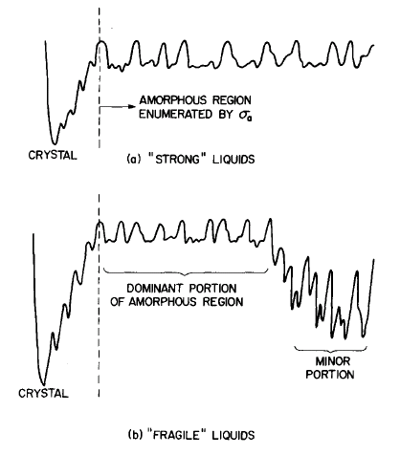
Potential energy landscape profiles (derived from TSP trajectories)
A. Kushima et al., JCP 131 (2009)
F. H. Stillinger, JCP 88 (1988)

Slide 12
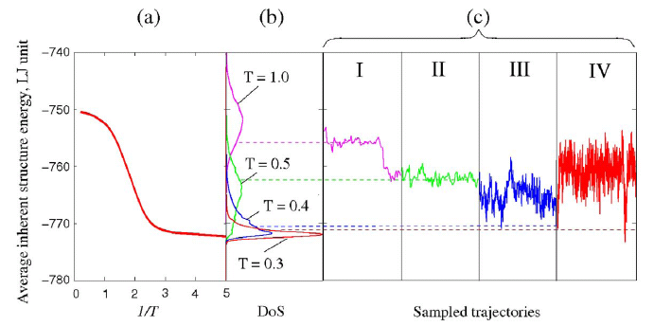
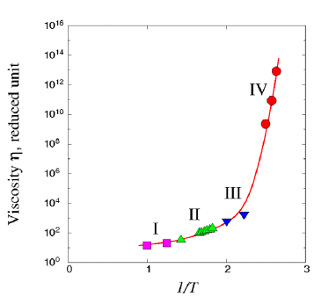




Green-Kubo calculation using Network Model and TSP trajectories
A. Kushima et al, J. Chem. Phys.130 (2009), J. Li, Plos ONE 6, e17909 (2011)

Slide 13
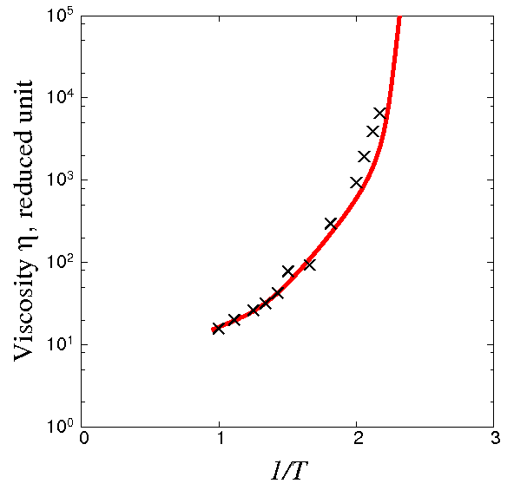
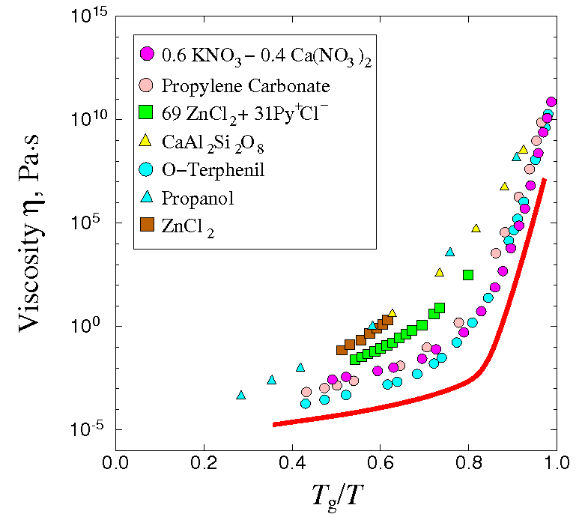
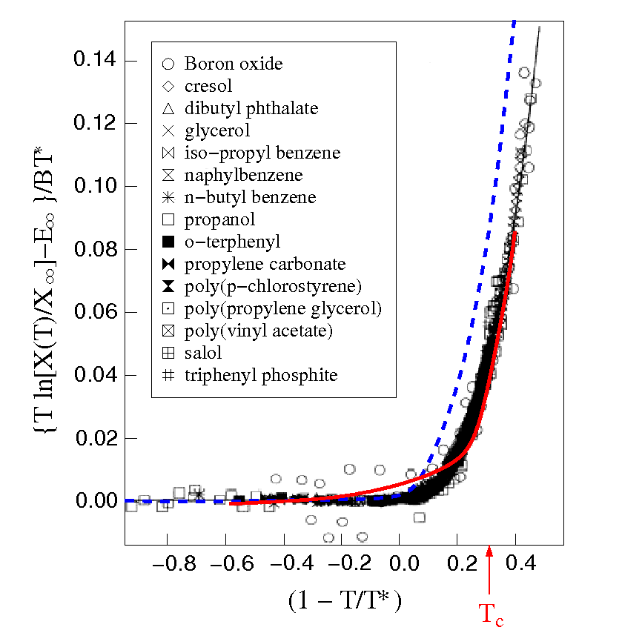
Green-Kubo (linear response theory) prediction
J. Li et al, Plos ONE (2011)

Slide 14
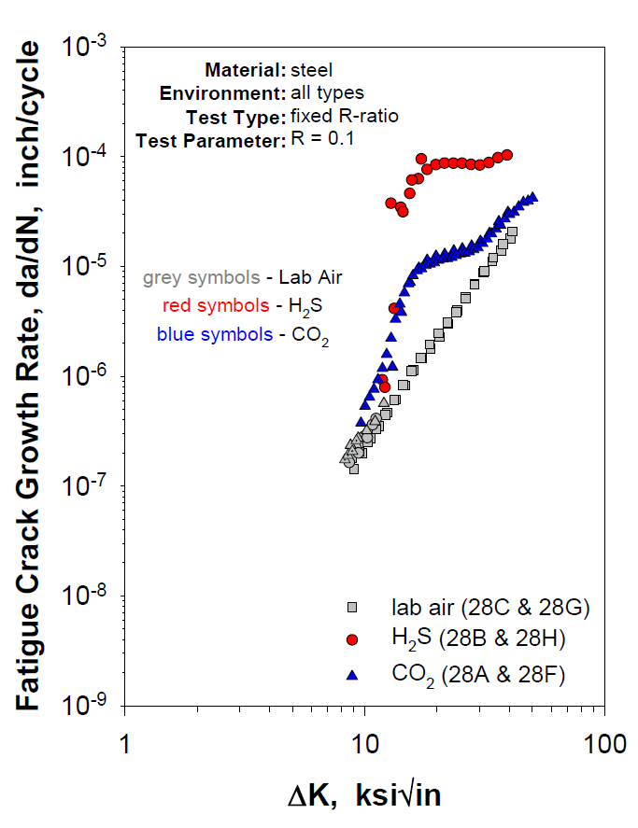
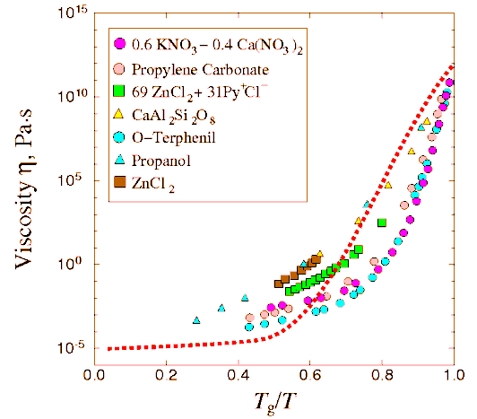
Energy Landscape Perspective
Transition State Pathway Sampling gives trajectories with saddle points
TSP trajectories → Q(T), Q(σ), Q(σ, T)
Besides n(T) one can study other phenomena involving thermal fluctuations or stress activations. In these problems atomistic modeling can probe the governing mechanisms
Cement setting
corrosion
creep
viscosity

Slide 15
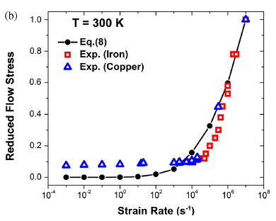
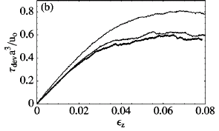
Strain-rate effects on yield stress in metals
strain localization
Fan et al. PRL 109 (2012)

Slide 16
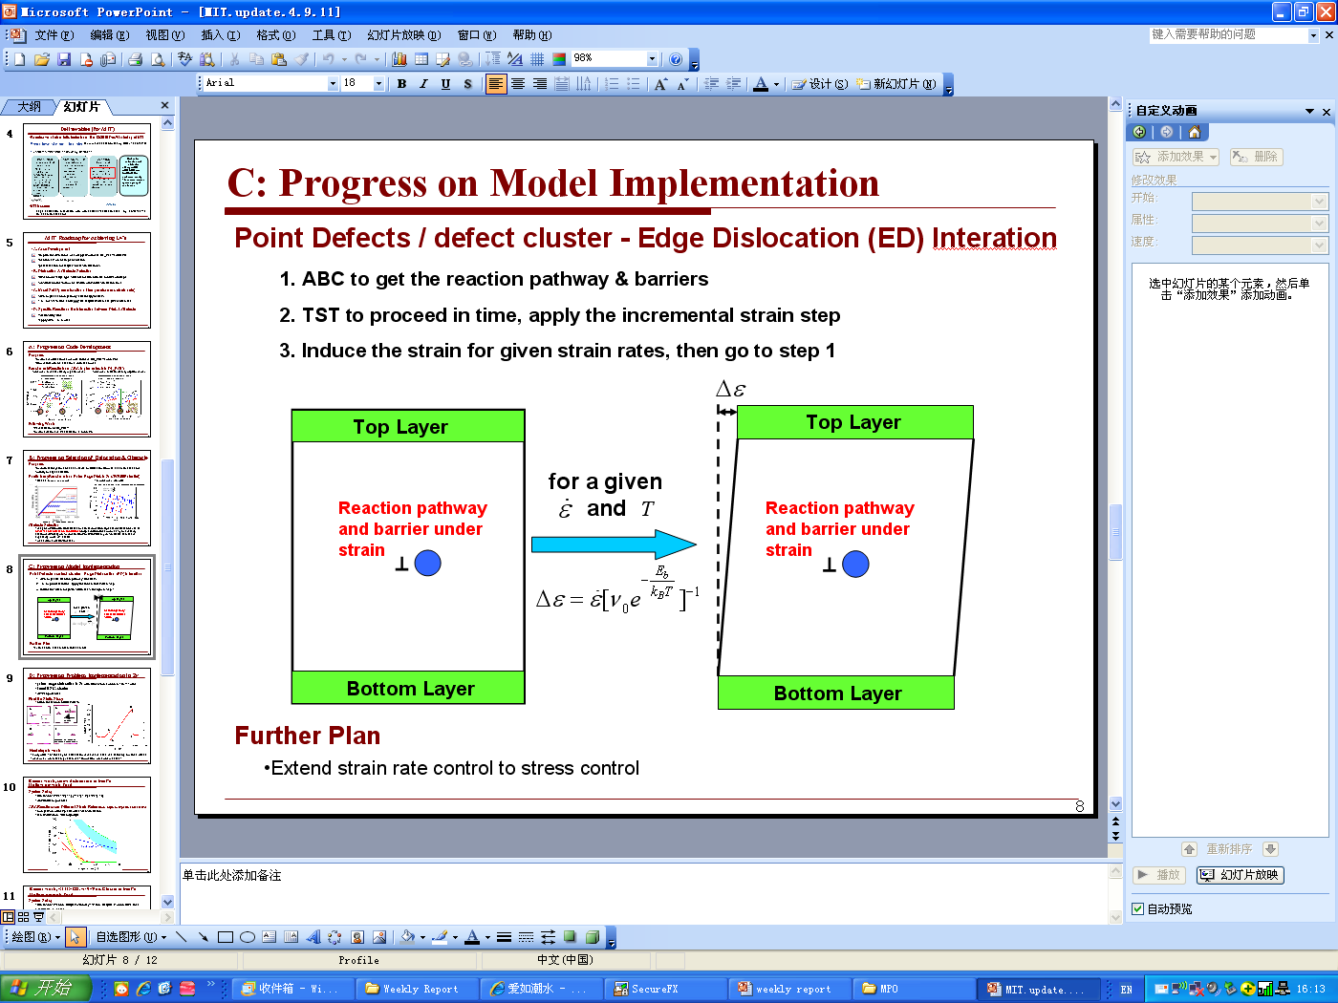
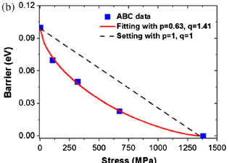
Dislocation mobility model to describe σ_{F}(έ)
stress/thermal activation TST
time-dep constitutive behavior
master eq. (coarse graining)
only unknown is
Dislocation (mobility and density) provides a measure of the ability of a material to endure plastic deformation

Slide 17
Solve one “grand challenge” problem to illustrate the accessibility to multiscale modeling of problems in materials aging
Atomistic modeling can provide insight into mechanisms that control key functional properties of complex materials
When a study is properly formulated and executed, it is possible to achieve fundamental scientific advances with technology impact

Slide 18
Back up slides

Slide 19
Creep deformation in steel P-91
MD strain rates ~ 10⁷ s^{-1 !}
R. L.Klueh, Int. Mat. Rev. 50, 287 (2005)

Slide 20
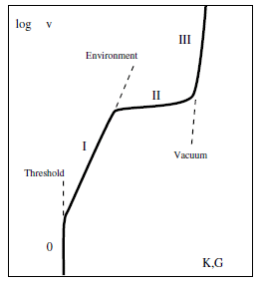
Stress corrosion cracking
C. Ciccotti, J. Phys. D 42 (2009)
J. W. Martin, BP Research (2010)

Slide 21










DOE Energy Innovation Hub in Nuclear Modeling and Simulation
CASL: Consortium for Advanced Simulation
of Light Water Reactors
Core partners
Oak Ridge
National Laboratory
Electric Power
Research Institute
Idaho National Laboratory
Los Alamos National Laboratory
Massachusetts Institute
of Technology
North Carolina State University
Sandia National Laboratories
Tennessee Valley Authority
University of Michigan
Westinghouse Electric Company
Awarded May 28, 2010
Vision: Create a predictive simulation capability
for a virtual LWR

Slide 22
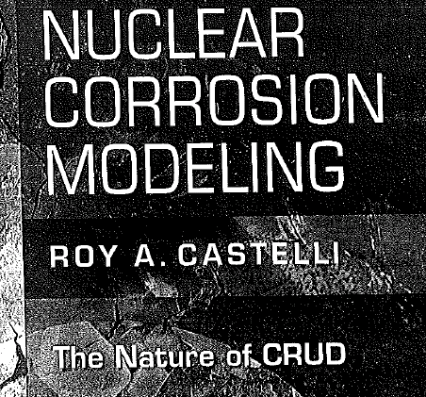
Chalk River Unidentified Deposits (CRUD)

Slide 23
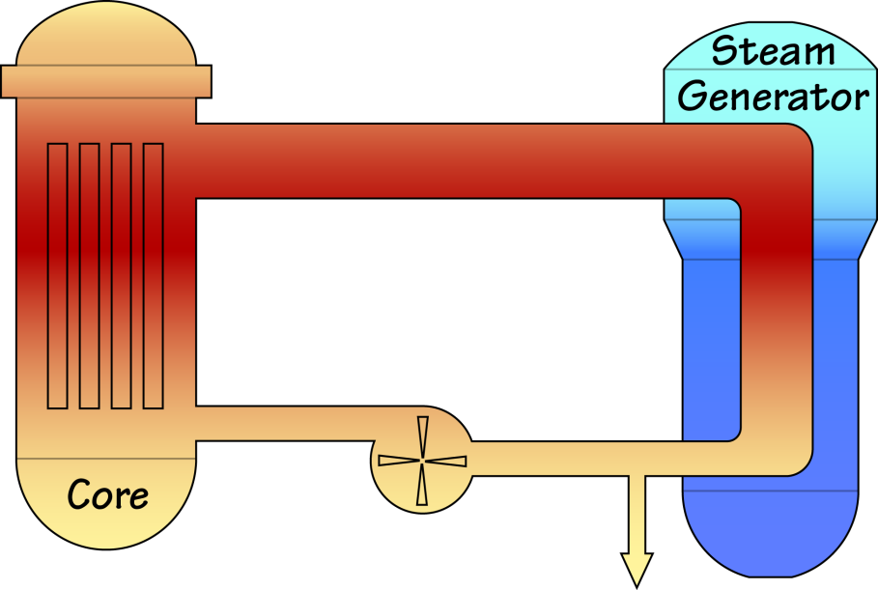
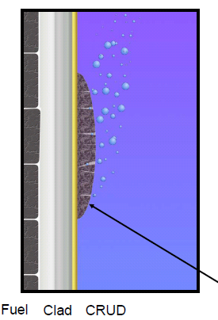
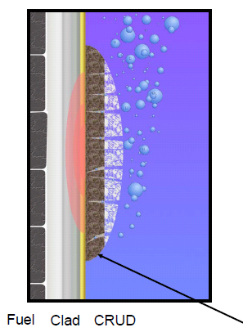

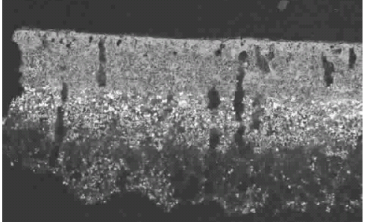
CRUD deposition/growth (early stage) and CRUD-induced
localized corrosion (late stage) leading to clad cracking
Fe++
Ni++

Slide 24
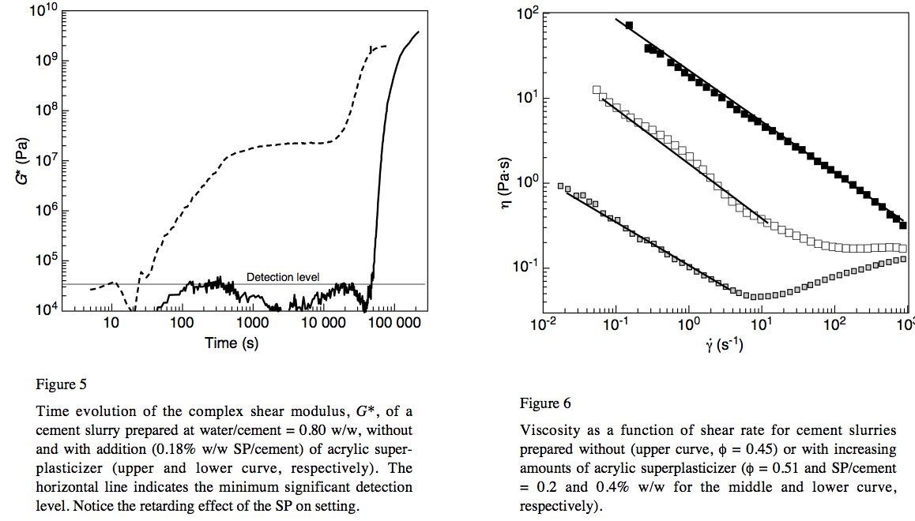
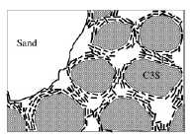
Cement hydration (setting) is a ‘grand challenge’ to molecular simulation
Shear
modulus
G* [Pa]
percolation/
jamming
C-S-H precipitation
gelation
C3S + H₂O → C-S-H + Ca(OH)₂
C3S = Ca₃SiO₃ C-S-H = CaO-SiO₂-H₂O
Ultrason measurement, w/c = 0.8 [Lootens 2004]

Slide 25

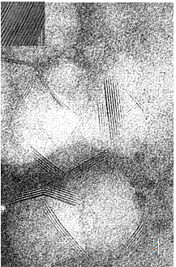
green = inter-layer Ca
grey = intra-layer Ca
blue = oxygen
white = hydrogen
(CaO)_{1.65}(SiO₂)(H₂0)_{1.75}

Slide 26
Binary Colloidal Model with sticky potentials [P. Monasterio, 2010]
Model is undergoing further development to incorporate
C-S-H nucleation/growth

