Slide 1
Atomistic Formation Mechanisms and Functionalization of Epitaxial Graphene on Transition Metal Substrates
Zhenyu Zhang
International Center For Quantum Design of Functional Materials (ICQD), Univ. of Science & Technology of China
&
Department of Physics, Univ. of Texas, Austin
Supported by
National Natural Science Foundation of China
U.S. National Science Foundation
U.S. Department of Energy

Slide 2
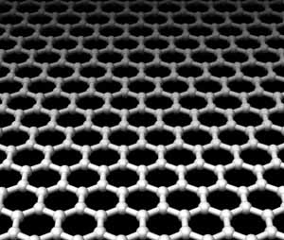
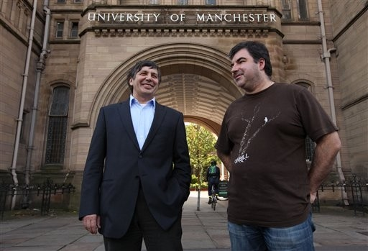
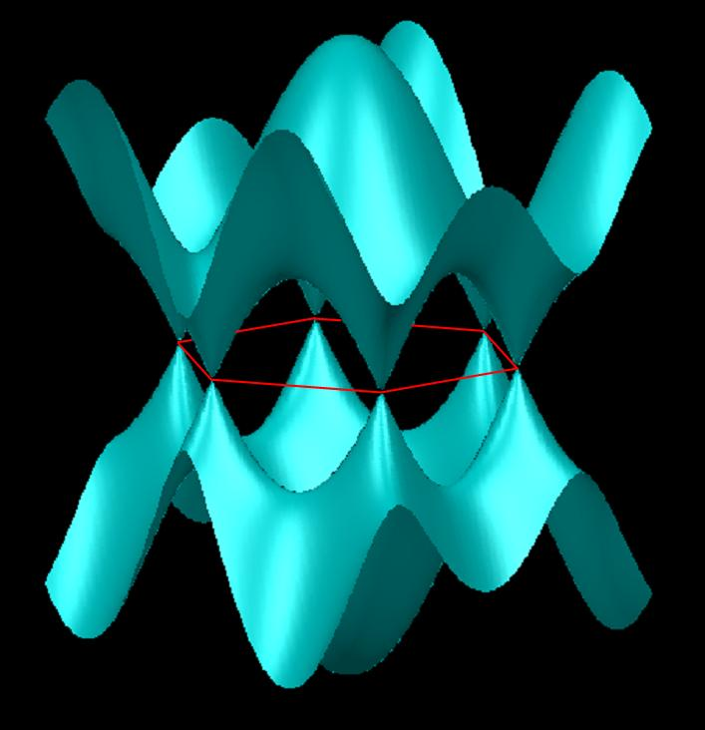
Graphene: Hot Topic, Big Prize, & Simple Tool
Going Beyond the “Scotch-Tape” Approach:
Fundamental Growth Science Towards
Mass Production of High Quality Graphene on Various Substrates
The Nobel Prize in Physics (2010):
Andre Geim and Novoselov Konstantin
Band Structure:
Linear Dispersion around the Dirac Points
(E ~ k, “relativistic”)
“Physics Nobel Prize Winners' Secret: Scotch Tape”

Slide 3


t_{zz}=0:
Beautiful Site, Stimulating Workshop, and Inspiring Lectures

Slide 4
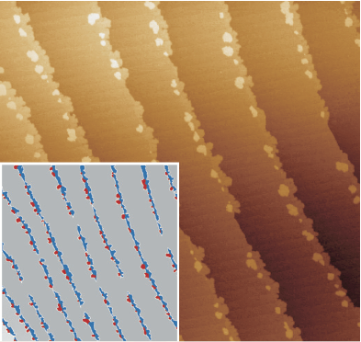
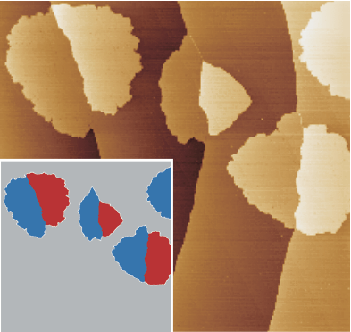
Step-edge Initiated Growth
on Ir(111) and Ru(0001)
STM
Graphene on Ir(111)
J. Coraux, T. Michely et al.,
New J. Phys. 11, 023006 (2009)
Graphene on Ru(0001)
P. W. Sutter, J.-I. Flege, & E. A. Sutter
Nature Mat. 7, 406 (2008)
Notes:
STM topograph (455 nm×455 nm) of graphene grown by CVD on a Ir(111) surface at 970K. The ethene partial pressure used for the growth of graphene is 5×10−10 mbar, and the exposure time is 40 s, except for (a) where it is 80 s. Insets show graphene as hashed areas or in red (blue) when attached at a descending (ascending) step edge.
The time evolution of C monomer concentration during C deposition at 740 K. Graphene first nucleates at step edges of the Ru substrate when the monomer concentration reaches Cnuclstep. At higher concentration cnuclterr, graphene nucleates on the terraces. The deposition flux was reduced at 770 s and turned off at 830 s. LEEM images (9.3μm field-of-view) taken at the labelled times.
4

Slide 5
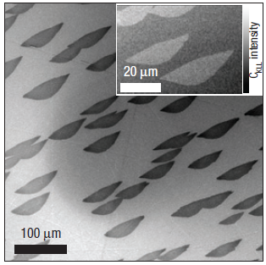
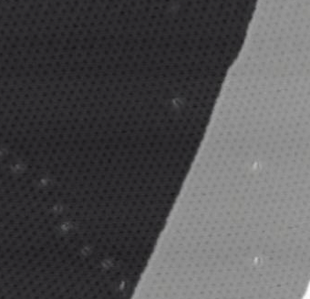
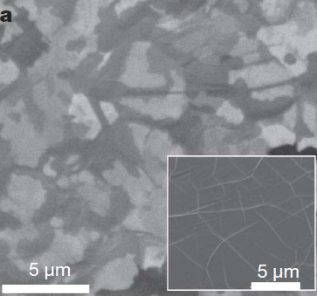
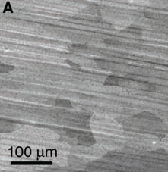
Epitaxial Graphene on Metal Substrates:
From Islanding to Micron-Sized Monolayers
Ru(0001)
Ir(111)
Ni(111)
Cu(111)
Ru(0001):
Sutter, Flege, and Sutter, Nature Mater. 7, 406 (2008).
Pan et al., Adv. Mater. 21, 2777 (2009).
Marchini, Gunther, and Wintterlin,
Phys. Rev. B 76, 075429 (2007).
Loginova, Bartelt, Feibelman, and McCarty,
New J. Phys. 10, 093026 (2008); 11, 063046(2009).
Ir(111):
Coraux, N′Diaye, Busse, and Michely,
Nano Lett. 8, 565 (2008).
Coraux et al., New J. Phys. 11, 023006 (2009).
Ni(111)
Kim et al., Nature 457, 706 (2009).
Yu et al., Appl. Phys. Lett. 93, 113103 (2008).
Reina et al., Nano Lett. 9, 30 (2009).
Cu(111):
Li et al., Science 324, 1312 (2009).
Li et al., Nano Lett. 9, 4268(2009).
Gao, Guest, and Guisinger, Nano Lett. 10, 3512 (2010).
Bae et al., Nature Nanotech. 5, 574 (2010).
Cao et al., Appl. Phys. Lett. 96, 122106 (2010).
Distinctive merits and potentials for graphene electronics:
Mass production, transferrable, “good” quality
Notes:
Controllability(self-terminating)

Slide 6
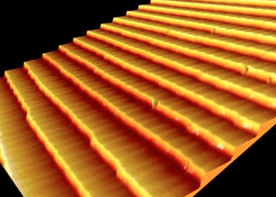
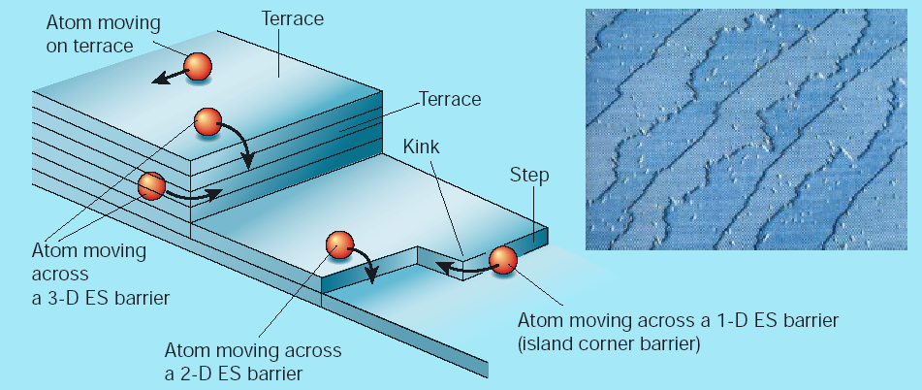
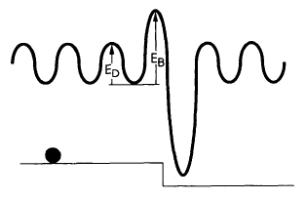
Atomistic Processes and Morphological Evolution on Stepped Substrates
Zhenyu Zhang, Max Lagally, and Many Collaborators
New playground:
Nucleation and growth of carbon islands on stepped metal surfaces
ES barrier
Try to stay away from the graphene “theory rush”

Slide 7
Outline
Brief Introduction on Motivation
Atomistic Mechanisms of Epitaxial Growth of Graphene:
  Why Cu is the preferred substrate? (Hua Chen)
  Carbon nanoarches (Robert van Wesep)
  Suppression of grain boundaries (Wei Chen)
    Low-temperature growth (Jin-Ho Choi)
  Functionalization of Graphene
    Magnetization (Shifei Qi)

Slide 8





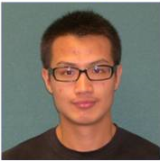
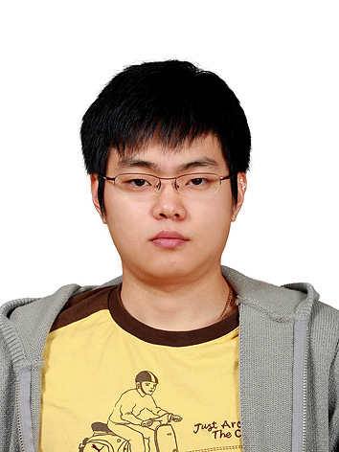
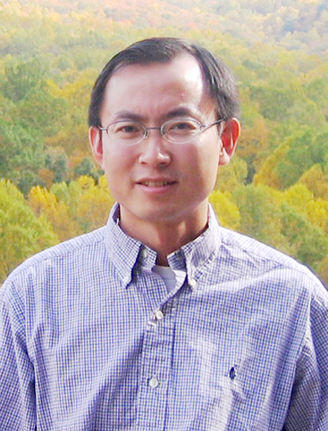


“Facebooked” Collaborators
Dr. Hua Chen, UTK/UT Austin
Robert Van Wesep, UTK
Mr. Wei Chen, UTK
Dr. Jin-Ho Choi, USTC
Dr. Shifei Qi, Shanxi Normal U
Dr. Wenguang Zhu, UTK/USTC
Dr. Ping Cui, USTC
Dr. Tim Schulze, UTK
Dr. Changan Zeng, USTC
Dr. Xiaohong Xu,
Shanxi Normal U

Slide 9
Outline
Brief Introduction on Motivation
Atomistic Mechanisms of Epitaxial Growth of Graphene:
  Why Cu is the preferred substrate? (Hua Chen)
  Carbon nanoarches (Robert van Wesep)
  Suppression of grain boundaries (Wei Chen)
    Low-temperature growth (Jin-Ho Choi)
  Functionalization of Graphene
    Magnetization (Shifei Qi)

Slide 10
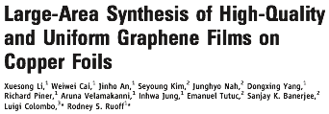
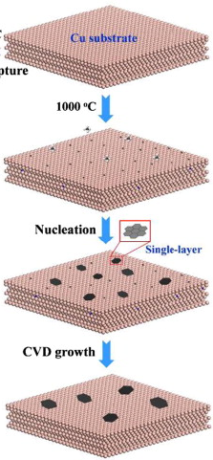
Graphene synthesis by CVD on Cu substrates
Typical CVD method
Dosing carbon source
eg) methane (CH4)
Science 324, 1312 (2009)
Previous: exfoliation method
Dehydrogenation
of the carbon sources
Limited graphene size
Chemical vapor deposition (CVD) on Cu substrates
Carbon coalescence
Graphene films of the order of centimeters
Formation of
large high-quality graphene
Most of the synthesized graphene films are monolayer in thickness (more than 95%).

Slide 11
Generic Understanding of Growth
Growth, by definition, is nonequilibrium in nature, and in many cases is far from equilibrium.
A specific growth mode is selected by the interplay between thermodynamics and growth kinetics.
Thermodynamics
Kinetics (various atomic rate processes)

Slide 12
Philosophy
If we can establish EVERY correspondence between
Atomic Rate Process
Morphological Evolution
then in principle we should be able to select a preferred growth mode via precise control of the various rate processes.

Slide 13
Atomistic Mechanisms: Back to “Arithmetics”
N=1: Rest areas of monomers
N=2: Preferred nucleation sites of dimers
N=3, 4, 5, …:
* Carbon Nanoarches
* 1D 2D transition
N=6 and beyond:
* On Cu(111): Good islands, bad islands
* On alloyed Cu(111):
# Good islands
# Minimal grain boundaries
Notes:
Controllability(self-terminating)

Slide 14
Atomistic Mechanisms: Back to “Arithmetics”
N=1: Rest areas of monomers
N=2: Preferred nucleation sites of dimers
N=3, 4, 5, …:
* Carbon Nanoarches
* 1D 2D transition
N=6 and beyond:
* On Cu(111): Good islands, bad islands
* On alloyed Cu(111):
# Good islands
# Minimal grain boundaries
Notes:
Controllability(self-terminating)

Slide 15
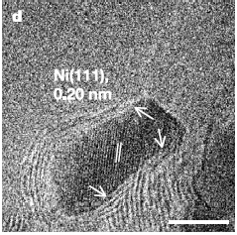
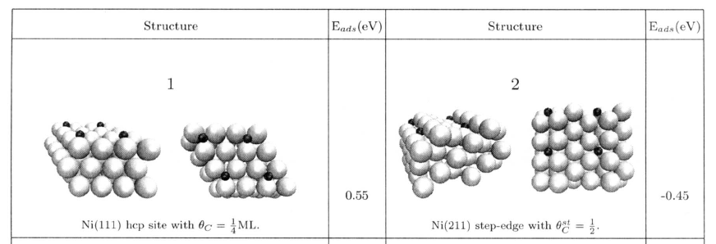
1st Thought: C monomers prefer step edges
(as shown on Ni(111))
S. Helveg et al., Nature 427, 6973 (2004)
F. Abild-Pedersen et al., PRB 73, 115419 (2006)
1 eV difference
Notes:
15

Slide 16
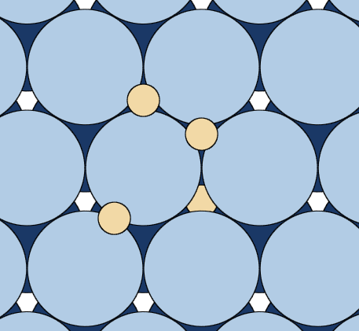
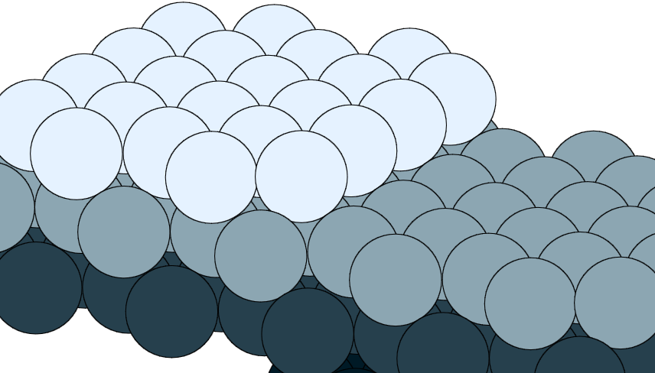
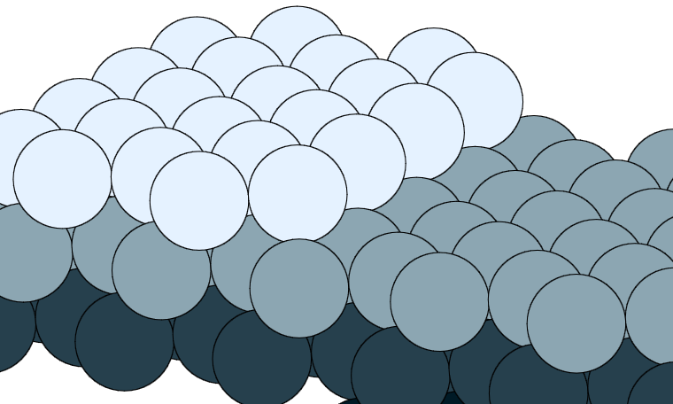
Methods
fcc
hcp
bridge
octahedral
VASP
PAW-PBE
Nudged Elastic Band
6-layer slab
2x4 square surface unit cell
Ir, Ru, Cu
tetrahedral
A-step
B-step
Notes:
16

Slide 17
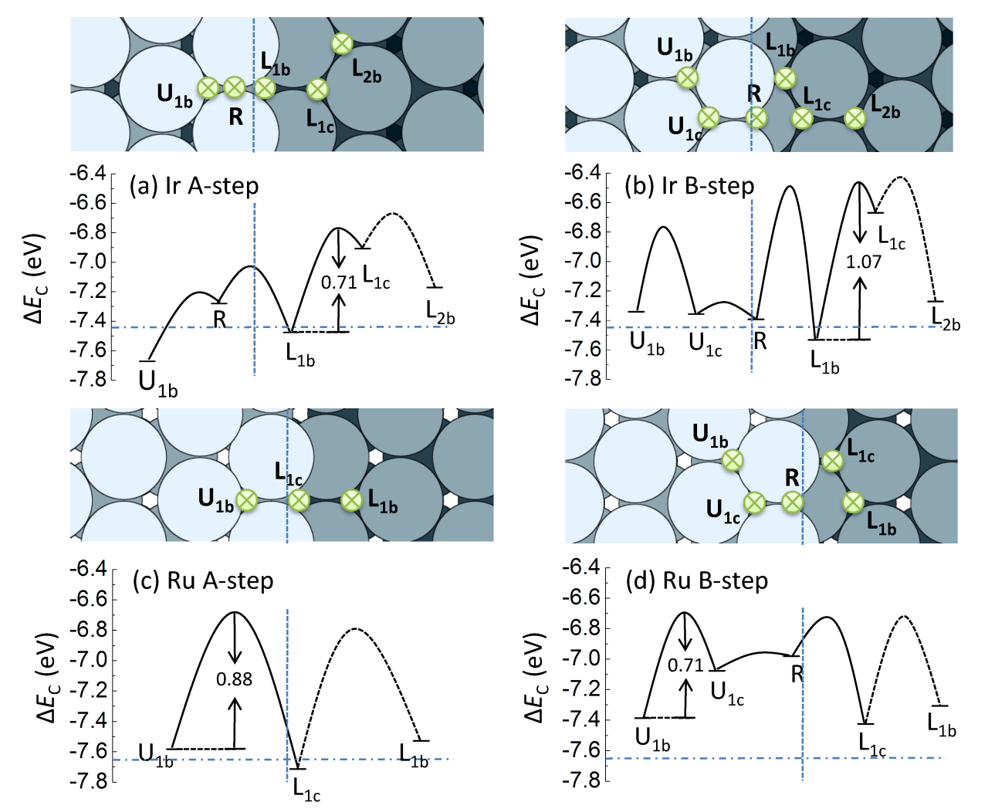
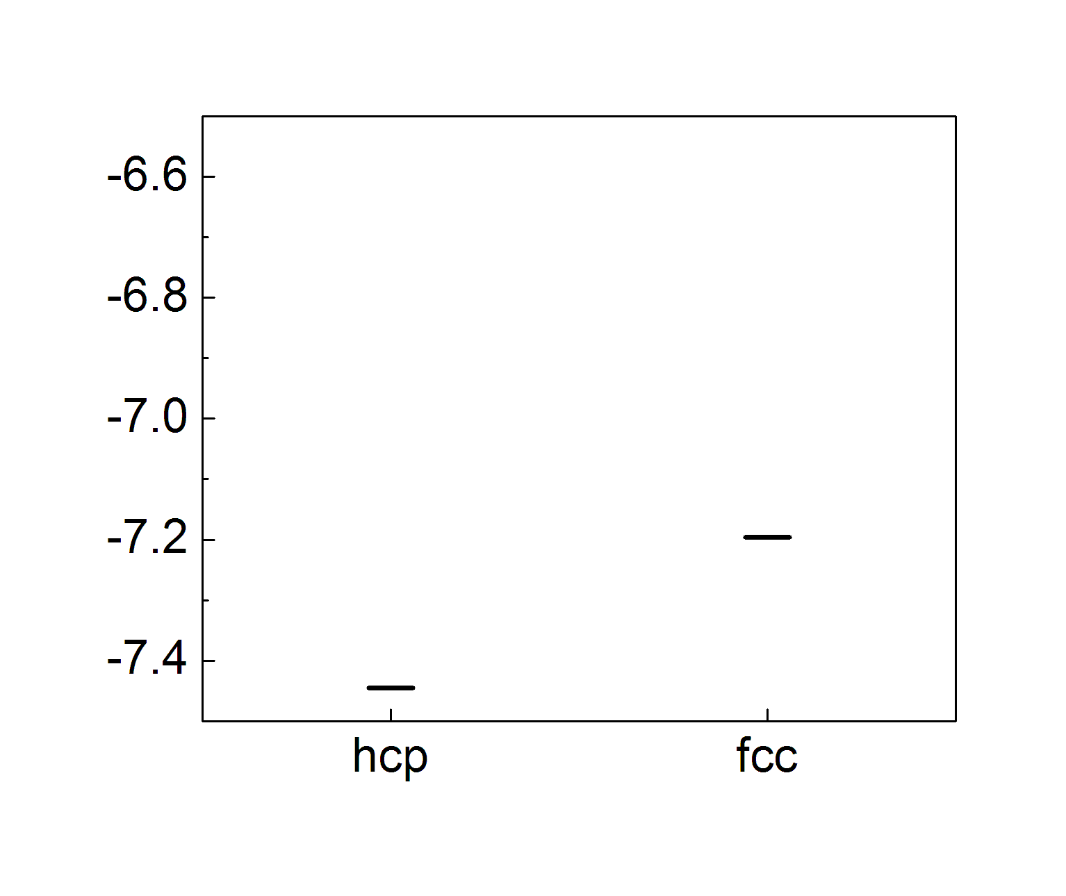
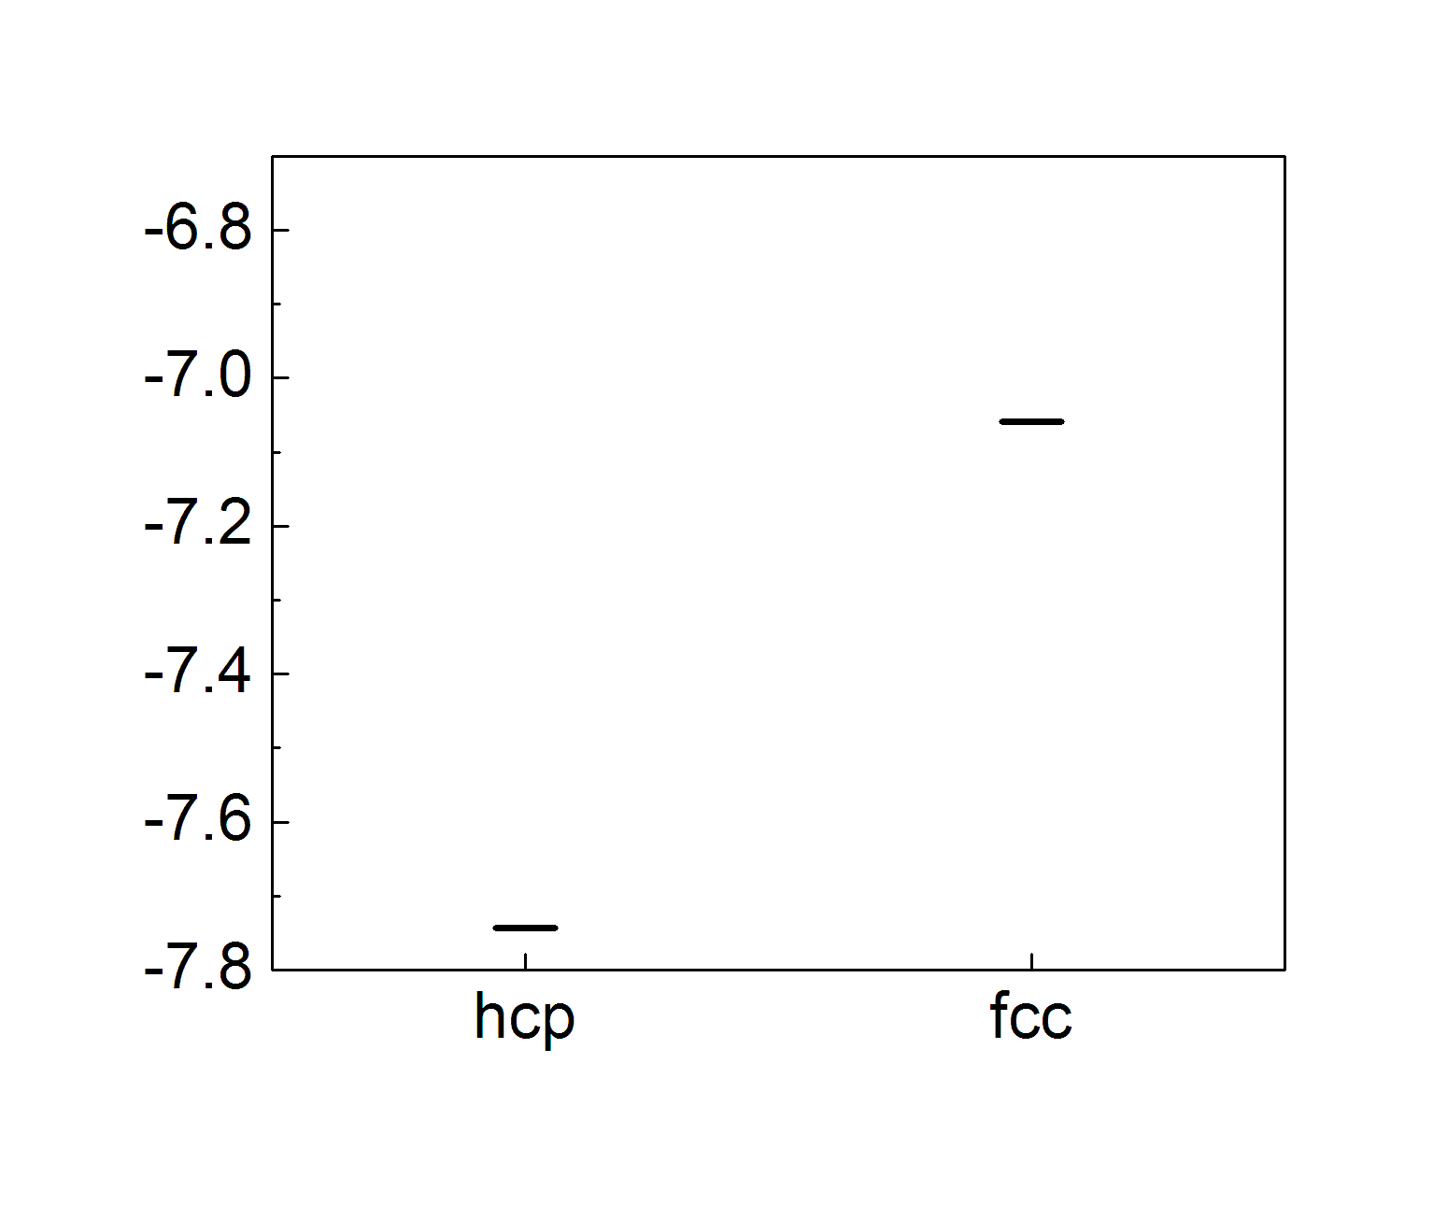
Energetics of C Monomers at Step Edges on Ir(111) and Ru(0001)
A-Step
Terrace
B-Step
Ir
0.75
C monomers cannot be effectively trapped at step edges
Ru
0.87
Notes:
17

Slide 18
Atomistic Mechanisms: Back to “Arithmetics”
N=1: Rest areas of monomers
N=2: Preferred nucleation sites of dimers
N=3, 4, 5, …:
* Carbon Nanoarches
* 1D 2D transition
Back to N=6 and beyond:
* On Cu(111): Good islands, bad islands
* On alloyed Cu(111):
# Good islands
# Minimal grain boundaries
Notes:
Controllability(self-terminating)

Slide 19
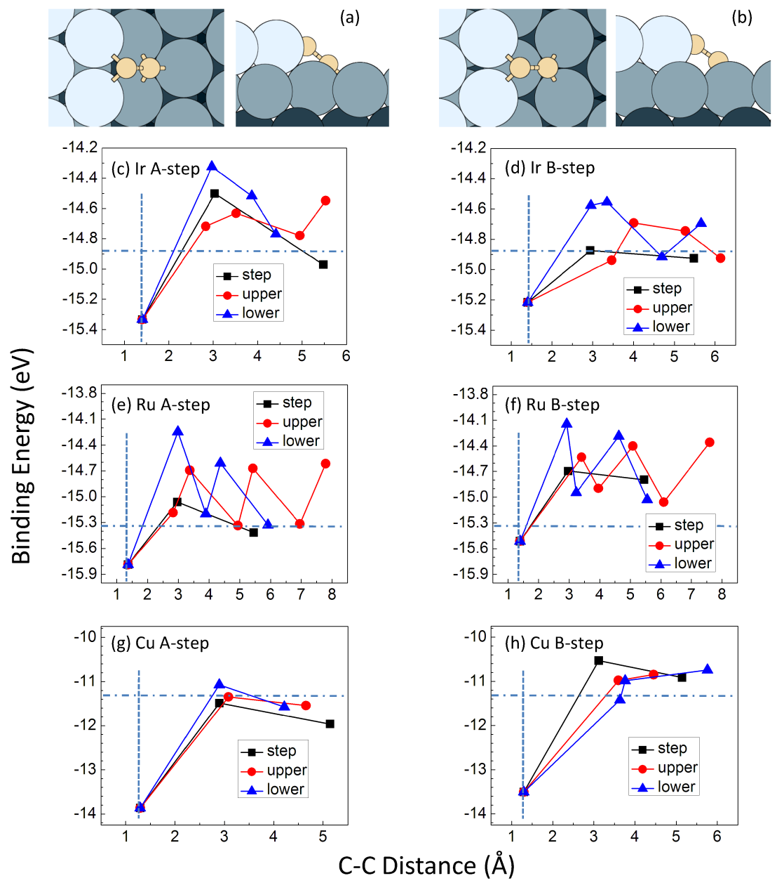
Energetics of Carbon Dimers at Step Edges
C
C
C
C
C
C
C
C
C
C dimerization is highly favorable at lower step edges
on Ir(111) and Ru(0001)
Notes:
19

Slide 20
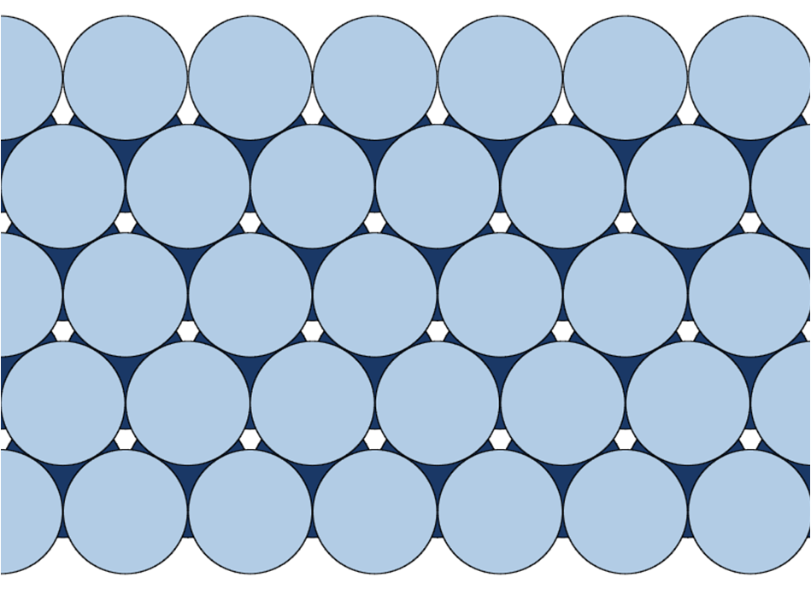
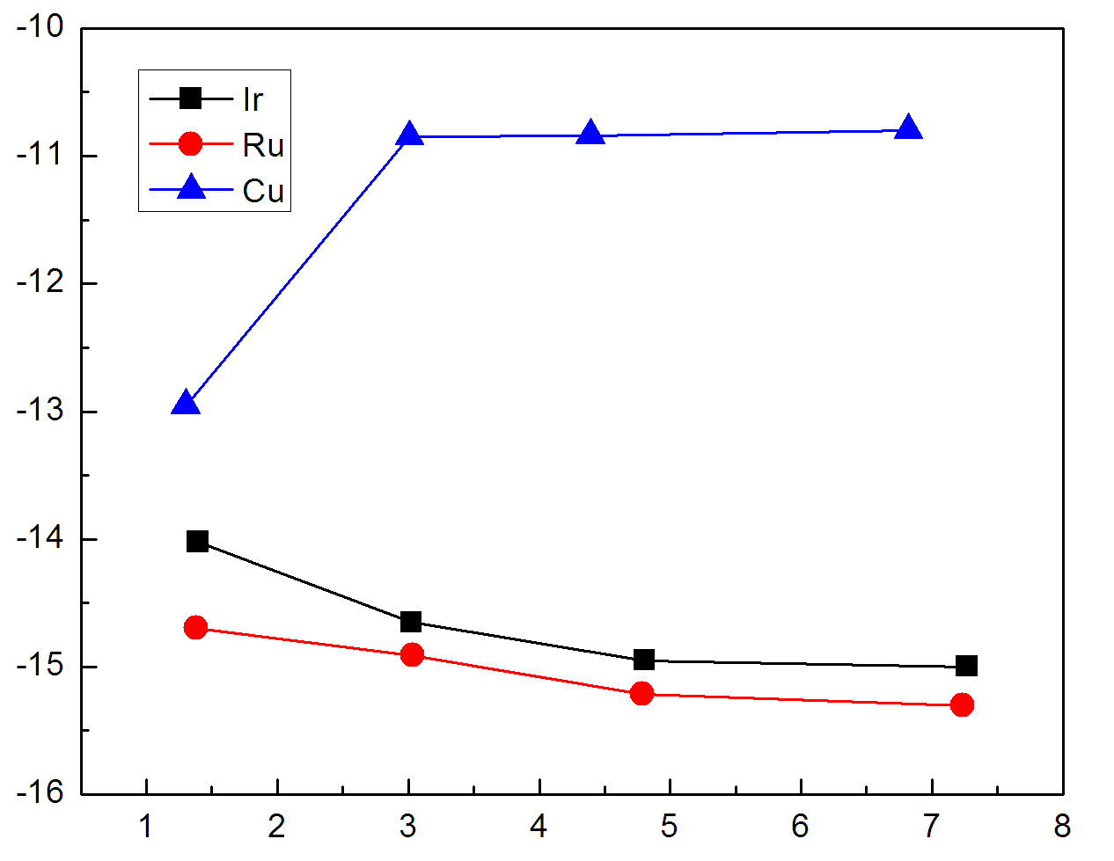
Energetics of Carbon Dimers on Terraces
C
Binding Energy (eV)
C
C-C Distance (Å)
C dimerization is unfavorable on Ir(111) and Ru(0001),
but is strongly favorable on Cu(111)
“Good” substrate for mass production: Cu(111)
Notes:
20

Slide 21

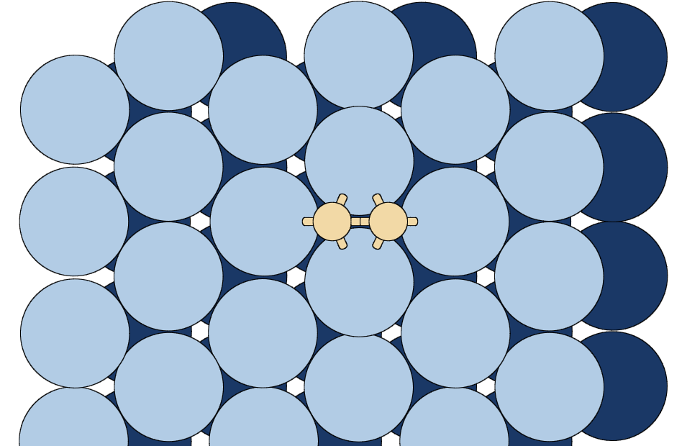








Why are C dimers more stable at step edges?
A-Step
Terrace
B-Step
Step edge can accommodate energetically more favorable dimer configurations
“Napping” effect
Notes:
21

Slide 22
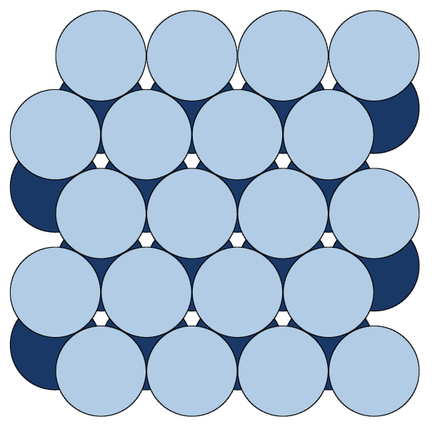
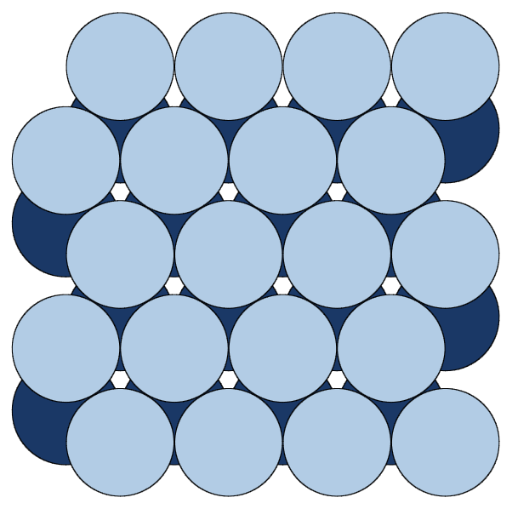
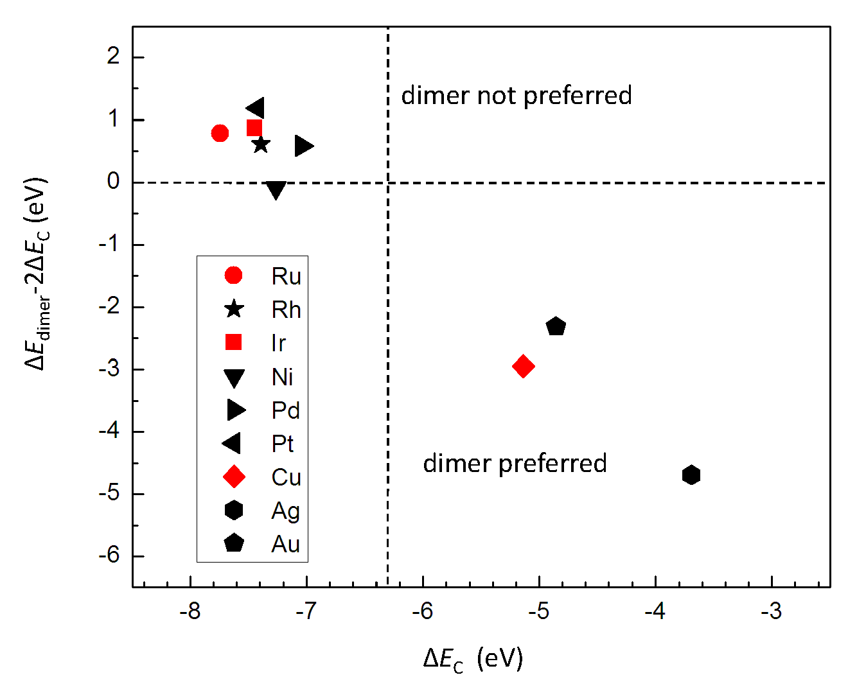
Why dimer formation is preferred on Cu(111),
but not on Ir(111) and Ru (0001)
On other metals:
Nucleation at step edges
C
C
C
~1.3 Å
C
C
C
On Cu, Ag, Au: Nucleation everywhere
C double bond
Hua Chen, Wenguang Zhu, ZZ, PRL 104, 186101 (2010)
Notes:
22

Slide 23
Outline
Brief Introduction on Motivation
Atomistic Mechanisms of Epitaxial Growth of Graphene:
  Why Cu is the preferred substrate? (Hua Chen)
  Carbon nanoarches (Robert van Wesep)
  Suppression of grain boundaries (Wei Chen)
    Low-temperature growth (Jin-Ho Choi)
  Functionalization of Graphene
    Magnetization (Shifei Qi)

Slide 24
Atomistic Mechanisms: Back to “Arithmetics”
N=1: Rest areas of monomers
N=2: Preferred nucleation sites of dimers
N=3, 4, 5, …:
* Carbon Nanoarches
* 1D 2D transition
N=6 and beyond:
* On Cu(111): Good islands, bad islands
* On alloyed Cu(111):
# Good islands
# Minimal grain boundaries
Notes:
Controllability(self-terminating)

Slide 25
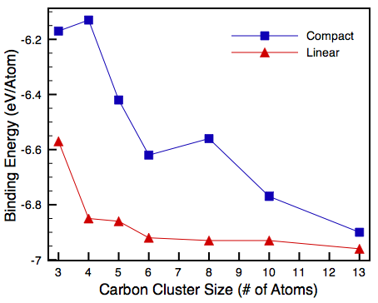
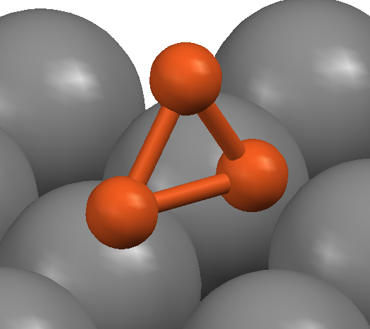
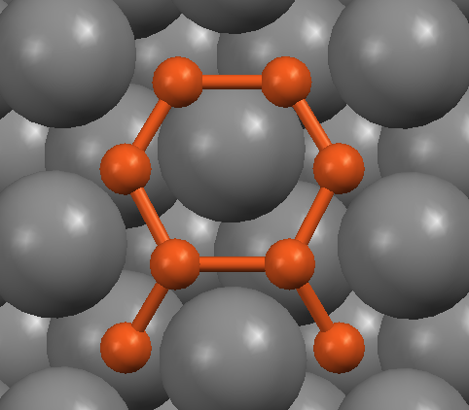
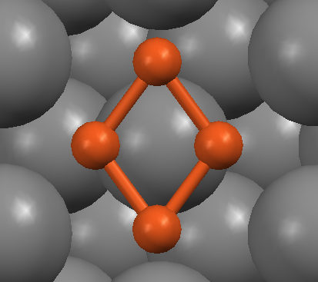
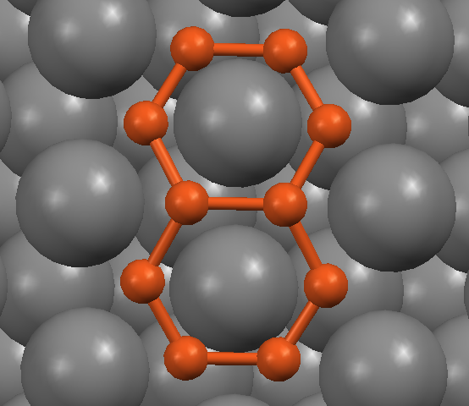
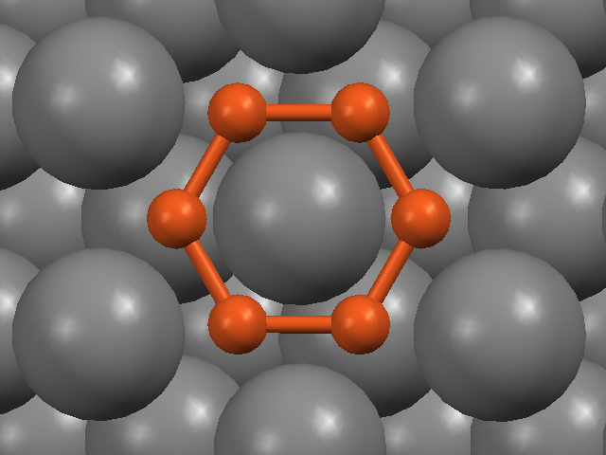
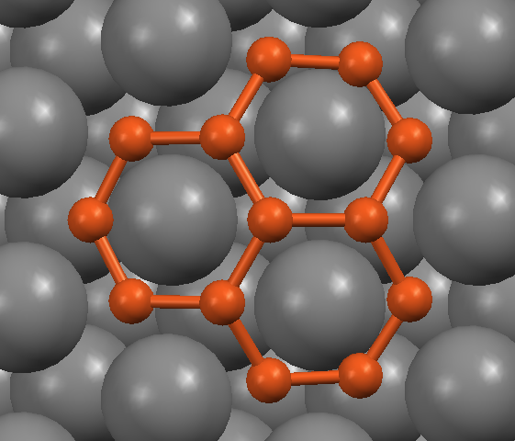
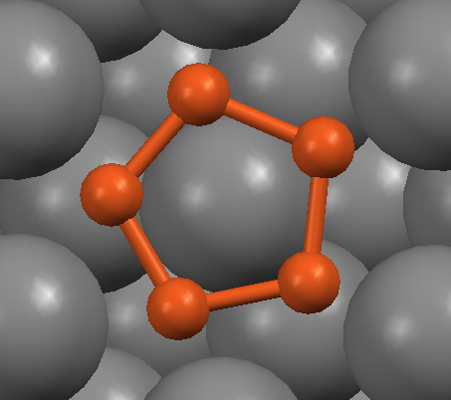
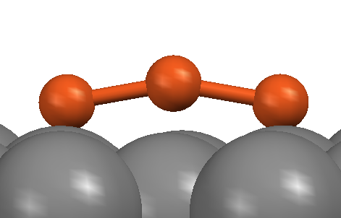
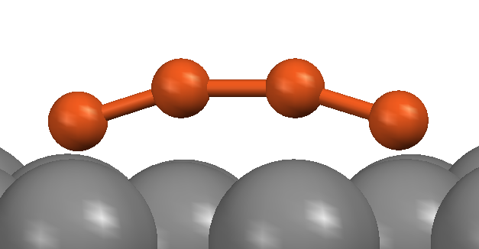
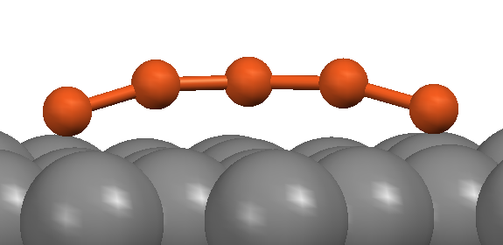
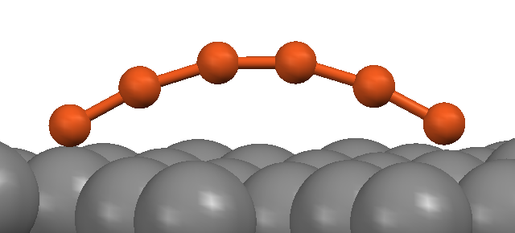
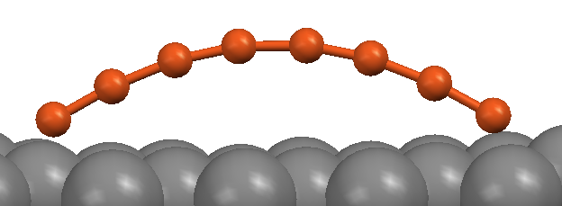
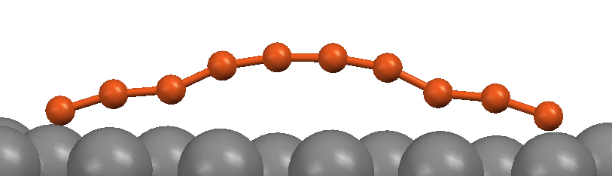
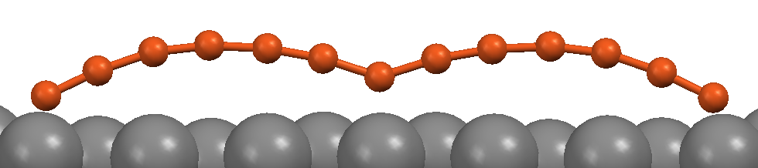
Energetics of Carbon Islands with
Increasing Size
Compact Structures
Carbon
Nanoarches

Slide 26
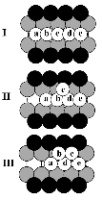
Mismatch and Dissociation
7 C Atoms
6 Binding Sites
Schematic of mismatch between C dimer separation and site-to-site separation
Schematic of Dissociation of a 1D Chain and Formation of a 2D Island for Ni on Au(110)¹
Fan, W. et al. Phys. Rev. B 66, 115418 (2002)

Slide 27
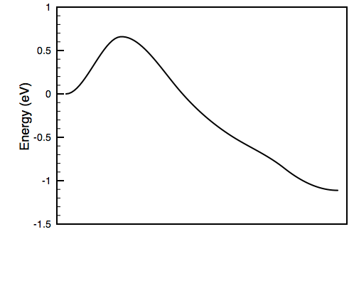
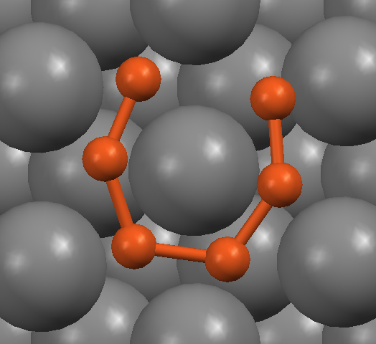




Kinetic Stability of a C6 Ring
0.66 eV
Relatively easy to break at typical CVD growth conditions

Slide 28
Estimating Critical Cluster Size for 1D to 2D Transition
Drawing an analogy to the work of Fan et al. compare the site-site distance (1.47 Å) to relaxed C-C distance (1.30 Å)
Find the number of C needed before there is a mismatch of 1 : 1/(1.47 – 1.30) = 6 => there are approx. 7 C atoms for 6 binding sites
This agrees with the collapse of the arches for C₁₀ and C₁₃
The barrier to breaking a ring is low enough that a single ring would not survive, but at C₁₀ there would be 2 rings to break, so if one were to form it may survive
Prediction: 2D islands will dominate at 10-13 carbon atoms

Slide 29

Indications of Linear Carbon Chains on Other Metal Substrates
Schematic of Growth Mechanism on Ru(0001) based on experiments and nucleation theory:
Attachments of linear C chains of critical size N =5
Loginova, Bartelt, Feibelman, and McCarty, New J. Phys. 10, 093026 (2008); 11, 063046(2009).
A few other independent recent reports on linear chain formation on Ir(111) and Ni(111) (DFT results).

Slide 30



STM observation of carbon chains
in graphene growth on Ru(0001):
Preliminary results
20 nm
4 nm
1 nm
Min Gao, Hongjun Gao, et al. @ IOP, China
How to definitely confirm the arched nature
of the linear carbon chains???

Slide 31

Pre-graphene:
carbon “nanodome” on Ir(111)
P. Lacovig et al., Phys. Rev. Lett. 103, 166101 (2009)
Notes:
eft) Carbon dome structure on an iridium substrate, indicating the tightly bound atoms at the edge of the island (C), the weakly bound atoms at the center (B) and intermediate atoms (A). (Right) Photoelectron spectrum at 970 K showing the contributions from the edge (C), center (B), and intermediate (A) atoms in the dome structure. (In this simplified schematic diagram, the dome structure is shown to consist of three types of carbon atoms; the actual structure is more complex.)
Our study may partially answer this question.
31

Slide 32

Nanodomes from DFT
Results of DFT Calculations of Carbon Islands on Ir(111) confirming photoelectron spectroscopy data indicating the formation nanodomes during epitaxial graphene growth¹
Contrast indicates an increasing height from the substrate at the center.
P. Lacovig et al., Phys. Rev. Lett. 103, 166101 (2009)

Slide 33
What’s between dimer and similar domed structures on Cu(111)? Nanoarches
Linear
?
Compact
Robert van Wesep, Hua Chen, Wenguang Zhu, ZZ,
J. Chem. Phys. 137, 171105 (2011)
Notes:
Continue to grow linearly, or form compact clusters right away
33

Slide 34
Atomistic Mechanisms: Back to “Arithmetics”
N=1: Rest areas of monomers
N=2: Preferred nucleation sites of dimers
N=3, 4, 5, …:
* Carbon Nanoarches
* 1D 2D transition
N=6 and beyond:
* On Cu(111): Good islands, bad islands
* On alloyed Cu(111):
# Good islands
# Minimal grain boundaries
Notes:
Controllability(self-terminating)

Slide 35
Outline
Brief Introduction on Motivation
Atomistic Mechanisms of Epitaxial Growth of Graphene:
  Why Cu is the preferred substrate? (Hua Chen)
  Carbon nanoarches (Robert van Wesep)
  Suppression of grain boundaries (Wei Chen)
    Low-temperature growth (Jin-Ho Choi)
  Functionalization of Graphene
    Magnetization (Shifei Qi)

Slide 36




CVD Growth on Transition Metals: Go for Cu!!!
Ir(111), Co(0001), Pt(111), Ru(0001), Ni(111)…
Cu(111)
J. Coraux et al., New Journal of Physics (2009)
A. L. Va´zquez de Pargaet al., PRL (2009)
K.S. Kim et al., Nature(2009)
X. Li et al., Science (2009)
Factors determining growth rate, thickness & uniformity:
Carbon solubility in Metals: low: Pt,Ru,Ir,Cu; high: Ni,Co
Lattice mismatch: small: Ni 1.24% Cu 3.72%
Carbon-Metal bond strength (nucleation sites)
Experimental conditions: gas concentration, pressure, temperature, cooling rate…

Slide 37




Daunting Challenge: Populous Grain Boundaries
30°
7°
15°
30°
P.Y.Huang et al., Nature (2011)
J.H. An et al., ACS Nano(2011)
* Grain boundaries are undesirable (in general)
* Grains of different orientations originate from nucleation site
* 12-fold periodicity diffraction data shows 2 main families of grains rotated by ~30°
How to reduce the ~30°rotational defects at the initial nucleation stage?
What are the elemental building blocks of different grains?

Slide 38



Diagnosis: Nearly degenerate orientations of C6 Rings on Cu
VASP
PAW-PBE
5-layer slab
3x3 unit cell
building blocks: 6-Carbon rings
30 °
Two stable geometries rotated by 30°
△E = 0.08eV
Nearly degenerate orientations
May explain the experimentally observed 30°rotational defects

Slide 39


Conjecturing from Building Blocks
to Grain Boundaries
5
7
28.7°
5
7
5
Rassin Grantab et al., Science(2010)
7
5
7
5
7
5
7
5
7
5
P.Y.Huang et al., Nature(2011)
7
30°rotational defects → GB’s with 5&7-membered rings and distorted hexagons

Slide 40


Going Beyond C6:
Effects of Substrates on 7C6
VASP
PAW-PBE
5-layer slab
6x6 unit cell
Spin polarized
A 7C6 island still prefers to rotate away from
the high-symmetry orientation.
Two such 7C6 islands have degenerate energies.
Grain boundaries with 22⁰ orientational angle expected.

Slide 41




Prescription: Graphene Growth on Patterned Substrate
V_{Carbon-X} > V_{Carbon-Cu} Search among transition metals with strong bond to carbon : Ru, Fe, Co, Ni, Mn
Only Mn atoms are repulsive at nearest-neighbor sites: Mn-Cu(111) patterned surface
Experiment:
J. Schneider et al., Applied surface science(1999)
R30° superstructure
Theory:

Slide 42

Adsorption of 7C6 on Mn-Cu (111)
A 7C6 island is pinned at the high-symmetry orientation due to stronger C-Mn interaction
Enhanced binding energy of 0.24 eV per edge atom compared to Cu(111)
No grain boundaries when coalescing

Slide 43



Two-Step Kinetic Pathway (SEED & GROW)
Coronene (C₂₄H₁₂): seed molecule
C-H bond strength vary little from that of benzene, which is used for low-T growth → coronene could also dehydrogenate easily
Enlargening and gap filling: back to CH₄
Wei Chen, Haiping Lan, Hua Chen, Ping Cui, Tim Schulze,
Wenguang Zhu, ZZ, (submitted)

Slide 44
Outline
Brief Introduction on Motivation
Atomistic Mechanisms of Epitaxial Growth of Graphene:
  Why Cu is the preferred substrate? (Hua Chen)
  Carbon nanoarches (Robert van Wesep)
  Suppression of grain boundaries (Wei Chen)
    Low-temperature growth (Jin-Ho Choi)
  Functionalization of Graphene
    Magnetization (Shifei Qi)

Slide 45


LT graphene growth by CVD using solid & liquid C sources
ACSNano 5, 3385 (2011)
A revised CVD method using solid (PMMA) & liquid (benzene) instead of CH4 gas
→ enabling low-temperature graphene growth around 300°C (significantly reduced from typical growth temperature of ~1000°C)
Synthesized graphene from benzene
500°C
300°C
Raman spectra & SEM images

Slide 46





Previous theoretical studies
ACS Nano 5, 3385 (2011) (no vdW)
Density functional theory calculations (PBE)
Adsorption energy
methane: 0.02 eV | benzene: 0.09 eV (exp. ~0.6 eV)
Activation energy of the dehydrogenation
methane: 1.77 eV | benzene: 1.47 eV
Inclusion of London dispersion forces
The van der Waals density functional (vdW-DF) provides adsorption energies consistent with experiments.
Surface Science 603,
2912 (2009)
PRB 85, 121409(R) (2012)

Slide 47

Desorption vs dehydrogenation
For the adsorbed hydrocarbon molecules, desorption and dehydrogenation will compete.
Dehydrogenated
Gas
Ea^{Deh}
Ea^{Des}
Adsorbed
Desorption
Dehydrogenation
Easy desorption can make the dehydrogenation slow.
Enhanced adsorption will prevent easy desorption.

Slide 48


Expectations and Approaches
Enhanced binding due to London dispersion forces leads to the followings:
→ preventing easy desorption of the adsorbed molecule
→ enabling the LT graphene growth from C6H6 and C18H18
CH4
C6H6
C18H14
Vienna Ab-initio Simulation Package (VASP)
Cu(111) 6x6, 5layers, 2x2x1 kpoints
PAW pseudo-potentials, 400 meV
PBE, vdW-DF

Slide 49

Enhanced binding due to London dispersion forces
CH4
C6H6
C18H14
vdW-DF calculations show a steep increase in E_{ads} with the molecular size.
- larger molecule → more electrons → larger fluctuating dipole moment
- aromatic structures → arranging parallel to surface → atoms close to the surface

Slide 50


Calculated energetics for the three different molecules
Transition states were obtained by NEB method (for only vdW-DF).
Dehydrogenation activation energies for the three molecules are almost same.
CH4 and C6H6
C18H14
Ea^{Des} < Ea^{Deh}
Ea^{Des} > Ea^{Deh}

Slide 51


Calculated energetics for the three different molecules
Desorption-dominant
Dehydrogenation-dominant
CH4 and C6H6
C18H14

Slide 52

Time needed for a dehydrogenation event (TD)
^{√: growth success}
×: growth failure
TD is obtained from calculated reaction rates.
Typical experimental graphene growth time: 15 min ~ 1 hour
Below 200°C, Ea^{Deh} of ~1.5 eV is too large to overcome.

Slide 53

Experimental LT graphene growth from C6H6 & C18H14 (Prof. Zeng’s group at USTC)
SEM images of the graphenes grown at 300°C
C6H6
C18H14
No graphene growth at lower temperature of 200°C
Theory and experiments are consistent.

Slide 54
Main Findings: ~1000 ºC => ~300 ºC!!!
1. Enhanced binding due to London dispersion forces
- prevents easy desorption of the adsorbed hydrocarbon sources
- therefore enables the LT graphene growth on Cu substrates
2. Comparison of three different hydrocarbon sources
- shows the enhanced bindings with increasing molecular size
- predicts the LT graphene growth from C18H14 (experimentally confirmed)
Jin-Ho Choi, Zhancheng Li, Ping Cui, Xiaodong Cui,
Changgan, Zeng, and ZZ, PRL (submitted)

Slide 55
Outline
Brief Introduction on Motivation
Atomistic Mechanisms of Epitaxial Growth of Graphene:
  Why Cu is the preferred substrate? (Hua Chen)
  Carbon nanoarches (Robert van Wesep)
  Suppression of grain boundaries (Wei Chen)
    Low-temperature growth (Jin-Ho Choi)
  Functionalization of Graphene
    Magnetization (Shifei Qi)

Slide 56

Graphene Based Spintronics
Generating ferromagnetism in graphene is important to the development of graphene-based spintronics.
M. M. Ugeda et al.
PRL 104, 096804, 2010
J. Fernadez-Rossier et al.
PRL 99, 177204, 2007
E. J. Santos et al.
PRB 81, 125433, 2010
B. Huang et al.
Nano. Lett. 9, 3867, 2009
Notes:
substitution
cutting the two-dimensional graphene into finite systems with zigzag edges
3. introducing carbon vacancies
4. hydrogenation
5. adsorption of transition metal on graphene

Slide 57
Pros and Cons of Typical Adsorption of Magnetic Elements
Advantages
predictable magnetic moments by STM.
tunable magnetic moment and Curie temperatures by
external electric field.
K. T. Chan, et al. PRB 77, 235430, 2008
B. Uchoa, et al. PRL 101, 026805, 2008
Disadvantages
Some adatoms are easily moved at surface, which lead to unstable state.
H. Johll, et al. PRB 79, 245416, 2009
The charge transfer leads to E_{f} shifts or destruction of the Dirac point.
K. A. Khomyakov et al. PRB 79, 195425, 2009
Notes:
The adsorption of transition metal on grapheme is a very effective way to control and tune electronic and magnetic properties of graphene. As contrast to other methods, adsorption of TM on grpahene has a least effect on Dirac point of graphene, and has its superiorities, such as predictable distributions of magnetic moments by scanning tunneling microscope and controllable Curie temperature by external electric field

Slide 58
Compensated n-p codoping of graphene
How to:
Enhance the binding energies of adatoms.
Improve of magnetic moment of TMs.
Find a way to compensate for the shift of E_{f} or keep Dirac point
X. H. Xu et al. NJP 8, 135, 2006
W. G. Zhu et al. PRL 100, 027205 ,2008
H. Chen et al. PRB 79,235202,2009
W.G. Zhu et al. PRL 103, 226401, 2009
n-p codopings
Why n-p codoping?
Charge compensation between p- and n-type dopants may solve E_{f} shifts.
Electrostatic interaction between the p- and n-type dopants may enhance the adsorption of TMs adatoms.
Notes:
Hence, solution of above questions are crucial to future applications of graphene-based spintronics. p-n codopings have a common character of simultaneously incorporating p- and n-type dopants into semiconductors.

Slide 59

Effects of n-p codoping on a single 3d transition metal adatom on graphene
Notes:
the picture of electrostatic interaction between TMs and codopant B that we have proposed is valid to enhance the adsorption of TMs adatoms on graphene. p-n codoping can increase the magnetic moments of Fe, Co, and Ni adatoms on graphene .

Slide 60

Nature of the magnetic coupling between two n-p pairs
What is the magnetic coupling between n-p pairs?
IF FM couping exists, is FM coupling long-range?
Notes:
Above results have indicated that substituted B and adsorbed TM atoms can form a stable p-n pair because of electrostatic interaction. We next will present that magnetic interaction between two p-n pairs.

Slide 61

Contrast Natures of the magnetic coupling between two n-p pairs of different elements
B-Fe pairs: short-range FM coupling
B-Co pairs : AFM coupling
B-Ni pairs: long-range FM coupling

Slide 62

Preservation of the Dirac electron nature
1) Dirac point preserved.
2) The difference in signs between the couplings of Ni and Fe or Co is most likely due to the different levels of doping to graphene by the three elements.
Notes:
We analyze the electronic structure of configuration with long-rang FM coupling in B-Ni codoped graphene.

Slide 63

Nature of the magnetic coupling between two n-p pairs
Mechanism of long-rang ferromagnetic coupling between two n-p pairs is similar to RKKY coupling
Notes:
We also can find that the directions of spin polarization of electrons from different C atoms are oscillated distribution.

Slide 64

Curie Temperature
K. Binder, PRL 47, 693 (1981).
In 15% B-Ni codoped graphene, Tc is about 200 K from MC simulations.
Notes:
To eliminate finite-size effects, the cumulant crossing method is used to determine the Curie temperature. This two-step approach has the
distinct advantage over the ordinary mean-field approach, both disorder and percolation effects are naturally and precisely taken into account.

Slide 65
Main Findings
The electrostatic attraction between the n- and p-type dopants effectively enhances the adsorption of the TM adatoms and suppress their undesirable clustering.
The p-doping by B significantly enhances the magnetic moments of the TM adatoms, and the compensated nature of the n-p codoping helps to preserve the Dirac nature of the charge carriers.
Ni-B codoped graphene has a robust ferromagnetic order at 15% doping, with a remarkably high Curie temperature of ~200K.
The n-p codoping approach established here provides a new and viable route to achieving ferromagnetic order in graphene.
“This is the way to go!” Michael Furher, UMD.
Shifei Qi, Hua Chen, Xiaohong Xu, ZZ, PRL (submitted)

Slide 66
Concluding Remarks
Epitaxial growth of graphene on various substrates provides an ideal new playground for the surface and thin-film growth community to make important contributions.
Such contributions will likely make a difference, by advancing the field more towards fundamental growth science.
Collectively, we may also help to deliver the high expectations in graphene electronics and other graphene-based functional devices.
Notes:
66

