Slide 1

An Optimization-Based Method for the Design of Novel Molecular Systems
Kyle V. Camarda
Chemical and Petroleum Engineering Department
The University of Kansas
Optimization, Search and Graph-Theoretical Algorithms for Chemical Compound Space
IPAM, UCLA
April 15, 2011

Slide 2
Outline
Background: Computational Molecular Design
Application to Ionic Liquids
Excipient Design: Including the System
Conclusions and Future Directions

Slide 3
Methodology: Molecular Design
Inverse Problem
Physical
Property
Targets
Optimization
Complete
Molecular
Structure
Forward Problem
correlate
compute
Topological
Indices
The forward problem, determining function given a structure, may be solved experimentally, via simulation, or approximately via predictive models
The inverse problem, or the product design problem, requires optimization to find a set of candidate molecules with properties close to targets chosen by the designer

Slide 4
Molecular Characterization
Physical
Property
Targets
Optimization
Complete
Molecular
Structure
correlate
compute
Topological
Indices
In order to quickly compute property values for a novel candidate ionic liquid, we need to describe key structural features with just a few easy-to-compute values

Slide 5
Connectivity Indices: χ₀ , χ_{1v}
Values based on molecular graph
Uniquely define 2-D topology of molecule
Encode information about:
Valence shell hybridization
Inner shell electrons
Electronic structure of bonded atom pairs

Slide 6
QSPR Generation
Physical
Property
Targets
Optimization
Complete
Molecular
Structure
correlate
compute
Topological
Indices
In this step, we solve the forward problem: the creation of a model to estimate physical, chemical or biological properties of a molecular system

Slide 7
Spanning the Molecular Space
Experiments to measure properties of interest for molecules of known structure are needed to provide data with which to build correlations
Consistency is key!
Selection of representative molecules is important – cost vs. coverage
As more complex systems/properties are considered, use of literature data becomes risky

Slide 8
Quantitative Structure-Property Relations (QSPR)
Bicerano (1996, 2002) correlated noncrosslinked polymer properties with connectivity indices
Kier and Hall (1986) employed similar structural descriptors to predict K_{OW} for various classes of drug molecules
Satyanarayana et al. (2009) applied connectivity indices to estimate missing UNIFAC groups
We have generated new correlations based on topological indices which predict physical and chemical properties within ~10%

Slide 9
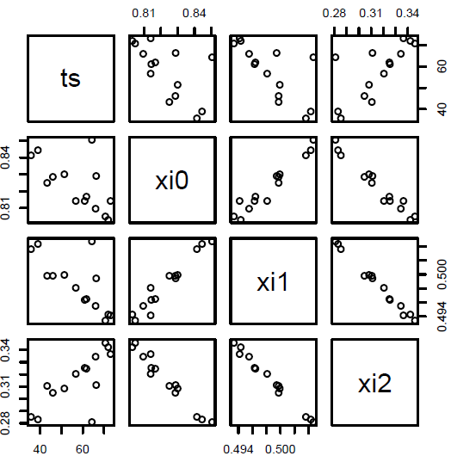
Descriptor Selection (from the R statistical package)

Slide 10
Example Predictive Model IL + R-134a
(all correlations based on 19 ionic liquid systems)
Correlation | r²
 | 0.91
 | 0.85

Slide 11
Methodology: Molecular Design
Physical
Property
Targets
Optimization
Complete
Molecular
Structure
correlate
compute
Topological
Indices
The predictive model is embedded in an optimization framework to find the molecular structure which results in properties most closely matching the targets

Slide 12
Problem Formulation
Objective function
Property prediction model
Structural feasibility constraints
For a complex property prediction model, a large nonconvex MINLP usually results

Slide 13
Structural Constraints
While connectivity index-based CMD gives a complete molecular structure, constraints are needed to ensure that the structure is reasonable
Valency
Connectedness
Avoidance of obviously unstable groups
Ring strain estimation

Slide 14
Solution Methodologies
Complete enumeration: The QSPR model is only valid for combinations of those functional groups found in the molecules experimentally tested. If this makes the solution space small enough, then complete enumeration may be used.
MILP or MINLP: if the possible set of molecules is too large for enumeration, standard optimization approaches may be used
Stochastic optimization: if nonconvex or highly complex models and constraints are used (like a neural network model), stochastic methods can still give us good solutions

Slide 15
Tabu Search
A stochastic optimization method that has been used to solve scheduling problems and constraint satisfaction problems
TS is a meta-heuristic approach that guides a local search procedure to explore the solution space beyond local optima.
TS performs a “guided search” by taking advantage of a memory consisting of historical information of the search process.
Helps to ensure that all regions of the search space are investigated
Minimizes the likelihood of becoming stuck in a local optimum.

Slide 16
Product Design Software
An easy-to-use graphical tool for drawing and computing structural descriptors of ionic liquid systems
Includes a database for building property correlations, and inputs/outputs to many standard molecular file formats
Includes subgraph isomorphism algorithm from Ullmann (1976) for determining similarity of structures, Tabu search for designing novel structures

Slide 17
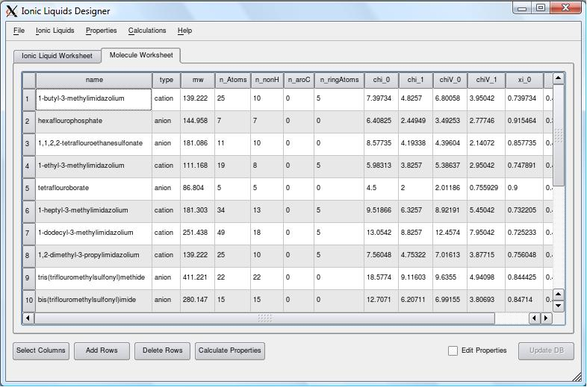
Software Package for Descriptor Calculations

Slide 18
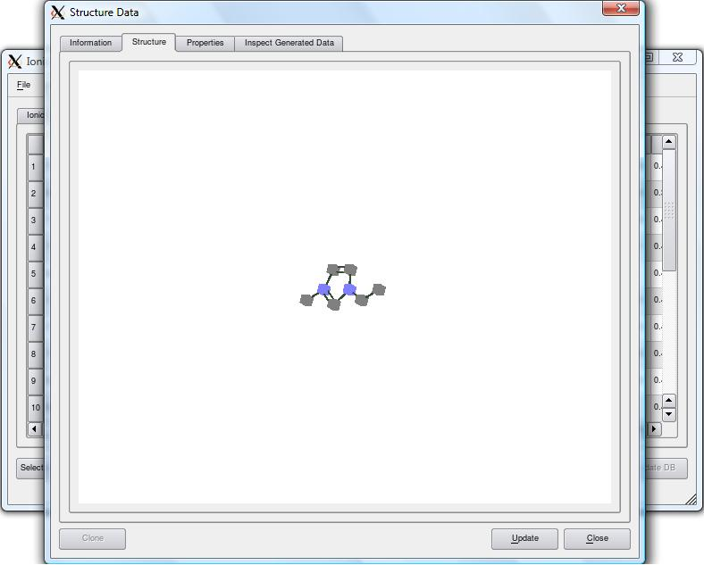
Software Package for Descriptor Calculations

Slide 19
Ionic Liquids Project: Motivation
Ionic liquids (IL’s) are attracting significant industrial and academic interest due to a set of unique properties:
Immeasurable vapor pressure, thus non-flammable and non-volatile
Ability to solvate both polar and nonpolar compounds
Tunable properties based on anion/cation selection
Computational Molecular Design (CMD) provides a method to guide the development of novel IL’s for specific applications

Slide 20
Applications
IL’s are currently being evaluated for use in systems such as
Refrigerants (stand-alone or as mixture components)
Solvents for extraction (Zhao et al. 2005)
Reaction media and heat transfer fluids (Brennecke and Maginn, 2001)
Thus a product selection/design scheme is needed to choose the best IL for a given application

Slide 21
Example: 1-butyl-3-methylimidazolium hexafluorophosphate

Slide 22
Need for Molecular Design
As many as 10¹⁴ anion/cation combinations may give feasible IL properties
The guess-and-test approach is therefore of questionable utility
Eike et al. (2004) have shown that prediction of activity coefficients of ionic liquids by correlation with structural descriptors can be effective

Slide 23
Target Properties: Ionic liquids
A number of physical and chemical properties need target values or ranges when designing a novel IL-mixed refrigerant:
Solubility
Diffusivity
Viscosity
Melting point
Thermal Decomposition Temperature
Toxicity
Note that some of these targets may conflict, in the sense that replacing a given functional group may bring one property value closer to its target, but bring another one farther from its target

Slide 24
Example Predictive Model IL + R-134a
(all correlations based on 19 ionic liquid systems)
Correlation | r²
 | 0.91
 | 0.85

Slide 25
Example: Novel IL Refrigerant
To test the design formulation and the software, example IL’s were designed for use in a refrigeration cycle, in a mixture with R-134a
Three target property values were set:
Property | Target Value
Solubility | 0.008 mol/L
Diffusivity | 20x10⁻¹¹ m²/sec
Melting Temp. | 198 K
Groups to be selected in candidate anions are all represented in the set of IL’s used in the correlations, such that the QSPR model is valid

Slide 26
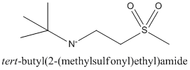

Optimal Structure
The problem was formulated as an MILP and solved via GAMS/CPLEX in about 3 minutes
Property | Predicted Value
Solubility | 0.053 mol/L
Diffusivity | 20x10¹¹ m²/sec
Melting Temp. | 199 K

Slide 27
Stabilizing Polymers for Protein Drugs
Peptide and protein drugs are known to be unstable in many cases, even in the lyophilized state. A recent case of a protein drug which aggregated prior to injection lead to fatalities during a clinical trial
Experimental results from Topp (2006) have found that the polymer poly(vinylpyrrolidone) significantly inhibited certain peptides from undergoing degradation
This goal of this project is to design novel excipients, polymeric or otherwise, which inhibit specific degradation pathways. The models must include information about the excipient and the protein, so that an excipient can be tailored to the specific pharmaceutical product

Slide 28
The First Question
Can we predict the most prevalent route of degradation for a specific protein or peptide from numerical descriptors of structure?
Minimized structures on PDB
Simulations on peptides
Experimental data
We need a larger-scale model for prediction than GC or connectivity indices can give us
Also, the 3-D structure is critical

Slide 29
Protein Descriptors
Given that we have the folded structure of the protein from the PDB, what do we know about the protein as a whole?
Number of amino acids & disulfide bonds
% alpha-helical, % beta-sheet, % ionic
Surface characteristics:
% Polar surface area
% Hydrophobic surface area
Which ones might be good predictors of aggregation or deamidation?

Slide 30
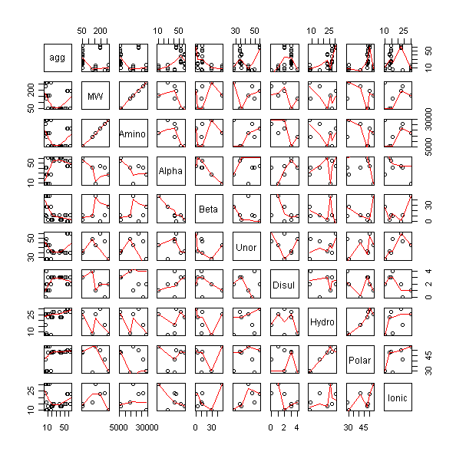

Slide 31
Prediction of Aggregation Rate
Models were built correlating hydrophobic surface area and other 3-D protein descriptors with published aggregation rate data
While the accuracy was enough for proof-of-concept, it is still insufficient for CAMD studies. Why?
Most likely, the data is to blame. We found multiple aggregation rates published for the same systems, and sometimes experiments are run at different temperatures or other conditions
Current experiments are showing the challenges in gathering sufficient, accurate data for protein aggregation under controlled conditions…

Slide 32
Aggrescan
Aggrescan available at http://bioinf.uab.es/aggrescan/
This computational prediction method looks at primary structure for “hot spots”
Amino acid regions with high aggregation propensity
Aggregation propensity based on experimental data
Does not account for tertiary structure
Amino acids in a 3-D region may not be near each other in the amino acid sequence

Slide 33
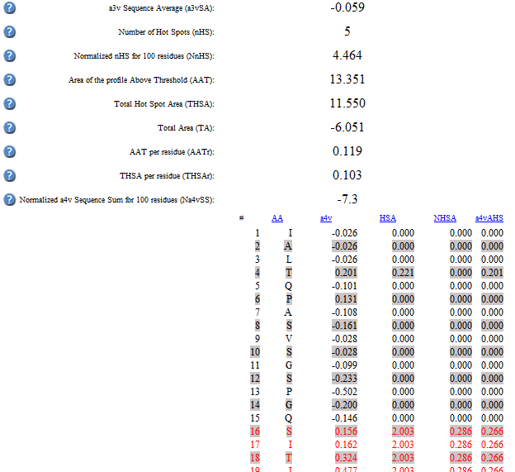
Example Aggrescan Output
The number of hot spots is predicted and they are highlighted in the sequence

Slide 34
Spatial Aggregation Propensity (SAP)
SAP used courtesy of Dr Naresh Chennamsetty, MIT
Determines aggregation regions based on
hydrophobicity
solvent accessible surface area
proximity in the 3-D folded structure
Accounts for tertiary structure
Only the solvent accessible surface area is assumed to be able to interact with other proteins during aggregation

Slide 35
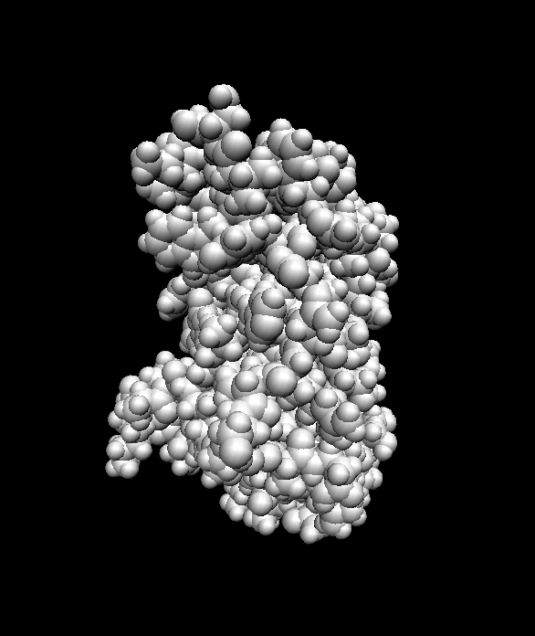
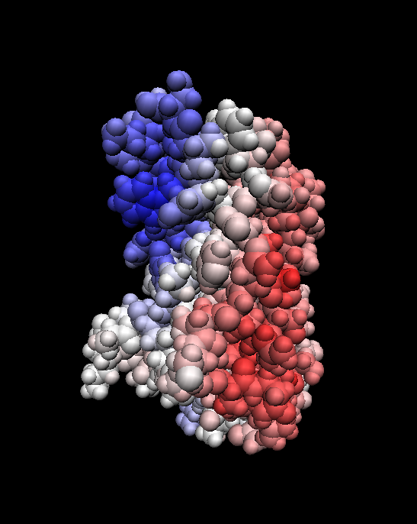
Example SAP Output

Slide 36
Modeling Deamidation
The simulations suggest that the stabilizing effect of PVP is caused by steric hindrance, along with a hydrophobic interaction
Steric effects and hydrophobicity are easily quantifiable using structural descriptors
Thus we are building a model using such descriptors (of both excipient and protein/peptide) to predict deamidation rate

Slide 37
Selection of Molecular Descriptors
A trade-off between accuracy and simplicity must be made when developing QSPRs
By using a high number of descriptors, perfect accuracy for the data set can be obtained. However, the correlation may perform poorly when predicting a property for a new molecule.
Several methods exist for determining the best number of descriptors to use.
Mallow’s C_{p} statistic, cross-validation, Akaike Information Criterion (AIC), penalty for training error, etc.
Mallow’s C_{p} statistic has been employed in our work
Not enough data to use training sets
C_{p} is not dependent on direction taking when changing the number of descriptors, as occurs when using methods like AIC

Slide 38
Mallow’s Cp Statistic
Assigns a score to a given QSPR based on goodness of fit, with a penalty for complexity
The penalty term can be adjusted as needed
Seems to be more effective than k-fold cross validation for smaller data sets

Slide 39
Example from Excipient Design
QSPR for glass transition of the maximally freeze concentrated solute
Determines the temperature that must be reached during freezing to ensure minimal water content in the formulation
Each point represents the lowest C_{p} value that could be achieved using the number of connectivity indices allowed for the QSPR.
For this property, a QSPR using six connectivity indices should be selected

Slide 40
Prediction Intervals
Our QSAR expressions predict the properties of a given molecule with some error, which is a function of the experimental error in the original data, plus the correlation error
Prediction intervals allow both types of error to be quantified, while standard confidence intervals only characterize the error due to correlation
A prediction interval is defined by the descriptors used to create the QSAR

Slide 41
Information Provided By PIs
A prediction interval provides a reasonable range for the expected properties of a molecule
Prediction intervals can also be used to determine if two solutions to a CMD problem are statistically different
Overlapping prediction intervals indicate that the predicted property of one molecule is not statistically different than the predicted property of the other molecule
Different locally optimal solutions to an MINLP can be compared
Despite giving different objective function values, different solutions may have predicted property values that are not statistically different

Slide 42
Example from Excipient Design
A stochastic method was used to solve an MINLP to optimize the property values of a carbohydrate excipient as related to forming amorphous solids
Different solutions represent different local optima for the CMD problem
Property | Targets
Glass Transition Temperature of the Anhydrous Solute | 100°C
Glass Transition Temperature of the Maximally Freeze-Concentrated Solute | -30°C
Melting Point of Ice | -25°C
Gordon-Taylor Constant | Not specified (used in calculation of water content)

Slide 43
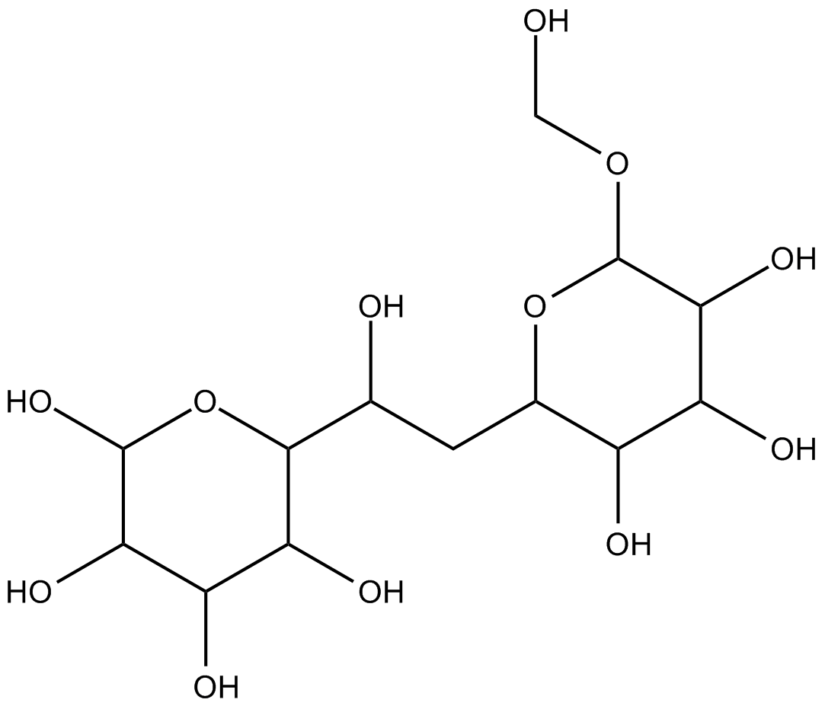
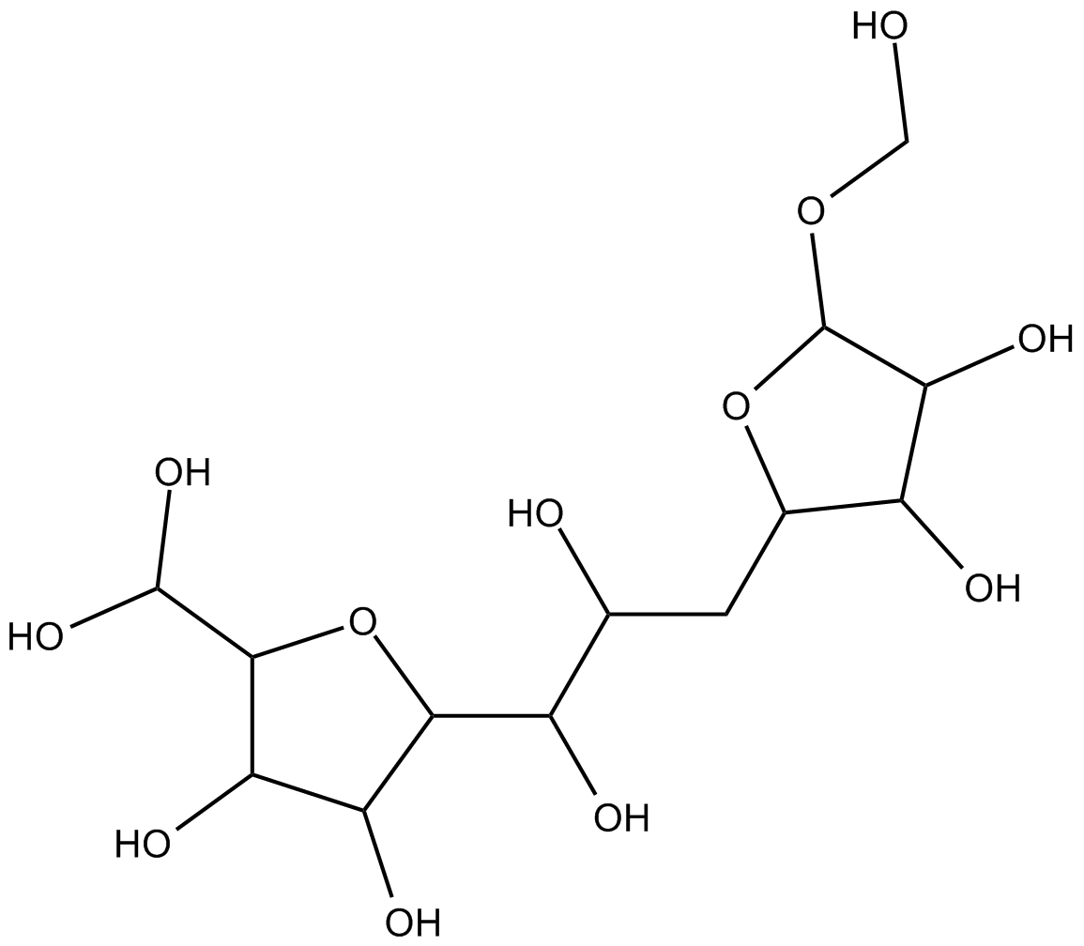
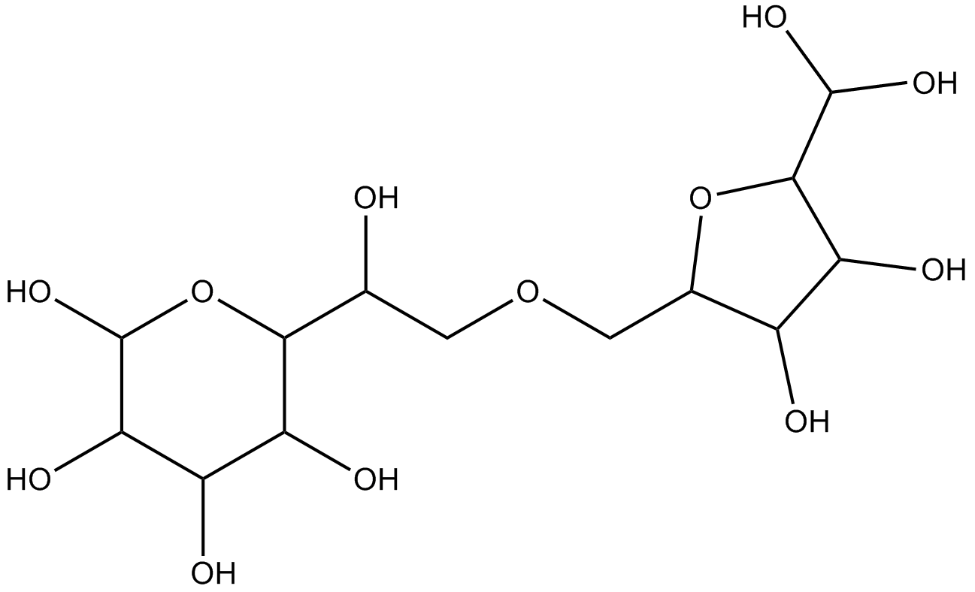
Example from Excipient Design
Candidate 1 – Objective function score = 0.00800
Candidate 2 – Objective function score = 0.01367
Candidate 3 – Objective function score = 0.01373

Slide 44
Example from Excipient Design
The three best solutions were compared. For all properties, all three solutions had overlapping prediction intervals.
All three solutions are equally valid
Several optimal candidates for use as a glass-forming excipient
Property | Candidate 1 | Candidate 2 | Candidate 3
T_{g} | 100.9 ± 12.7°C | 99.8 ± 15.0°C | 90.3 ± 20.6°C
T_{g}’ | -32.6 ± 6.5°C | -33.1 ± 6.7 °C | -31.7 ± 5.0°C
T_{m}’ | -24.8 ± 3.2°C | -23.7 ± 3.5°C | -24.1 ± 4.1°C
k | 6.76 ± 0.37 | 6.73 ± 0.44 | 6.46 ± 0.61
Obj function | 0.00800 | 0.01367 | 0.01373

Slide 45
Example from Surfactant Design
The design targets are given by
Hydrophilic-lipophilic balance (HLB) = 6
Critical micelle concentration (CMC) = 10⁵ mol/L
Lubricity = 6 N/kg
Formulated as a MILP
Solved two ways
Deterministic (CPLEX in GAMS)
Stochastic (Tabu search)

Slide 46

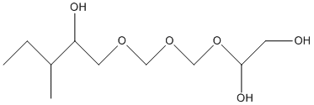
Solutions
Deterministic
HLB = 5.9
log₁₀CMC = 5 mol/L
Lubricity = 6.1 N/kg
Stochastic
HLB = 5.96
log₁₀CMC = 4.67 mol/L
Lubricity = 5.66 N/kg

Slide 47
Use of Prediction Intervals: Deterministic vs. Stochastic
Deterministic methods will give the global optimum for the CMD problem
Stochastic methods report local optima
Due to error, as quantified by prediction intervals, the predicted properties of the molecule given by the globally optimal solution may not be statistically different from the predicted properties of a molecule given by a locally optimal solution
In CMD, deterministic methods may not be necessary.
Stochastic methods may be preferred as they can yield several near optimal solutions that can be synthesized and tested, rather than just one
Still narrow the search space, but allow flexibility
Methods are also usually faster

Slide 48
Comparison of HLB Predicted Values

Slide 49
Comparison of Lubricity Predicted Values

Slide 50
Results from Prediction Interval Comparison
The predicted property values of the two solutions have overlapping prediction intervals for all properties
They are not statistically different
Both the deterministic and the stochastic solutions are valid for further consideration
For many molecular systems, it may not be possible or feasible to formulate the problem as a MILP
Stochastic solutions to a MINLP can offer many solutions that would not be statistically different from a guaranteed globally optimal solution

Slide 51
Conclusions
Computational Molecular Design is a tool which can be applied to a variety of complex molecular systems. The methodology creates a set of candidate structures useful to a designer
Sufficient, consistent data to build a QSPR model is needed. Numerous structural descriptors are available, and statistical techniques are used to select from those and relate them to properties of interest
Tabu search provides a solution method for this optimization approach which is fast, does not require convexity or closed-form constraints, and generates numerous near-optimal solutions. These solutions are as valuable as the global optimum, since the property prediction algorithms include significant error.

Slide 52
Future Directions
For larger molecular systems, three-dimensional descriptors are needed, which require an estimated minimized structure.
The Tabu search algorithm has not yet been tuned for maximum performance, nor have we yet taken advantage of its inherent parallelizability
Current work on biomolecule design seeks to “close the loop”: actually synthesize a few promising candidates, measure their properties, update the QSPR models, and redesign as needed

Slide 53
Acknowledgements
Ionic Liquids: Brock Roughton, John Eslick, Prof. Aaron Scurto, Nicholas Hoffmann, John White
Excipients: Brock Roughton, Sandipan Sinha, Steele Reynolds, Anthony Pokphanh, Prof. Elizabeth Topp
Others: Dr. Bao Lin, Dr. Dave Miller, Prof. Rafiqul Gani + CAPEC
Funding Sources:
Kimberly-Clark Corporation, KU Honors Program, NIH R01 DE14392

