Slide 1
Computational Design of Protein Structures and Interfaces
Brian Kuhlman
University of North Carolina, Chapel Hill

Slide 2
Outline: Three Protein Design Stories
Using Flexible Backbone Design for the Complete Redesign of a Protein Core
Designing the Structure and Sequence of a Protein-Binding Peptide
Design of Metal-Mediated Protein-Protein Interactions

Slide 3
Central problem of protein design: identifying amino acid sequences that will stabilize a target structure or interaction

Slide 4
Central problem of protein design: identifying amino acid sequences that will stabilize a target structure or interaction

Slide 5
Rosetta’s Full Atom Energy Function
1) Lennard-Jones potential (favors atom close, but not too close)
2) Lazaridis-Karplus implicit solvation model (penalizes buried polar atoms)
3) orientation dependent hydrogen bonding (allows buried polar atoms)
4) knowledge-based pair potential between charged amino acids
5) knowledge-based torsional preferences
6) amino acid references energies (unfolded state)
(3)
(2)
(1)
(5)
(4)

Slide 6
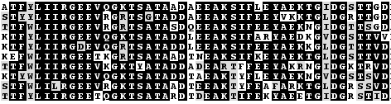
Sequence Optimization
Simulated Annealing
start with a random sequence
make a single amino acid replacement or rotamer substitution
accept or reject move based on the Metropolis Criterion
repeat many times decreasing the temperature as you go
Results from 10 independent runs on a small glubular protein

Slide 7
The usefulness of backbone sampling when performing design
Initial target structure is often not designable
Backbone sampling

Slide 8
Backbone Sampling in Rosetta
Monte Carlo Sampling of Internal Degrees of Freedom (phi,psi)
  Fragment insertions (aggressive sampling)
  Small random changes to phi/psi (refinement)
Gradient-based minimization of backbone (and side chain) torsion angles
Loop closure algorithms
  cyclic coordinate descent
  kinematic loop closure
Docking
  Monte Carlo sampling
  Gradient-based minimization

Slide 9
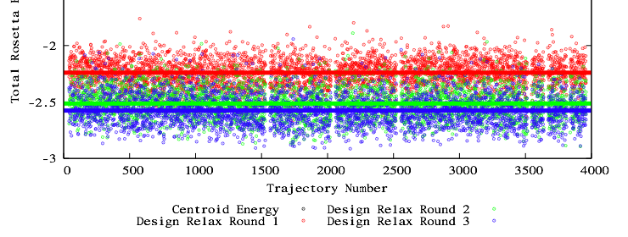
Our Typical Strategy For Designing Novel Structures or Interactions
Create Starting Model of Target Backbone Conformation
Rosetta Energy Per Residue
Perform Sequence Optimization
Trajectory Number
Red Design Relax Round 1
Green Design Relax Round 2
Blue Design Relax Round 3
Backbone Optimization
Evaluate Models with Rosetta Score and other Structure Quality Metrics
Average Rosetta Energy per Residue of Relaxed Crystal Structures = -2.5

Slide 10
Outline: Three Protein Design Stories
Using Flexible Backbone Design for the Complete Redesign of a Protein Core
Designing the Structure and Sequence of a Protein-Binding Peptide
Design of Metal-Mediated Protein-Protein Interactions

Slide 11
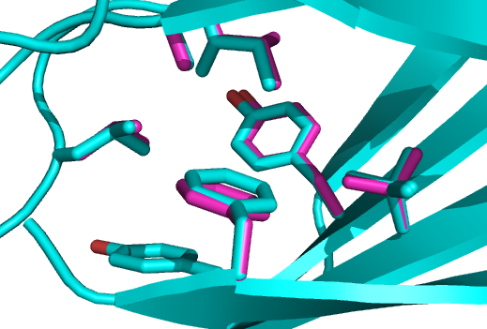
Background: Protein Redesign with a Naturally Occurring Backbone Generally Recovers Sequences with High Identity to the Wild Type Sequence
In the core it is typical to see greater than 50% sequence identity with the WT protein.
Cyan: native tenascin
Magenta: design model
Conclusions: Simulations are not sampling large regions of sequence space compatible with a given fold. ‘Memory’ of the native sequence makes the test less rigorous.

Slide 12
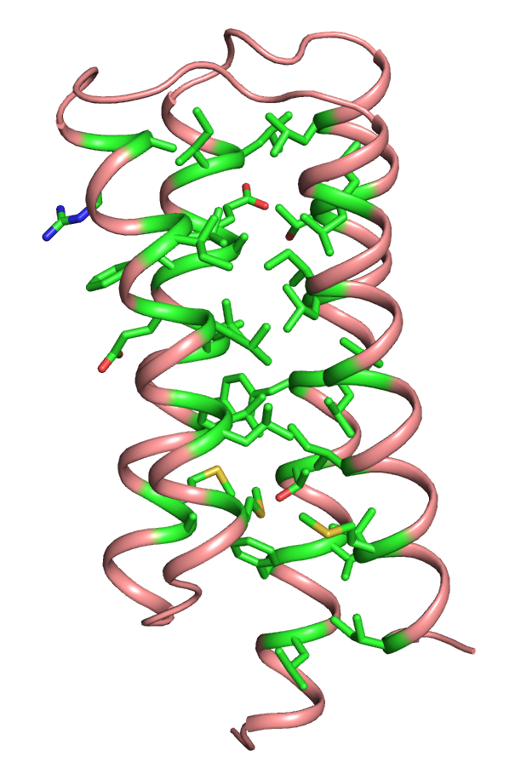
A More Rigorous Test: The Complete Redesign of a Protein Core
Model System: Four Helix Bundle, CheA phosphotransferase domain (pdb code: 1tqg).
37 core positions selected for flexible backbone redesign. The native amino acid was not allowed during the simulation.

Slide 13
Design Protocol: Flexible Backbone Redesign
Iterative cycles (5) of sequence design and backbone refinement
10,000 independent trajectories performed
50 best scoring sequences were evaluated with a non-pairwise additive packing term and a secondary structure prediction server (jpred3)

Slide 14
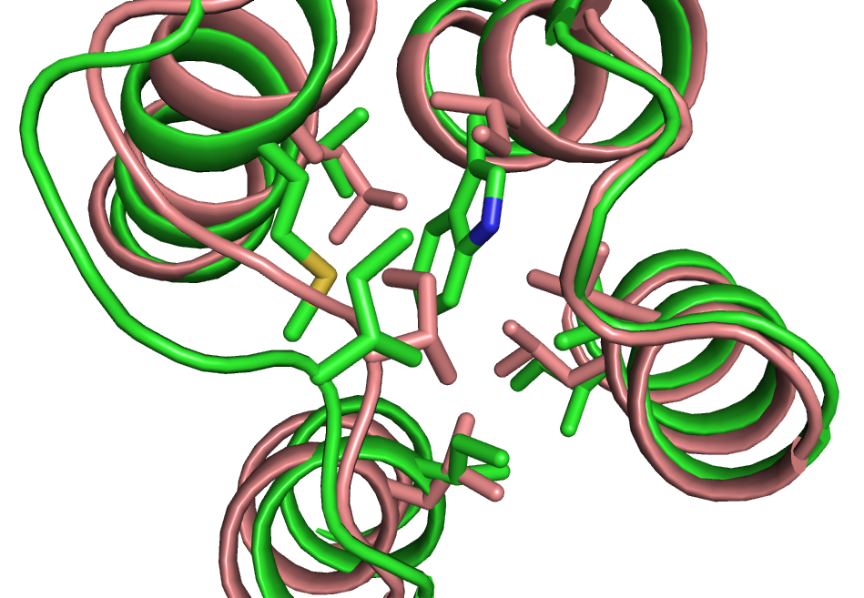
Design Model Compared to the WT Structure
7
10
11
14
17
18
21
24
25
28
37
38
40
41
42
44
45
48
51
52
60
63
64
67
68
70
71
74
75
86
89
92
93
96
99 100 103
Green: Design Model
Salmon: WT crystal structure
Redesigned Positions
WT - L F V T Y L L T L L L I E A F A L L M A M L C L E I L A R L I G V I M V I
Des - I V T L L I V D I V Y W K I Y L V M I T V V L I M L V M L I V K L V E L K

Slide 15
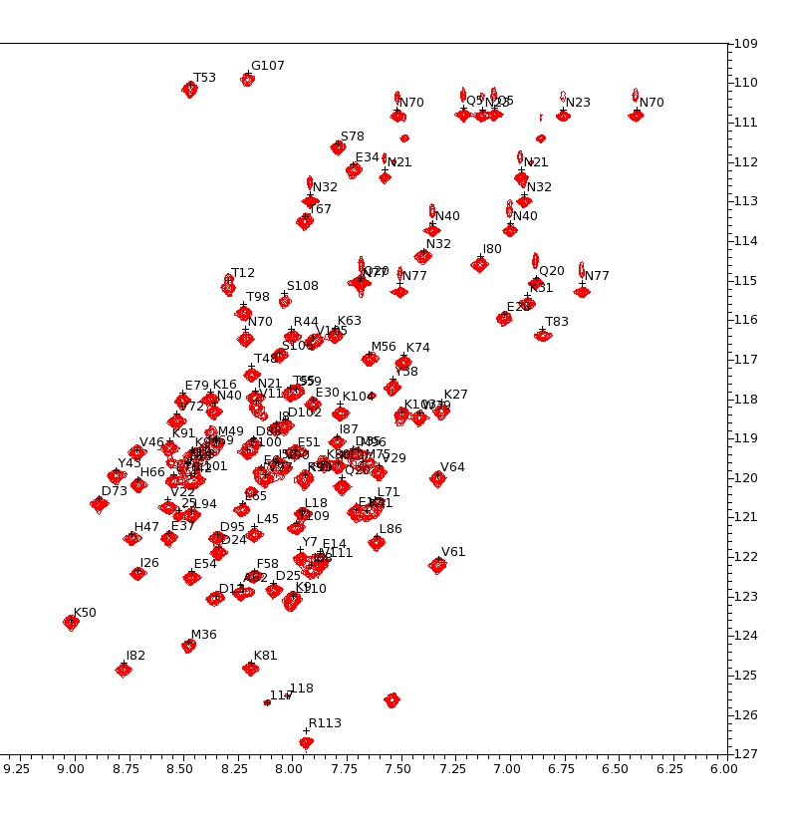
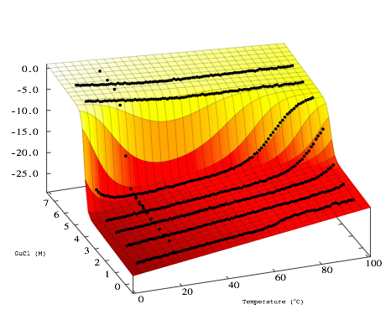
The CheA Redesign is Well-Folded and is Hyperthermophilic
¹H-¹⁵N HSQC
Circular Dichroism Unfolding Experiments
Mean residue ellipticity
N15
GuHCl(M)
Temperature (ºC)
T_{m} = 140-150 (ºC) (extrapolated)
ΔG_{f}(20°C) = -19 kcal / mol
HN

Slide 16
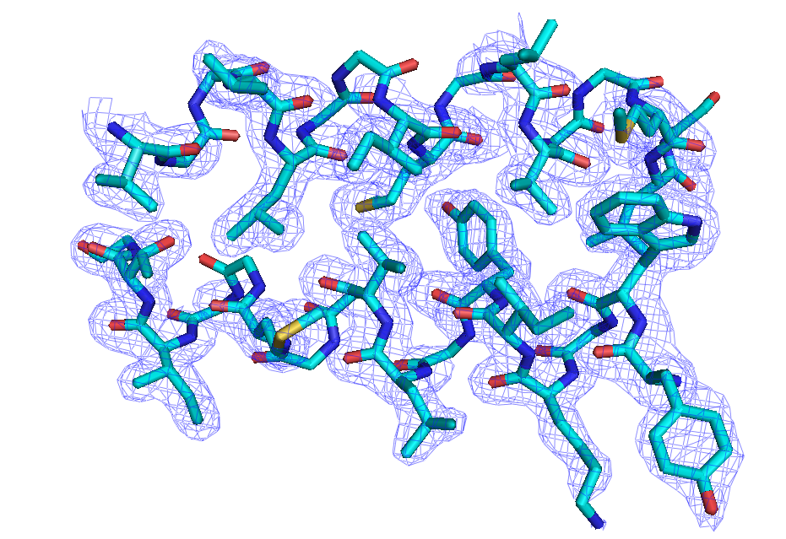
Crystal Structure of CheA Redesign
Close up: Helix 2 and 3
Resolution: 1.8 Å

Slide 17
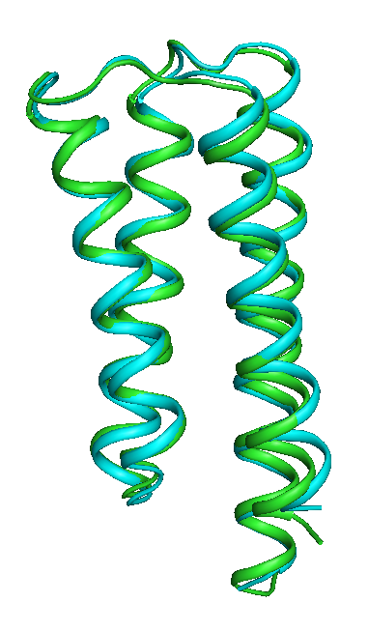
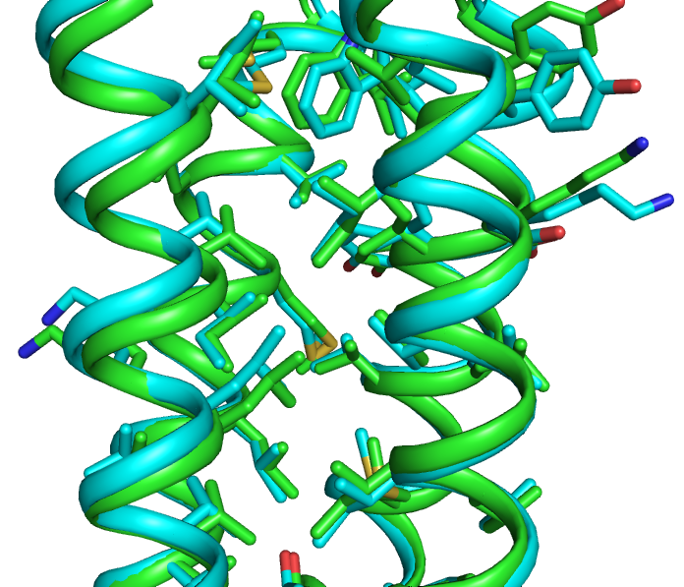
Crystal Structure Compared with the Design Model
Green: Design Model, Cyan: Crystal Structure

Slide 18
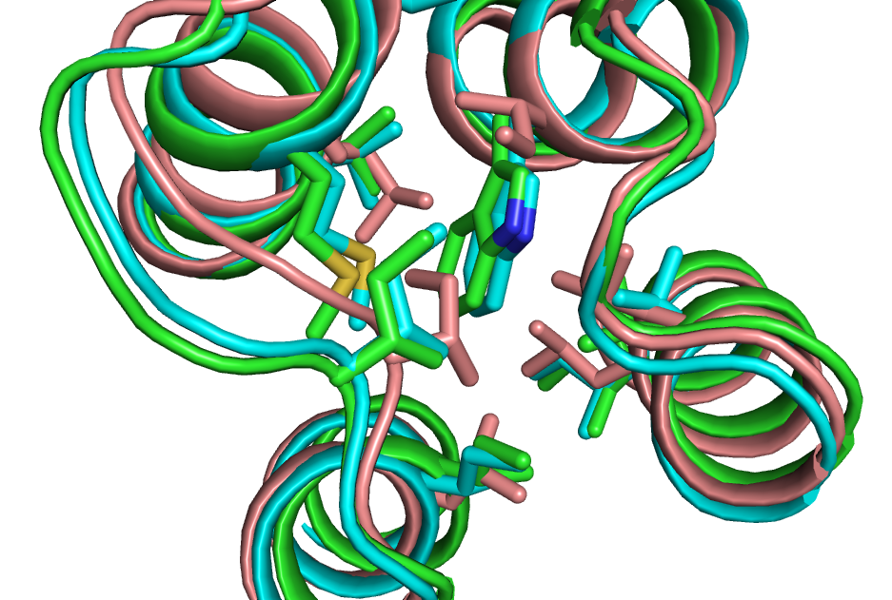
Comparison: WT, X-Ray of Redesign and Redesign Model
Salmon: WT
Green: Redesign Model
Cyan: X-Ray Redesign

Slide 19
Conclusions and Future Directions for CheA Redesign
Demonstrates that sequence design can be combined with backbone sampling to more aggressively redesign proteins.
Extreme thermostability can be achieved by remodeling a protein’s core.
Why is the redesign stabilized? Possibilities: tighter packing, more favorable rotamers, stronger helical propensities, burial of more hydrophobic surface area, more dynamic, …

Slide 20
Outline: Three Protein Design Stories
Using Flexible Backbone Design for the Complete Redesign of a Protein Core
Designing the Structure and Sequence of a Protein-Binding Peptide
Design of Metal-Mediated Protein-Protein Interactions

Slide 21
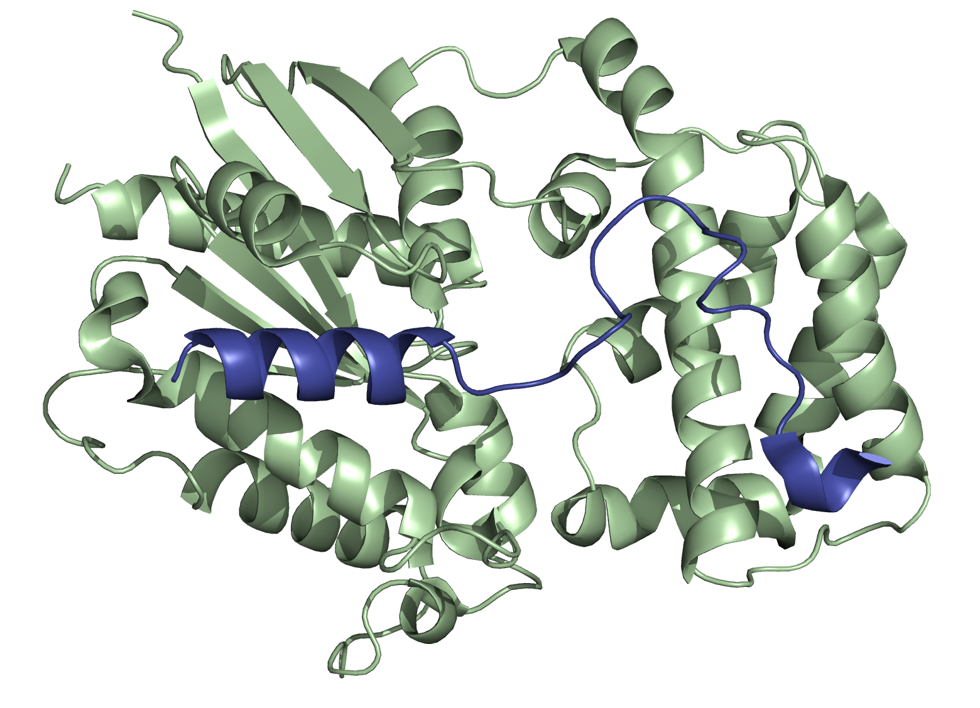
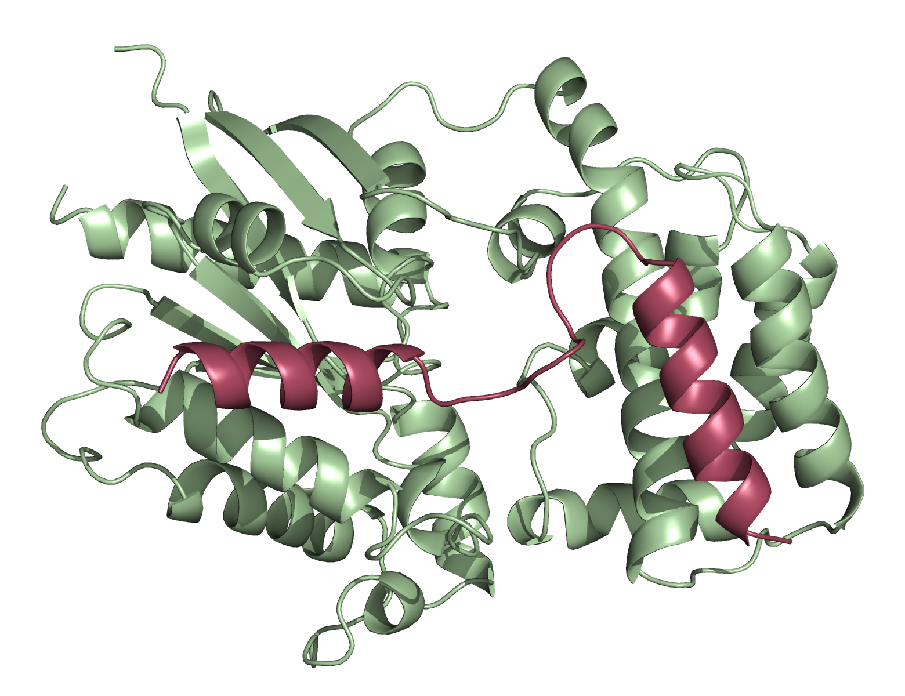
Designing a New Docked Conformation for a Protein-Binding Peptide
WT GoLoco motif (blue) with WT Gα_{i1}(green)
Design goal: Change the sequence of GoLoco so the C-terminal residues of GoLoco adopt a helix when bound to Gα_{i1.}
Deanne Sammond, Glenn Butterfoss

Slide 22
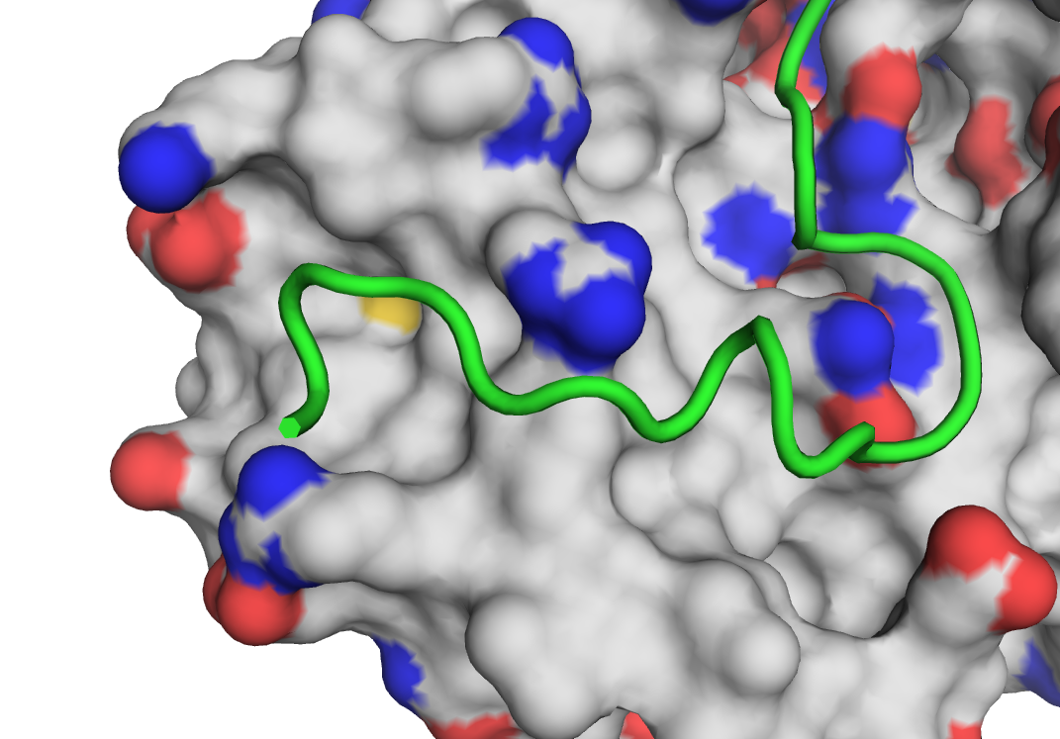
Designing Sequence and Structure at an Interface
Remove the portion of the structure to be remodeled
Build in a new backbone with the target conformation (fragment assembly)
Design a sequence for the new backbone
Refine the conformation of the designed residues
Iterate steps 3 and 4

Slide 23
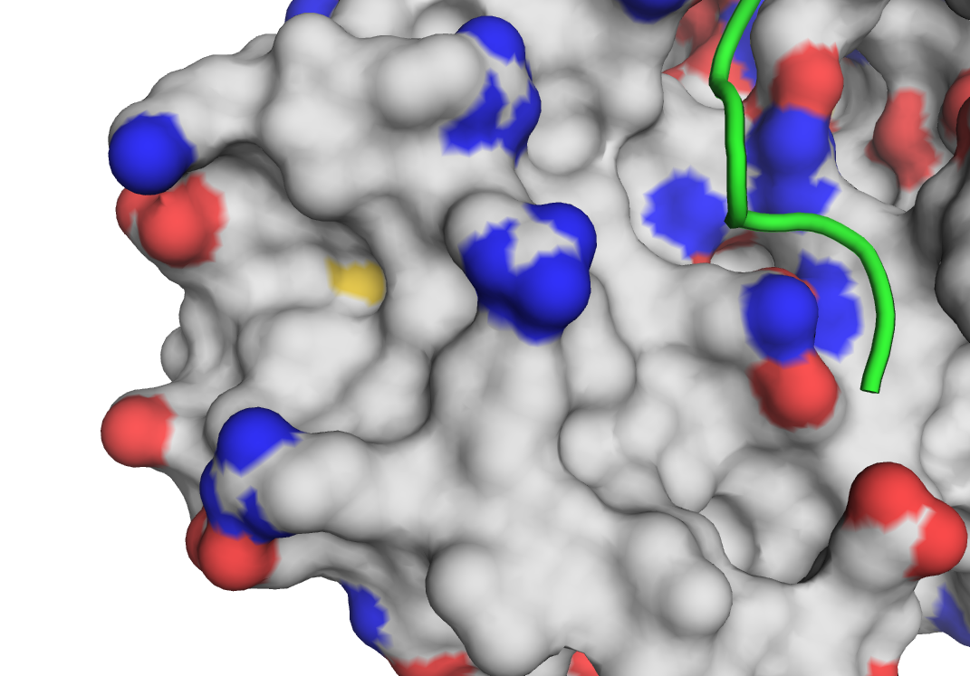
Designing Sequence and Structure at an Interface
Remove the portion of the backbone to be remodeled
Build in a new backbone with the target conformation (fragment assembly)
Design a sequence for the new backbone
Refine the conformation of the designed residues
Iterate steps 3 and 4

Slide 24
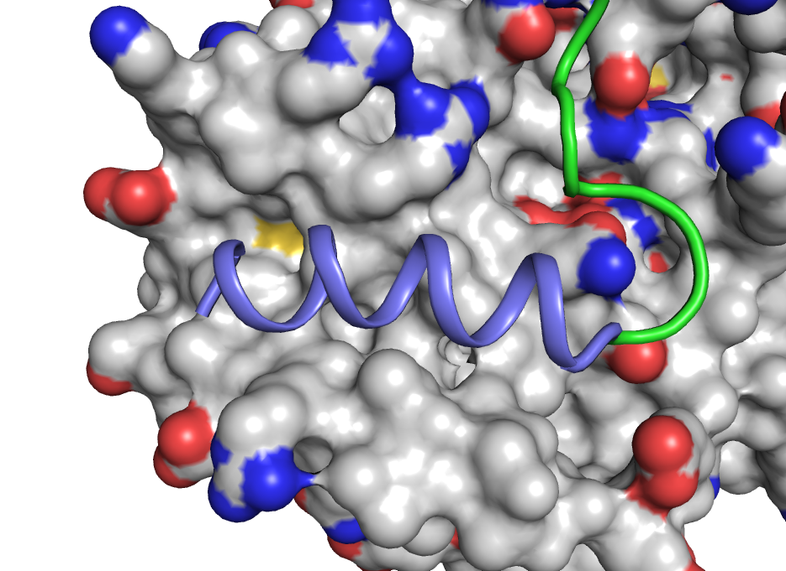
Designing Sequence and Structure at an Interface
Remove the portion of the backbone to be remodeled
Build in a new backbone with the target conformation (fragment assembly)
Design a sequence for the new backbone
Refine the conformation of the designed residues
Iterate steps 3 and 4

Slide 25
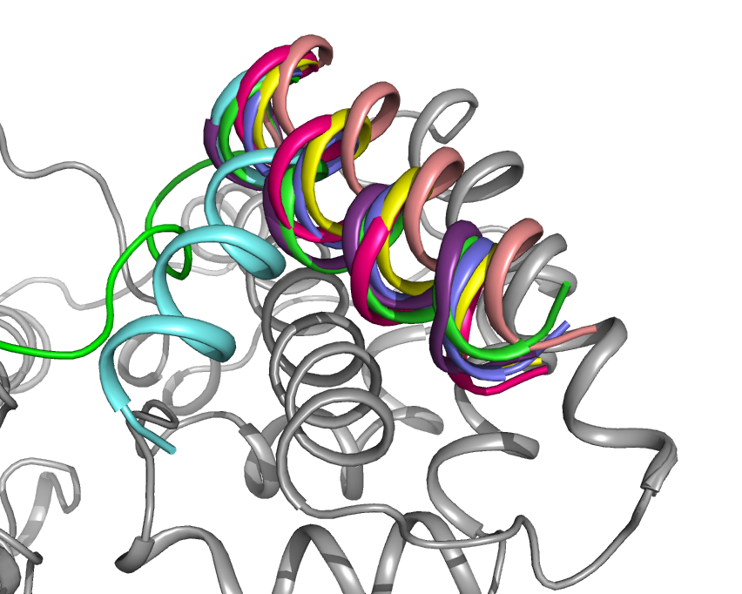
Representative Starting Structures

Slide 26
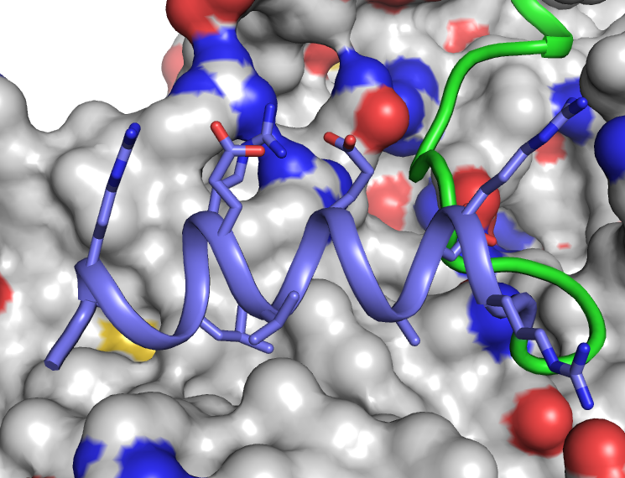
Designing Sequence and Structure at an Interface
Remove the portion of the backbone to be remodeled
Build in a new backbone with the target conformation (fragment assembly)
Design a sequence for the new backbone
Refine the conformation of the designed residues
Iterate steps 3 and 4

Slide 27
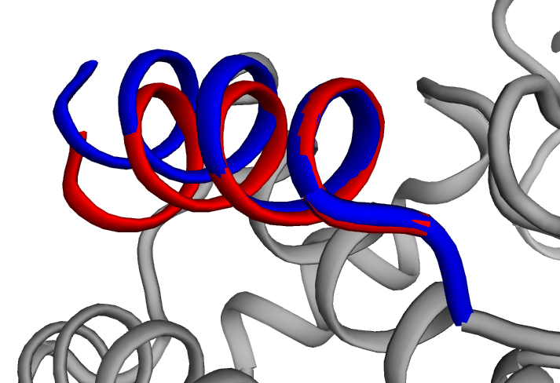
Designing Sequence and Structure at an Interface
Remove the portion of the backbone to be remodeled
Build in a new backbone with the target conformation (fragment assembly)
Design a sequence for the new backbone
Refine the conformation of the designed residues
Iterate steps 3 and 4

Slide 28
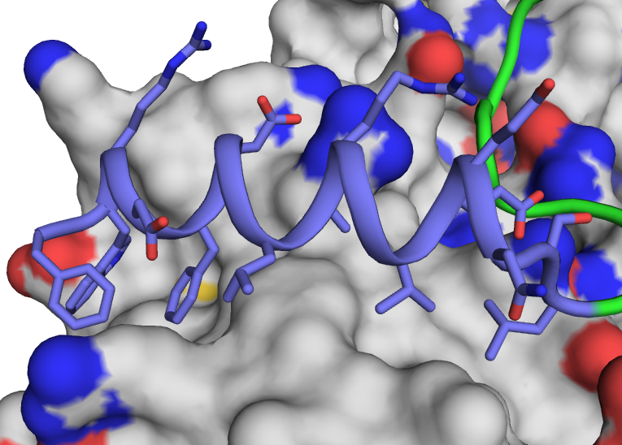
Designing Sequence and Structure at an Interface
Remove the portion of the backbone to be remodeled
Build in a new backbone with the target conformation (fragment assembly)
Design a sequence for the new backbone
Refine the conformation of the designed residues
Iterate steps 3 and 4

Slide 29
Designing Sequence and Structure at an Interface
From two thousand design trajectories, four designs were selected for experimental characterization. One bound with an affinity tighter than the truncated GoLoco peptide.
Binding curves for GoLoco Redesigns
Normalized Fluorescence Polarization
GL_{helix}-4, K_{d}= 810 nM
Gα_{i1} (μM)
Design: GL_{helix}-4

Slide 30
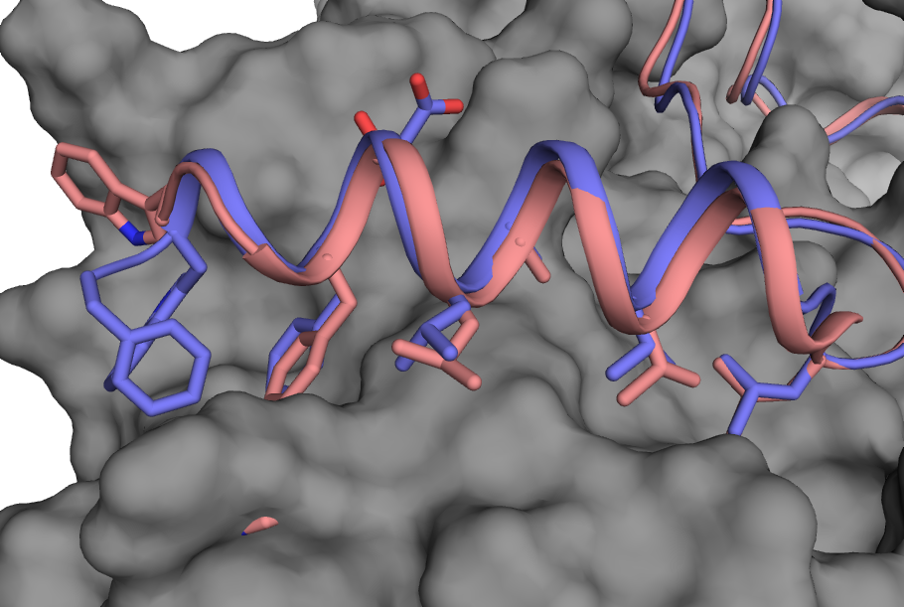
Crystal Structure of the GoLoco Redesign
Purple: design model, Salmon: crystal structure
Dustin Bosch, Mischa Machius, David Siderovski

Slide 31
Outline: Three Protein Design Stories
Using Flexible Backbone Design for the Complete Redesign of a Protein Core
Designing the Structure and Sequence of a Protein-Binding Peptide
Design of Metal-Mediated Protein-Protein Interactions

Slide 32
Metal binding can potentially addresse two major pitfalls of protein-protein interface design
Pitfall #1: No binding!
Pitfall #2: Incorrect binding orientation
Metal coordination bonds are:
enthalpically strong and geometrically constrained

Slide 33
Symmetric Metal Interface Design Protocol
Step 0: Choose scaffold proteins.
Step 1: Design half zinc sites 1 and 2.
Step 2: Generate symmetric complex, 2 flips.
Step 3: Search rigid body alignments.
filter 1 = zinc geometry
filter 2 = backbone clashes
Step 4: Symmetric design of interface sidechains, symmetric backbone minimization.
Step 5: Score.
Step 6: Visual inspection.

Slide 34
Symmetric Metal Interface Design Protocol
Step 0: Choose scaffold proteins.
Step 1: Design half zinc sites 1 and 2.
Step 2: Generate symmetric complex, 2 flips.
Step 3: Search rigid body alignments.
filter 1 = zinc geometry
filter 2 = backbone clashes
Step 4: Symmetric design of interface sidechains, symmetric backbone minimization.
Step 5: Score.
Step 6: Visual inspection.
RosettaMatch – Geometric Hashing Algorithm
Clarke and Yuan, 1995
Zanghellini et al., 2006

Slide 35
Symmetric Metal Interface Design Protocol
Step 0: Choose scaffold proteins.
Step 1: Design half zinc sites 1 and 2.
Step 2: Generate symmetric complex, 2 flips.
Step 3: Search rigid body alignments.
filter 1 = zinc geometry
filter 2 = backbone clashes
Step 4: Symmetric design of interface sidechains, symmetric backbone minimization.
Step 5: Score.
Step 6: Visual inspection.

Slide 36
Symmetric Metal Interface Design Protocol
Step 0: Choose scaffold proteins.
Step 1: Design half zinc sites 1 and 2.
Step 2: Generate symmetric complex, 2 flips.
Step 3: Search rigid body alignments.
filter 1 = zinc geometry
filter 2 = backbone clashes
Step 4: Symmetric design of interface sidechains, symmetric backbone minimization.
Step 5: Score.
Step 6: Visual inspection.

Slide 37
Symmetric Metal Interface Design Protocol
Step 0: Choose scaffold proteins.
Step 1: Design half zinc sites 1 and 2.
Step 2: Generate symmetric complex, 2 flips.
Step 3: Search rigid body alignments.
filter 1 = zinc geometry
filter 2 = backbone clashes
Step 4: Symmetric design of interface sidechains, symmetric backbone minimization.
Step 5: Score.
Step 6: Visual inspection.

Slide 38
Symmetric Metal Interface Design Protocol
Step 0: Choose scaffold proteins.
Step 1: Design half zinc sites 1 and 2.
Step 2: Generate symmetric complex, 2 flips.
Step 3: Search rigid body alignments.
filter 1 = zinc geometry
filter 2 = backbone clashes
Step 4: Symmetric design of interface sidechains, symmetric backbone minimization.
Step 5: Score.
Step 6: Visual inspection.
-
-
+
+

Slide 39
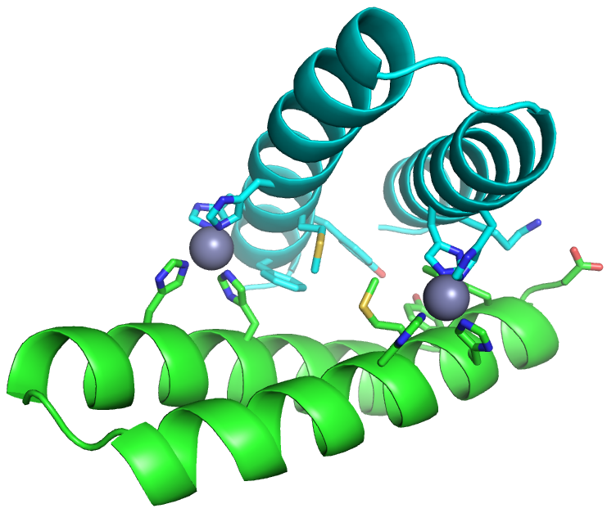
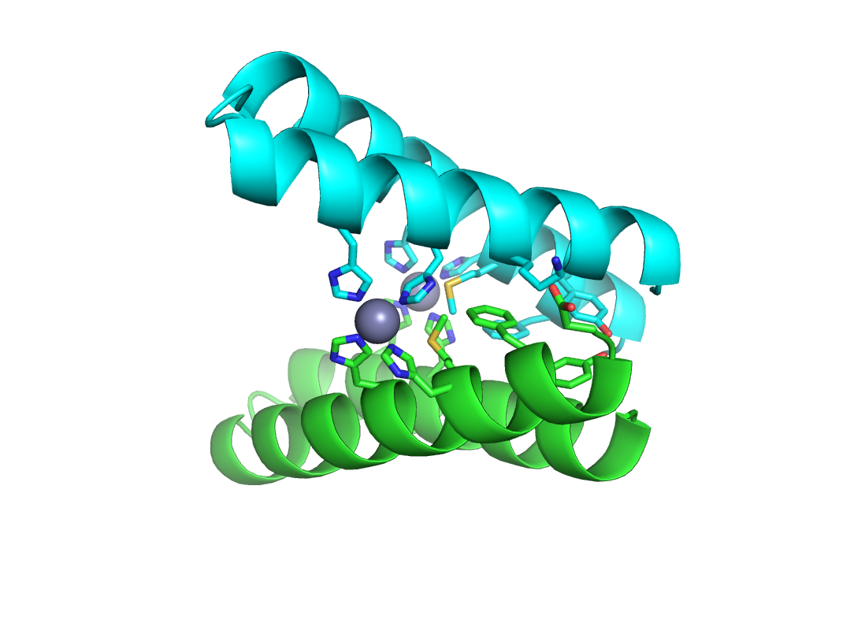
Symmetric Metal Interface Design Protocol
dG_{bind} dSASA dG_{bind}/dSASA uns_hbond
-23.4 1230 -0.0191 0
Step 0: Choose scaffold proteins.
Step 1: Design half zinc sites 1 and 2.
Step 2: Generate symmetric complex, 2 flips.
Step 3: Search rigid body alignments.
filter 1 = zinc geometry
filter 2 = backbone clashes
Step 4: Symmetric design of interface sidechains, symmetric backbone minimization.
Step 5: Score.
Step 6: Visual inspection.
90º

Slide 40
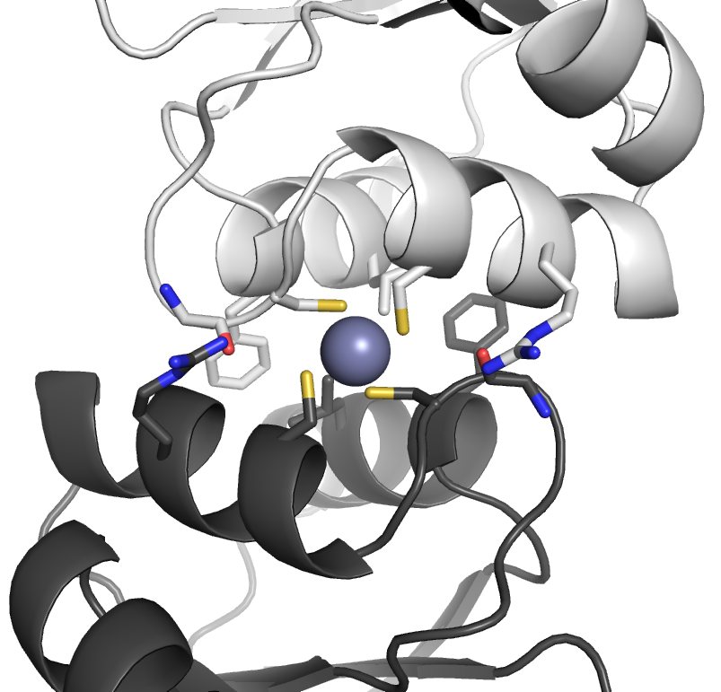
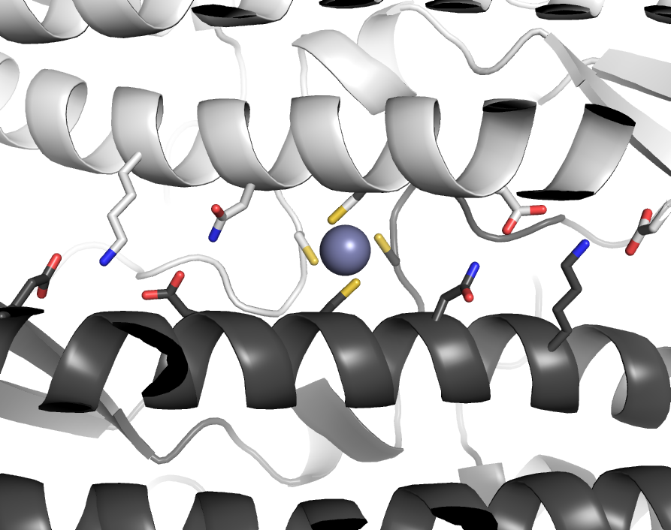
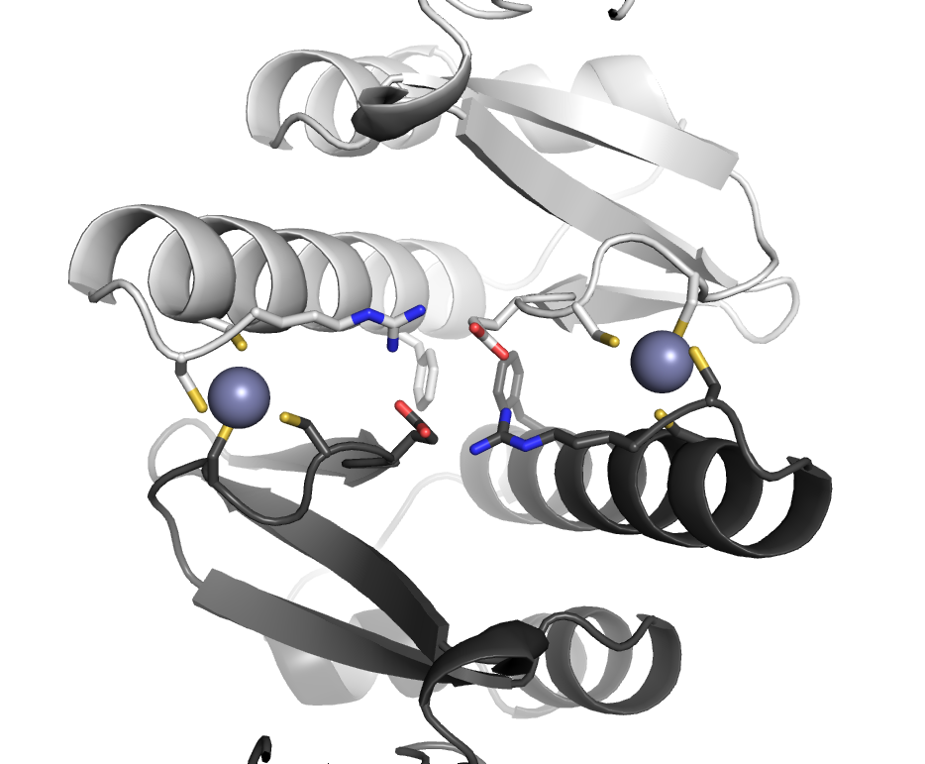
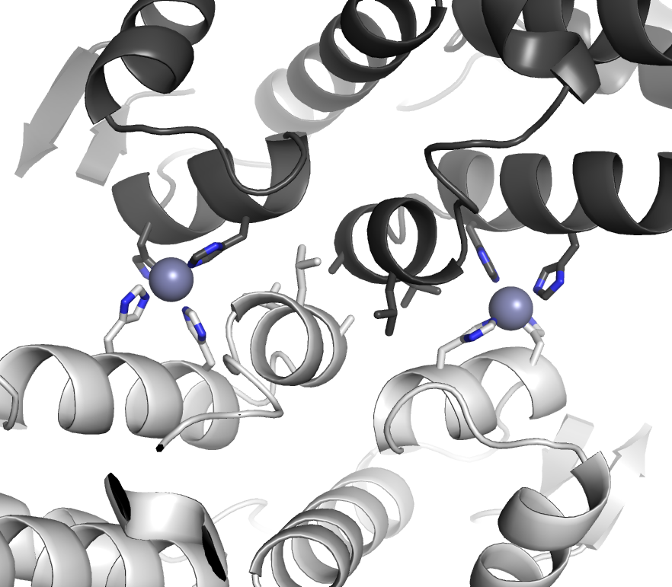
Representative Design Models

Slide 41
1YZMsym Forms a Dimer
Analytical S75 gel filtration
Analytical ultracentrifugation and multi-angle light scattering also confirm dimer formation.
Model of 1YZMsym

Slide 42
Zinc Binding stabilizes 1YZMsym
Circular Dichroism (CD) thermal denaturation
Ellipticity (220 nm)
Ellipticity (220 nm)
T_{m} (ºC)
1YZMsym 57
1YZMsym + cobalt (equamolar) 69
1YZMsym + zinc (equamolar) ~90
T_{m} (ºC)
1YZM_wtHis 46
1YZM_wtHis + zinc 51

Slide 43
Zinc Promotes Homodimer Formation
Fluorescence Polarization Binding Assay
Assay: Titration of 1YZMsym into a small amount of 1YZMsym labeled with a polarizable dye.
Normalized Fluorescence Polarization
[Titrant] (uM)
1YZMsym, 12 uM ZnSO₄, K_{d} < 30 nM
1YZMsym, no ZnSO₄, K_{d} = 3 uM
+

Slide 44
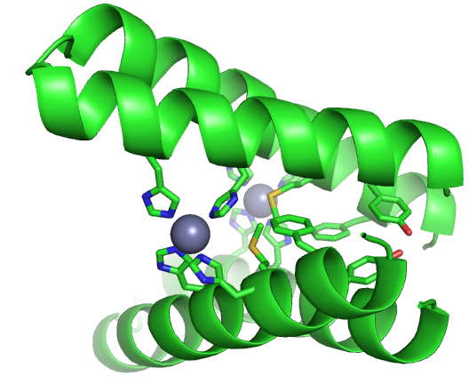
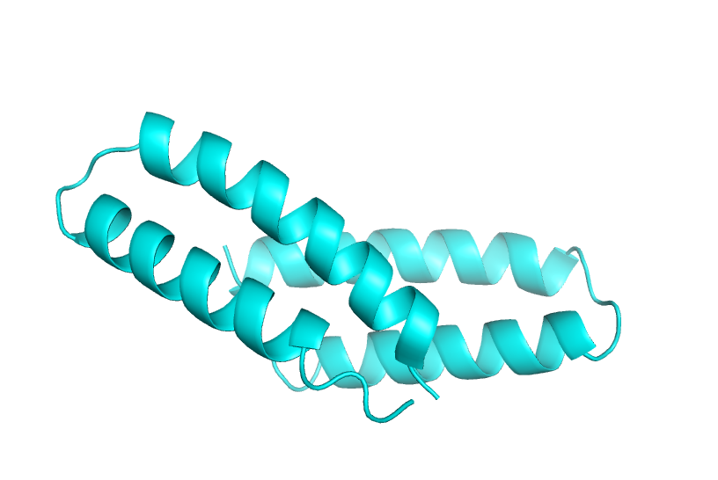
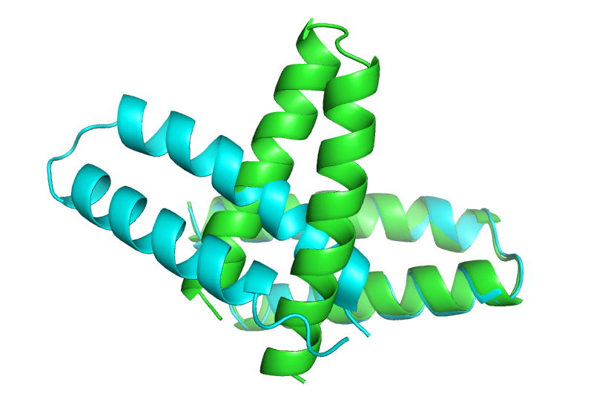
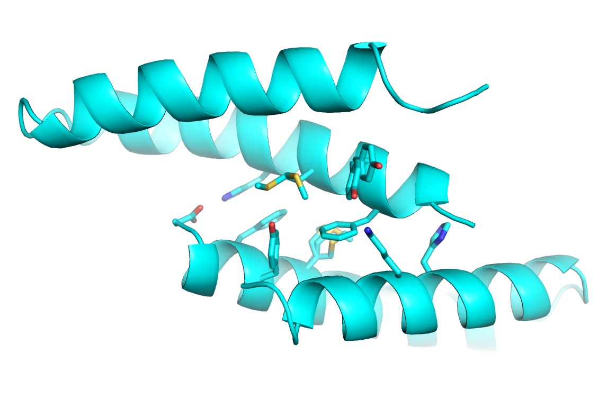
Crystal Structure of 1YZMsym without Metal
Cyan: 1YZMsym no metal crystal structure (1.2 Å resolution)
Green: 1YZMsym design model with zinc

Slide 45
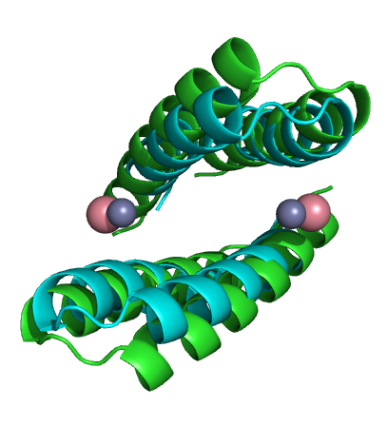
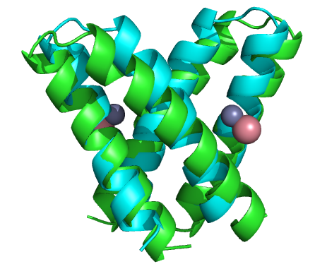
Crystal Structure of 1YZMsym with Cobalt
Green: Design Model with Zinc
Cyan: Crystal Structure with Cobalt

Slide 46
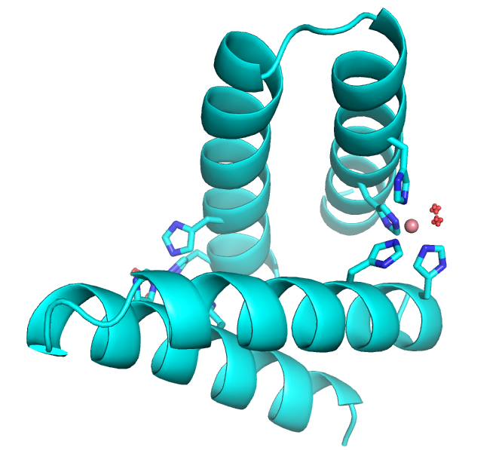
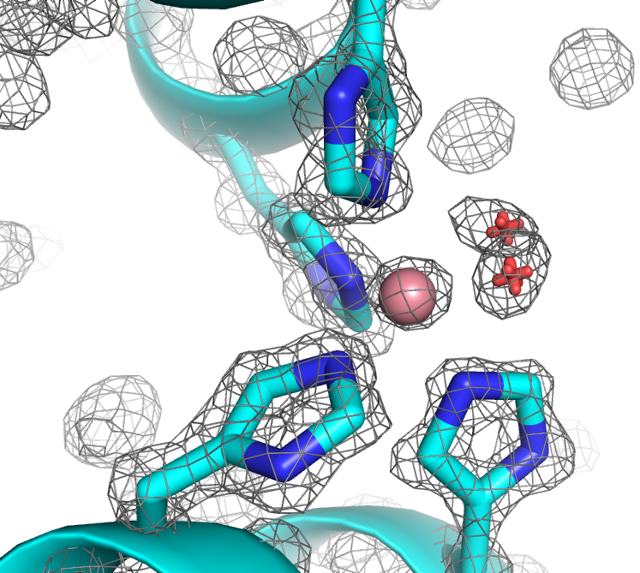
1YZMsym Cobalt: Octahedral Coordination

Slide 47
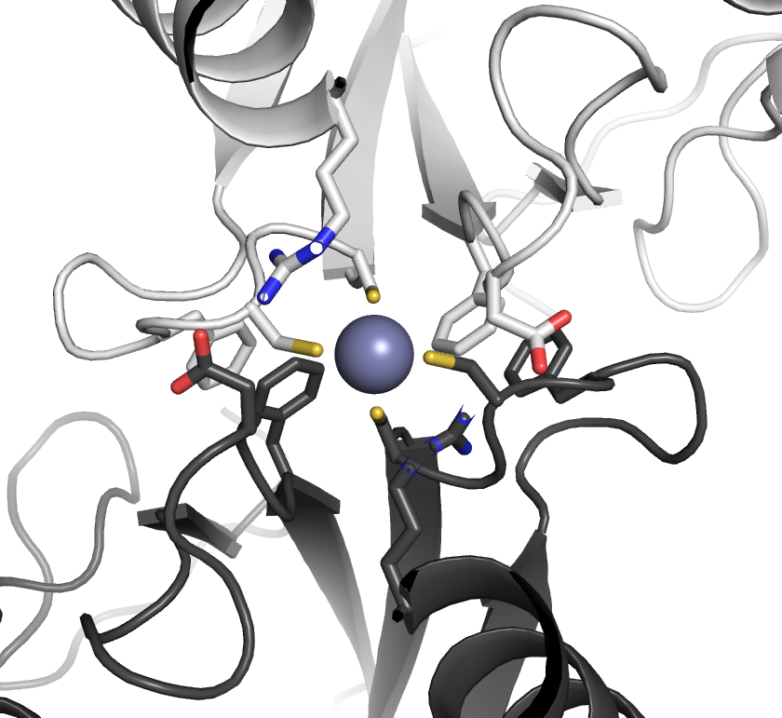
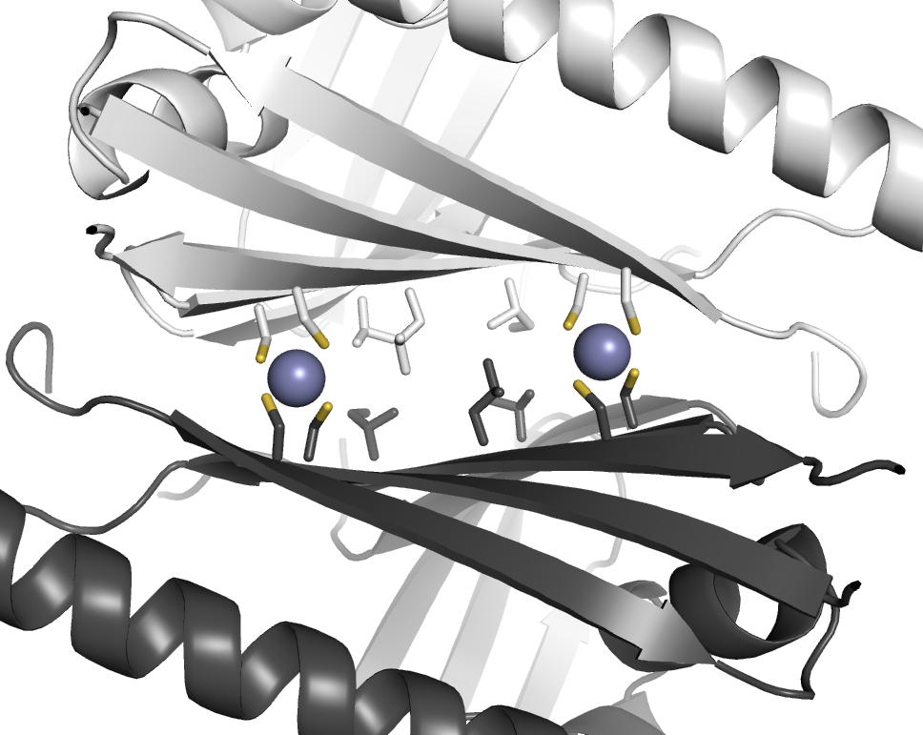
Multiple ways to miss the design goal
2Q0Vsym: dimer without zinc, high-order oligomer with zinc, poor expression
2A9Osym: monomer-dimer equilibrium when dilute MBP fusion → zinc promotes dimer
2D4Xsym: monomer
1G2Rsym: high-order oligomer
2IL5sym: high-order oligomer
1RZ4sym: poor expression

Slide 48
Summary and Future Directions: Metal-Mediated Interface Design
Metal binding can promote tight binding and allow specification of binding orientation
Demonstrated creation of a symmetric interaction
Next step – apply strategy to heterodimers

Slide 49
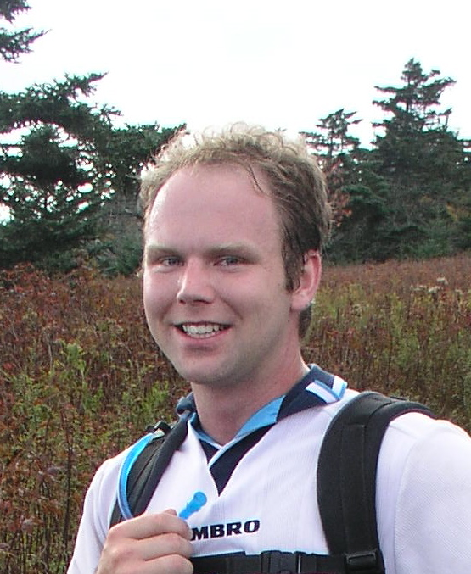

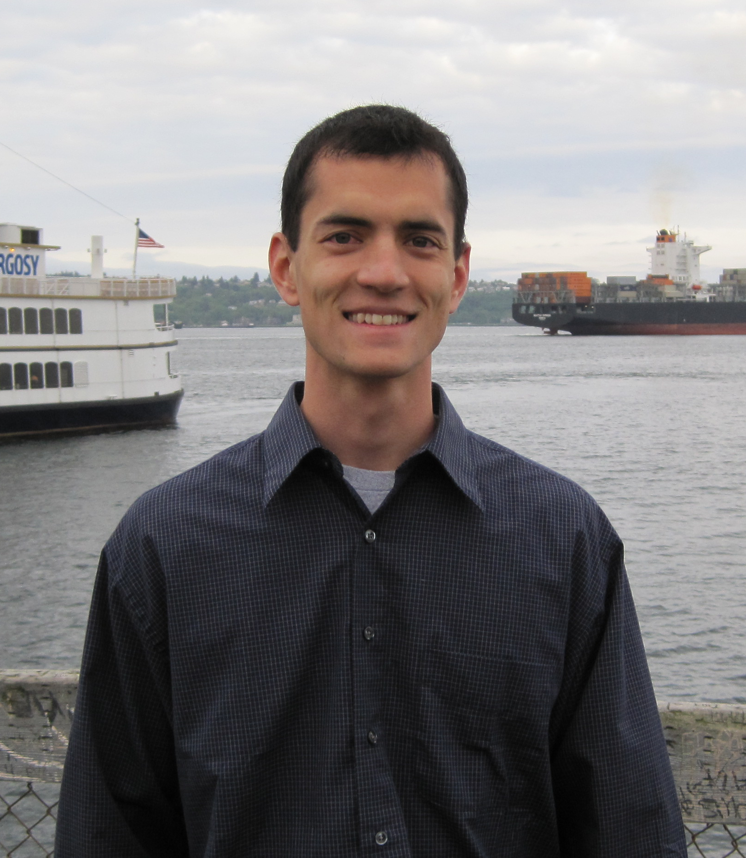
Acknowledgements
  Core Redesign
  Grant Murphy
  GoLoco Peptide Redesign
  Deanne Sammond
  Glenn Butterfoss
  Dustin Bosch (UNC Pharmacology)
  David Siderovski (UNC Pharmacology)
  Metal-Mediated Interface Design
  Bryan Der
  Ramesh Jha
  Steven Lewis
Andrew Leaver-Fay (RosettaMatch)
Mike Miley (UNC Center for Struct. Biol)
Mischa Machius (UNC Center for Struct. Biol.)
Ash Tripathy (UNC Mac-In-Fac)

Slide 50
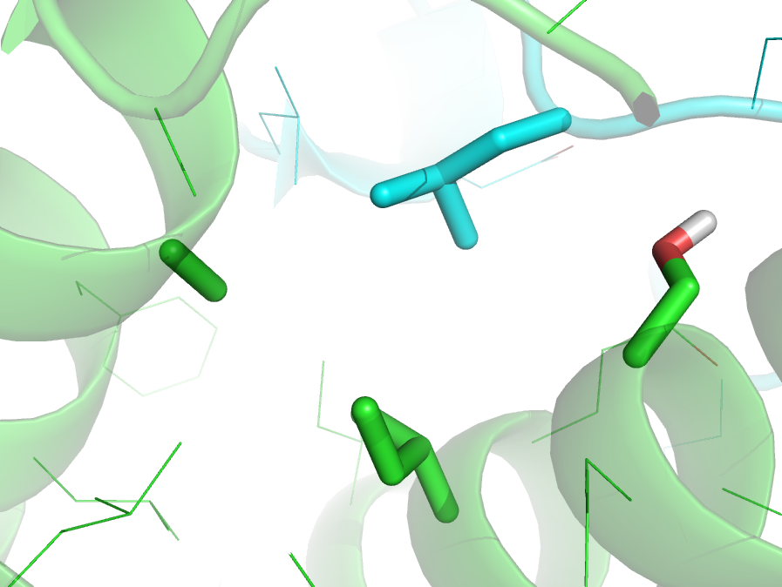
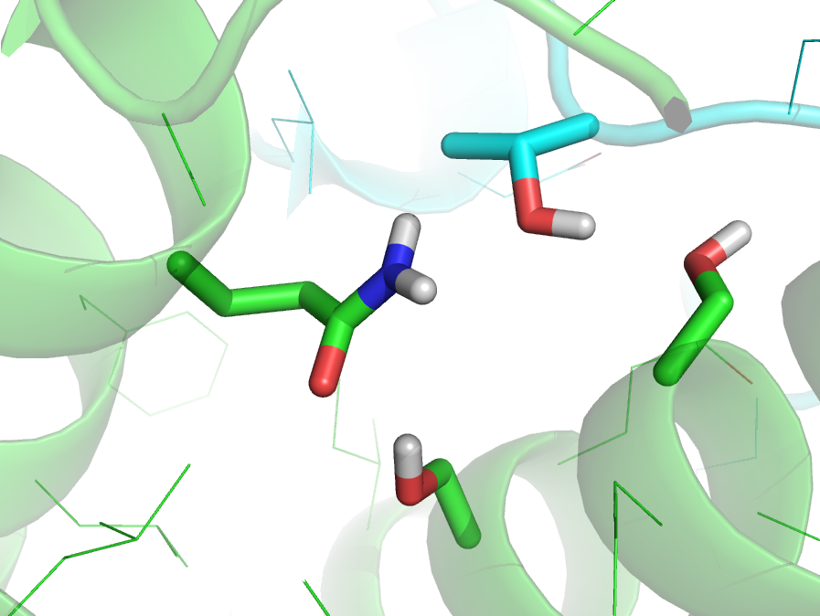
The Challenge of Designing Hbond Networks
T519
S75
Q111
S78
WT: K_{d} = 100 nM
Triple mutant: K_{d} > 20 μM

Slide 51
RosettaMatch: Designing a zinc binding site
Define zinc coordination geometry
RosettaMatch algorithm
free
1
3
2.33 Å
109º
2
109º
Clarke and Yuan, 1995
Zanghellini et al., 2006

Slide 52
RosettaMatch: Designing a zinc binding site
Define zinc coordination geometry
RosettaMatch algorithm
free
1
3
2.33 Å
109º
109º
Clarke and Yuan, 1995
Zanghellini et al., 2006

Slide 53
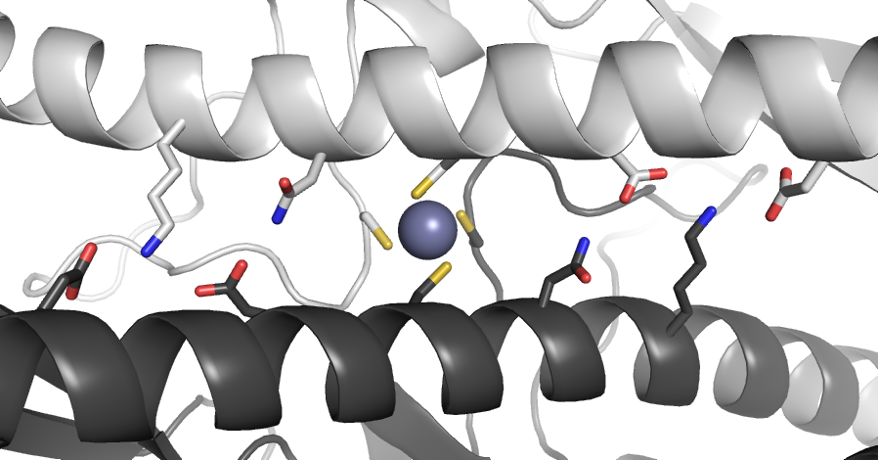
Example of Failed Design: No Binding

