Slide 1
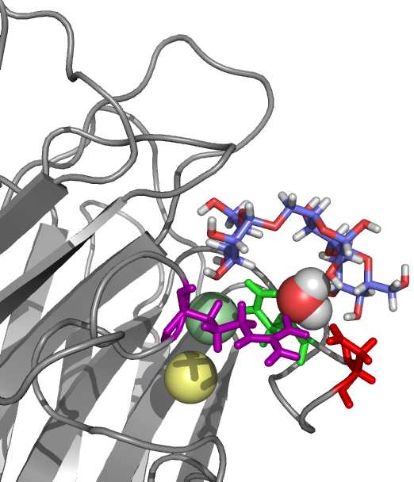
Quantifying the energetics of highly conserved water molecules in carbohydrate-binding proteins.
Elisa Fadda
Computational Glycoscience Lab,
School of Chemistry, NUI Galway
elisa.fadda@nuigalway.ie
Design of Drugs and Chemicals that Influence Biology, IPAM, UCLA, Apr 4th- 8th 2011

Slide 2
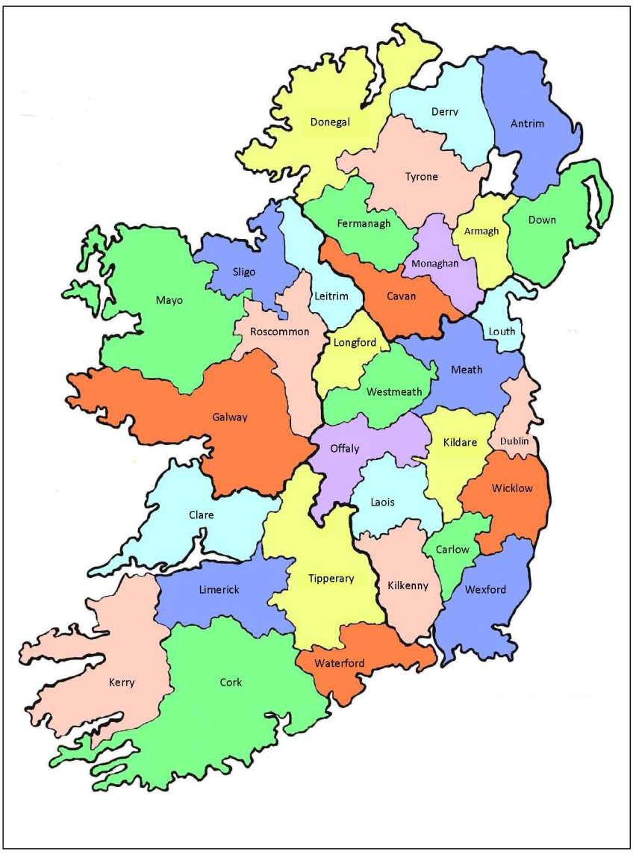

Slide 3
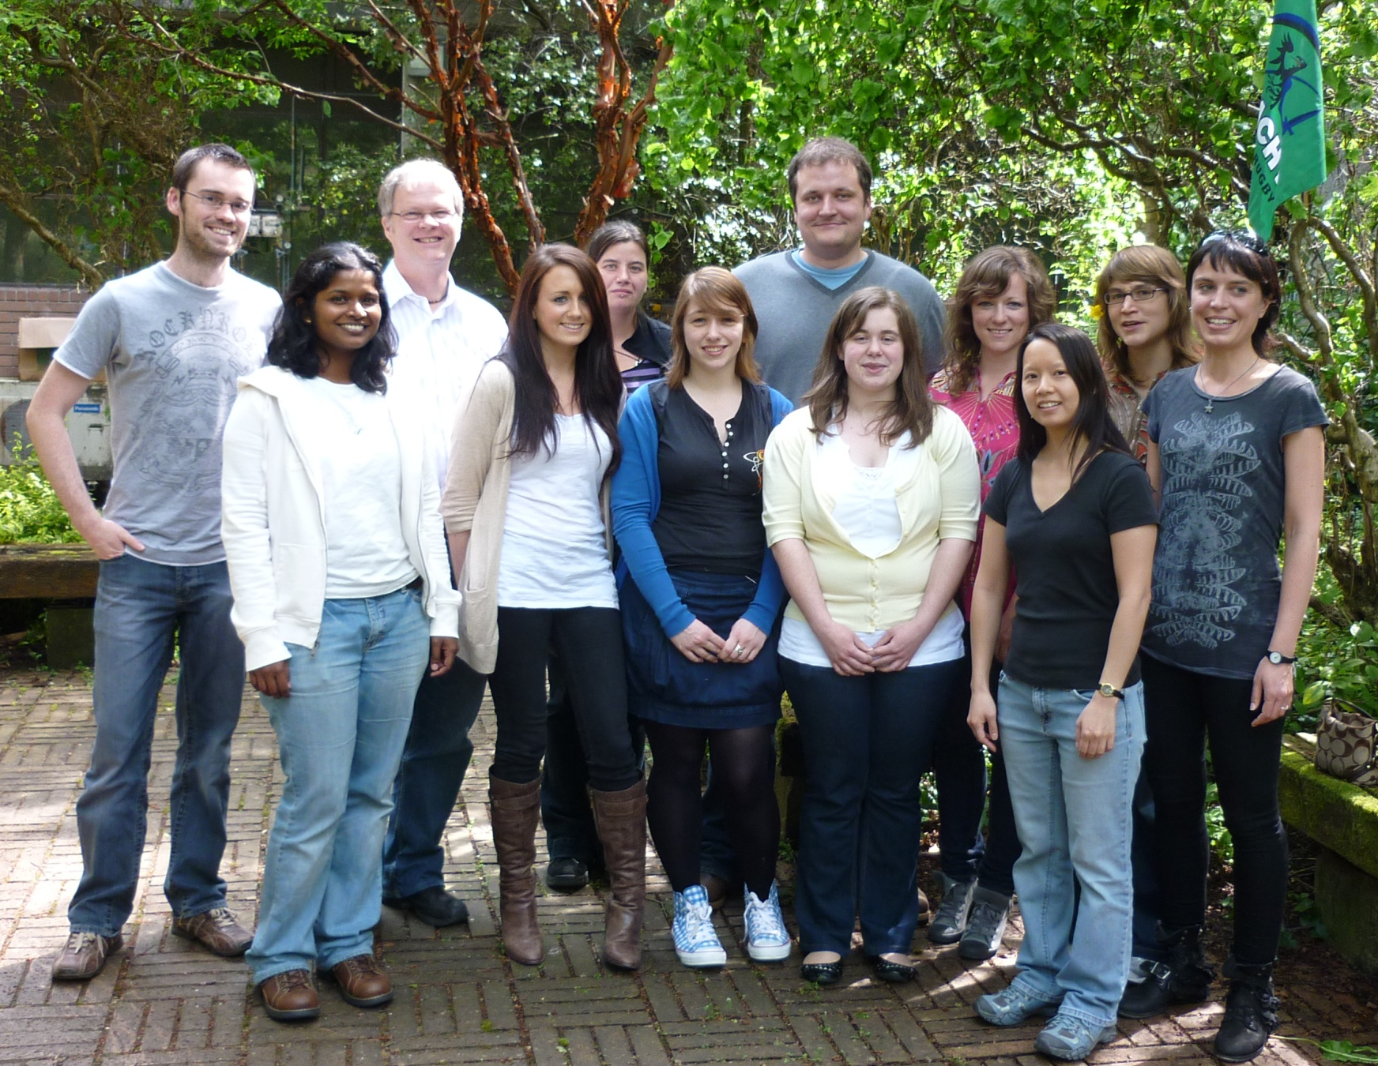
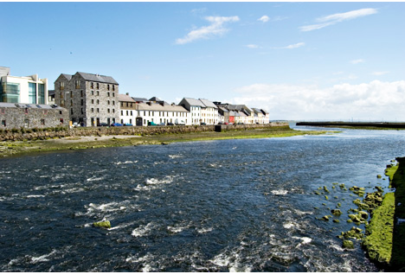
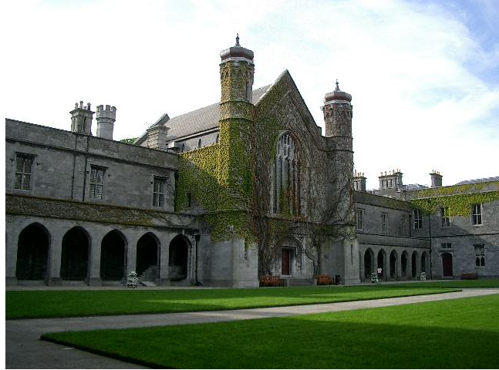
Summer 2010
Woods Glycoscience Lab @ NUI Galway

Slide 4
“In house” Approach to Glycoscience @ NUIG
Enzyme Re-engineering
Inhibitors (Glycomimetics) Design
Computational Predictions
Biological Assays
Virtual Glycan Array Screening
CFG Screening

Slide 5
Computational Glycoscience @ NUIG
Carbohydrate-binding protein engineering
Protein-carbohydrate interaction and dynamics
Glycomimetics
http://glycam.ccrc.uga.edu/
Fadda E. and Woods R.J., Drug. Disc. Today (2010), 15, 596-609

Slide 6
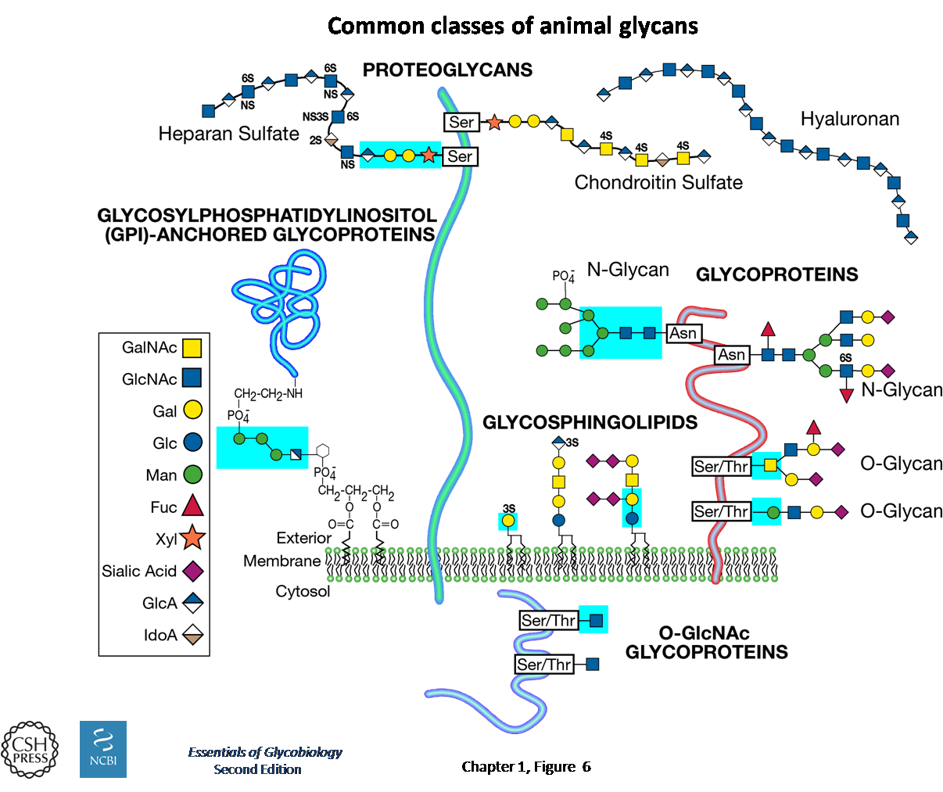
Common Classes of Animal Glycans

Slide 7
Carbohydrates facilitate the interaction between cells and:
Other cells
Viruses
Bacteria
Toxins

Slide 8
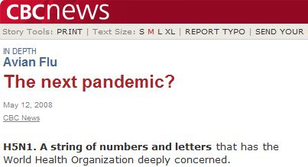
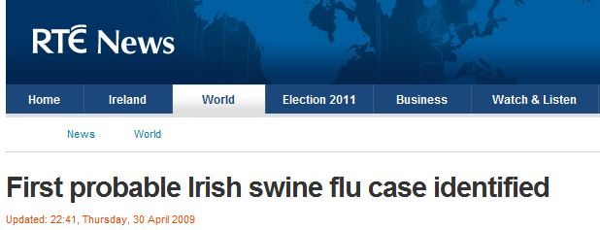
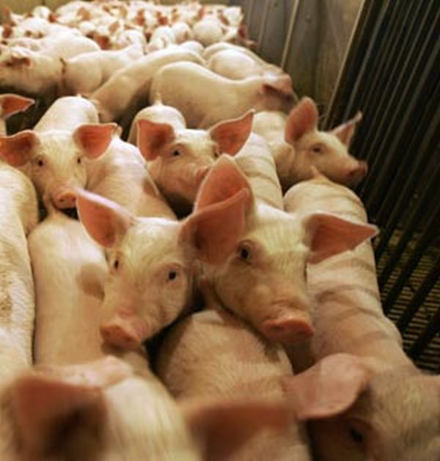
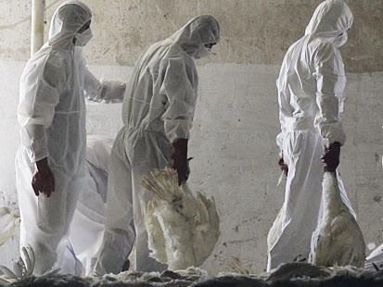
Influenza Viruses
H5N1 Avian Flu (South East Asia), 2008
A/H1N1 Swine Flu (Mexico), 2009

Slide 9
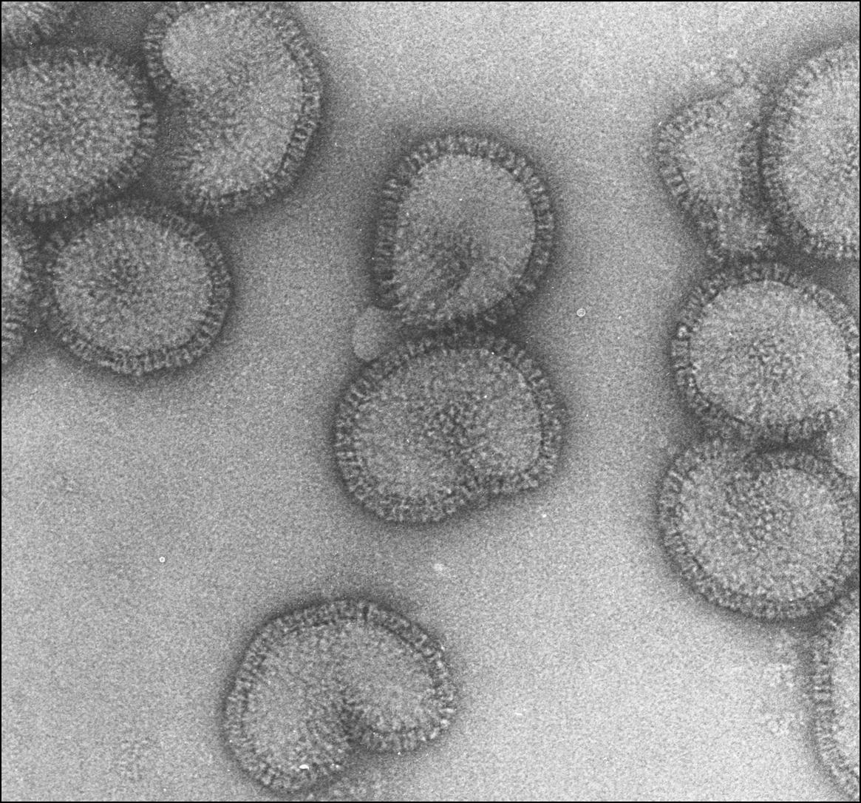
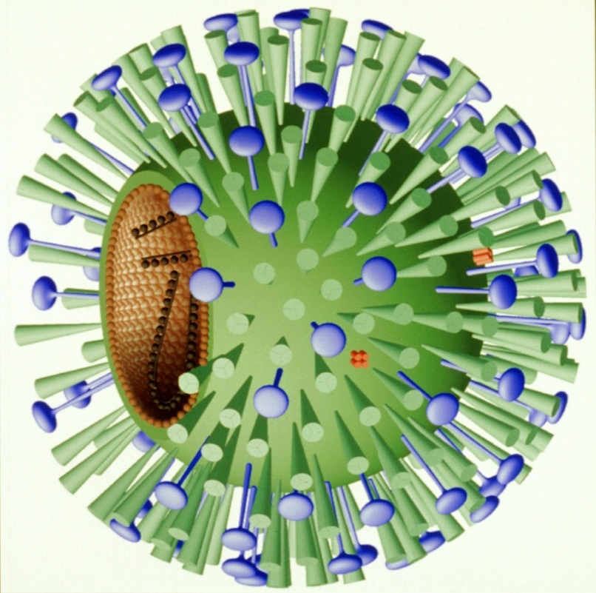
Influenza Virus H1N1
http://download.roche.com/selection/tamiflu2009/html/detail_8.html
http://www.esrf.eu/news/general/flu/ (Credits: Rob Ruigrok/ UVHCI)
Notes:
An electron microscopy image of the flu virus. Credits: Rob Ruigrok/ UVHCI.

Slide 10
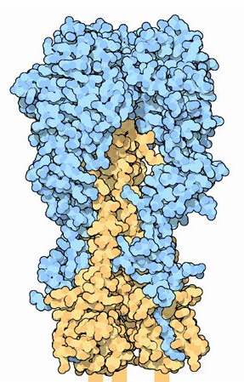
Flu Virus Infection ad Replication
Virus binds sialic acid containing carbohydrates on the cell surface via hemagglutinins.
Virus delivers its genome into the host cell.
Produces new copies of the viral proteins.
Exits the cell while neuraminidases cleave the sialic acid from the glycans on the cell surface.
2) Neuraminidase
1) Hemagglutinin
http://www.pdb.org/pdb/static.do?p=education_discussion/molecule_of_the_month/pdb113_1.html
http://www.pdb.org/pdb/static.do?p=education_discussion/molecule_of_the_month/pdb76_1.html
Notes:
surface to favor mobility of the virus , allowing the virus to spread

Slide 11
Glycomimetic Drug Design
Fadda E. and Woods R.J., Drug. Disc. Today (2010), 15, 596-609
PDBID 3CL0
Notes:
Panel a) Structure of the de-esterified form of the neuraminidase inhibitor oseltamivir in complex with the H274Y mutant of influenza virus N1 neuraminidase that displays resistance to treatment with oseltamivir (PDBID 3CL0, Ref.[136]). Schematic representations of the natural substrate (neuraminic acid) and the inhibitor are shown in Panels b) and c), respectively.

Slide 12
Polysaccharides Structure
branched
extremely flexible
amphipathic
Notes:
From 3 monosaccharides→ 27648 trisaccharides!

Slide 13
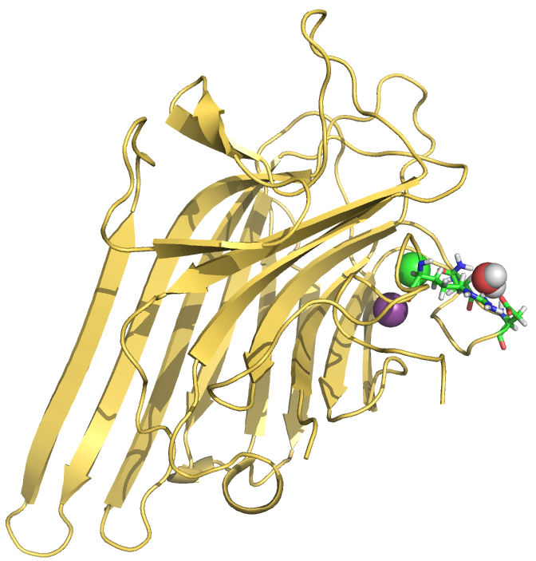
Legume Lectins: Concanavalin A
Legume lectins use water molecules not only to bind the metals, but also for carbohydrate binding.
Notes:
Legume lectins represent the largest and more thoroughly studies family of sugar-binding proteins. Legume lectins’ primary structure is amazingly highly conserved, although they exhibit a variety of monosaccharides and oligosaccharides specificities. They all exhibit the “jelly roll” fold aka “lectin fold”, all have the two ions Ca and Mn, necessary to bind the carbohydrate. The binding site looks like a small depression on each monomer’s surface and has a classic D and N residue, in ConA the Gly is replaced by an ARG. ConA is a mannose/glucose specific lectin.

Slide 14
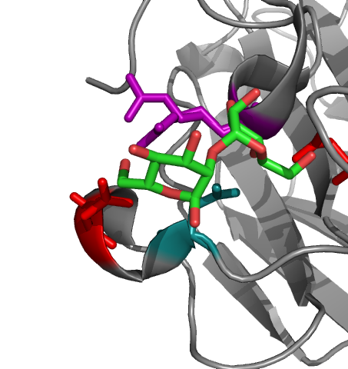
Carbohydrate binding a) Hbonds (enthalpic) b) Desolvation (entropic)
“High” energy water
Protein∙nH₂O + Carb ∙mH₂O →
Complex ∙qH₂O + (n+m-q)H₂O
Klein et al., Ang. Chem. (2008), 120, 2733-2736
Lemieux, Acc. Chem. Res. (1996), 29, 373
Notes:
Crystal structures of carbohydrate-binding proteins reveal dense networks of intermolecular hbonds, but these bonds can only form after desolvation of the binding surface.
Complex formation involves the interchange of carbohydrate-OH groups with H2O molecules, which is not an obviously favorable process.
Both carbohydrates and carbohydrate binding sites are actually amphiphylic. It has been argued that their surfaces might be inefficiently hydrated so that the water on the left of Eq. Is high energy and drives the formation of the complex.

Slide 15
Displacement of Structural Water
Design of glycomimetics that displace structural water upon binding.
Higher binding affinity due to gain in entropy for the release of well ordered water into bulk.
Binding affinity of structural water.

Slide 16
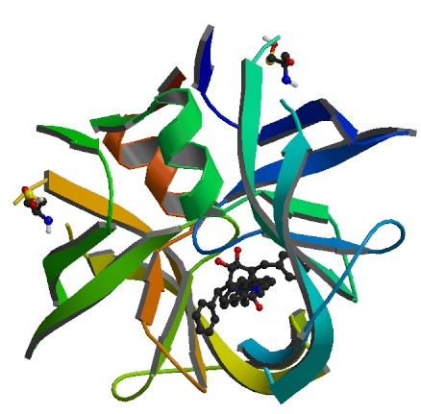
HIV Protease Inhibitor Design
Lam et al, Science (1994), 263, 380-384; PDBid 1HVR
Notes:
Non-peptide cyclic urea ligand. The water displaced had a binding free energy between -4-6 kcal/mol in one instance and -10 +/- 0.5 from Barillari et al JACS.

Slide 17
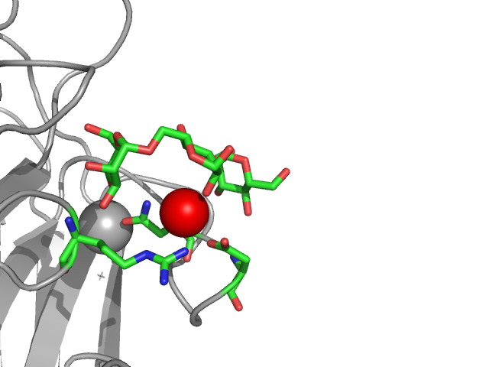
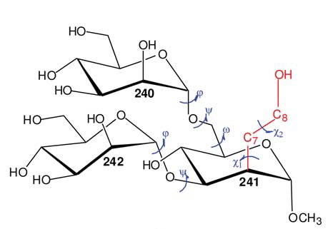
Structural water in Concanavalin A
Man-α-(1-6)-[Man-α-(1-3)]-Man
N14
D16
R228
Kadirvelraj R. et al, J. Am. Chem. Soc. (2008), 130, 16933-16942
PDBid: 1CVN
Notes:
The main problem for consideration of water molecules in drug design is to know which molecules are important in mediating the interaction between a protein and a ligand and which instead can be targeted for displacement.
Is it really worthwhile to target water molecules for displacement through rational design.

Slide 18
Structural water in Concanavalin A
Man-α-(1-6)-[Man-α-(1-3)]-Man
N14
D16
R228
PDBid: 1CVN
PDBid: 3D4K
Notes:
The main problem for consideration of water molecules in drug design is to know which molecules are important in mediating the interaction between a protein and a ligand and which instead can be targeted for displacement.
Is it really worthwhile to target water molecules for displacement through rational design.

Slide 19
Questions
What is the energetic contribution that makes this water so highly conserved?
Water model dependence?
Is it possible to displace the water?
Why the synthetic ligand is not successful in displacing the structural water?

Slide 20
Standard Binding Free Energy
“.. Then there is the dynamics vs. static problem: drug molecules and their binding targets never stop moving, folding and flexing. Modelling this realistically is hard, and increases the computational burden substantially.”
D.Lowe, Nature, 7 May 2010

Slide 21
Double Decoupling Approach: Thermodynamic breakdown
Pw_{(sol)}
P_{(sol)} + w_{(gas)}
w_{(sol)}
w_{(gas)}
P_{(sol)} + w_{(sol)}
Pw_{(sol)}
Gilson et al., Biophys J. (1997), 72, 1047-1069
Hamelberg and McCammon, J. Am. Chem. Soc. (2004), 126, 7683-7689
Notes:
Thermodynamic breakdown of the double decoupling method.

Slide 22
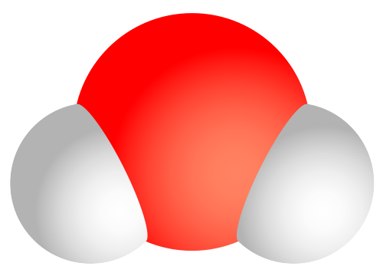
Double Decoupling Approach
fully interacting
only vdW
“ghost”
Gilson et al., Biophys J. (1997), 72, 1047-1069
Hamelberg and McCammon, J. Am. Chem. Soc. (2004), 126, 7683-7689
Notes:
External coordinates can be defined as the 3 degrees of freedom due to rotation as defined by the 3 euler angles of any three atoms used to define the molecular axes of A.
DG is defined as the free energy required to decouple the water from the binding site of P during the simulation. During the later part of the simulation when B is weakly coupled to A, B would have to explore the entire simulation box in order for DG to converge. This can be circumvented by constraining the coordinates of B to occupy the binding site of A using a restraining potential while decoupling the interaction of B.
The first term can be evaluated using TI by molecular dynamic simulation as lambda is varied from 0 to 1. The third term is a correction term due to the constraining of the translational degrees of freedom of B during the free energy simulation. They are the change in free energy when the constrained ligand is allowed to expand and occupy a volume 1/C0 (and to rotate freely)

Slide 23
3- and 5-Site Water Models
TIP3P§
TIP5P*
Model | q_{H} | ε₀(kcal/mol) | σ(Å)
TIP3P | 0.417 | 0.1521 | 3.15061
TIP5P | 0.241 | 0.16 | 3.12
§Jorgensen et al., J. Chem. Phys. (1983), 79, 926
*Mahoney and Jorgensen, J. Chem. Phys. (2000), 112, 8910
Notes:
T3P vs. T5P
The large computational demand imposed by such models does not necessarily equate to higher accuracy. The water is often represented by rigid three point charge models as TIP3P which has been parameterized for a single temperature 298 K and therefore poorly captures the temperature dependence of its properties.

Slide 24
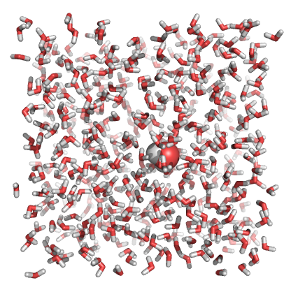
ΔG_{w} of 3- and 5-Site Water Models
25 Å
Desolvation free energies (all values in kcal/mol).
Model | Coulomb | vdW | ΔG⁰ | Lit.
TIP3P | 8.5 (0.1) | -2.2 (0.1) | 6.3 | 6.5(0.4); 6.1 (0.2)
TIP5P | 7.7 (0.1) | -2.0 (0.1) | 5.7 | -
Notes:
T3P vs. T5P
The large computational demand imposed by such models does not necessarily equate to higher accuracy. The water is often represented by rigid three point charge models as TIP3P which has been parameterized for a single temperature 298 K and therefore poorly captures the temperature dependence of its properties.

Slide 25
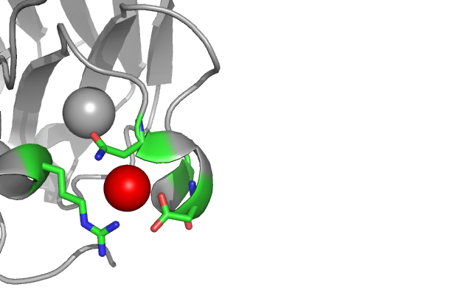
Free ConA (1GVK)
Res-id | bond | Distance (Å)
N14 | N-O_{W} | 2.9
D16 | O-O_{W} | 2.6
R228 | N-O_{W} | 3.0
N14 | Cβ-O_{w} | 3.5
All values in kcal/mol
1GKB | Coulomb | vdW
TIP3P | +14.9 | -5.7 | +6.2 | +0.1 (0.1)
TIP5P | +15.5 | -4.5 | +8.0 | -2.3 (0.2)
Correction term of -3.0 kcal/mol
Notes:
1GKB is at 1.56 Angstroms resolution.
Hysteresis indicates 0.7 kcal/mol error

Slide 26
ConA/3MAN (1CVN)
Res-id | bond | Distance (Å)
N14 | N-O_{W} | 2.7
D16 | O-O_{W} | 2.8
R228 | N-O_{W} | 3.1
MAN | O2-O_{w} | 2.4
1CVN | Coulomb | vdW
TIP3P | +21.7 | -11.4 | +7.3 | -1.0 (0.2)
TIP5P | +21.1 | -5.3 | +12.8 | -7.1 (0.1)
All values in kcal/mol

Slide 27
ConA/3HET (3D4K)
Res-id | bond | Distance (Å)
N14 | N-O_{W} | 2.7
D16 | O-O_{W} | 2.5
R228 | N-O_{W} | 3.0
MAN | O8-O_{w} | 3.0
3D4K | Coulomb | vdW
TIP3P TIP5P | +18.7 +19.0 | -4.6 -4.6 | +11.1 +11.4 | -4.8 (0.1) -5.7 (0.2)
All values in kcal/mol
Notes:
The binding of the native ligand induces only a small displacement in the position of the conserved water relative to the ligand-free structure, but the synthetic ligand significantly distorts the position.
Exp binding energy of 3MAN vs hydroxyet

Slide 28
Standard Binding Free Energies (TIP3P)
All values in kcal/mol
 | Free | 3MAN | 3HET
ΔG_{b}⁰ | +0.1 (0.1) | -1.0 (0.2) | -4.8 (0.1)
ConA/3MAN
ConA/3HET

Slide 29
Standard Binding Free Energies (TIP5P)
All values in kcal/mol
 | Free | 3MAN | 3HET
ΔG_{b}⁰ | -2.3 (0.2) | -7.1 (0.1) | -5.7 (0.2)
ConA/3MAN
ConA/3HET

Slide 30
Changing vdW parameters:TIP3P-MOD
 | T3P | T3P-MOD | T5P
ε (kcal/mol) | 0.152 | 0.190 | 0.160
σ (Å) | 3.151 | 3.123 | 3.120
q (O) | -0.834 | -0.834 | 0
q (H) | 0.417 | 0.417 | 0.241
ΔG_{h}⁰ | -6.3 | -6.1 | -5.7
TIP3P-MOD§
“By increasing the depth of the vdW well from 0.152 kcal/mol to 0.190 kcal/mol, the solvation energies of small alkanes improved compared to experimental data.”
§ Sun and Kollman, J. Comp. Chem. (1995), 16(9), 1164-1169
Notes:
Non-bonded vdW parameters for T3P water could be adjusted without significantly changing its liquid water properties. By increasing the depth of the vdW well from 0.152 kcal/mol to 0.190 kcal/mol, the solvation energies of small alkanes improved compared to experimental data.

Slide 31
Standard Binding Free Energies (TIP3P-MOD)
All values in kcal/mol
ΔG_{b}⁰ | Free | 3MAN | 3HET
TIP3P-MOD | -0.3 (0.2) | 0.0 (0.2) | -1.7 (0.2)
TIP3P | +0.1 (0.1) | -1.0 (0.2) | -4.8 (0.1)
ConA/3MAN
ConA/3HET

Slide 32
4-site water model TIP4P
 | TIP3P | TIP4P§ | TIP5P
ε (kcal/mol) | 0.152 | 0.155 | 0.160
σ (Å) | 3.151 | 3.154 | 3.120
q (O/M) | -0.834 | -1.04 | -0.241
q (H) | 0.417 | 0.52 | 0.241
ΔG_{h}⁰ | -6.3 | -6.1 | -5.7
§Jorgensen et al., J. Chem. Phys. (1983), 79, 926
Notes:
Non-bonded vdW parameters for T3P water could be adjusted without significantly changing its liquid water properties. By increasing the depth of the vdW well from 0.152 kcal/mol to 0.190 kcal/mol, the solvation energies of small alkanes improved compared to experimental data.

Slide 33
Standard Binding Free Energies (TIP4P)
All values in kcal/mol
ΔG_{b}⁰ | Free | 3MAN | 3HET
TIP4P | -2.3 (0.1) | -2.3 (0.3) | 0.2 (0.4)
ConA/3MAN
ConA/3HET
Notes:
Í

Slide 34
Does the water have a structural function in ConA?
Model | Free | 3MAN | 3HET
TIP3P | unbound | w. bound | structural
TIP5P | structural | structural | structural
TIP3P-MOD | unbound | unbound | w. bound
TIP4P | structural | structural | unbound
it depends on the water model…
Notes:
Í

Slide 35
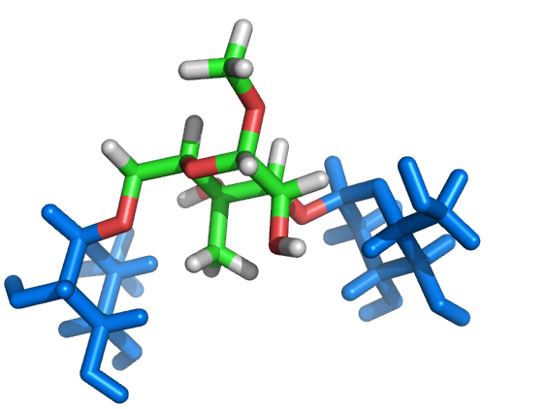
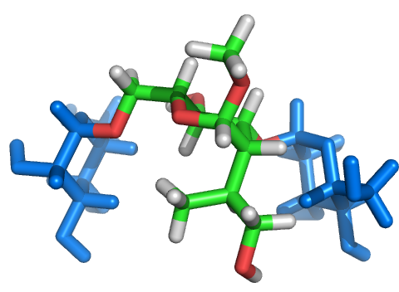
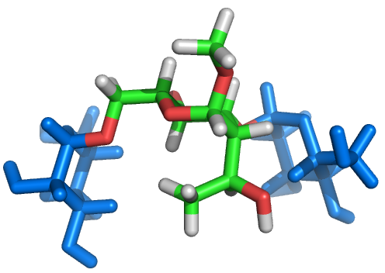
3MAN Glycomimetic Candidates
a)
a)
b)
c)

Slide 36
Conclusions
The choice of water model has a significant impact on the assessment and interpretation of standard binding free energies.
Within the context of non-polarizable force fields, TIP5P 5-site model seems to be a step in the right direction.
The water is not displaced by the synthetic ligand because it is able to preserve its tetrahedral coordination.
A bulkier synthetic ligand (e.g. hydroxypropyl) might be able to form favourable vdW contacts with N14 Cβ, with the OH replacing the water in the binding site.

Slide 37
Acknowledgements
Prof. Rob Woods
Oliver Grant
Joanne Martin
Hannah Smith
Niall Walshe
Dr. Nina Weisser
Dr. Lori Yang
Dr. Jen Hendel
Dr. Marleen Renders
Valerie Murphy
@ Sickkids:
Dr. Régis Pomès
Chris Neale

Slide 38
Unbound ConA with TIP3P-MOD
1GKB | Coulomb | vdW
T3P | +13.4 (0.3) | -3.9 (0.2) | +6.5 | -0.3 (0.2)
T5P | +13.0 (0.5) | -3.2 (0.3) | +6.8 | -1.1 (0.4)
T3P-MOD | +12.6 (0.2) | -4.1 (0.2) | +5.5 | +0.7 (0.2)
All values in kcal/mol
WATER
T3P | +6.2
T5P | +5.7
T3P-MOD | +6.2*
* Shirts and Pande, J. Chem. Phys. (2005), 122, 134508-13
Notes:
Non-bonded vdW parameters for T3P water could be adjusted without significantly changing its liquid water properties. By increasing the depth of the vdW well from 0.152 kcal/mol to 0.190 kcal/mol, the solvation energies of small alkanes improved compared to experimental data.

Slide 39
1CVN vs. 3D4K (TIP5P)
All values in kcal/mol
PDBid | Coulomb | vdW
ConA/3MAN | 18.3 (0.4) | -5.5 (0.4)
ConA/3HET | 16.8 (0.2) | -4.2 (0.5)
ΔG_{b}⁰
-4.1 (0.4)
-3.9 (0.4)
1CVN
3D4K

