Slide 1
Beyond Lazy Training for
Over-parametrized Tensor Decomposition
Rong Ge
Duke University
Workshop III: Mathematical Foundations and Algorithms for Tensor Computations
Based on joint work with Xiang Wang, Chenwei Wu, Jason D. Lee and Tengyu Ma

Slide 2
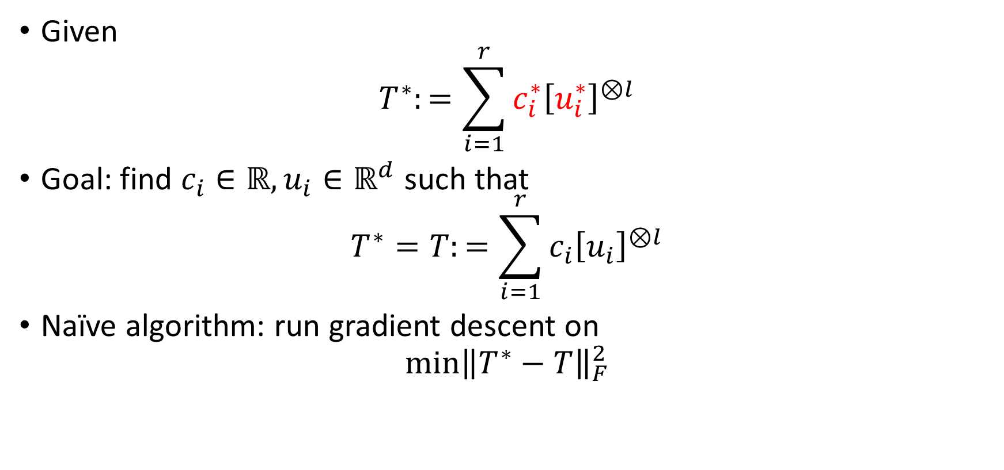
Tensor (CP) decomposition
Given
$$T^{∗}:=\sum_{i=1}^{r}{c_{i}^{∗}{\left[u_{i}^{∗}\right]}^{⊗l}}$$
Goal: find $c_{i}∈ℝ, u_{i}∈ℝ^{d}$ such that
$$T^{∗}=T:=\sum_{i=1}^{r}{c_{i}{\left[u_{i}\right]}^{⊗l}}$$
Naïve algorithm: run gradient descent on
$$\min{{\left\|T^{∗}−T\right\|}_{F}^{2}}$$

Slide 3
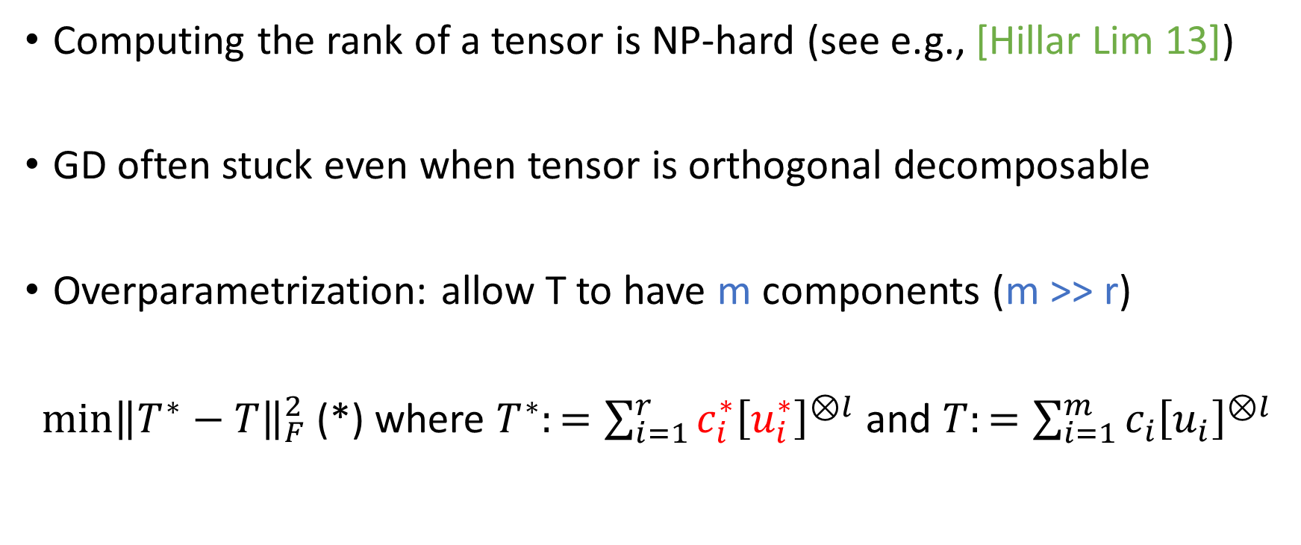
Why naïve algorithm fails
Computing the rank of a tensor is NP-hard (see e.g., [Hillar Lim 13])
GD often stuck even when tensor is orthogonal decomposable
Overparametrization: allow T to have m components (m >> r)
$\min{{\left\|T^{∗}−T\right\|}_{F}^{2}}$ (*) where $T^{∗}:=\sum_{i=1}^{r}{c_{i}^{∗}{\left[u_{i}^{∗}\right]}^{⊗l}}$ and $T:=\sum_{i=1}^{m}{c_{i}{\left[u_{i}\right]}^{⊗l}}$
Question: How large does m need to be for GD to optimize this objective?

Slide 4
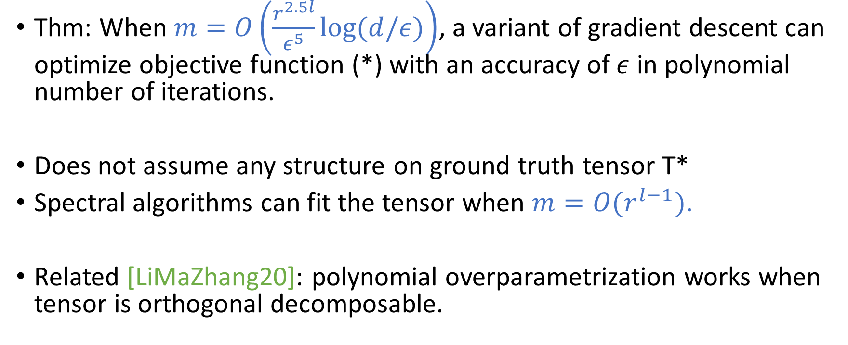
Our Results
Thm: When $m=O\left(\frac{r^{2.5l}}{ε^{5}}\log{(d/ε)}\right)$, a variant of gradient descent can optimize objective function (*) with an accuracy of $ε$ in polynomial number of iterations.
Does not assume any structure on ground truth tensor T*
Spectral algorithms can fit the tensor when $m=O(r^{l−1})$.
Related [LiMaZhang20]: polynomial overparametrization works when tensor is orthogonal decomposable.

Slide 5
Why gradient descent?
Gradient descent is a natural and scalable algorithm.
Properties for analyzing gradient descent can often be useful for analyzing other algorithms.
Tensor decomposition is closely related to training a two-layer neural network, and (stochastic) gradient descent is the default algorithm for neural networks.

Slide 6
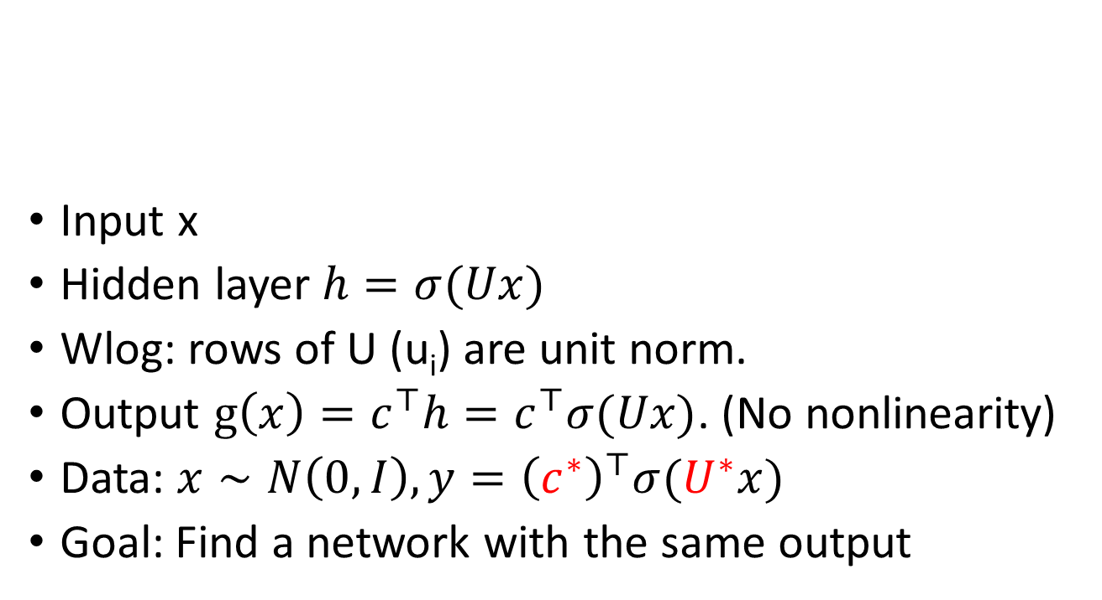
Two-Layer Neural Network.
x
h
U
Input x
Hidden layer $h=σ(Ux)$
Wlog: rows of U (u_{i}) are unit norm.
Output $g\left(x\right)=c^{⊤}h=c^{⊤}σ(Ux)$. (No nonlinearity)
Data: $x∼N\left(0,I\right), y={\left(c^{∗}\right)}^{⊤}σ(U^{∗}x)$
Goal: Find a network with the same output
U
u_{i}
c

Slide 7
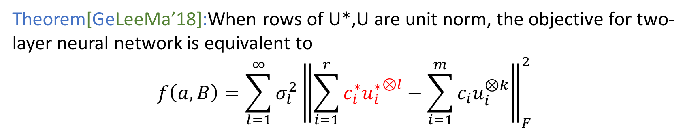
Form of the objective
Theorem[GeLeeMa’18]:When rows of U*,U are unit norm, the objective for two-layer neural network is equivalent to
$$f\left(a,B\right)=\sum_{l=1}^{∞}{σ_{l}^{2}{\left\|\sum_{i=1}^{r}{c_{i}^{∗}{u_{i}^{∗}}^{⊗l}}−\sum_{i=1}^{m}{c_{i}u_{i}^{⊗k}}\right\|}_{F}^{2}}$$
l-th Hermite coefficient
l-th moment for
true parameters
l-th moment for
current parameters
Objective is a sum of moment-matching objectives.
Non-zero Hermite coefficients for ReLU includes 1, 2, 4, 6,…

Slide 8
Lazy training
Neural Tangent Kernel [Jacot et al.18, Du et al. 18…]:
Gradient descent on a very wide neural network is similar to a kernel, and the neurons don’t move very far
Lazy training [ChizatBach19]: Similar phenomenon when init. Is large.

Slide 9
Difficulties of analyzing gradient descent
Lazy training fails
0 is a high order saddle point
There are local minima away from 0.

Slide 10
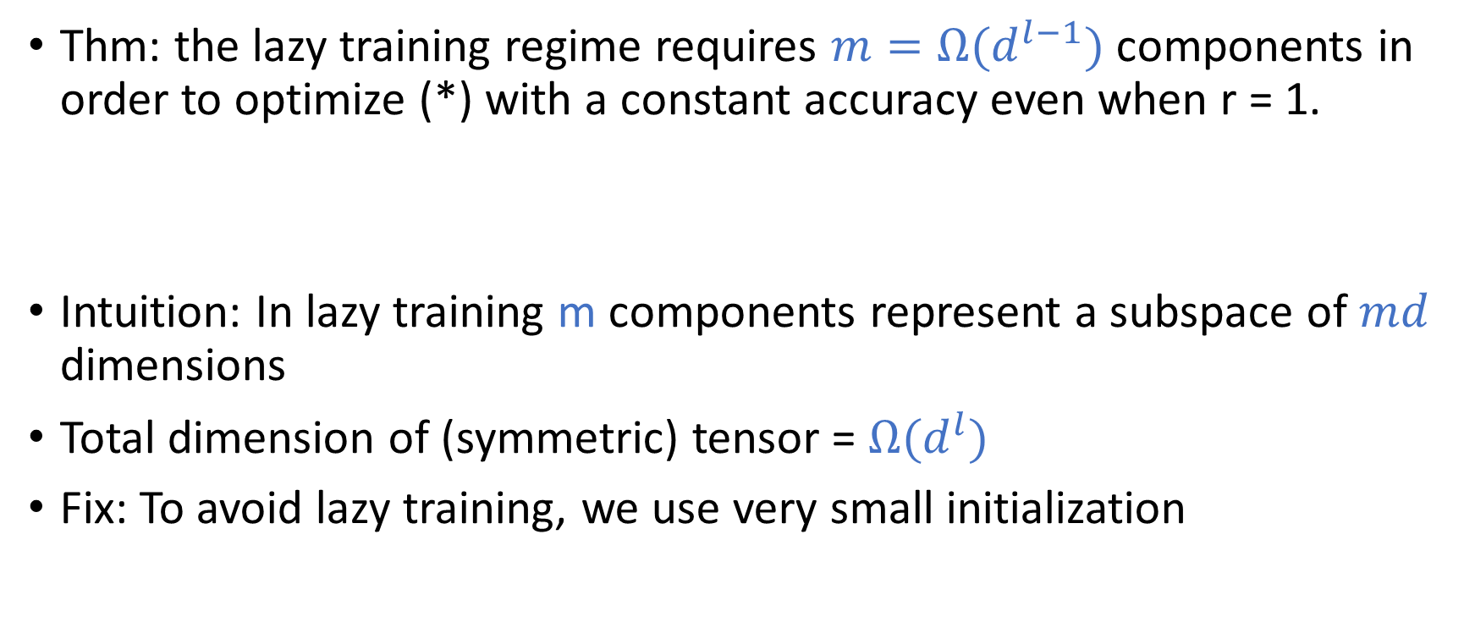
Lazy training fails
Thm: the lazy training regime requires $m=Ω(d^{l−1})$ components in order to optimize (*) with a constant accuracy even when r = 1.
Intuition: In lazy training m components represent a subspace of $md$ dimensions
Total dimension of (symmetric) tensor = $Ω(d^{l})$
Fix: To avoid lazy training, we use very small initialization

Slide 11
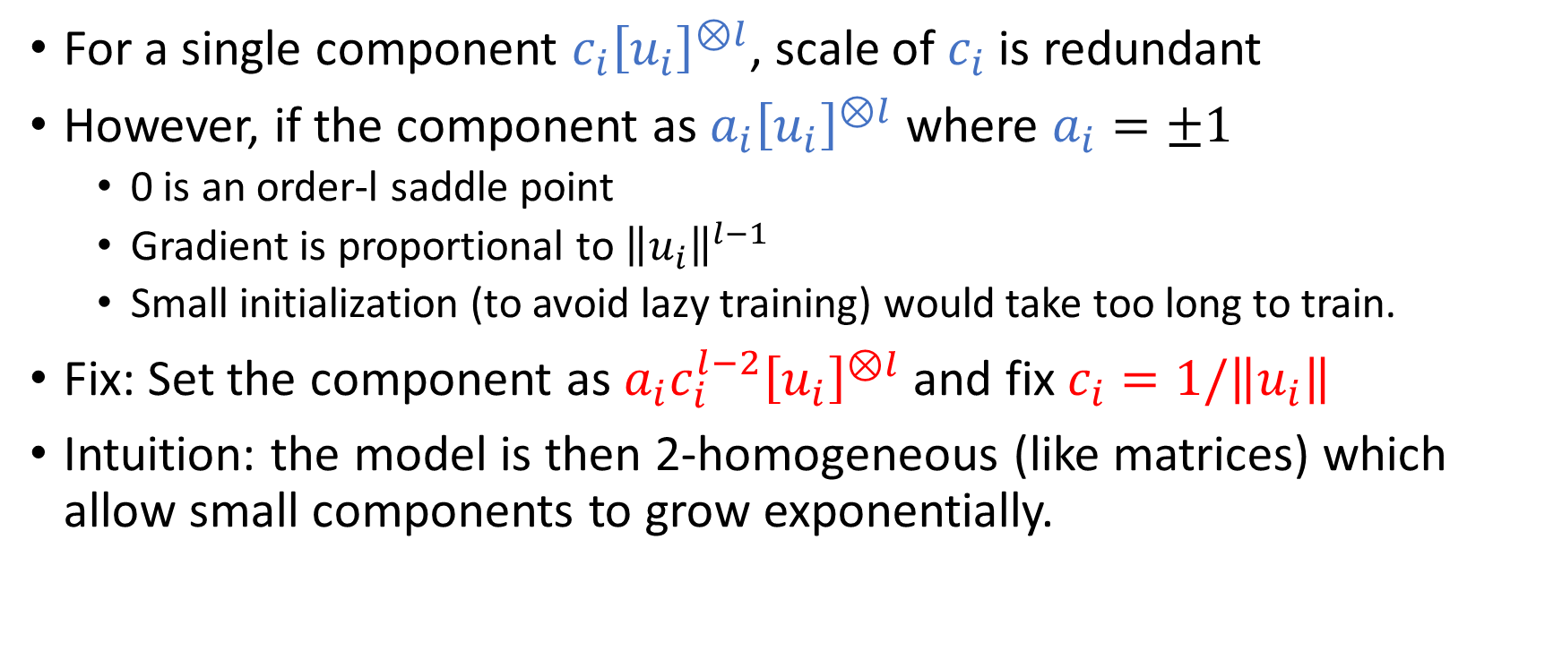
0 is a high order saddle point
For a single component $c_{i}{\left[u_{i}\right]}^{⊗l}$, scale of $c_{i}$ is redundant
However, if the component as $a_{i}{\left[u_{i}\right]}^{⊗l}$ where $a_{i}=±1$
  0 is an order-l saddle point
  Gradient is proportional to ${\left\|u_{i}\right\|}^{l−1}$
  Small initialization (to avoid lazy training) would take too long to train.
Fix: Set the component as $a_{i}c_{i}^{l−2}{\left[u_{i}\right]}^{⊗l}$ and fix $c_{i}=1/\left\|u_{i}\right\|$
Intuition: the model is then 2-homogeneous (like matrices) which allow small components to grow exponentially.

Slide 12
There are local minima away from 0
Thm: Assume l ≥ 3, m ≥ r(l + 1) + 1. There exists a symmetric ground truth tensor T* with rank at most r(l + 1) + 1 such that a local minimum with function value l(l − 1)r/4 exists while the global minimum has function value zero.
Fix: To escape from these local minima, we reinitialize a small fraction of components randomly.

Slide 13
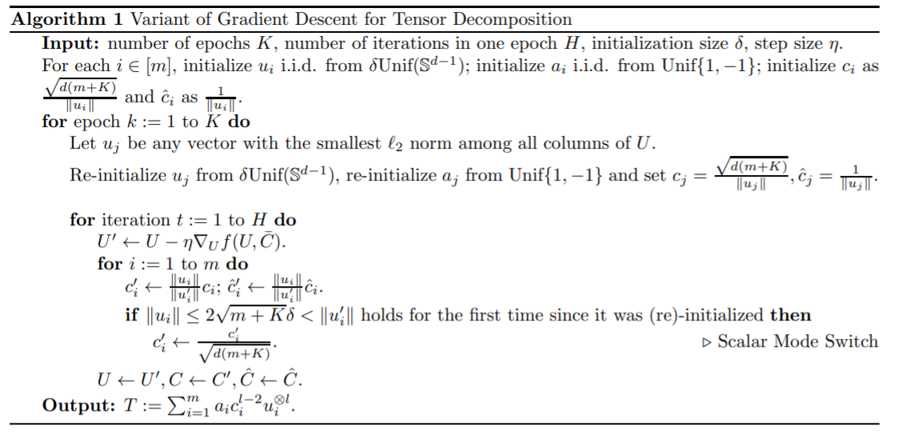
Our (high level) algorithm
Set the component as $a_{i}c_{i}^{l−2}{\left[u_{i}\right]}^{⊗l}$, use small initialization
Randomly reinitialize to escape from local minima
Run gradient descent and fix $c_{i}=1/\left\|u_{i}\right\|$

Slide 14
Proof ideas
Iterates remain close to correct subspace
Escaping local minima by random correlation
Amplify initial correlation by tensor power method

Slide 15
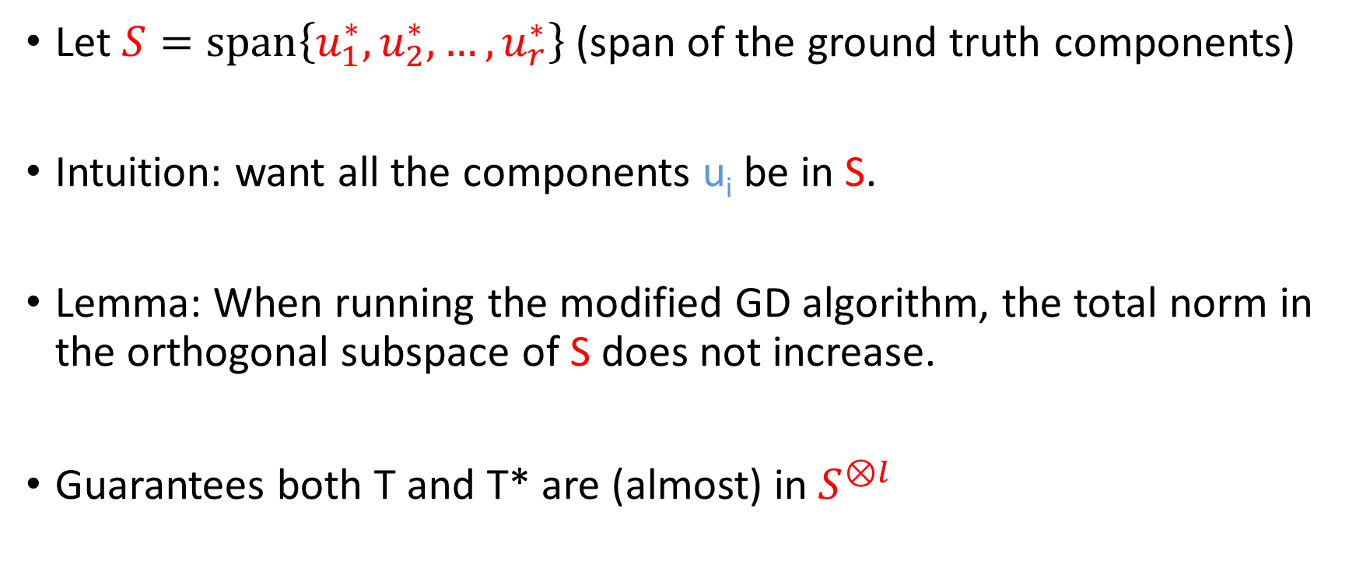
Iterates remain close to correct subspace
Let $S=span\left\{u_{1}^{∗},u_{2}^{∗}, …,u_{r}^{∗}\right\}$ (span of the ground truth components)
Intuition: want all the components u_{i} be in S.
Lemma: When running the modified GD algorithm, the total norm in the orthogonal subspace of S does not increase.
Guarantees both T and T* are (almost) in $S^{⊗l}$

Slide 16
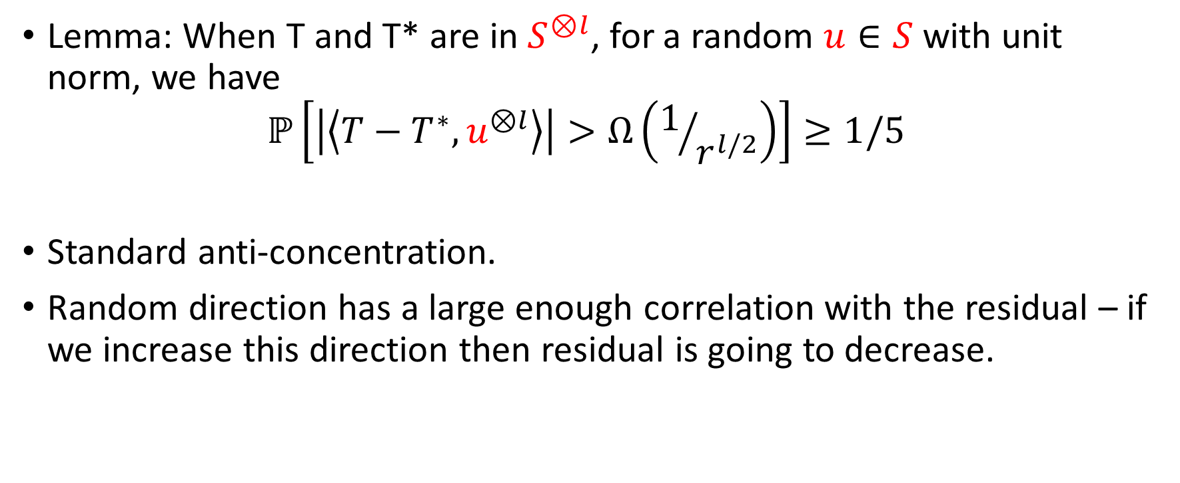
Escaping local minima by random correlation
Lemma: When T and T* are in $S^{⊗l}$, for a random $u∈S$ with unit norm, we have
$$ℙ\left[\left|\left\langle T−T^{∗},u^{⊗l}\right\rangle \right|>Ω\left(1/{r^{l/2}}\right)\right]≥1/5$$
Standard anti-concentration.
Random direction has a large enough correlation with the residual – if we increase this direction then residual is going to decrease.

Slide 17
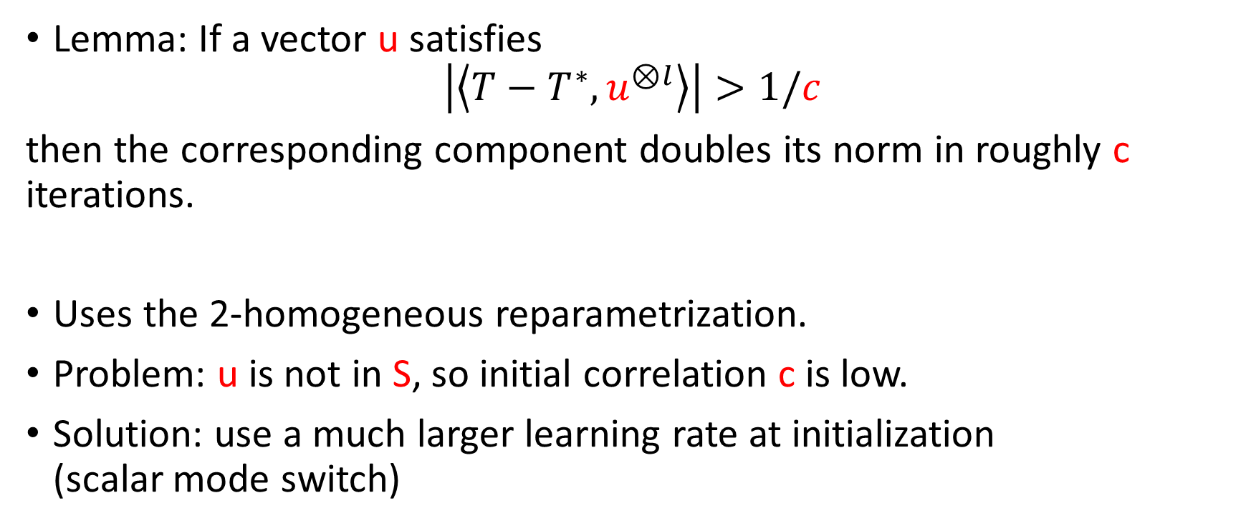
Amplify initial correlation by tensor power method
Lemma: If a vector u satisfies
$$\left|\left\langle T−T^{∗},u^{⊗l}\right\rangle \right|>1/c$$
then the corresponding component doubles its norm in roughly c iterations.
Uses the 2-homogeneous reparametrization.
Problem: u is not in S, so initial correlation c is low.
Solution: use a much larger learning rate at initialization
(scalar mode switch)

Slide 18
Conclusions and Open Problems
(Variant of) gradient descent can automatically discover low rank structure in the target tensor.
Over-parametrization can potentially help tensor CP decomposition.
Generalizing the result to two-layer ReLU network (sum of tensors of different orders)
Can gradient descent discover any other structure?
Thank you!

