Slide 1
Umhhh…. I have some questions…
John Doyle
John G Braun Professor
Control and Dynamical Systems, EE, & BioE
C a #l t e c h

Slide 2
What is the probability that Munzer will see something that does not exist?
A Bayesian Perspective
John Doyle
John G Braun Professor
Control and Dynamical Systems, EE, & BioE
C a #l t e c h

Slide 3
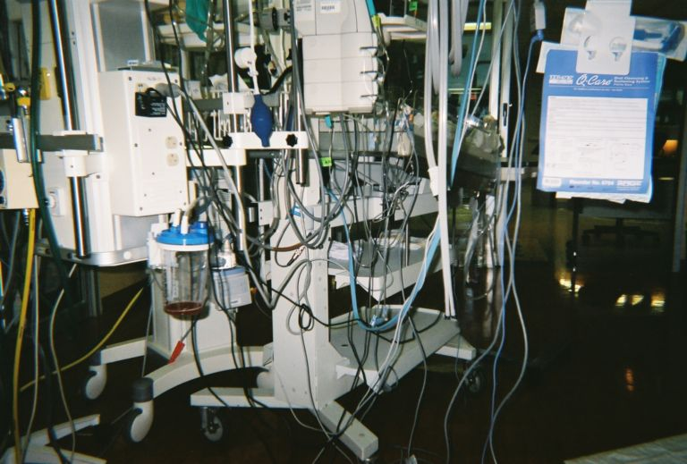
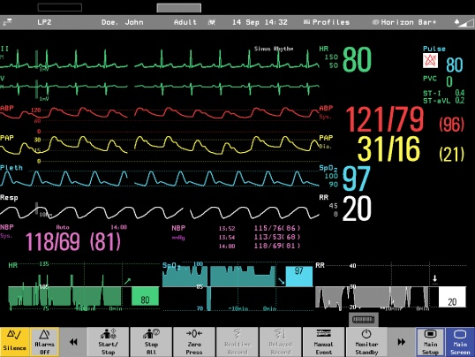

Slide 4
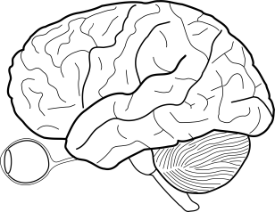
Physiology/
Mechanism
HR Data
CBF
160
300
SaO₂
P_{as}
Watts
200
120
100
Errors:
SaO₂,
P_{as} ,
ΔO₂
80
H
H
0
40
Controls:
H, , R_{s}
0
50
100
150
200
250
300
350
Time (seconds)
Disturbance: W
W

Slide 5
Shift so HR units are same
180
300
160
250
140
140
Watts
HR
Lower mean, higher variability
200
120
120
HR
150
100
100
100
80
80
50
60
60
0
40
40
0
0
50
50
100
100
150
150
200
200
250
250
300
300
350
350
0
0
50
50
100
100
150
150
200
200
250
250
300
300
350
350
400
400
Subject 1
Subject 2

Slide 6
CBF
SaO₂
P_{as}
Physiology/
Mechanism
Errors:
SaO₂,
P_{as} ,
ΔO₂
H
H
Controls:
H, , R_{s}
Disturbance: W
W

Slide 7

Case studies
Neuroscience
Tech nets (Cyber-Phys)
Cell biology
Smartgrid, cyber-phys
Medical physiology
Wildfire ecology
Earthquakes
Lots of aerospace
Physics:
  turbulence,
  stat mech (QM?)
“Toy”:
  Lego
  clothing, fashion
Buildings, cities
Synesthesia
Fundamentals!
A rant

Slide 8
Architecture case studies comparison
 | Bacteria | TechNets | Brain
Understood? | ☺ | ☺☺ | ☹
By scientists? | ☺ | ☹☹ | ☹
Live demos?!? | ☹ | ☺ | ☺
Who cares? | ☹ | ☺ | ☺☺
Design quality? | ☺☺ | ☺☹ | ☺☹
 Math? | ☺ | ☺☺ | ☺☹

Slide 9
P
physical
P
C
act &
sense
P
P
cyber
C
C
P
P

Slide 10
Delays
(and dynamics)

Slide 11
P
P
Heterogeneity
C
C
C
P
P
C
C
C
P
P
Fat = low delay

Slide 12
P
physical
C
Challenges
Physical uncertainty
Act & sense
  delay
  power
Cyber
  delay
  energy
  noise/bw
  memory
act &
sense
P
cyber
C
P

Slide 13
Compute
Comms
Gödel
Shannon
Turing
Von Neumann
Theory?
Deep, but fragmented, incoherent, incomplete
Nash
Carnot
Boltzmann
Bode
Heisenberg
Control, OR
Einstein
Physics

Slide 14
Compute
Communicate
Turing
Shannon
Delay and risk are most important
Delay and risk are least important
Carnot
Bode
Boltzmann
Control, OR
Heisenberg
Physics
Einstein

Slide 15
Compute
Worst-case (risk)
Time complexity (delay)
Turing
Delay and risk are most important
Computation for control
Off-line design
On-line implementation
Learning and adaptation
Bode
Worst-case (risk)
Delay severely degrades robust performance
Control, OR

Slide 16
Physiology/
Mechanism
Data
CBF
160
300
SaO₂
P_{as}
Watts
200
120
100
Errors:
SaO₂,
P_{as} ,
ΔO₂
80
H
H
0
40
Controls:
H, , R_{s}
0
50
100
150
200
250
300
350
Time (seconds)
Disturbance: W
W

Slide 17
Shift so HR units are same
180
300
160
250
140
140
Watts
HR
Lower mean, higher variability
200
120
120
HR
150
100
100
100
80
80
50
60
60
0
40
40
0
0
50
50
100
100
150
150
200
200
250
250
300
300
350
350
0
0
50
50
100
100
150
150
200
200
250
250
300
300
350
350
400
400
Subject 1
Subject 2

Slide 18
CBF
SaO₂
P_{as}
Physiology/
Mechanism
Errors:
SaO₂,
P_{as} ,
ΔO₂
H
H
Controls:
H, , R_{s}
Disturbance: W
W

Slide 19
1st order linear model
HR dynamic linear (global) fit
160
120
HR data
HR dynamic NL (local linear) fit
80
40
0
50
100
150
200
250
300
350

Slide 20
HR
Vent.
80
40
60
0
40
-40
0
50
100
150
200
250
300
80
60
40
120
130
140
150
160
170
180

Slide 21
(A)
120
Model @ 50 w
100
80
60
40
Heart Rate Data
Model @ 0 W
(B)
Ventilation flow rate (L/min)
40
0
@ 50 W
-40
-80
0
50
100
150
200
250
300
350
(C)
40
0
-40
Ventilation flow rate (L/min)
@ 0 W
-80
0
50
100
150
200
250
300
350
Time (seconds)

Slide 22
Physiology/
Mechanism
160
120
80
0
50
100
150
200
250
300
350
400
CBF
[O₂ ] _{T}
(ml O₂/ 1 L blood)
160
SaO₂
P_{as}
120
P_{as} (mmHg)
HR model
80
Errors:
SaO₂,
P_{as} ,
ΔO₂
H
40
Workload (watts)
HR data
H
Controls:
H, , R_{s}
0
0
50
100
150
200
250
300
350
400
Time (seconds)
Disturbance: W
W

Slide 23
160
120
80
0
50
100
150
200
250
300
350
400
[O₂ ] _{T}
(ml O₂/ 1 L blood)
160
120
P_{as} (mmHg)
HR model
80
40
Workload (watts)
HR data
0
0
50
100
150
200
250
300
350
400
Time (seconds)

Slide 24
Communicate
Space complexity
Shannon
Dominates “high impact
science” literature
Average case (risk neutral)
Random ensembles
Asymptotic (infinite delay)
Carnot
Boltzmann
Heisenberg
Physics
Einstein

Slide 25
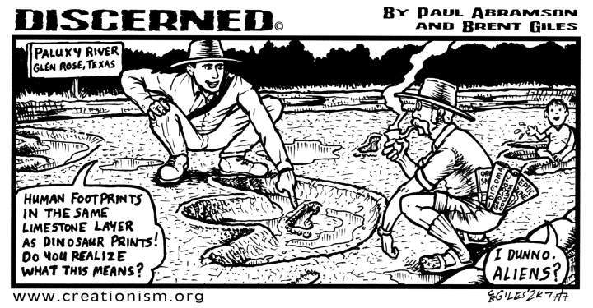
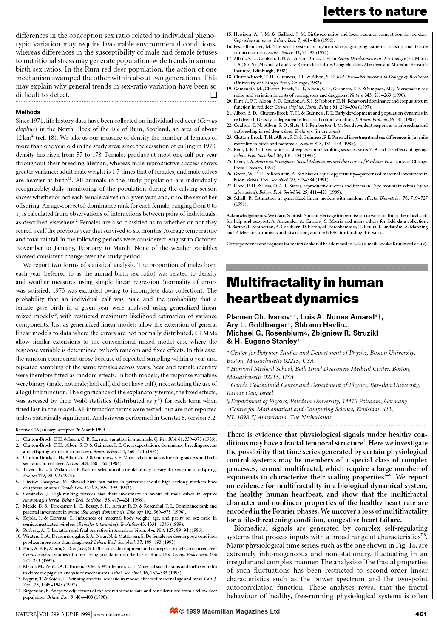
Other views
Molecular genetics
Creation science
New sciences of
  complexity
  networks
180
160
140
120
Which gene?
100
80
60
40
0
0
50
50
100
100
150
150
200
200
250
250
300
300
350
350
400
400

Slide 26
Compute
Communicate
Turing
Shannon
Delay and risk are most important
Delay and risk are least important
New progress!
Bode
Control, OR
Physics

Slide 27
New theory (QI)
P
physical
Challenges
Physical uncertainty
Act & sense
  delay
  power
Cyber
  delay
  energy
  noise/bw
  memory
C
act &
sense
P
cyber
C
P
System ID? Adaptive? L1?

Slide 28
New theory (QI)
P
physical
Challenges
Physical uncertainty
Act & sense
  delay
  power
Cyber
  delay
  energy
  noise/bw
  memory
C
act &
sense
P
cyber
C
Modern unifying themes
Dynamics/Time
Robust/Condition
Convexity
Relaxation
Regularization
P
System ID? Adaptive? L1?

Slide 29
Centralized control
P
P
Realizable
fragile
large delay
P
C
P
Unrealizable
P
P
P
P
Ideal =no delay
P
P
Typical scenario
robust
P
P
efficient
impossible

Slide 30
P
P
Centralized
fragile
(slow)
P
C
P
P
P
Unrealizable
P
P
C
C
P
P
P
C
C
P
Ideal =no delay
C
C
P
P
P
P
robust
(fast)
P
P
Distributed
efficient
impossible

Slide 31
P
P
Centralized
fragile
(slow)
P
C
P
fragile
P
P
Simple dichotomous tradeoff pairs
efficient
Unrealizable
P
P
C
C
P
P
robust
P
C
C
P
Ideal =no delay
efficient
P
P
C
C
wasteful
P
P
robust
(fast)
P
P
Distributed
efficient
impossible

Slide 32
Requirements on systems and architectures
accessible
accountable
accurate
adaptable
administrable
affordable
auditable
autonomy
available
credible
process capable
compatible
composable
configurable
correctness
customizable
debugable
degradable
determinable
demonstrable
dependable
deployable
discoverable
distributable
durable
effective
efficient
evolvable
extensible
fail transparent
fast
fault-tolerant
fidelity
flexible
inspectable
installable
Integrity
interchangeable
interoperable
learnable
maintainable
manageable
mobile
modifiable
modular
nomadic
operable
orthogonality
portable
precision
predictable
producible
provable
recoverable
relevant
reliable
repeatable
reproducible
resilient
responsive
reusable
robust
safety
scalable
seamless
self-sustainable
serviceable
supportable
securable
simplicity
stable
standards compliant
survivable
sustainable
tailorable
testable
timely
traceable
ubiquitous
understandable
upgradable
usable

Slide 33
When concepts fail, words arise.
Mephistopheles, Faust, Goethe
Requirements on systems and architectures
accessible
accountable
accurate
adaptable
administrable
affordable
auditable
autonomy
available
credible
process capable
compatible
composable
configurable
correctness
customizable
debugable
degradable
determinable
demonstrable
dependable
deployable
discoverable
distributable
durable
effective
efficient
evolvable
extensible
fail transparent
fast
fault-tolerant
fidelity
flexible
inspectable
installable
Integrity
interchangeable
interoperable
learnable
maintainable
manageable
mobile
modifiable
modular
nomadic
operable
orthogonality
portable
precision
predictable
producible
provable
recoverable
relevant
reliable
repeatable
reproducible
resilient
responsive
reusable
robust
safety
scalable
seamless
self-sustainable
serviceable
supportable
securable
simplicity
stable
standards compliant
survivable
sustainable
tailorable
testable
timely
traceable
ubiquitous
understandable
upgradable
usable
Mephistopheles. …Enter the templed hall of Certainty.
Student. Yet in each word some concept there must be.
Mephistopheles. Quite true!
But don't torment yourself too anxiously;
For at the point where concepts fail,
At the right time a word is thrust in there…

Slide 34
Concrete case studies
Theorems
When concepts fail, words arise.
Mephistopheles, Faust, Goethe
Mephistopheles. …Enter the templed hall of Certainty.
Student. Yet in each word some concept there must be.
Mephistopheles. Quite true!
But don't torment yourself too anxiously;
For at the point where concepts fail,
At the right time a word is thrust in there…

Slide 35
Neuroscience
Tech nets
Cell biology
Smartgrid, cyber-phys
Medical physiology
Case studies
Wildfire ecology
Earthquakes
Lots of aerospace
Physics:
  turbulence,
  stat mech (QM?)
“Toy”:
  Lego
  clothing, fashion
Buildings, cities
Synesthesia
Fundamentals!
A rant

Slide 36
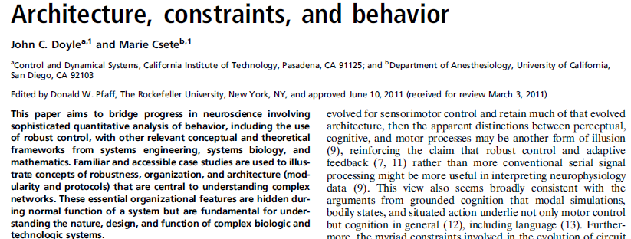
This paper aims to bridge progress in neuroscience involving sophisticated quantitative analysis of behavior, including the use of robust control, with other relevant conceptual and theoretical frameworks from systems engineering, systems biology, and mathematics.
Most accessible
No math
Doyle, Csete, Proc Nat Acad Sci USA, JULY 25 2011

Slide 37
Sustainable ≈ robust + efficient
accessible
accountable
accurate
adaptable
administrable
affordable
auditable
autonomy
available
compatible
composable
configurable
correctness
customizable
debugable
degradable
determinable
demonstrable
dependable
deployable
discoverable
distributable
durable
effective
evolvable
extensible
fail transparent
fast
fault-tolerant
fidelity
flexible
inspectable
installable
Integrity
interchangeable
interoperable
learnable
maintainable
manageable
mobile
modifiable
modular
nomadic
operable
orthogonality
portable
precision
predictable
producible
provable
recoverable
relevant
reliable
repeatable
reproducible
resilient
responsive
reusable
safety
scalable
seamless
self-sustainable
serviceable
supportable
securable
simple
stable
standards
survivable
tailorable
testable
timely
traceable
ubiquitous
understandable
upgradable
usable
efficient
sustainable
robust

Slide 38
PCA ≈ Principal Concept Analysis ☺
accessible
accountable
accurate
adaptable
administrable
affordable
auditable
autonomy
available
compatible
composable
configurable
correctness
customizable
debugable
degradable
determinable
demonstrable
dependable
deployable
discoverable
distributable
durable
effective
evolvable
extensible
fail transparent
fast
fault-tolerant
fidelity
flexible
inspectable
installable
Integrity
interchangeable
interoperable
learnable
maintainable
manageable
mobile
modifiable
modular
nomadic
operable
orthogonality
portable
precision
predictable
producible
provable
recoverable
relevant
reliable
repeatable
reproducible
resilient
responsive
reusable
safety
scalable
seamless
self-sustainable
serviceable
supportable
securable
simple
stable
standards
survivable
tailorable
testable
timely
traceable
ubiquitous
understandable
upgradable
usable
fragile
Simple dichotomous tradeoff pairs
efficient
sustainable
robust
efficient
wasteful
robust

Slide 39
fragile
Actually
Ideally
robust
efficient
wasteful

Slide 40
fragile
robust

Slide 41
Sustainable = efficient + robust
accessible
accountable
accurate
adaptable
administrable
affordable
auditable
autonomy
available
compatible
composable
configurable
correctness
customizable
debugable
degradable
determinable
demonstrable
dependable
deployable
discoverable
distributable
durable
effective
evolvable
extensible
fail transparent
fast
fault-tolerant
fidelity
flexible
inspectable
installable
Integrity
interchangeable
interoperable
learnable
maintainable
manageable
mobile
modifiable
modular
nomadic
operable
orthogonality
portable
precision
predictable
producible
provable
recoverable
relevant
reliable
repeatable
reproducible
resilient
responsive
reusable
safety
scalable
seamless
self-sustainable
serviceable
supportable
securable
simple
stable
standards
survivable
tailorable
testable
timely
traceable
ubiquitous
understandable
upgradable
usable
efficient
sustainable
robust

Slide 42
Focus: aspects of robustness/resilience
accessible
accountable
accurate
administrable
affordable
auditable
autonomy
available
credible
process capable
compatible
composable
configurable
correctness
customizable
debugable
degradable
determinable
demonstrable
dependable
deployable
discoverable
distributable
durable
effective
efficient
extensible
fail transparent
fault-tolerant
fidelity
inspectable
installable
Integrity
interchangeable
interoperable
learnable
maintainable
manageable
mobile
modifiable
modular
nomadic
operable
orthogonality
portable
precision
predictable
producible
provable
recoverable
relevant
repeatable
reproducible
responsive
reusable
safety
scalable
seamless
self-sustainable
serviceable
supportable
securable
simplicity
standards compliant
survivable
sustainable
tailorable
testable
timely
traceable
ubiquitous
understandable
upgradable
usable
adaptable
evolvable
stable
fast
flexible
reliable
resilient
robust

Slide 43
Speed flexibility tradeoffs
accessible
accountable
accurate
administrable
affordable
auditable
autonomy
available
credible
process capable
compatible
composable
configurable
correctness
customizable
debugable
degradable
determinable
demonstrable
dependable
deployable
discoverable
distributable
durable
effective
efficient
extensible
fail transparent
fault-tolerant
fidelity
inspectable
installable
Integrity
interchangeable
interoperable
learnable
maintainable
manageable
mobile
modifiable
modular
nomadic
operable
orthogonality
portable
precision
predictable
producible
provable
recoverable
relevant
repeatable
reproducible
responsive
reusable
safety
scalable
seamless
self-sustainable
serviceable
supportable
securable
simplicity
standards compliant
survivable
sustainable
tailorable
testable
timely
traceable
ubiquitous
understandable
upgradable
usable
Laws = Tradeoffs?
adaptable
evolvable
stable
fast
flexible
reliable
resilient
robust

Slide 44
Speed and flexibility tradeoffs
Concrete case studies?
Theorems ?
Slow
fragile
Fast
robust
Flexible
Inflexible

Slide 45
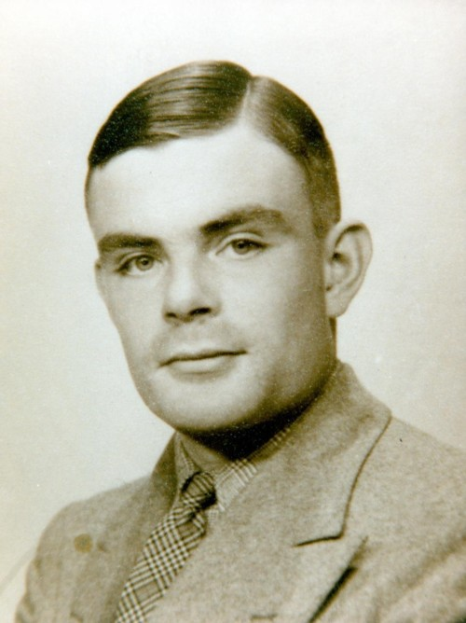
Laws and architectures
(Turing, 1936)
Slow
Turing
1912-1954
Universal Turing Machine
Architecture (constraints that deconstrain)
Undecidable
Fast
Flexible
Inflexible
General
Special
Notes:
.

Slide 46
Computational complexity
Really slow
Slow
hard limits
Fast
Undecidable
Decidable
NP
P
Flexible/
General
Inflexible/
Specific
Notes:
.

Slide 47
PSPACE⊃NP⊃P⊃NL
PSPACE ≠ NL
Computational complexity
Space is powerful and/or cheap.
Decidable
PSPACE
NP
P
NL
Flexible/
General
Inflexible/
Specific
Notes:
.

Slide 48
Compute
Turing (1912-1954)
Turing 100th birthday in 2012
Turing
  machine (math, CS)
  test (AI, neuroscience)
  pattern (biology)
Arguably greatest*
  all time math/engineering combination
  WW2 hero
  “invented” software
*Also world-class runner.

Slide 49
Key papers/results
Theory (1936): Turing machine (TM), computability, (un)decidability, universal machine (UTM)
Practical design (early 1940s): code-breaking, including the design of code-breaking machines
Practical design (late 1940s): general purpose digital computers and software, layered architecture
Theory (1950): Turing test for machine intelligence
Theory (1952): Reaction diffusion model of morphogenesis, plus practical use of digital computers to simulate biochemical reactions

Slide 50
Turing as “new” starting point?
Essentials:
0. Model
Universal laws
Universal architecture
Practical implementation
Turing’s 3 step research:
0. Virtual (TM) machines
hard limits, (un)decidability using standard model (TM)
Universal architecture achieving hard limits (UTM)
Practical implementation in digital electronics (biology?)
Software
Hardware
Digital
Analog

Slide 51
…being digital should be of greater interest than that of being electronic. That it is electronic is certainly important because these machines owe their high speed to this… But this is virtually all that there is to be said on that subject.
That the machine is digital however has more subtle significance. … One can therefore work to any desired degree of accuracy.
1947 Lecture to LMS
Hardware
Digital
Analog

Slide 52
… digital … of greater interest than that of being electronic …
…any desired degree of accuracy…
This accuracy is not obtained by more careful machining of parts, control of temperature variations, and such means, but by a slight increase in the amount of equipment in the machine.
1947 Lecture to LMS
Hardware
Digital
Analog

Slide 53
Summarizing Turing:
Digital more important than electronic…
Robustness: accuracy and repeatability.
Achieved more by internal hidden complexity than precise components or environments.
TM
Hardware
Turing Machine (TM)
Digital
Symbolic
Logical
Repeatable/robust
Digital
Analog

Slide 54
avalanche
The butterfly effect
… quite small errors in the initial conditions can have an overwhelming effect at a later time. The displacement of a single electron by a billionth of a centimetre at one moment might make the difference between a man being killed by an avalanche a year later, or escaping.
1950, Computing Machinery and Intelligence, Mind

Slide 55
… small errors in the initial conditions can have an overwhelming effect at a later time….
It is an essential property of the mechanical systems which we have called 'discrete state machines' that this phenomenon does not occur.
Even when we consider the actual physical machines instead of the idealised machines, reasonably accurate knowledge of the state at one moment yields reasonably accurate knowledge any number of steps later.
1950, Computing Machinery and Intelligence, Mind

Slide 56
intrinsic computational complexity of problems.
Must still seek algorithms that achieve the limits, and architectures that support this process.
Really slow
Architectures
Slow
hard limits
Fast
Undecidable
Decidable
NP
P
Flexible/
General
Inflexible/
Specific
Notes:
.

Slide 57
Modern unifying themes
Essentials:
0. Model
Universal laws
Universal architecture
Practical implementation
Turing Machine (TM)
Repeatable/robust
Digital
Symbolic
Logical
Dynamics/Time
Robust/Condition
Convexity
Relaxation
Regularization

Slide 58
Compute
Communicate
Turing
Shannon
Dynamics/Time
Robust/Condition
Convexity
Relaxation
Regularization
Bode
Control, OR
Physics

Slide 59
Speed and flexibility tradeoffs
Concrete case studies?
Theorems ?
Slow
fragile
Fast
robust
Flexible
Inflexible

Slide 60
Explain this amazing system.
Slow
Vision
Fast
Flexible
Inflexible

Slide 61
Head and hand motion
head
hand
eye
vision
eye
Compensating eye movement
Vestibular Ocular Reflex (VOR)
A handwaving explanation illustrating fundamental tradeoffs

Slide 62
d = head
Speed and flexibility tradeoffs
vision
-
e=d-u
VOR
u
d = hand
slow
delay
Act
fast
Slow
vision
Vestibular Ocular Reflex (VOR)
VOR
Fast
Flexible
Inflexible

Slide 63
Easy
Hard
head
hand
eye
vision
eye
Why?
Head
 | Still | Move
Still | Easy | Easy
Move | Hard | Hardest
Accident or necessity?
Hand

Slide 64
hand
eye
vision
eye
vision
error=d-u
-
u
d =
disturbance
= hand
u =
eye position
Act

Slide 65
hand
eye
vision
eye
slow
Hard
vision
-
e=d-u
slow
u
d = hand
delay
Act

Slide 66
head
eye
vision
eye
d = head
vision
-
e=d-u
u
Act

Slide 67
head
eye
vision
fast
eye
Easy
d = head
vision
-
e=d-u
VOR
u
Act
fast

Slide 68
Doesn’t depend on vision
Works in the dark
head
eye
fast
eye
Easy
d = head
-
e=d-u
VOR
u
Act
fast

Slide 69
head
eye
vision
fast
eye
Easy
d = head
vision
-
e=d-u
VOR
u
Act
fast

Slide 70
head
hand
eye
vision
fast
eye
slow
d = head
vision
-
e=d-u
slow
VOR
u
d = hand
delay
Act
fast

Slide 71
d = head
Speed and flexibility tradeoffs
vision
-
e=d-u
VOR
u
d = hand
slow
delay
Act
fast
Vestibular Ocular Reflex (VOR)
Slow
vision
VOR
Fast
Flexible
Inflexible

Slide 72
Speed and flexibility tradeoffs
fragile
Slow
vision
VOR
Fast
robust
Flexible
Inflexible

Slide 73
Sustainable = efficient + robust
accessible
accountable
accurate
adaptable
administrable
affordable
auditable
autonomy
available
compatible
composable
configurable
correctness
customizable
debugable
degradable
determinable
demonstrable
dependable
deployable
discoverable
distributable
durable
effective
evolvable
extensible
fail transparent
fast
fault-tolerant
fidelity
flexible
inspectable
installable
Integrity
interchangeable
interoperable
learnable
maintainable
manageable
mobile
modifiable
modular
nomadic
operable
orthogonality
portable
precision
predictable
producible
provable
recoverable
relevant
reliable
repeatable
reproducible
resilient
responsive
reusable
safety
scalable
seamless
self-sustainable
serviceable
supportable
securable
simple
stable
standards
survivable
tailorable
testable
timely
traceable
ubiquitous
understandable
upgradable
usable
Slow
vision
efficient
sustainable
Fast
VOR
Flexible
Inflexible
Global
Local
robust

Slide 74
Speed and flexibility tradeoffs
Combining controls
Slow
vision
both
VOR
Fast
Flexible
Inflexible

Slide 75
Speed and flexibility tradeoffs
Accident or necessity?
Slow
vision
both
VOR
laws? (constraints)
Fast
Flexible
Inflexible

Slide 76
Standing and seeing
 | 2 legs | 1 leg
eyes open | Easiest | Harder
eyes shut | Easy | Hardest
Vision is important in balance?
Why?

Slide 77
Standing and seeing
eyes | 2 legs | 1 leg
open | Easiest | Harder
shut | Easy | Hardest
Better at low frequencies
Slow
vision
Better at high frequencies
VOR
Fast
Flexible
Inflexible

Slide 78

Standing and seeing
vision
-
VOR
u
delay
Act
delay
Act

Slide 79
…if it were done when 'tis done,
then 'twer well it 'twer done quickly…
Macbeth, act 1 scene 7
Well done is quickly done.
Augustus Caesar, from Suetonius
emphasis mine

Slide 80
Sensing fast and slow
Applies to vision and hearing?
For action (fast, luminance, expensive)
For “perception” (slow, inc. color, cheap)

Slide 81
head
hand
eye
vision
fast
eye
slow
d = head
vision
-
e=d-u
slow
VOR
u
d = hand
delay
Act
fast

Slide 82
B&W (luminence only):
3D, motion, and action
d = head
3D +
motion
B&W
vision
-
e=d-u
VOR
u
slow
fast
delay
Act

Slide 83
B&W (luminence only):
3D, motion, and action
3D +
motion
B&W
vision
-
e=d-u
u
slow
fast
delay
Act
VOR

Slide 84
color
vision
Slowest
3D +
motion
B&W
vision
-
e=d-u
u
slow
fast
delay
Act
VOR

Slide 85
color
vision
Slowest
3D +
motion
-
Art and vision
Marge Livingstone
(Doris Tsao’s PhD advisor)

Slide 86
Stare at the intersection
This is pretty good.

Slide 88
Stare at the intersection
This is pretty good.

Slide 90
Stare at the intersection
This is pretty good.

Slide 92
Extreme heterogeneity in delay
Slowest
color
B&W
vision
-
Slow/
cheap
slow
fast
VOR
Fast/
costly
Flexible
Inflexible

Slide 93
Extreme heterogeneity in delay
Slowest
color
B&W
vision
-
Slow/
cheap
slow
Mixed?
fast
VOR
Fast/
costly
Flexible
Inflexible

Slide 94
Extreme heterogeneity in delay
Slowest
color
B&W
vision
-
Slow/
cheap
slow
Mixed?
fast
VOR
Fast/
costly
Flexible
Inflexible

Slide 95
Extreme heterogeneity in delay
Slowest
color
B&W
vision
-
Slow/
cheap
slow
Universal
architectures
fast
VOR
Fast/
costly
Flexible
Inflexible

Slide 96
brains
Communicate
e=d-u
B&W
vision
1e5-1e8 kT J/bit
(Laughlin)
slow
delay
and perfect parts
delay
1 kT J/bit
(Landauer)
Physics

Slide 97
Happy families are all alike; every unhappy family is unhappy in its own way.

Slide 98
Happy families are all alike; every unhappy family is unhappy in its own way.
Leo Tolstoy,
Anna Karenina,
Chapter 1, first line
What does this mean?
Given diversity of people and environments?
⇒ About organization and architecture.
Happy ≈ empathy + cooperation + simple rules?
Constraints on components and architecture

Slide 99
Laws and architectures: lessons from VOR and vision
Robust control
  nested, diverse feedbacks
  hidden, automatic, unconscious
Speed vs flexibility tradeoffs (laws?)
Good architectures manage tradeoffs
Evolution: necessity vs accident?
Universal?

Slide 100
Formalize architecture as constraints
Good architecture = “constraints that deconstrain” (G&K)
Most effective architectures are layered
Constraints on system and components
  System level function and uncertainty
  Component level capability and uncertainty
Laws, hard limits, tradeoffs
Protocols (are the essence of constraints that deconstrain)

Slide 101
Happy families are all alike; every unhappy family is unhappy in its own way.
Good architectures
bad architectures
Leo Tolstoy,
Anna Karenina,
Chapter 1, first line
What does this mean?
Given diversity of people and environments?
⇒ About organization and architecture.
Happy ≈ empathy + cooperation + simple rules?
Constraints on components and architecture

Slide 102
Want fast, flexible, and general
Slow
Architecture
Architecture (constraints that deconstrain)
Impossible
Fast
Flexible
Inflexible
General
Special
Notes:
.

Slide 103
Universal tradeoffs?
Slow
Learning
Evolution
Fast
Flexible
Inflexible

Slide 104
Learning
Slow
Flexible
Prefrontal
Motor
Slow
Sensory
Striatum
Extreme heterogeneity
Reflex
(Fastest,
Least
Flexible)
Ashby & Crossley
Notes:
.

Slide 105
Extreme heterogeneity
Prefrontal
Motor
Sensory
Striatum
Reflex
(Fastest,
Least
Flexible)
Ashby & Crossley
Notes:
.

Slide 106
Learning can be very slow.
Slow
Flexible
Prefrontal
Motor
Fast
Sensory
Striatum
Learning
Fast
Inflexible
Reflex
(Fastest,
Least
Flexible)
Ashby & Crossley
Notes:
.

Slide 107
Learning can be very slow.
Universal tradeoffs?
Evolution is even slower.
Prefrontal
Slow
Learn
Motor
Fast
Sense
Evolve
Reflex
Fast
Flexible
Inflexible

Slide 108
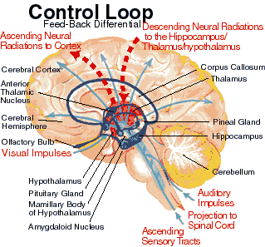
delay=death
sense
Spine
move

Slide 109
Reflect
Reflex
sense
Spine
move

Slide 110
Reflect
Reflex
sense
Spine
move

Slide 111
Reflect
Layered
Reflex
sense
Spine
move

Slide 112
Reflect
move

Slide 113
Reflect
Layered
Reflex
sense
Spine
move

Slide 114
Layered architectures (cartoon)
Physiology
Organs
Cortex
Cortex
Cortex
Cells
Neurons
Neurons
Neurons
Cells
Notes:
.

Slide 115
Reflect
Prediction
Goals
Actions
Actions
Layered
Reflex
errors
sense
Spine
move

Slide 116
Meta-layers cartoon
Prediction
Goals
Actions
Physiology
Organs
Cortex
Actions
errors
Notes:
.

Slide 117
Why?
Visual
Cortex
?
Visual
Thalamus
10x

Slide 118
What are the
consequences?
Prediction
Goals
Actions
Physiology
Organs
Prediction
Goals
Actions
Conscious
perception
errors
Why?
There are 10x feedback neurons
10x
Visual
Cortex
?
Visual
Thalamus

Slide 119
Seeing is dreaming
3D
+time
Simulation
Zzzzzz…..
Conscious
perception
Conscious
perception
Notes:
.

Slide 120
Same size?

Slide 122
Same size

Slide 123
Same size

Slide 124
Same size
Toggle between this slide and the ones before and after
Even when you “know” they are the same, they appear different

Slide 125
Same size?
Vision: evolved for complex simulation and control, not 2d static pictures
Even when you “know” they are the same, they appear different

Slide 126
Seeing is dreaming
3D
+time
Simulation
+ complex
models
(“priors”)
Zzzzzz…..
Conscious
perception
Conscious
perception
Notes:
.

Slide 127
Seeing is dreaming
3D
+time
Simulation
+ complex
models
(“priors”)
Prediction
Conscious
perception
Conscious
perception
errors
Notes:
.

Slide 128
Which blue line is longer?

Slide 129
Which blue line is longer?

Slide 130
Which blue line is longer?

Slide 131
Which blue line is longer?

Slide 132
Which blue line is longer?

Slide 133
Which blue line is longer?

Slide 134
Which blue line is longer?
With social pressure, this one.
Standard social psychology experiment.

Slide 135

Unconscious but high level
Effect: rival-schemata ambiguity

Slide 136
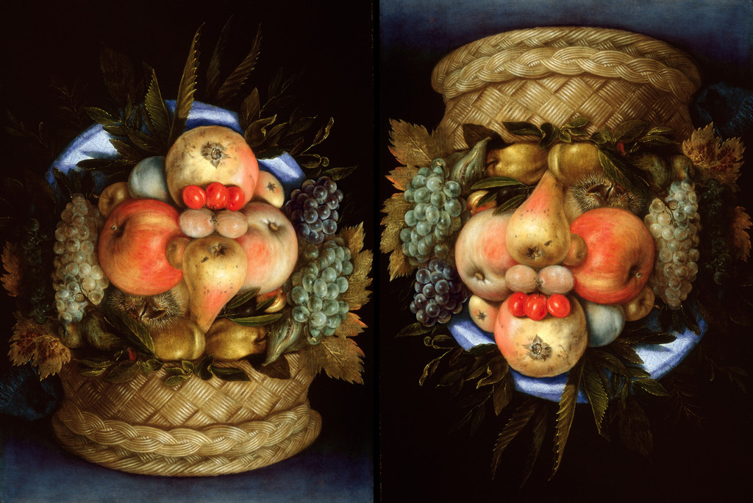

Slide 137
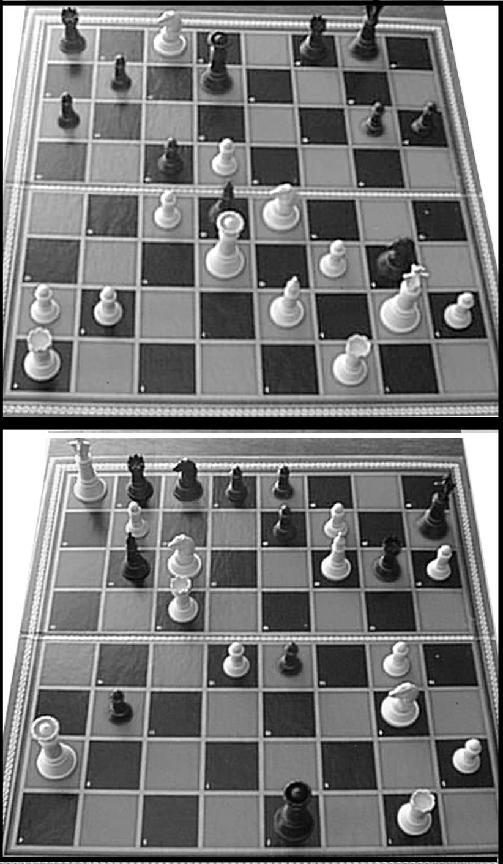
Chess experts
can reconstruct entire chessboard with < ~ 5s inspection
can recognize 1e5 distinct patterns
can play multiple games blindfolded and simultaneous
are no better on random boards
(Simon and Gilmartin, de Groot)
www.psywww.com/intropsych/ch07_cognition/expertise_and_domain_specific_knowledge.html

Slide 138
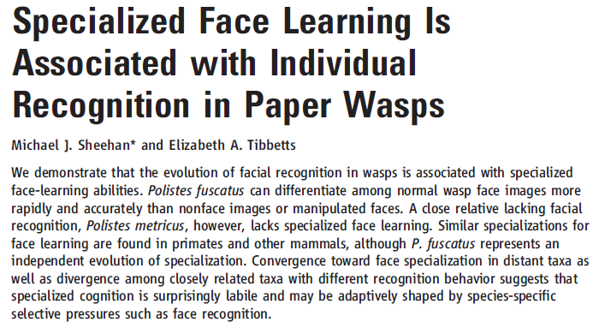

When needed, even wasps can do it.

Slide 139
Polistes fuscatus can differentiate among normal wasp face images more rapidly and accurately than nonface images or manipulated faces.
Polistes metricus is a close relative lacking facial recognition and specialized face learning.
Similar specializations for face learning are found in primates and other mammals, although P. fuscatus represents an independent evolution of specialization.
Convergence toward face specialization in distant taxa as well as divergence among closely related taxa with different recognition behavior suggests that specialized cognition is surprisingly labile and may be adaptively shaped by species-specific selective pressures such as face recognition.

Slide 140
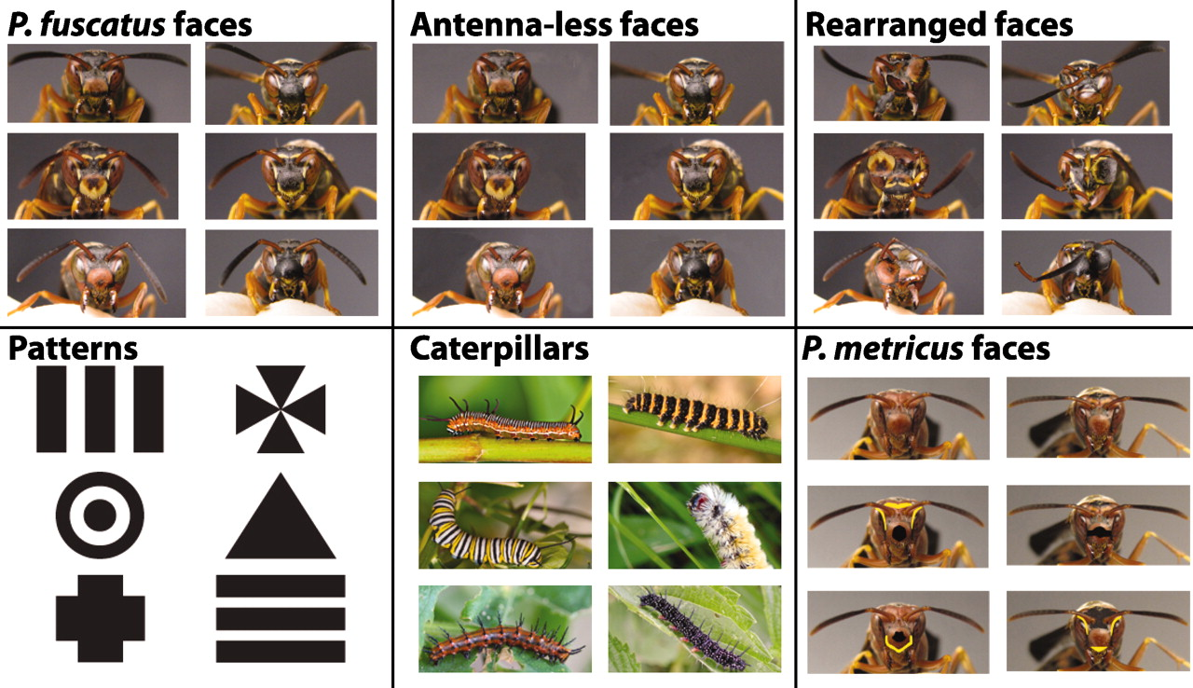

Fig. 1 Images used for training wasps.
M J Sheehan, E A Tibbetts Science 2011;334:1272-1275
Published by AAAS
Notes:
Images used for training wasps. Wasps were trained to discriminate between pairs of images. Pairs are shown in the same row except for P. metricus face images. For P. metricus face images, the unmanipulated faces in the top row were paired with the manipulated images of the other face (for example, top left paired with middle left and bottom left). Image statistics for all images are provided in table S1.

Slide 141
Universal architectures
Prefrontal
Learn
Evolution on
long timescales
Evolution on
long timescales
Motor
Fast
Sense
Evolve
Reflex

Slide 142
Many more dimensions
accessible
accountable
accurate
administrable
affordable
auditable
autonomy
available
credible
process capable
compatible
composable
configurable
correctness
customizable
debugable
degradable
determinable
demonstrable
dependable
deployable
discoverable
distributable
durable
effective
efficient
extensible
fail transparent
fault-tolerant
fidelity
inspectable
installable
Integrity
interchangeable
interoperable
learnable
maintainable
manageable
mobile
modifiable
modular
nomadic
operable
orthogonality
portable
precision
predictable
producible
provable
recoverable
relevant
repeatable
reproducible
responsive
reusable
safety
scalable
seamless
self-sustainable
serviceable
supportable
securable
simplicity
standards compliant
survivable
sustainable
tailorable
testable
timely
traceable
ubiquitous
understandable
upgradable
usable
adaptable
evolvable
stable
fast
flexible
reliable
resilient
robust

Slide 143
Modern Turing tradeoffs:
PC, smartphone, router, etc
Slow
Apps
OS
HW
Digital
Lumped
Distrib.
OS
HW
Digital
Lumped
Distrib.
Digital
Lumped
Distrib.
Lumped
Distrib.
Accident or necessity?
Distrib.
Fast
Flexible
Inflexible
General
Special

Slide 144
Flexible/ Adaptable/Evolvable
Software
Hardware
Horizontal App Transfer
Digital
Apps
OS
HW
Digital
Lumped
Distrib.
OS
HW
Digital
Lumped
Distrib.
Digital
Lumped
Distrib.
Lumped
Distrib.
Analog
Slow
Distrib.
Depends crucially on layered architecture
Fast
Flexible
Inflexible
Notes:
.

Slide 145
Horizontal Meme Transfer
Prefrontal
Flexible/ Adaptable/Evolvable
Motor
Learning
Sensory
Software
Striatum
Hardware
Reflex
Horizontal App Transfer
DNAp
Gene
Repl.
DNA
Digital
RNAp
xRNA
transc.
RNA
ATP
Analog
Ribosome
transl.
AA
Proteins
Horizontal Gene Transfer
Depends crucially on layered architecture
Nucl.
ATP
AA
Catabolism
Precursors
Notes:
.

Slide 146
Sequence ~100 E Coli (not chosen randomly)
~ 4K genes per cell
~20K different genes in total
~ 1K universally shared genes
~ 300 essential (minimal) genes
DNAp
Gene
Repl.
DNA
RNAp
xRNA
transc.
RNA
ATP
Ribosome
transl.
AA
Proteins
Horizontal Gene Transfer
See slides on bacterial biosphere
Nucl.
ATP
AA
Catabolism
Precursors
Notes:
.

Slide 147
Mechanisms in molecular biology
0. HGT (Horizontal Gene Transfer)
DNA replication
DNA repair
Mutation
Transcription
Translation
Metabolism
Signal transduction
…
Think of this as a “protocol stack”
Notes:
147
1. RpoS stress response controls a switch to mutagenic DSBR under stress.
This restricts mutagenesis in time, to when cells are stressed.
2. We hypothesize that coupling mutagenesis to might cause local mutagenesis,
IMPORTANT--1,
2,
NEXT SHOW EVIDENCE THAT MUTATIONS DO HAPPEN LOCALLY NEAR DNA BREAKS.

Slide 148
Control 1.0
0. HGT
DNA replication
DNA repair
Mutation
Transcription
Translation
Metabolism
Signal transduction
…
Highly controlled
Think of this as a “protocol stack”
Notes:
148
1. RpoS stress response controls a switch to mutagenic DSBR under stress.
This restricts mutagenesis in time, to when cells are stressed.
2. We hypothesize that coupling mutagenesis to might cause local mutagenesis,
IMPORTANT--1,
2,
NEXT SHOW EVIDENCE THAT MUTATIONS DO HAPPEN LOCALLY NEAR DNA BREAKS.

Slide 149
Control 2.0
0. HGT
DNA replication
DNA repair
Mutation
Transcription
Translation
Metabolism
Signal transduction
…
Highly controlled ?!?
Highly controlled
Think of this as a “protocol stack”
Notes:
149
1. RpoS stress response controls a switch to mutagenic DSBR under stress.
This restricts mutagenesis in time, to when cells are stressed.
2. We hypothesize that coupling mutagenesis to might cause local mutagenesis,
IMPORTANT--1,
2,
NEXT SHOW EVIDENCE THAT MUTATIONS DO HAPPEN LOCALLY NEAR DNA BREAKS.

Slide 150
Apps
OS
HW
Digital
Lumped
Distrib.
OS
HW
Digital
Lumped
Distrib.
Digital
Lumped
Distrib.
Lumped
Distrib.
Distrib.
Slow
Cheap
HGT
  DNA replication
    DNA repair
      Mutation
        Transcription
          Translation
            Metabolism
              Signal…
Fast
Costly
Flexible
Inflexible
General
Special

Slide 151
 | Prosen-cephalon | Telen- cephalon | Rhinencephalon, Amygdala, Hippocampus, Neocortex, Basal ganglia, Lateral ventricles
 |  | Dien- cephalon | Epithalamus, Thalamus, Hypothalamus, Subthalamus, Pituitary gland, Pineal gland, Third ventricle
 | Brain stem | Mesen-cephalon | Tectum, Cerebral peduncle, Pretectum, Mesencephalic duct
 |  | Rhomb-encephalon | Meten- cephalon | Pons, Cerebellum
 |  |  | Myelen-cephalon | Medulla oblongata
Spinal cord
CNS HW “stack”
Brain

Slide 152
Universal architectures
What can go wrong?

Slide 153
Horizontal Bad Meme Transfer
Exploiting layered architecture
and zombies
Horizontal Bad App Transfer
Fragility?
Virus
Horizontal Bad Gene Transfer
Virus
Parasites & Hijacking
Notes:
.

Slide 154

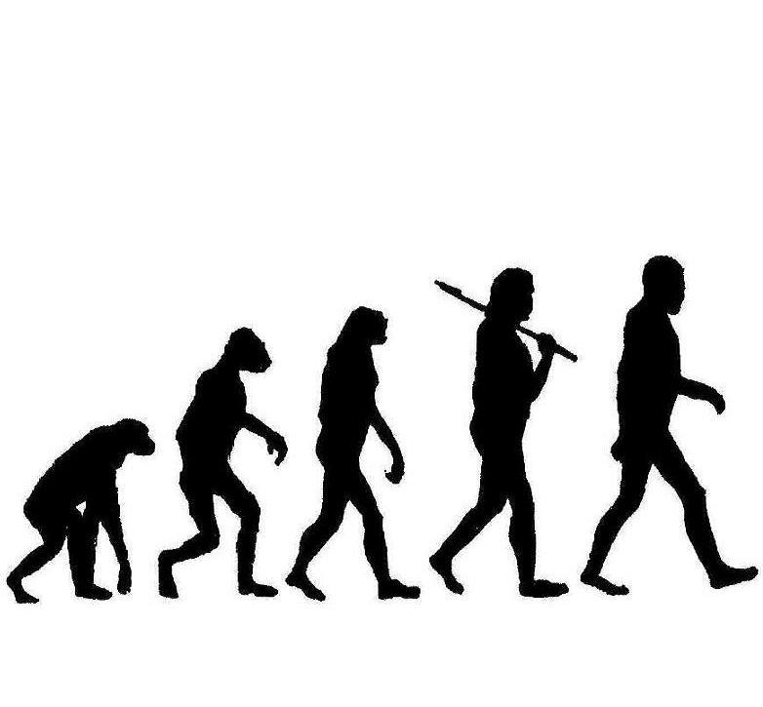
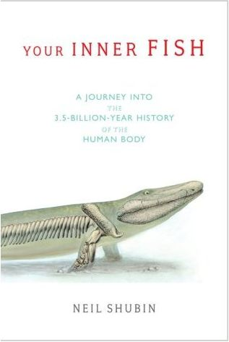
Unfortunately, not intelligent design
Ouch.

Slide 155
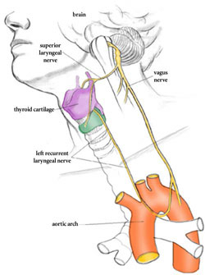
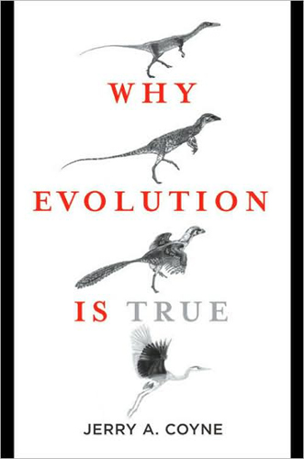
Why?
left recurrent laryngeal nerve

Slide 156
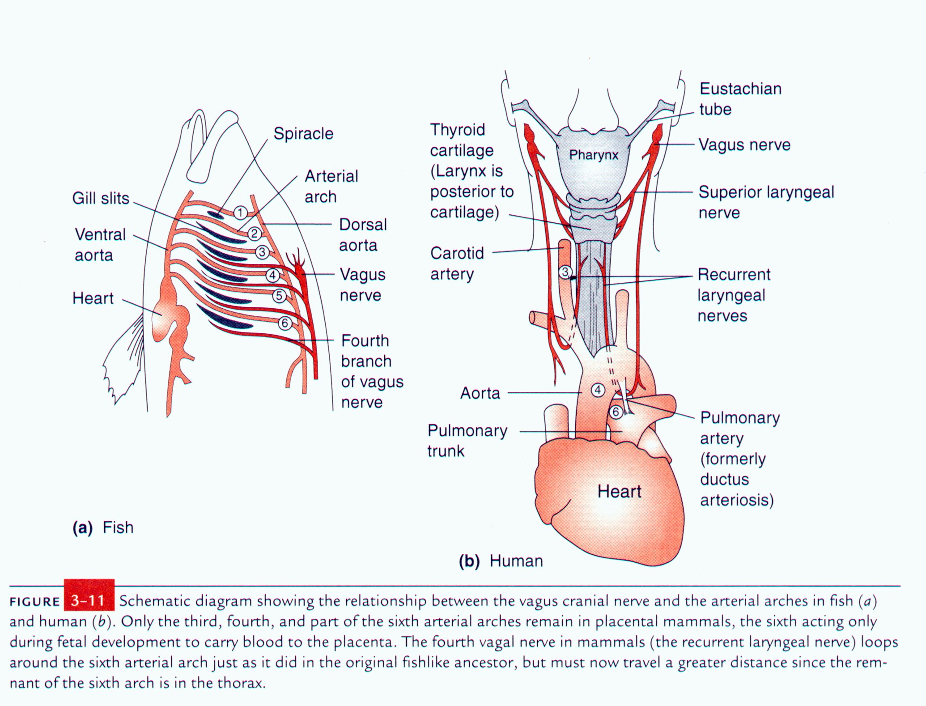
Why? Building humans from fish parts.
Fish parts

Slide 157
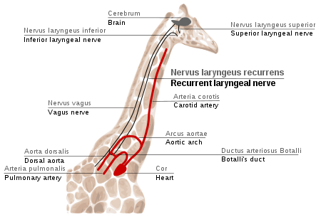
It could be worse.

Slide 158
Original design challenge?
Deconstrained
(Applications)
Networked OS
TCP/
IP
Expensive mainframes
Trusted end systems
Homogeneous
Sender centric
Unreliable comms
Constrained
Deconstrained
(Hardware)
Facilitated wild evolution
Created
  whole new ecosystem
  completely opposite

Slide 159
IPC
App
App
caltech.edu?
DNS
Global and direct access to physical address!
IP addresses interfaces (not nodes)
131.215.9.49
Dev
Dev2
CPU/Mem
Dev2
Dev2
CPU/Mem
CPU/Mem

Slide 160
IPC
App
App
DNS
Global and direct access to physical address!
Robust?
Secure
Scalable
Verifiable
Evolvable
Maintainable
Designable
…
IP addresses interfaces (not nodes)
Dev
Dev2
CPU/Mem
Dev2
Dev2
CPU/Mem
CPU/Mem

Slide 161
Naming and addressing need to have scope and
resolved within layer
translated between layers
not exposed outside of layer
Related “issues”
VPNs
NATS
Firewalls
Multihoming
Mobility
Routing table size
Overlays
…
Application
TCP
IP
Physical

Slide 162
Next layered architectures
Deconstrained
(Applications)
Few global variables
Don’t cross layers
Constrained
?
Control, share, virtualize, and manage resources
Comms
Memory, storage
Latency
Processing
Cyber-physical
Deconstrained
(Hardware)

Slide 163
Persistent errors and confusion (“network science”)
Architecture is least graph topology.
Every layer has different diverse graphs.
Application
Architecture facilitates arbitrary graphs.
TCP
IP
Physical

Slide 164
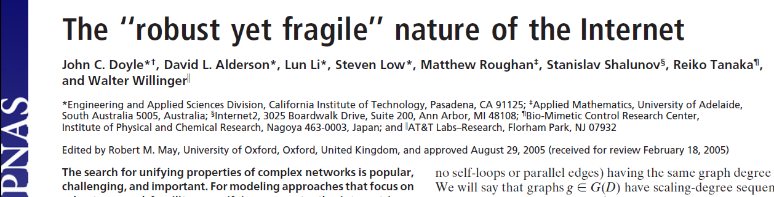

Slide 165
Universal laws (constraints)
Well known from physics and chemistry:
Classical: gravity, energy, carbon,…
Modern: speed of light, “Heisenberg”, …
Not so much:
Robustness
  Critical to study of complex systems
  Unknown outside narrow technical disciplines
  Theorems, not mere metaphors

Slide 166
How general is this picture?
Slow
Architecture
Architecture (constraints that deconstrain)
Impossible
Fast
Flexible
Inflexible
General
Special
Notes:
.

Slide 167
Balancing an inverted pendulum

Slide 168
Also harder if old and/or slow.
easy
hard
harder
Easy to prove using simple models.

Slide 169
What is sensed matters.
hard
harder
hardest!
Why?
Easy to prove using simple models.

Slide 170
This is the most interesting and counter-intuitive result.
If the sensed point is kept a fixed distance from the hand, longer sticks are much harder.
RHP zeros!
harder
hardest!
Why?
Easy to prove using simple models.

Slide 171
cyber
act & sense
physical
vision
-
VOR
u
delay
Act
delay
Act

Slide 172
noise
error
Delay τ

Slide 173
change sense
change length
Fragility
down
L
This is a cartoon, but can be made precise.

Slide 174
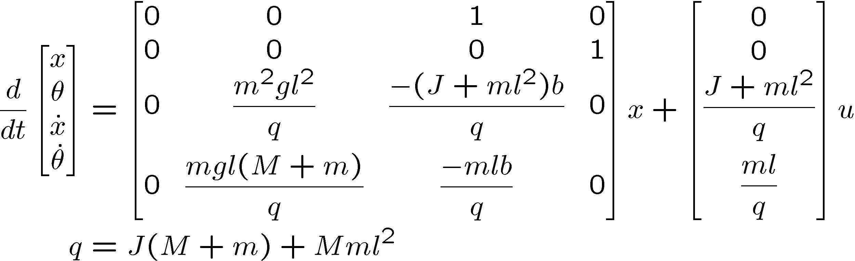
Linearized pendulum on a cart
m
m
θ
x
M
M
u

Slide 175
m
linearize
M

Slide 176
Robust
=agile and balancing

Slide 177
Robust
=agile and balancing

Slide 178
m
M
Efficient=length of pendulum (artificial)

Slide 179
m
transform+algebra
Low
Control

Slide 180
Easy, even with eyes closed
No matter what the length
Proof: Standard UG control theory:
Easy calculus, easier contour integral, easiest Poisson Integral formula

Slide 181
1
Sensitivity Function
0.5
0
-0.5
-1
-1.5
-2
0
5
10
Frequency

Slide 182
Harder if delayed or short
Short
Delay
M

Slide 183
noise
error
Delay τ

Slide 184
noise
error
Delay is hard
Delay τ

Slide 185
noise
error
This holds for any controller so is an intrinsic constraint on the difficulty of the problem.
Any control
Delay is hard
Delay τ

Slide 186
For fixed length
Too fragile
Fragility
L
up
down
large τ
small 1/τ
small τ
large 1/τ
1/delay

Slide 187
We would like to tolerate large delays (and small lengths), but large delays severely constrain the achievable robustness.
large τ
small 1/τ
small τ
large 1/τ

Slide 188
Short
is hard
M
Delay τ

Slide 189
Too fragile
For fixed delay
Fragility
Why oscillations?
Side effects of hard tradeoffs
L
up
down
length L

Slide 190
Too fragile
The ratio of delay between people is proportional to the lengths they can stabilize.
Fragility
L
up
down
length L

Slide 191
Also harder if sensed low
(details later)
m
Low
Control
M

Slide 192
Eyes moved down is harder
(RHP zero)
Similar to delay
m
M

Slide 193
m
M

Slide 194
Compare
m
Move eyes
M

Slide 195
change sense
change length
Fragility
down
L
This is a cartoon, but can be made precise.

Slide 196
Hard limits on the intrinsic robustness of control problems.
Must (and do) have algorithms that achieve the limits, and architectures that support this process.
Fragility
down
L
This is a cartoon, but can be made precise.

Slide 197
How general is this picture?
Implications for human evolution?
Cognition?
Technology?
Basic sciences?
fragile
simple tech
robust
complex tech
efficient
wasteful

Slide 198
This picture is very general
Implications for human evolution?
Cognition?
Technology?
Basic sciences?
fragile
simple tech
robust
complex tech
cheap
metabolic expensive
large delay τ
small τ
fast multiply
slow

Slide 199
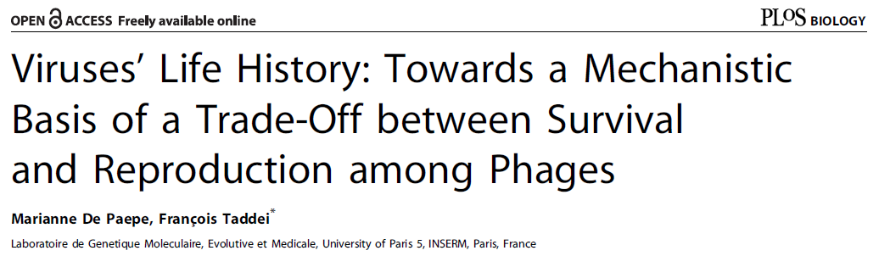

I recently found this paper, a rare example of exploring an explicit tradeoff between robustness and efficiency.
This seems like an important paper but it is rarely cited.

Slide 200
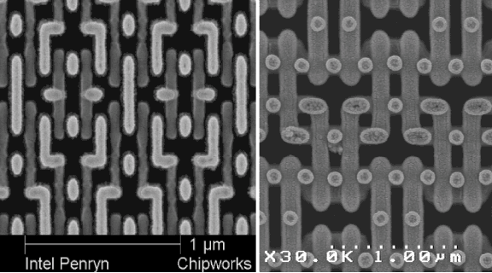
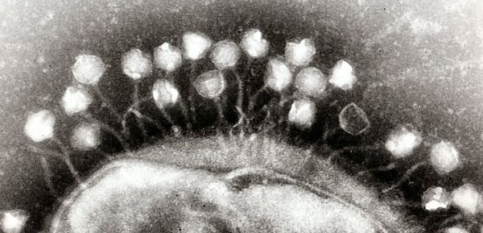
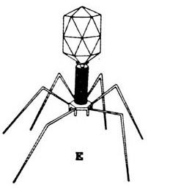
1μm
Phage
Bacteria

Slide 201
Phage lifecycle
Survive
Lyse
Infect
Multiply

Slide 202
thin
small
Capsid
Genome
fragile
Good architectures?
Survive
Hard limits?
thick
big
robust
fast
slow
Multiply

Slide 203
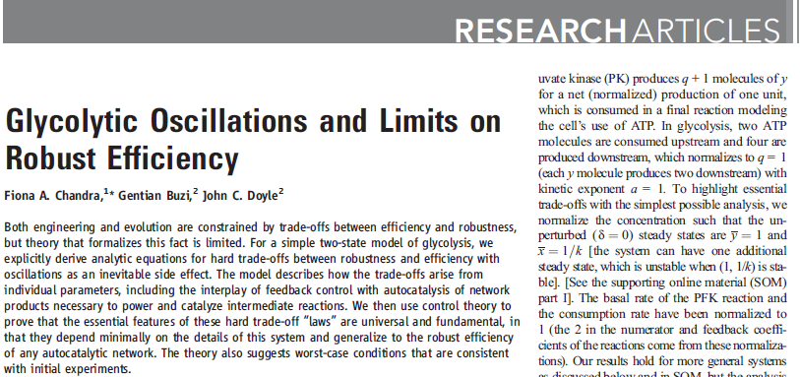

UG biochem, math, control theory
Chandra, Buzi, and Doyle
Most important paper so far.

Slide 204
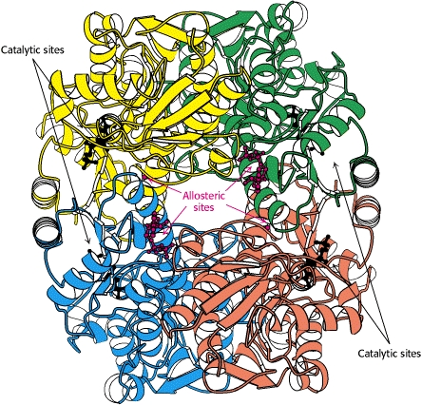
Theorem!
z and p functions of enzyme complexity and amount
Fragility
simple enzyme
complex enzyme
Enzyme amount
Savageaumics

Slide 205
Hard tradeoff in glycolysis is
robustness vs efficiency
absent without autocatalysis
too fragile with simple control
plausibly robust with complex control
fragile
10
1
Simple, but too fragile
complex
No tradeoff
10
0
10
-1
10
0
expensive
10
1

Slide 206
This picture is very general
Domain specific costs/tradeoffs
metabolic overhead
metabolic expensive
cheap
CNS reaction time τ (delay)
large τ
small τ
phage multiplication rate
fast multiply
slow

Slide 207
This picture is very general
fragile
simple tech
robust
complex tech
metabolic cost
cheap
expensive
reaction time τ
large τ
small τ
phage x rate
fast
slow
Domain specific costs/tradeoffs

Slide 208
thin
small
Capsid thickness
Genome size
fragile
Good architectures?
Survive
Hard limits?
thick
big
robust
fast multiply
slow

Slide 209
For fixed length
Too fragile
Fragility
L
up
down
large τ
small 1/τ
small τ
large 1/τ
1/delay

Slide 210
m
change sense
change length
Fragility
M
down
L
This is a cartoon, but can be made precise.

Slide 211
Hard tradeoff in glycolysis is
robustness vs efficiency
absent without autocatalysis
too fragile with simple control
plausibly robust with complex control
fragile
10
1
Simple, but too fragile
complex
No tradeoff
10
0
10
-1
10
0
10
1
metabolic cost

Slide 212
Computational complexity
Really slow
Turing has the original “universal law”
Slow
hard limits
Fast
Decidable
NP
P
Flexible/
General
Inflexible/
Specific
Notes:
.

Slide 213
noise
How do these two constraints (laws) relate?
control
Delay τ
Computation delay adds to total delay.
largedelay
This is about speed and flexibility of computation.
Computation is a component in control.
hard limits
small delay
Flexible
Inflexible
Notes:
.

Slide 214
noise
Delay comes from sensing, communications, computing, and actuation.
Delay limits robust performance.
control
Delay τ

Slide 215
Fragility
Delay makes control hard.
up
L
down
large τ
small τ
Computation delay adds to total delay.
largedelay
computation.
Computation is a component in control.
hard limits
small delay
Flexible
Inflexible
Notes:
.

Slide 216
Compute
Computational complexity of
Designing control algorithms
Implementing control algorithms
Software
Delay is even more important in control
Hardware
Digital
Analog
Control
Plant
Control
Sense
Act
Notes:
.

Slide 217
Fragility
up
This needs formalization:
What flexibility makes control hard?
Large, structured uncertainty?
down
large τ
small τ
Flexible
Inflexible
Notes:
.

Slide 218
Limitations on
hard limits
Fragility
General
Rigorous
First principle
simple
complex
Overhead, waste
?
Domain specific
Ad hoc
Phenomenological
Plugging in domain details

Slide 219
Alderson &Doyle, Contrasting Views of Complexity and Their Implications for Network-Centric Infrastructure,
IEEE TRANS ON SMC,
JULY 2010
Complex networks
Control
Sandberg, Delvenne,
& Doyle, On Lossless Approximations, the Fluctuation-Dissipation Theorem, and Limitations of Measurement,
IEEE TRANS ON AC,
FEBRUARY, 2011
Stat physics
Carnot
Boltzmann
Heisenberg
Physics

Slide 220
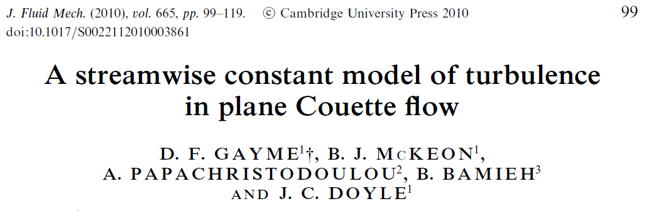

J. Fluid Mech (2010)
Turbulence and drag?
Flow
Streamlined
Laminar Flow
Transition to Turbulence
Increasing Drag, Fuel/Energy Use and Cost
Turbulent Flow

Slide 221
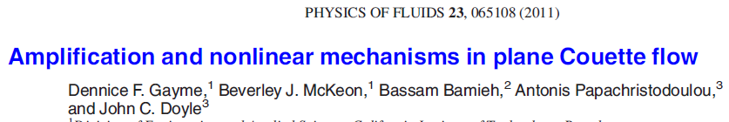
Physics of Fluids (2011)
y
y
Flow
x
z
z
x
Coherent structures and turbulent drag
high-speed
region
3D coupling
upflow
Blunted turbulent velocity profile
low speed
streak
downflow
Turbulent
Laminar

Slide 222
Fundamentals!
Turbulent
Laminar
fragile
Laminar
Control?
Turbulent
?
robust
efficient
wasteful

Slide 223
Extreme heterogeneity in delay
Slowest
color
B&W
vision
-
Slow/
cheap
slow
Mixed?
fast
VOR
Fast/
costly
Flexible
Inflexible

Slide 224
Extreme heterogeneity in delay
Slowest
color
B&W
vision
-
Slow/
cheap
slow
Mixed?
fast
VOR
Fast/
costly
Flexible
Inflexible

Slide 225
P
physical
P
C
act &
sense
P
P
cyber
C
C
P
P

Slide 226
cyber
act & sense
physical
vision
-
VOR
u
delay
Act
delay
Act

Slide 227
cyber
act & sense
physical
vision
-
VOR
u
delay
Act
delay
Act
physical
delay
Act

Slide 228
P
physical
P
C
act &
sense
P
P
cyber
C
C
P
P

Slide 229
Delays
(and dynamics)

Slide 230
New theory (QI)
P
physical
Challenges
Physical uncertainty
Act & sense
  delay
  power
Cyber
  delay
  energy
  noise/bw
  memory
C
act &
sense
P
cyber
C
P
System ID? Adaptive? L1?

Slide 231


B = nxb dim incidence matrix
Y_{e} = bxb dim diag edge admittance matrix
Y_{g} = nxn dim diag node to grnd adm matrix
x = n dim node voltage vector
y = b dim edge current vector
N = unit white noise injected at nodes
N
RLC circuits

Slide 232
Only J-N noise, some quick algebra
B = nxb dim incidence matrix
Y_{e} = bxb dim diag edge admittance matrix
Y_{g} = nxn dim diag node to grnd adm matrix
W_{e} = b dim edge current unit white noise vector
W_{g} = n dim node-ground current unit white noise
V = n dim node voltage vector
A = BB’-2I_{n} = nxn dim adjacency matrix
Y=B Y_{e} B’= node admittance matrix
N= J-N noise seen at nodes as current

Slide 233
Only J-N noise
Sparsity in circuit appears in inverse
Missing node voltages creates S-L problem
Perfect simple motivation for S-L decomp
Direct formulas in terms of admittance

Slide 234
B = nxb dim incidence matrix
Y_{e} = bxb dim diag edge admittance matrix
Y_{g} = nxn dim diag node to grnd adm matrix
x = n dim node voltage vector
y = b dim edge current vector
N = unit white noise injected at nodes
N
RLC circuits

Slide 235
Minimal circuit dynamics
For each node, add capacitor to ground
This will allow measurements on capacitor voltages, which are not white, but low pass white
Note: dynamics are similar to linearized Kuramoto oscillator

Slide 236
White noise inputs

