Slide 1





Accelerated, Parallel and
PROXimal coordinate descent
A
P
PROX
Peter Richtárik
IPAM
February 2014
(Joint work with Olivier Fercoq - arXiv:1312.5799)

Slide 2

Contributions

Slide 3
Variants of Randomized
Coordinate Descent Methods
Block
  can operate on “blocks” of coordinates
  as opposed to just on individual coordinates
General
  applies to “general” (=smooth convex) functions
  as opposed to special ones such as quadratics
Proximal
  admits a “nonsmooth regularizer” that is kept intact in solving subproblems
  regularizer not smoothed, nor approximated
Parallel
  operates on multiple blocks / coordinates in parallel
  as opposed to just 1 block / coordinate at a time
Accelerated
  achieves O(1/k^2) convergence rate for convex functions
  as opposed to O(1/k)
Efficient
  avoids adding two full feature vectors

Slide 4
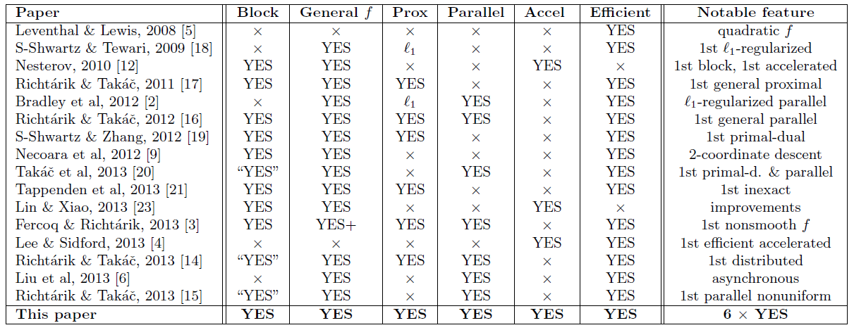
Brief History of
Randomized Coordinate Descent Methods
+ new long stepsizes

Slide 5
Introduction

Slide 6
I.
Block Structure
II.
Block Sampling
III.
Proximal Setup
IV.
Fast or Normal?

Slide 7
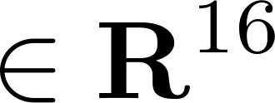

I. Block Structure

Slide 8

I. Block Structure

Slide 9
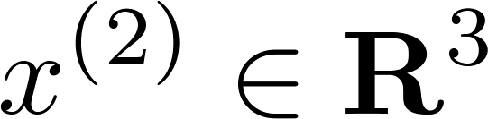
I. Block Structure

Slide 10

I. Block Structure

Slide 11
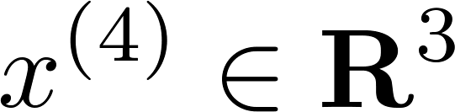
I. Block Structure

Slide 12



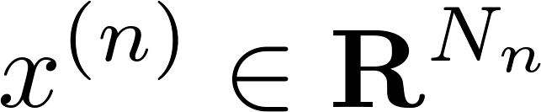
I. Block Structure
N = # coordinates
(variables)
n = # blocks

Slide 13
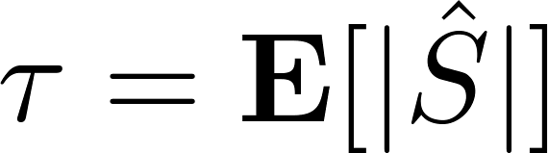
II. Block Sampling
Block sampling
Average # blocks selected by the sampling

Slide 14
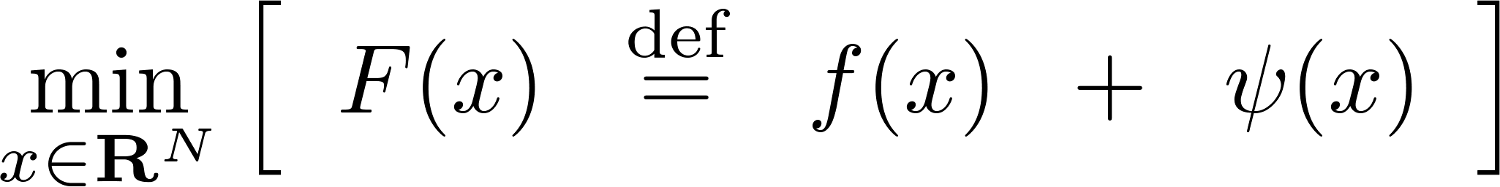
III. Proximal Setup
Loss
Regularizer
Convex & Smooth
Convex & Nonsmooth

Slide 15

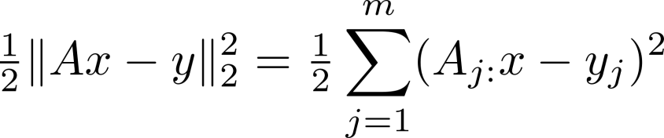
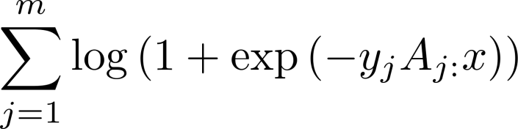


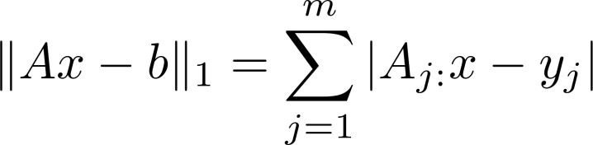
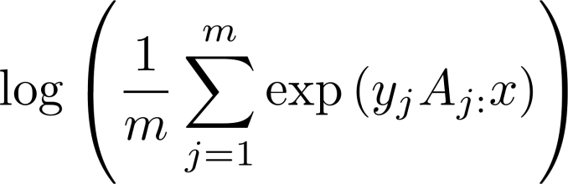
III. Proximal Setup
Loss Functions: Examples
Quadratic loss
BKBG’11
RT’11b
TBRS’13
RT ’13a
Logistic loss
Square hinge loss
L-infinity
L1 regression
FR’13
Exponential loss

Slide 16
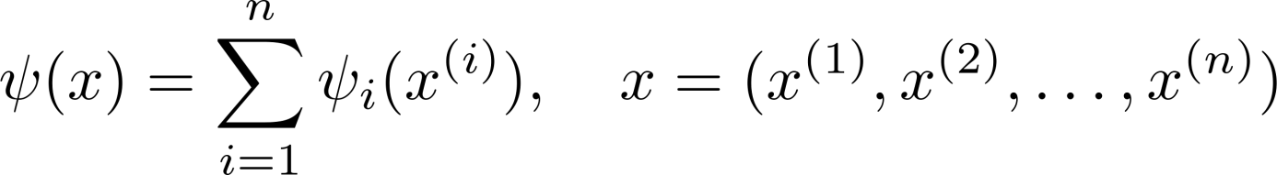

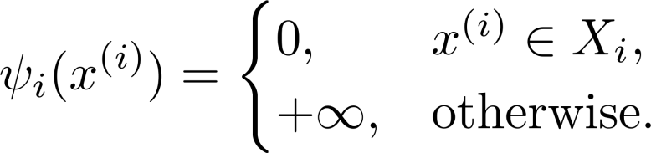
III. Proximal Setup
Regularizers: Examples
e.g., LASSO
No regularizer
Weighted L1 norm
Box constraints
Weighted L2 norm
e.g., SVM dual

Slide 17
The Algorithm

Slide 18
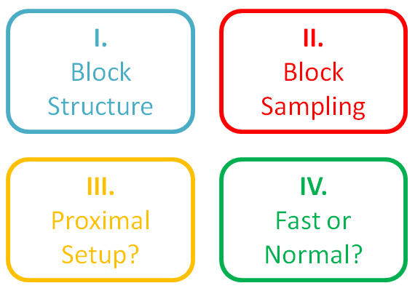
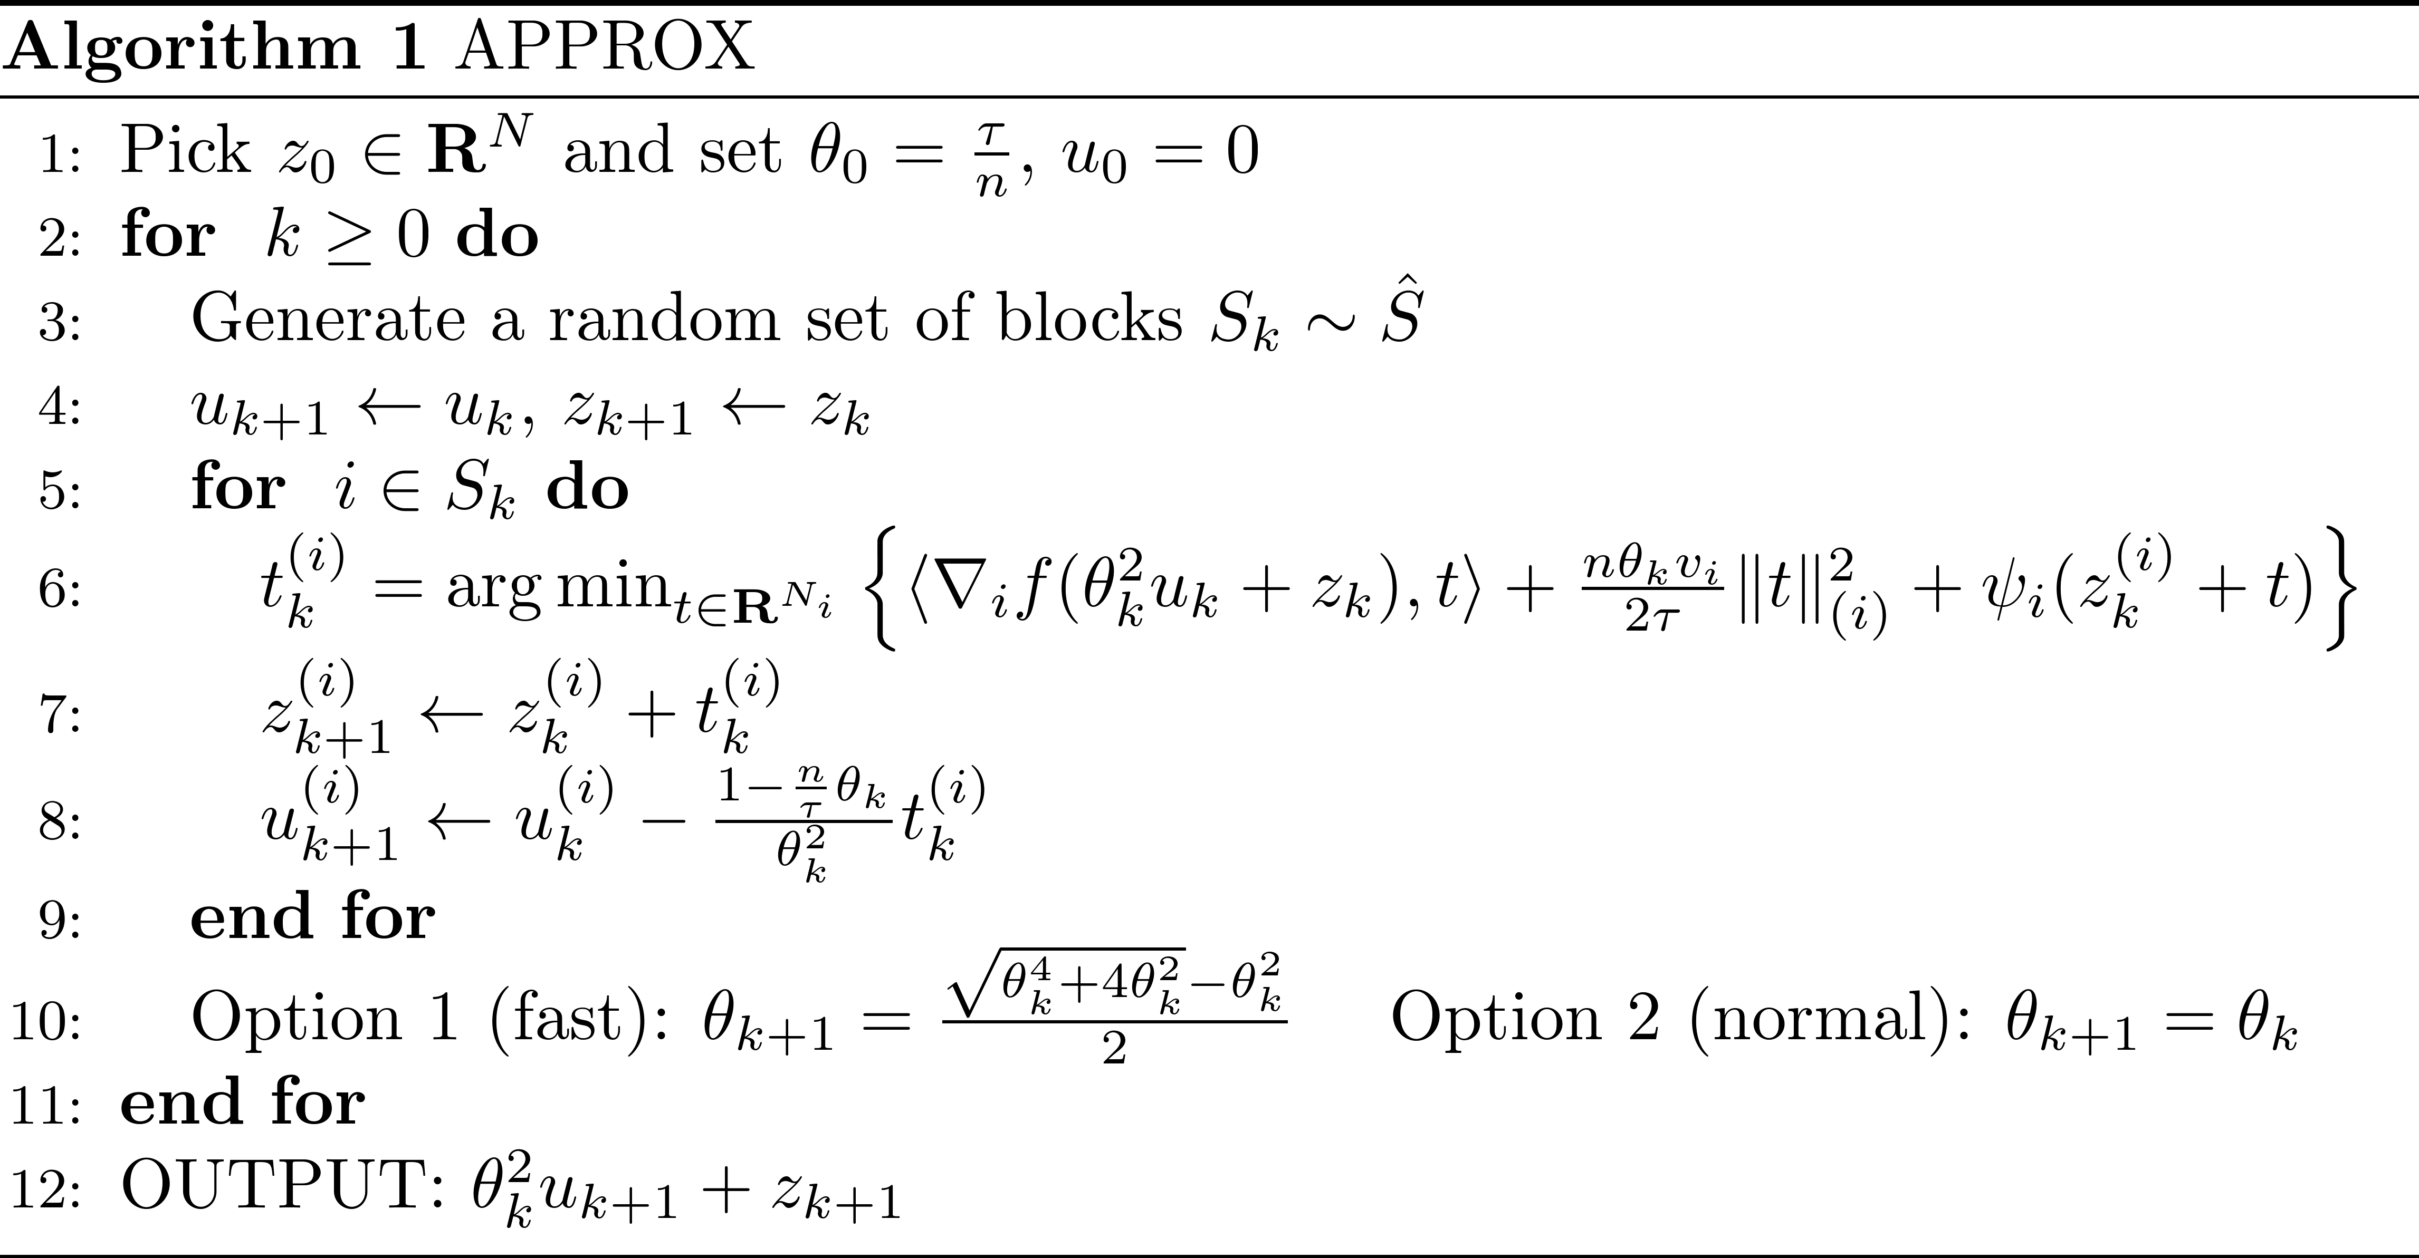

APPROX
Olivier Fercoq and P.R. Accelerated, parallel and proximal coordinate descent, arXiv:1312.5799, December 2013

Slide 19

Part C
RANDOMIZED
COORDINATE DESCENT
Olivier Fercoq and P.R. Accelerated, parallel and proximal coordinate descent, arXiv:1312.5799, Dec 2013
Part B
GRADIENT METHODS
B1
GRADIENT DESCENT
B2
PROJECTED
GRADIENT DESCENT
C1
PROXIMAL
COORDINATE DESCENT
C2
PARALLEL
COORDINATE DESCENT
ISTA
new FISTA
B3
PROXIMAL
GRADIENT DESCENT
B4
FAST PROXIMAL
GRADIENT DESCENT
C3
DISTRIBUTED
COORDINATE DESCENT
C4
FAST PARALLEL
COORDINATE DESCENT

Slide 20
PCDM
P.R. and Martin Takac. Parallel coordinate descent methods for big data optimization, arXiv:1212.0873, December 2012
IMA Fox Prize in Numerical Analysis, 2013

Slide 21

2D Example

Slide 22
Convergence Rate

Slide 23
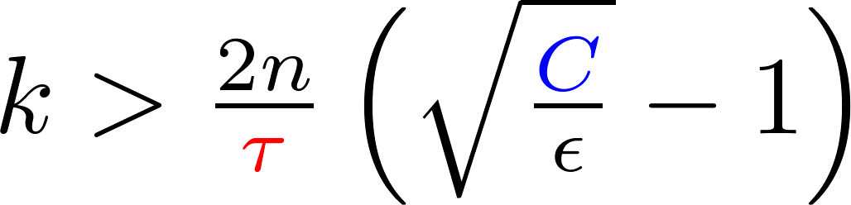
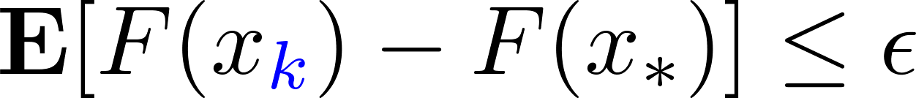
Convergence Rate
Theorem [Fercoq & R. 12/2013]
# iterations
# blocks
average # coordinates updated / iteration
implies

Slide 24
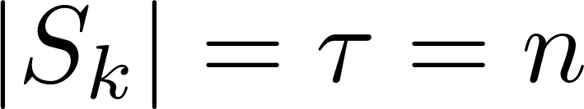
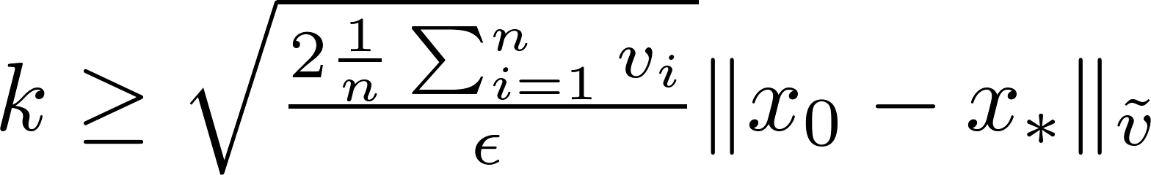
Special Case: Fully Parallel Variant
all blocks are updated in each iteration
# iterations
# normalized weights (summing to n)
implies

Slide 25
New Stepsizes

Slide 26
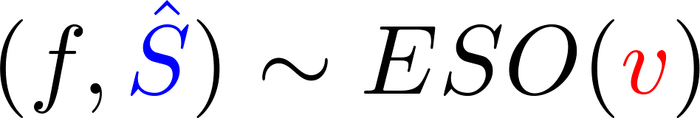

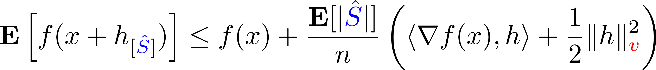
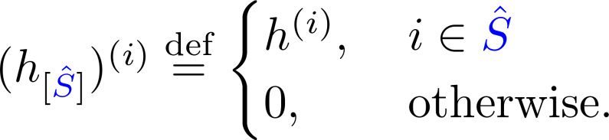

Expected Separable Overapproximation (ESO):
How to Choose Block Stepsizes?
P.R. and Martin Takac. Parallel coordinate descent methods for big data optimization, arXiv:1212.0873, December 2012
Olivier Fercoq and P.R. Smooth minimization of nonsmooth functions by parallel coordinate descent methods, arXiv:1309.5885, September 2013
SPCDM
P.R. and Martin Takac. Distributed coordinate descent methods for learning with big data, arXiv:1310.2059, October 2013

Slide 27
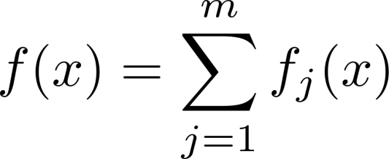




Assumptions: Function f
(a)
(b)
(c)
Example:

Slide 28














Visualizing Assumption (c)

Slide 29

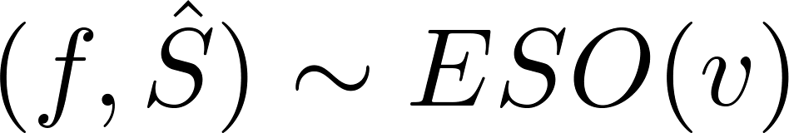

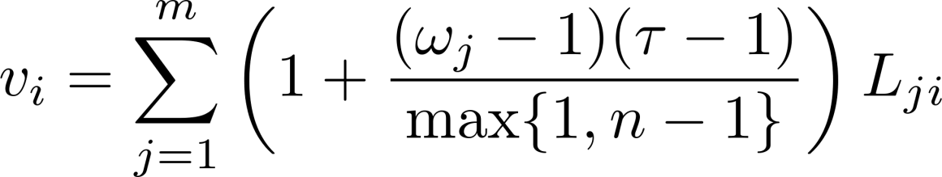
New ESO
Theorem (Fercoq & R. 12/2013)
(i)
(ii)

Slide 30

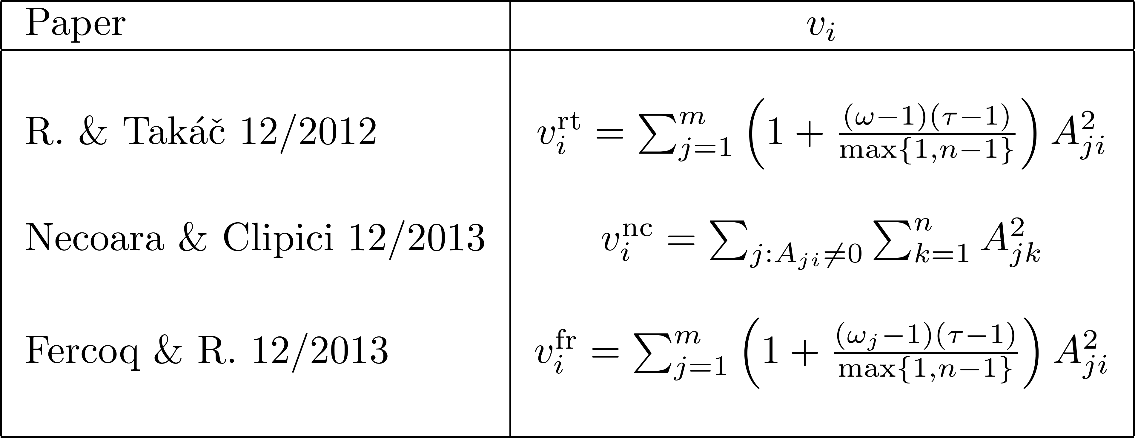
Comparison with Other Stepsizes for Parallel Coordinate Descent Methods
Example:

Slide 31
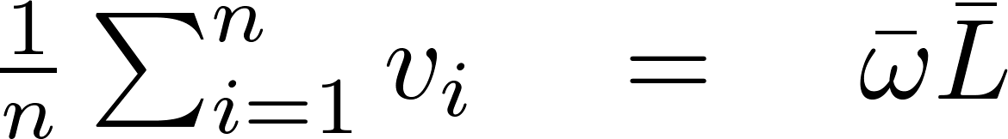
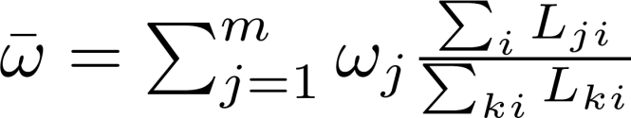
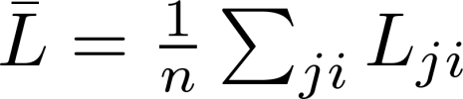
Complexity for New Stepsizes
With the new stepsizes, we have:
Average degree of separability
“Average” of the Lipschitz constants

Slide 32
Work in 1 Iteration

Slide 33
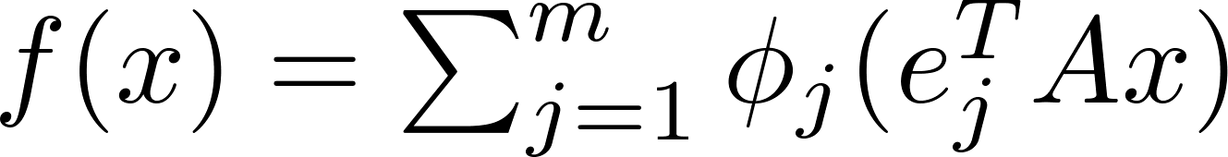
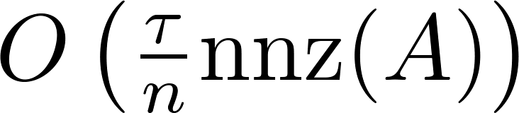

Cost of 1 Iteration of APPROX
Scalar function: derivative = O(1)
Assume N = n (all blocks are of size 1)
and that
Sparse matrix
Then the average cost of 1 iteration of APPROX is
arithmetic ops
= average # nonzeros in a column of A

Slide 34
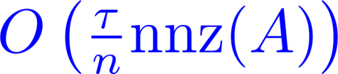


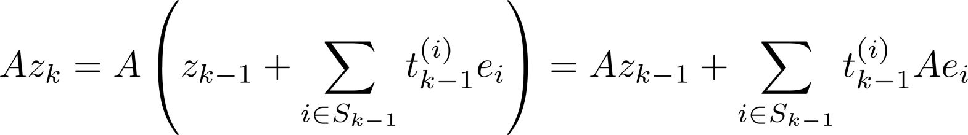
Bottleneck: Computation of Partial Derivatives
maintained

Slide 35
Preliminary
Experiments

Slide 36
L1 Regularized L1 Regression
Gradient Method
Nesterov’s Accelerated Gradient Method
SPCDM
APPROX
Dorothea dataset:

Slide 37
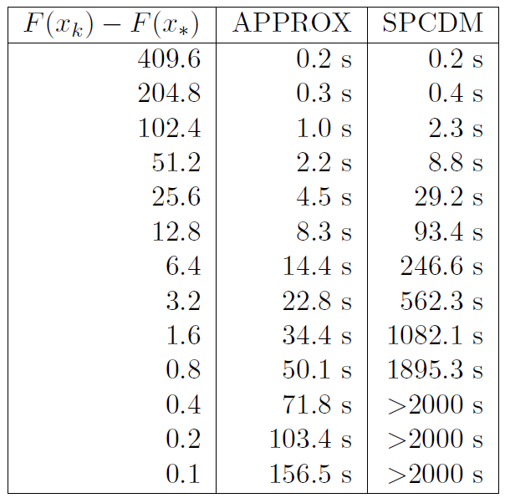


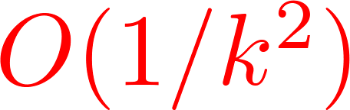
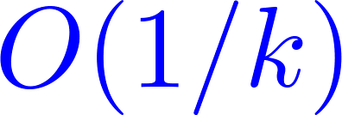
L1 Regularized L1 Regression

Slide 38
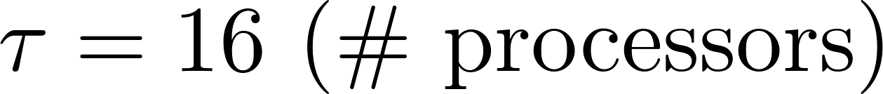
L1 Regularized Least Squares (LASSO)
PCDM
APPROX
KDDB dataset:

Slide 39
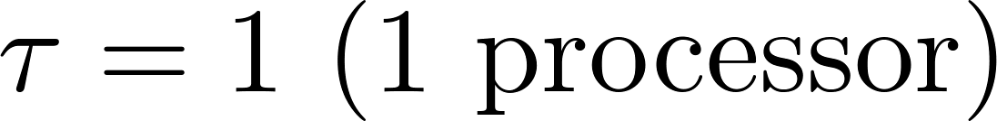
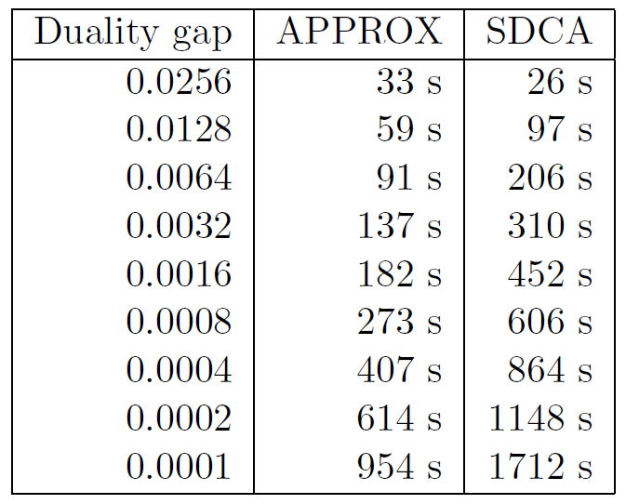
Training Linear SVMs
Malicious URL dataset:

Slide 40
Importance Sampling

Slide 41
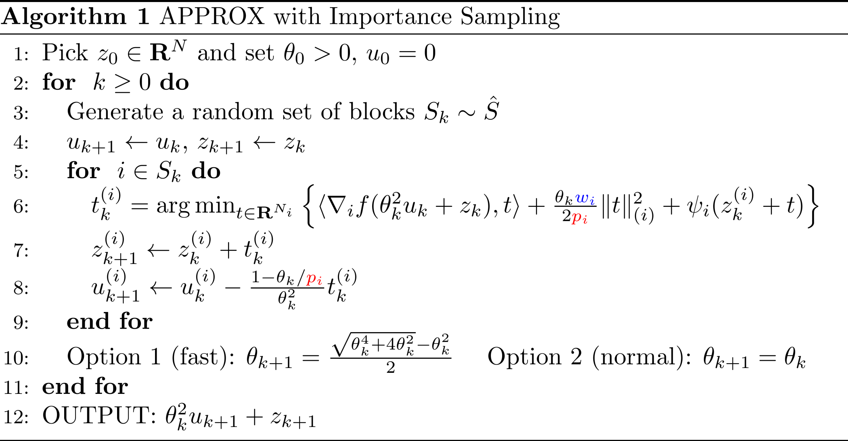

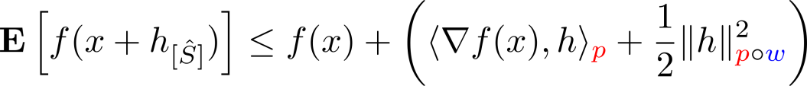
with Importance Sampling
Nonuniform ESO
Zheng Qu and P.R. Accelerated coordinate descent with importance sampling, Manuscript 2014
P.R. and Martin Takac. On optimal probabilities in stochastic coordinate descent methods, aXiv:1310.3438, 2013

Slide 42
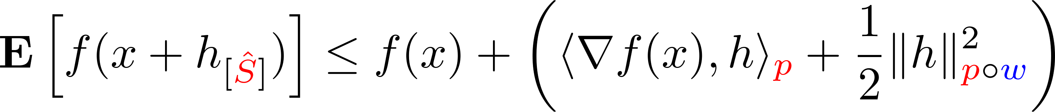
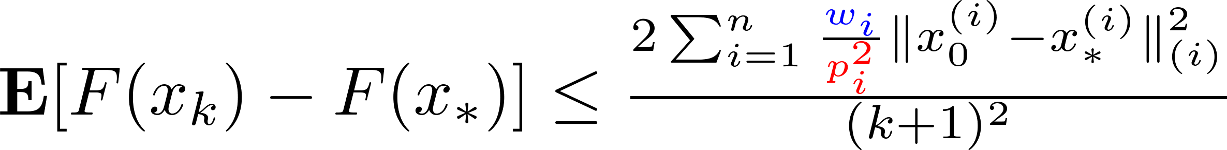
Convergence Rate
Theorem [Qu & R. 2014]

Slide 43
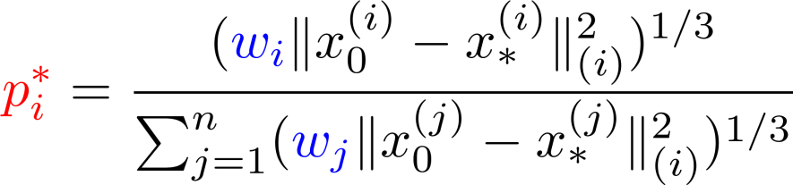
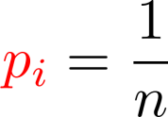
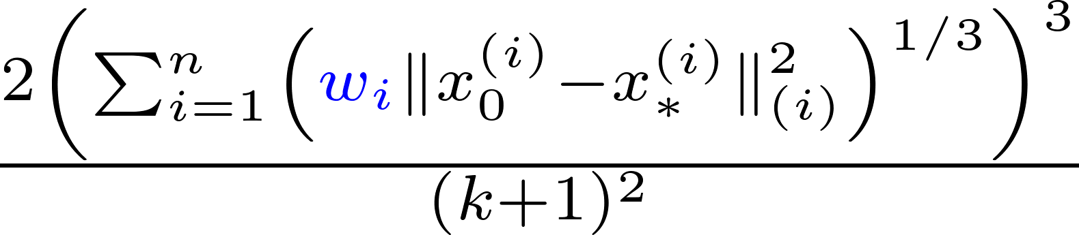
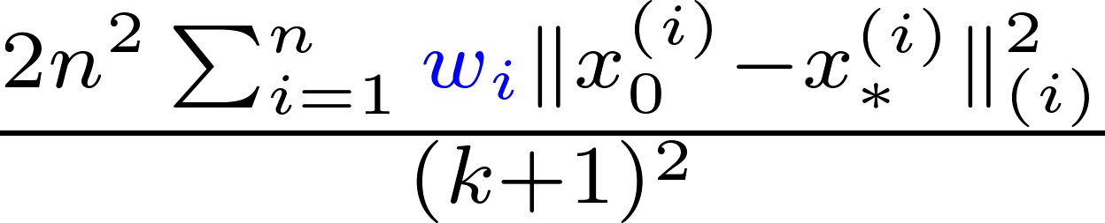
Serial Case: Optimal Probabilities
Nonuniform serial sampling:
Uniform Probabilities
Optimal Probabilities

Slide 44
Extra 40 Slides

