Slide 1





Computational Challenges in Warm Dense Matter, Los Angeles, CA.
Tuesday, May 22, 2012, 4:30 PM
Perspectives on plasma simulation techniques from the IPAM quantum simulation working group
L. Shulenburger
Sandia National Laboratories
2012-4210 C
Sandia National Laboratories is a multi program laboratory managed and operated by Sandia Corporation, a wholly owned subsidiary of Lockheed Martin Corporation, for the U.S. Department of Energy's National Nuclear Security Administration under contract DE-AC04-94AL85000.
.
Notes:
Thank you to the organizers of this workshop (Mike, Sam, etc.)
Thank you to the organizers of the long program (Fank etc.)
Thank you to the IPAM staff for facilitating our work (Russ Caflish, Christian Rasch, Roland MacFarlane and
Personally I would like to thank all of the members of the working group, it has been a great experience and I’m looking forward to continuing the collaboration

Slide 2
Quantum Simulations Working Group
Paul Grabowski
Michael Murillo
Christian Scullard
Sam Trickey
Dongdong Kang
Jiayu Dai
Winfried Lorenzen
Aurora Pribram-Jones
Stephanie Hansen
Yong Hou
Bedros Afeyan
Notes:
This has been a loosely constituted group that formed during the first week of the long program
Plasma simulation has a wide variety of methods that differ greatly in language and in application
Find kindred travelers with whom to work

Slide 3
Quantum Simulations Working Group
Paul Grabowski → Quantum Mechanics via Molecular Dynamics
Michael Murillo → Quantum Mechanics via Molecular Dynamics
Christian Scullard → Quantum Mechanics via Molecular Dynamics
Sam Trickey → DFT, Orbital Free DFT, Functional Development
Dongdong Kang → DFT-MD and extensions
Jiayu Dai → DFT-MD and extensions
Winfried Lorenzen → DFT-MD
Aurora Pribram-Jones → Electronic Structure Theory
Stephanie Hansen → Average Atom
Yong Hou → Average Atoms and extensions
Bedros Afeyan → Mathematical underpinnings
Notes:
First challenge was organization
Wide variety of interests
Establish a common goal → How to understand the use of various methods rather than develop them further

Slide 4
Goal: Evaluate methods with an eye towards plasma simulation
What are the regimes of validity of each method?
  Accuracy?
  What physics can be treated?
How computationally intensive is each approach?
What is the leading edge research for each method?
Notes:
Broadly Speaking, when should each of these techniques be used?
-- By regime of validity we mean both
-- In which conditions are approximations thought to be small
-- What physics is left out – for instance time dependence or structure
-- Next two points make themselves

Slide 5
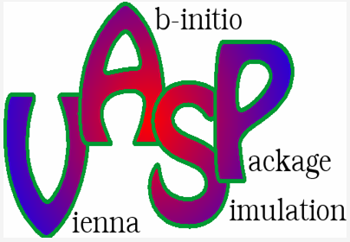

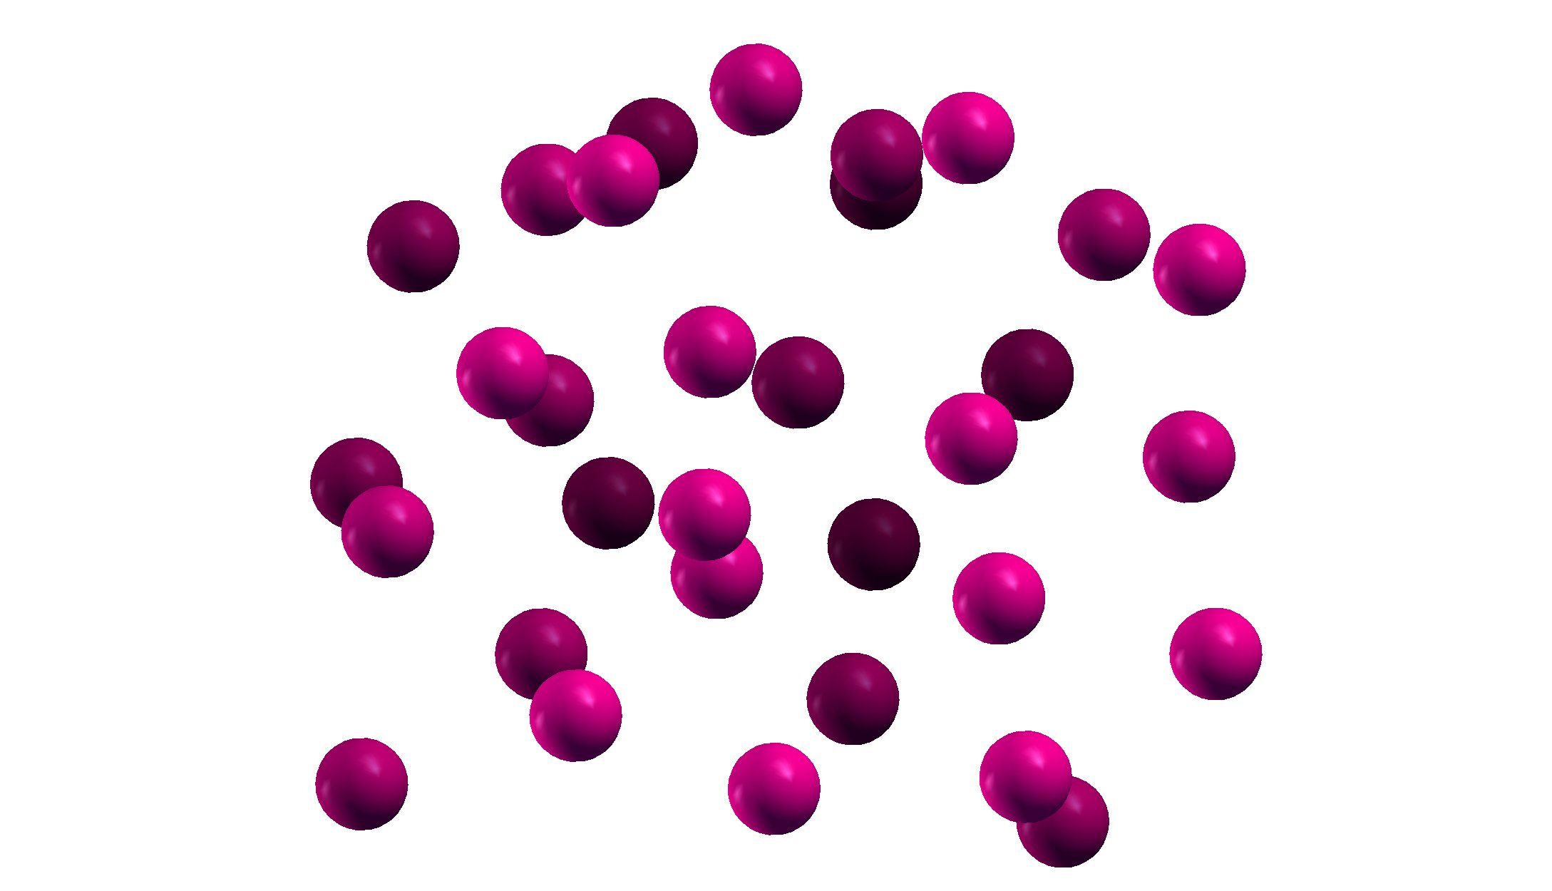
Quantum Molecular Dynamics
Density functional theory (DFT) based molecular dynamics simulation
Strengths
Well established at low temperatures
Fundamental approximations are well studied
Numerous codes are available (low barrier to entry)
Possible to calculate many properties
Notes:
-- Method has been used extensively in solid state physics and chemistry at or near ambient conditions
-- Mapping from KS to real hamiltonian is exact and much work has been done on understanding the functionals
-- There are a plethora of freely available codes. For plasma conditions plane waves appear desirable and three very polished codes appear often in literature
-- Routine calculation of pressure, structural properties and response functions

Slide 6
Quantum Molecular Dynamics
Density functional theory (DFT) based molecular dynamics simulation
Strengths
Well established at low temperatures
Fundamental approximations are well studied
Numerous codes are available (low barrier to entry)
Possible to calculate many properties
Limitations
Finite temperature generalization is not as well developed
Approximations are not “mechanically” improvable
Poor computational complexity O(N³) requires small systems
Generally Born-Oppenheimer approximation is made
Ions are not treated quantum mechanically
High temperatures are computationally demanding
Notes:
-- Fundamental derivation at finite T has been around for a long time, but few explicit finite temperature XC functionals (small effect?)
-- Functionals do not get uniformly better as more information is added, for instance “Jacob’s Ladder” does not always lead to better results
-- A few thousands of electrons are possible but it is hard to imagine even most mesoscale problems will become tractable without methodological advances
-- Born-Oppenheimer approximation renders most time dependent and non-equilibrium effects inaccessible
-- Ions are generally point particles, effect may not be small particularly with regards to H, He etc
-- Kohn-Sham approximation means high temperature is nearly expensive as larger systems!!!!

Slide 7
Quantum Molecular Dynamics
Density functional theory (DFT) based molecular dynamics simulation
Strengths
Well established at low temperatures
Fundamental approximations are well studied
Numerous codes are available (low barrier to entry)
Possible to calculate many properties
Limitations
Finite temperature generalization is not as well developed
Approximations are not “mechanically” improvable
Poor computational complexity O(N³) requires small systems
Generally Born-Oppenheimer approximation is made
Ions are not treated quantum mechanically
High temperatures are computationally demanding
Leading Edge Research
Functional development
(ground state and finite T)
Orbital free methods
(beyond Kohn-Sham)
Nonequilibrium extensions: TDDFT and Langevin
Calculation of new observables
Quantum nuclei
Notes:
-- Functionals are always being improved (or at least worked on)
-- Computational complexity is not set in stone.. Orbital free methods would relax this enormously
-- Nonequilibrium properties may become accessible either through building in explicit temperature dependence or integrating over it
-- New properties are being simulated all the time, for instance dynamic structure factor
-- Methods like PIMD can recover quantum effects for the protons

Slide 8
Average Atom
INFERNO
PURGATORIO
Single center impurity problem embedded in effective medium
Strengths
Theoretical connection to weakly coupled plasma picture
Incredibly fast and robust
Can be easily combined with other approaches
Applicable over a wide range of ρ and T
Generalizations to allow access to spectroscopic information
x
Notes:
-- Add quantum effects to a plasma where ionic correlations are small (note terminological difficulty)
-- Results are often had in seconds or minutes rather than hours or days
-- This computational ease allows for useful embedding in other methods
-- Particularly wide range is important for generation of EOS where low density and high temperature states are often needed
-- Energy levels are available, contrast to molecular dyanmics

Slide 9
Average Atom
INFERNO
PURGATORIO
Single center impurity problem embedded in effective medium
Strengths
Theoretical connection to weakly coupled plasma picture
Incredibly fast and robust
Can be easily combined with other approaches
Applicable over a wide range of ρ and T
Generalizations to allow access to spectroscopic information
Limitations
Ionic correlations are neglected
Interstitial regions are treated approximately
Single center makes chemistry impossible
x
Notes:
-- Medium is treated as jellium, so structure is lost
-- Between atoms, elecrons are treated as being free and unperturbed by presence of ions
-- Chemistry is of course not possible

Slide 10
Average Atom
INFERNO
PURGATORIO
Single center impurity problem embedded in effective medium
Strengths
Theoretical connection to weakly coupled plasma picture
Incredibly fast and robust
Can be easily combined with other approaches
Applicable over a wide range of ρ and T
Generalizations to allow access to spectroscopic information
Limitations
Ionic correlations are neglected
Interstitial regions are treated approximately
Single center makes chemistry impossible
Leading Edge Research
Adding ionic correlations
Moving beyond single site model
Calculation of new observables
x
Notes:
-- Have heard excellent talks today on incorporating ionic structure
-- Also multiple sites are possible (again today)
-- Calculations of effects such as XRTS are possible

Slide 11
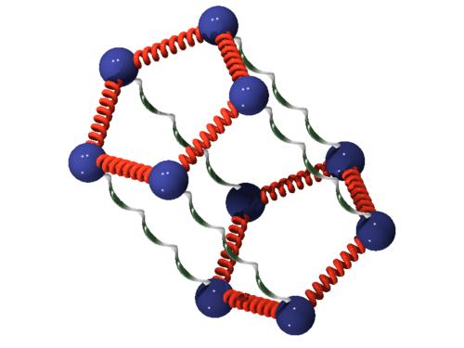
Path Integral Monte Carlo
PIMC++
UPI
Numerically sample Feynman path integral to determine partition function
Strengths
High accuracy particularly at high temperatures
Approximations are variational with respect to free energy
Massively parallel
Electrons and ions are easily treated on same footing
Notes:
-- Will here more about this tomorrow afternoon
-- Sample Feynman path integrals utilizing mapping with ring polymers
-- Quantum mechanics are included exactly when statistics become unimportant → accuracy at high temperature
-- Approximations due to fermi statistics can in principle be improved
-- Monte Carlo Method means that scaling with computer power is quite good
-- Electrons and Ions can be treated on equal footings (improvement even over DFT based PIMD)

Slide 12
Path Integral Monte Carlo
PIMC++
UPI
Numerically sample Feynman path integral to determine partition function
Strengths
High accuracy particularly at high temperatures
Approximations are variational with respect to free energy
Massively parallel
Electrons and ions are easily treated on same footing
Limitations
Approximations are less well exercised
High computational cost
Unfavorable computational complexity
Codes are not as well developed
Ergodicity problems at low temperatures
Real time dynamics are difficult
Notes:
-- Many fewer results than QMD or average atom
-- Hundreds to Thousands of times more expensive than DFT
-- Again N^3 scaling means truly large systems are not currently accessible
-- Reaching low temperatures is difficult due to ergodicity problems
-- Dynamics occur in imaginary time, so real time requires technique such as an inverse laplace transform

Slide 13
Path Integral Monte Carlo
PIMC++
UPI
Numerically sample Feynman path integral to determine partition function
Strengths
High accuracy particularly at high temperatures
Approximations are variational with respect to free energy
Massively parallel
Electrons and ions are easily treated on same footing
Limitations
Approximations are less well exercised
High computational cost
Unfavorable computational complexity
Codes are not as well developed
Ergodicity problems at low temperatures
Real time dynamics are difficult
Leading Edge Research
Efficiency improvements
Improving constraints
Application to higher Z elements
Notes:
-- There is work to improve efficiency via improving action or sampling
-- Improvements in constraints are under way
-- Recent paper on all electron C, this is probably not feasible for high Z, develop some sort of pseudopotential or improved sampling schemes

Slide 14

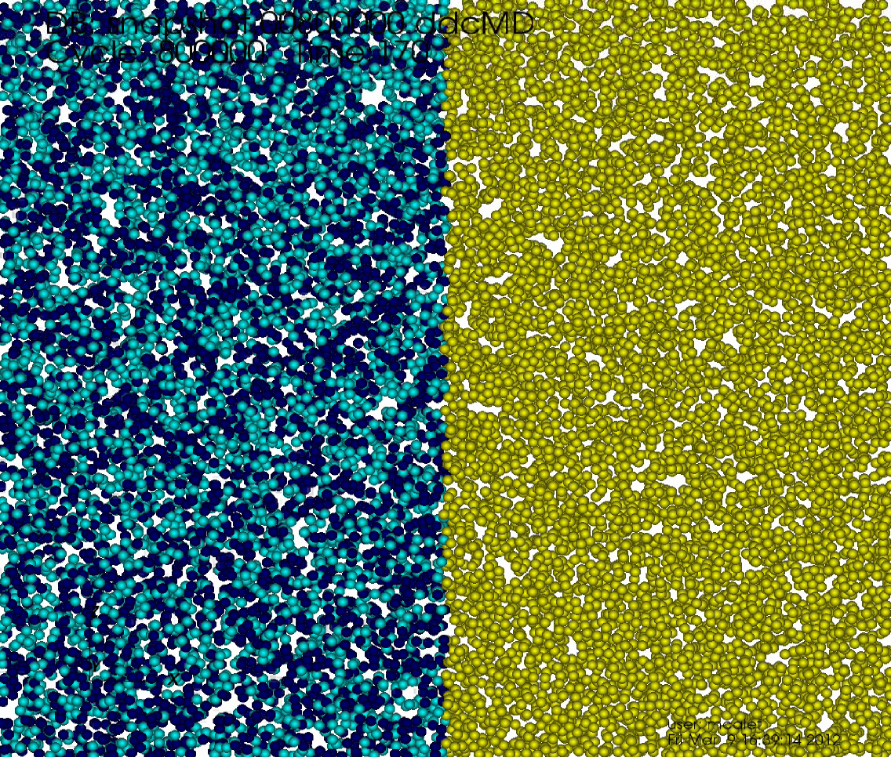
Quantum Statistical Potentials
DDCMD
Cimarron
Use quantum relations to generate effective interactions for electrons and ions
Strengths
Maps a quantum problem to a classical one
Scales well to many more particles than other methods
Ability to do electron and ion dynamics near equilibrium
Codes are well developed and tuned
Notes:
-- Utilize machinery of classical molecular dyanmics and quantum mechanics to allow large systems in real time
-- Scaling is excellent and millions of particles are possible or even routine
-- Near range where potentials are valid, real time dynamics of electrons are possible
-- Codes such as DDCMD are tuned and well developed (Gordon Bell Prize)

Slide 15
Quantum Statistical Potentials
DDCMD
Cimarron
Use quantum relations to generate effective interactions for electrons and ions
Strengths
Maps a quantum problem to a classical one
Scales well to many more particles than other methods
Ability to do electron and ion dynamics near equilibrium
Codes are well developed and tuned
Limitations
Derivation only valid for equilibrium
Changes binary cross sections
Diffraction and Pauli should not be treated separately
Two-body approximation
Notes:
-- Garbage in, garbage out
-- potentials are only derived for equilibrium properties
-- Pauli-Exclusion and scattering are treated as separable
-- Potentials are treated as pairwise
-- All of this will mean bound states are not treated properly and chemistry or crystal structures are not correct

Slide 16
Quantum Statistical Potentials
DDCMD
Cimarron
Use quantum relations to generate effective interactions for electrons and ions
Strengths
Maps a quantum problem to a classical one
Scales well to many more particles than other methods
Ability to do electron and ion dynamics near equilibrium
Codes are well developed and tuned
Limitations
Derivation only valid for equilibrium
Changes binary cross sections
Diffraction and Pauli should not be treated separately
Two-body approximation
Leading Edge Research
Improved integration techniques
Improved potential forms
Extensions to lower temperatures
Notes:
-- Numerical difficulties have led to derivation of improved integrators
-- Better potentials will yield better results
-- Lower temperatures may be possible with better potentials

Slide 17
Accuracy is key → Method comparison benchmark
Define a series of test problems which test various aspects of the physics in several regimes
Tests must be as simple as possible and computationally tractable
Observables are experimentally motivated but not comparisons to experiment
All approximations must be explicitly controlled where possible
Generate a survey paper
Notes:
Elephant in the room
-- Have not quantitatively decided how accurate each method is for simulation of a given type of plasma
-- Define a series of tests to decide how accurate these methods are
-- Choose tests which are tractable and hopefully tell us something about methods
-- Decision to not have experimental results available
-- Must work extremely hard to make sure to test the methods themselves, not our imperfect application of them

Slide 18
Define a problem to exercise methods
Two materials: H and C
Temperatures: 1, 5, 10, 100 and 1 keV
Densities: 0.1, 1 and 30 g/cc
Observables:
  P
  g_{ii}(r), g_{ei}(r), g_{ee}(r)
  S(k,ω)
  Diffusion coefficient for electrons and ions
  Average ionization
  Electrical conductivity
  Thermal conductivity
Notes:
Rationale for observables
-- P is an integrated quantity
-- pair correlation function could potentially give an idea whether electron or ion treatment was the culprit
-- structure factor could eventually provide a path to XRTS
-- Diffusion coefficient also tells about structure, but distinguishes between Born Oppenheimer or time dependene
-- Conductivities have intrinsic importance

Slide 19
Work in progress
Initial submissions have covered a range of methods
  DFT-MD
  Average Atom
  Average Atom-MD
  Quantum Statistical Potentials

Slide 20
Conclusion #1: Average atom is fast!!!
First results from AA calculations arrived less than a week after the problem was defined
  Skilled practitioners
  Fewer approximations to converge
  Not significantly more expensive for C than H
Notes:
-- Results came back fast
-- Even if method is qualitatively correct, speed may argue for use as a rapid prototype
-- Why is it so fast?
-- skilled practitioner: Stephanie Hansen
-- less knobs to turn

Slide 21
Examples: Initial validation of DFT-MD
Submissions attempt to understand errors from many sources
  Pseudopotentials / PAWs
  Finite size simulation cells
  Functional
  Incomplete basis
  Timestep
Example for a reduced model: simple cubic hydrogen
SC Hydrogen at 1 g/cc
Notes:
For each method I mentioned we needed to at least understand the errors inherent in our application
-- Example for DFT – simple cubic hydrogen to be as simple and unambiguous as possible
-- Can we currently use orbital free DFT? → Probably needs more work. Much harder task than KS and functionals are still under development
-- Effect of choice of functional
-- LDA and PBE from VASP are within 3 Gpa for all temperatures
-- What about Finite temperature effects – Look at far right pane
-- Finite temperature functionals reduce pressure from zero temperature functional
-- Object of some concern, highest temperture points may be too high in pressure

Slide 22
Results for a range of methods
H
Computed pressure as a function of temperature for different densities
Except for lowest temperatures, results are indistinguishable from tabulated
SESAME 5251
  Not necessarily indicative of success
Notes:
-- With methods well understood now find results for one of the properties in our test set
-- Pressure of H at 3 densities and a range of temperatures
-- A log scale hides a lot of things, but for most T, rho we find excellent agreement with SESAME
-- SESAME is not exact, there are reasons to believe that there are errors with this table
-- Look more closely at 1 g/cc results which are the most numerous

Slide 23
Insights from closer inspection
Percent deviation of H pressure from SESAME 5251
Relative spread decreases at high temperature
Methods within a class give similar results
Average atom gives a large error at low temperature
Notes:
Zoom in to 1 g/cc hydrogen results. Look at relative error compared to Sesame.
-- Difficult to choose how to compare, errors ~ 10% are no great concern
-- Differences between same code for different methods are more interesting
-- Average atom deviations at low temperature have a physical reason

Slide 24
Role of ion structure
Hydrogen pair correlation function for 1 g/cc
Pair correlation from DFT-MD
Results rapidly approach gas structure as temperature increases
Notes:
First results on structure of H from DFT-MD shows why Average-Atom results are likely worse at low temperature
-- Although still largely gaslike, structure is becoming more important
-- Not quite bonding yet at this density, but instructive
We are looking forward to more insights of this nature as more calculations are completed

Slide 25
Conclusion
IPAM is an excellent place to explore new computational methods
Several methods exist for the quantum simulation of plasmas
No globally best method exists
We explore methodological differences by comparison of results for a set of test problems
  Physical insight from tests can provide understanding of limitations
  Spread of results can be compared to requirements on accuracy
Notes:
In conclusion, IPAM has been a great venue to explore computational methods
We have identified several choices for plasmas which are only a subset of what is possible
No globally best method exists
-- Must choose between computational cost, size, accuracy etc.
We are currently working to understand some of these trade offs by a comparison project

Slide 26
Conclusion
IPAM is an excellent place to explore new computational methods
Several methods exist for the quantum simulation of plasmas
No globally best method exists
We explore methodological differences by comparison of results for a set of test problems
  Physical insight from tests can provide understanding of limitations
  Spread of results can be compared to requirements on accuracy
Work Continues….
Notes:
Stay tuned for more later.

