Slide 1

Time-dependent density-functional theory
for matter under (not so) extreme conditions
Carsten A. Ullrich
University of Missouri
IPAM
May 24, 2012

Slide 2
Outline
● Introduction: strong-field phenomena
● TDDFT in a nutshell
● What TDDFT can do well, and where
it faces challenges
● TDDFT and dissipation

Slide 3
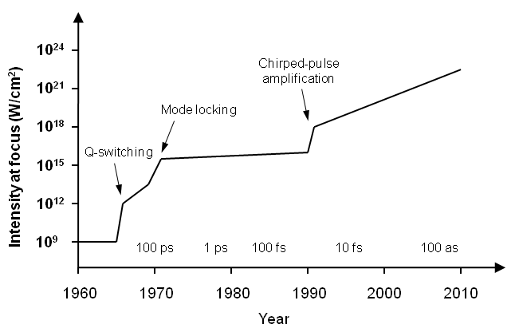
Evolution of laser power and pulse length
New light sources in the 21st century: DESY-FLASH, European XFEL,
SLAC LCLS
Free-electron lasers in the VUV (4.1 nm – 44 nm) to X-ray (0.1 nm – 6 nm)
with pulse lengths < 100 fs and Gigawatt peak power
(there are also high-power infrared FEL’s, e.g. in Japan and Netherlands)

Slide 4
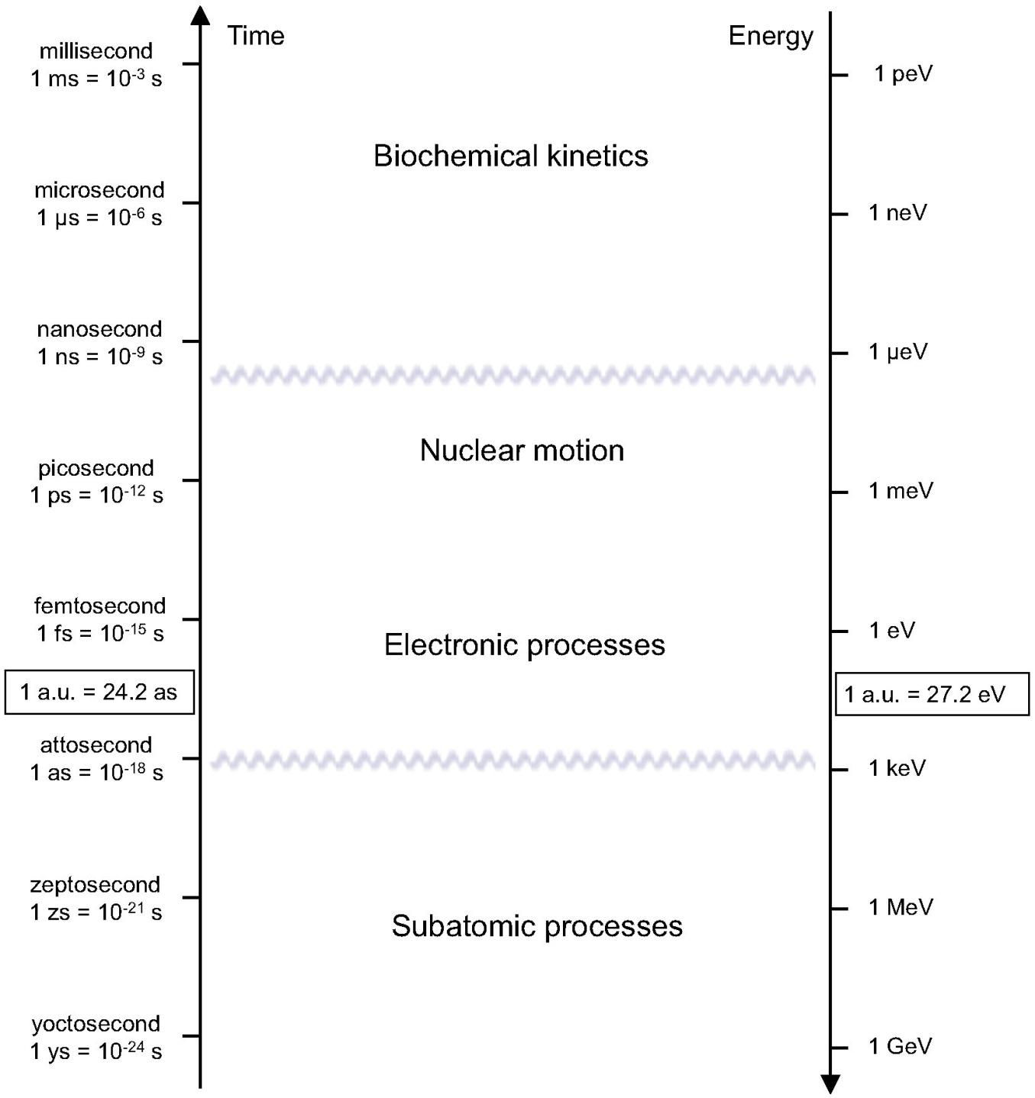
Overview of time and energy scales
TDDFT is
applied
in this
region

Slide 5
What do we mean by “Extreme Conditions”?
atomic unit of intensity
atomic unit of electric field
External field strengths approaching E₀:
► Comparable to the Coulomb fields responsible for
electronic binding and cohesion in matter
► Perturbation theory not applicable: need to
treat Coulomb and external fields on same footings
► Nonlinear effects (possibly high order) take place
► Real-time simulations are necessary to deal with
ultrafast, short-pulse effects

Slide 6
But we don’t want to be too extreme...
Nonrelativistic time-dependent Schrödinger equation: valid
as long as field intensities are not too high.
electronic motion in laser focus
becomes relativistic.
● requires relativistic dynamics
● can lead to pair production and
other QED effects

Slide 7
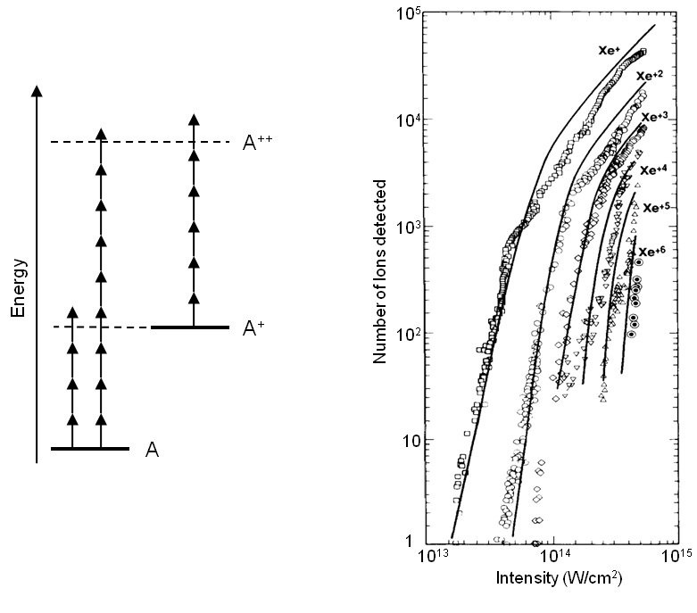
Multiphoton ionization
Perry et al., PRL 60, 1270 (1988)

Slide 8
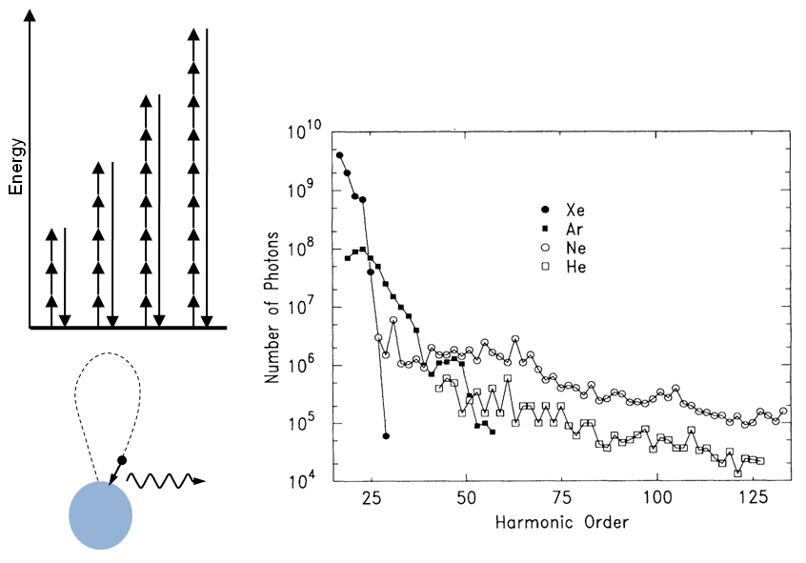
High-harmonic generation
L’Huillier and Balcou, PRL 70, 774 (1993)

Slide 9
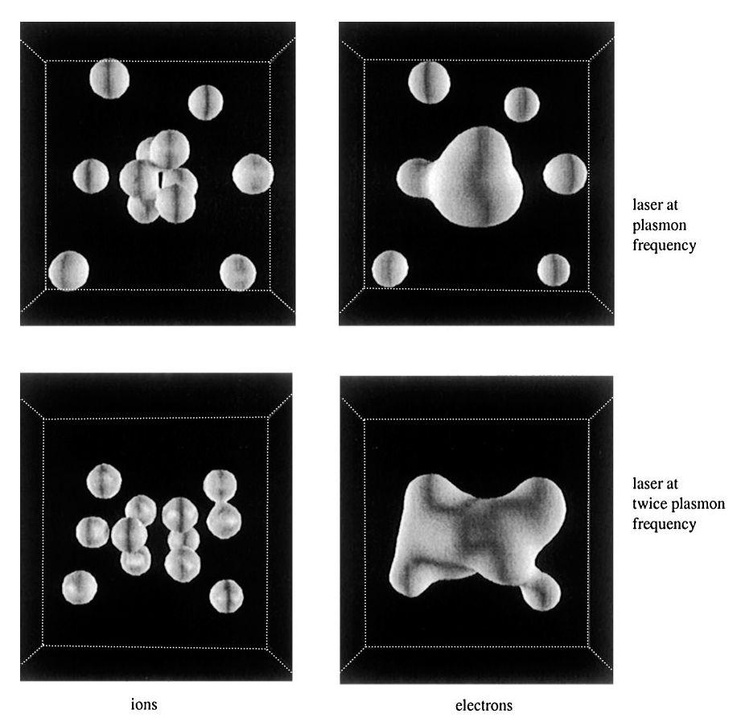
Coulomb explosion
F. Calvayrac, P.-G. Reinhard,
and E. Suraud, J. Phys. B 31,
5023 (1998)
50 fs laser pulse
Na₁₂ Na₁₂³⁺
Non-BO dynamics

Slide 10
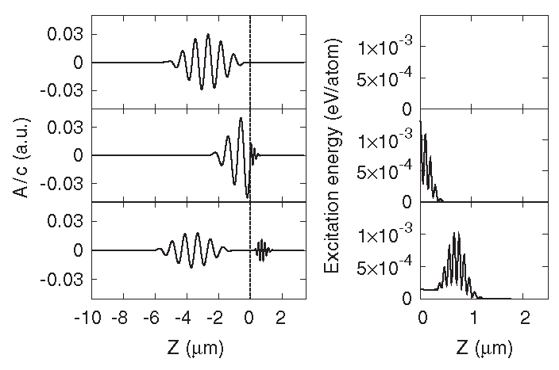
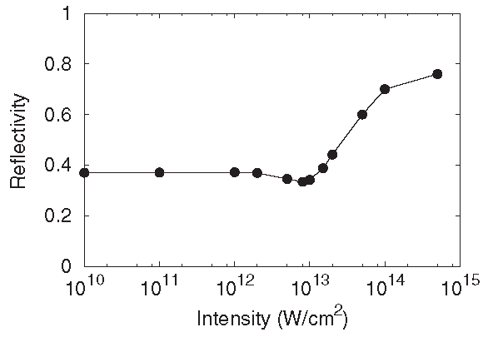
e-h plasma in solids, dielectric breakdown
K. Yabana, S. Sugiyama, Y. Shinohara, T. Otobe, and G.F. Bertsch, PRB 85, 045134 (2012)
Vacuum Si
Si
● Combined solution of TDKS and Maxwell’s equations
● High-intensity fs laser pulses acting on crystalline solids
● e-h plasma is created within a few fs
● Ions fixed, but can calculate forces on ions

Slide 11
Outline
● Introduction: strong-field phenomena
● TDDFT in a nutshell
● What TDDFT can do well, and where
it faces challenges
● TDDFT and dissipation

Slide 12
Static and time-dependent density-functional theory
Hohenberg and Kohn (1964):
All physical observables of a static many-body system are,
in principle, functionals of the ground-state density
most modern electronic-structure calculations use DFT.
Runge and Gross (1984):
Time-dependent density determines, in principle,
all time-dependent observables.
TDDFT: universal approach for electron dynamics.

Slide 13
Time-dependent Kohn-Sham equations (1)
Instead of the full N-electron TDSE,
one can solve
N single-electron
TDSE’s:
such that the time-dependent densities agree:
The TDKS equations give the exact density, but not the wave function!

Slide 14
Time-dependent Kohn-Sham equations (2)
Hartree
exchange-correlation
►The TDKS equations require an approximation for the xc potential.
Almost everyone uses the adiabatic approximation (e.g. ALDA)
►The exact xc potential depends on
►The relevant observables must be expressed as functionals of
the density n(r,t). This may require additional approximations.

Slide 15
TDDFT: a 3-step process
1
Prepare the initial state, usually the ground state, by
a static DFT calculation. This gives the initial orbitals:
2
Solve TDKS equations self-consistently, using an approximate
time-dependent xc potential which matches the static one used
in step 1. This gives the TDKS orbitals:
3
Calculate the relevant observable(s) as a functional of
DFT: eigenvalue problems
TDDFT: initial-value problems

Slide 16
Time-dependent xc potential: properties
similar
to static
case
● long-range asymptotic behavior
● discontinuity upon change of particle number
● non-adiabatic: memory of previous history
truly
dynamic
BUT: the relative importance of these requirements
depends on system (finite vs extended)!

Slide 17
Static DFT and excitation energies
► Only highest occupied KS eigenvalue has rigorous meaning:
► There is no rigorous basis to interpret KS eigenvalue differences
as excitation energies of the N-particle system:
How to calculate excitation energies exactly? With TDDFT!

Slide 18
The Casida formalism for excitation energies
Excitation energies follow
from eigenvalue problem
(Casida 1995):
xc kernel needs
approximation
This term only
defines the RPA
(random phase
approximation)

Slide 19

Molecular excitation energies
(632 valence electrons! )
N. Spallanzani et al., J. Phys. Chem. 113, 5345 (2009)
Vasiliev et al., PRB 65,
115416 (2002)
TDDFT can handle big molecules,
e.g. materials for organic solar cells
(carotenoid-diaryl-porphyrin-C60)

Slide 20
Excited states with TDDFT: general trends
Energies typically accurate within 0.3 eV
Bonds to within about 1%
Dipoles good to about 5%
Vibrational frequencies good to 5%
Cost scales as N²-N³, vs N⁵ for wavefunction methods of comparable accuracy (eg CCSD, CASSCF)
Standard functionals, dominating the user market:
►LDA (all-purpose)
►B3LYP (specifically for molecules)
►PBE (specifically for solids)
K. Burke, J. Chem. Phys. 136, 150901 (2012)

Slide 21
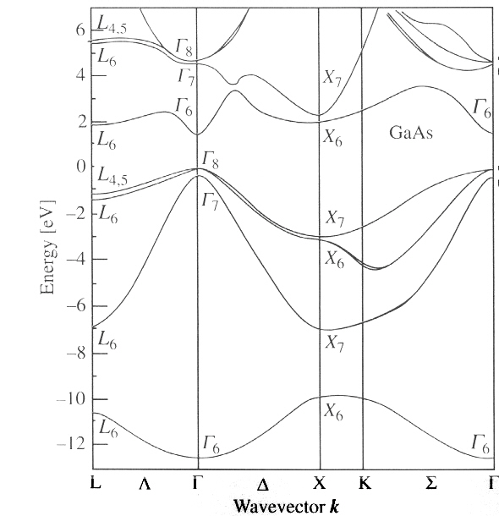
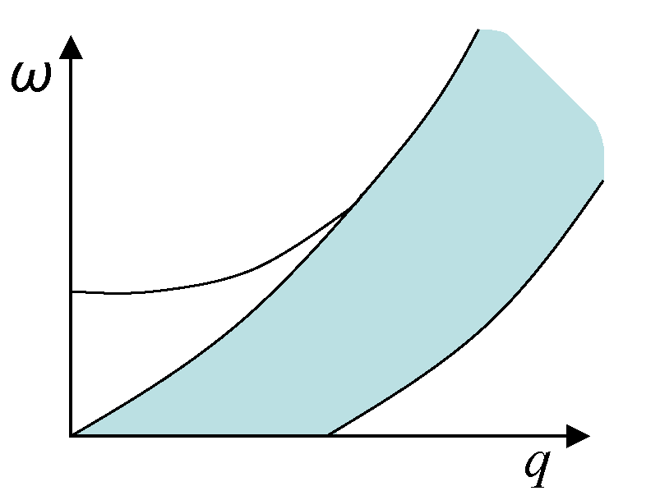
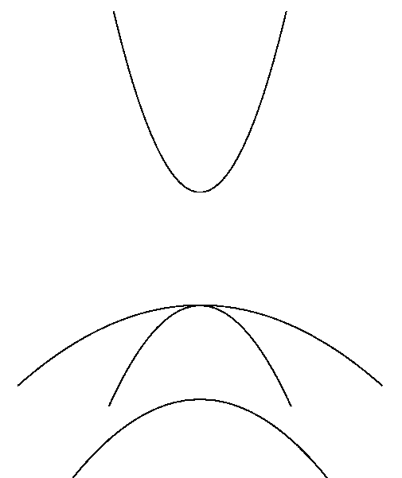
Metals vs. Insulators
plasmon
Excitation spectrum of simple metals:
● single particle-hole continuum
(incoherent)
● collective plasmon mode
● RPA already gives dominant
contribution, f_{xc} typically small
corrections (damping).
Optical excitations
of insulators:
● interband transitions
● excitons (bound
electron-hole pairs)

Slide 22

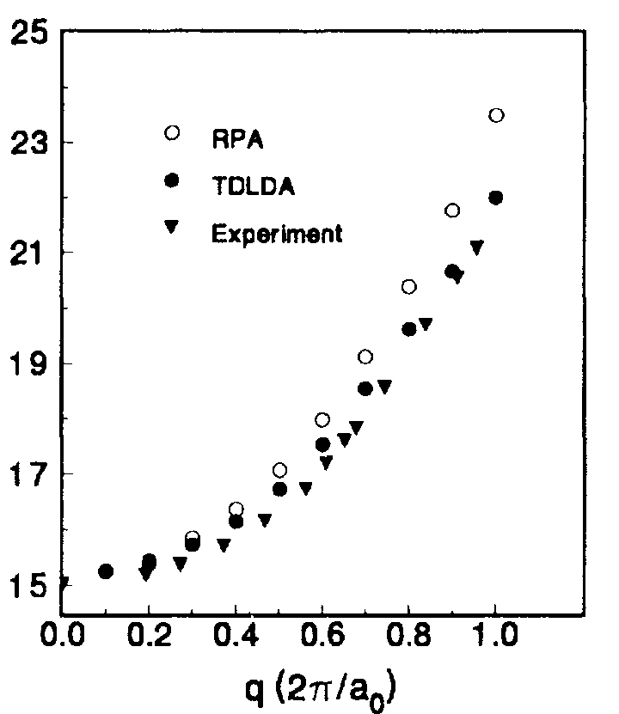
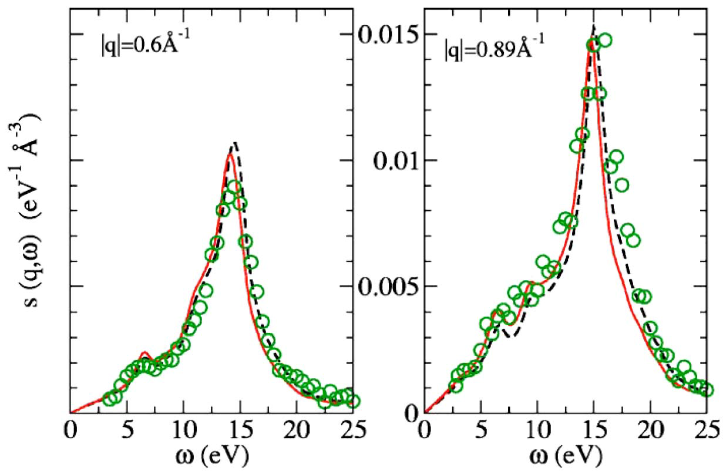
Plasmon excitations in bulk metals
Sc
Al
Quong and Eguiluz,
PRL 70, 3955 (1993)
Gurtubay et al., PRB 72, 125114 (2005)
● In general, excitations in (simple) metals very well described by ALDA.
●Time-dependent Hartree already gives the dominant contribution
● f_{xc} typically gives some (minor) corrections (damping!)
●This is also the case for 2DEGs in doped semiconductor heterostructures

Slide 23
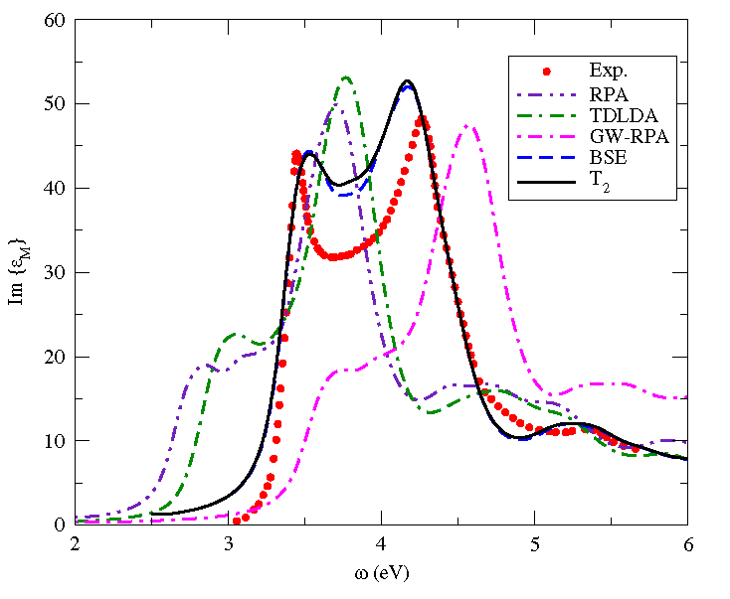
TDDFT for insulators: excitons
ALDA fails because it does
not have correct long-range
behavior
Silicon
Long-range xc kernels:
exact exchange, meta-GGA,
reverse-engineered many-
body kernels
Kim and Görling (2002)
Sharma, Dewhurst, Sanna,
and Gross (2011)
Nazarov and Vignale (2011)
Leonardo, Turkorwski,
and Ullrich (2009)
Yang, Li, and Ullrich (2012)
Reining, Olevano, Rubio, Onida,
PRL 88, 066404 (2002)
F. Sottile et al., PRB 76, 161103 (2007)

Slide 24
Outline
● Introduction: strong-field phenomena
● TDDFT in a nutshell
● What TDDFT can do well, and where
it faces challenges
● TDDFT and dissipation

Slide 25
What TDDFT can do well: “easy” dynamics
When the dynamics of the interacting system is qualitatively
similar to the corresponding noninteracting system.
Single excitation processes that have
a counterpart in the Kohn-Sham spectrum
Multiphoton processes where the driving laser
field dominates over the particle-particle interaction;
sequential multiple ionization, HHG
When the electron dynamics is highly collective, and the
charge density flows in a “hydrodynamic” manner, without
much compression, deformations, or sudden changes.
Plasmon modes in metallic systems (clusters,
heterostructures, nanoparticles, bulk)

Slide 26
What TDDFT can do well: “easy” observables
● Dipole moment:
power spectrum:
excitation energies,
HHG spectra
● Total number of escaped electrons:
These observables are directly obtained from the density.

Slide 27
Where TDDFT faces challenges: “tough” dynamics
When the dynamics of the interacting system is highly correlated
Multiple excitation processes (double, triple...)
which have no counterpart in the Kohn-Sham spectrum
Direct multiple ionization via rescattering mechanism
Highly delocalized, long-ranged excitation processes
Charge-transfer excitations, excitons
When the electron dynamics is extremely non-hydrodynamic
(strong deformations, compressions) and/or non-adiabatic.
Tunneling processes through barriers or constrictions
Any sudden switching or rapid shake-up process

Slide 28
Where TDDFT has problems: “tough” observables
● Photoelectron spectra
● Ion probabilities
● Transition probabilities
● Anything which directly involves the wave function
(quantum information, entanglement)
These observables cannot be easily obtained from the density
(but one can often get them in somewhat less rigorous ways).

Slide 29
Ion probabilities
Exact definition:
is the probability to find the system in charge state +n
evaluate the above formulas with
A deadly sin in TDDFT!

Slide 30
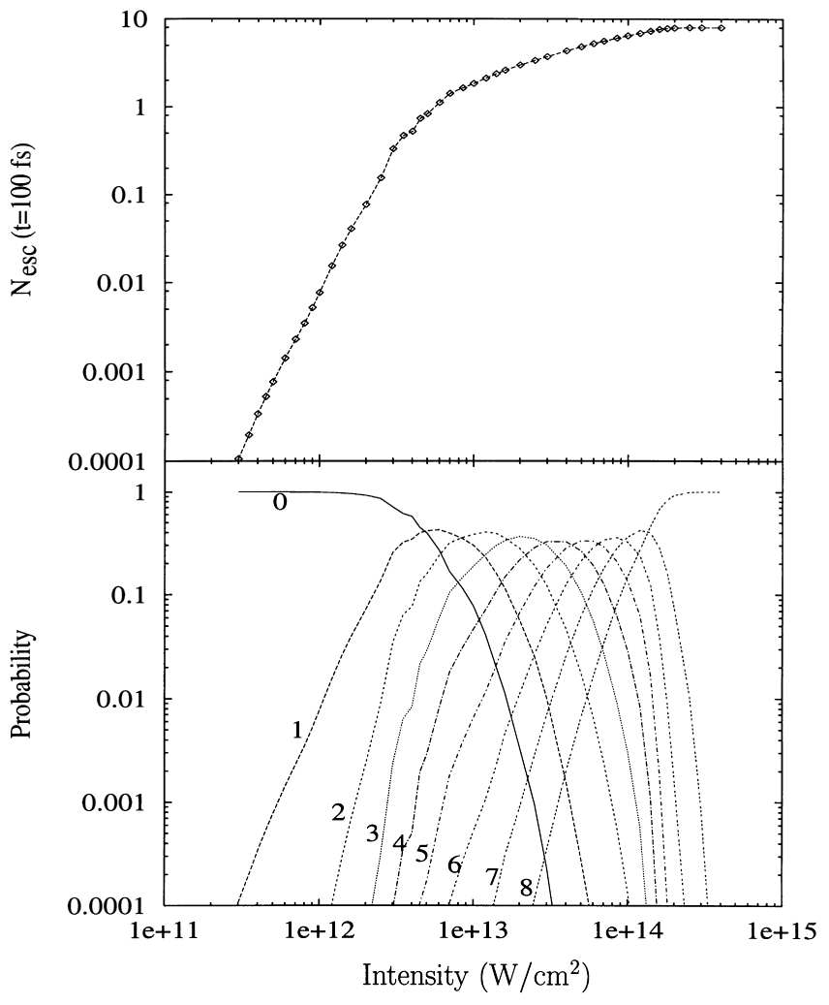
KS Ion probabilities of a Na₉⁺ cluster
25-fs pulses
0.87 eV photons
KS probabilities exact for
and whenever ionization
is completely sequential.

Slide 31
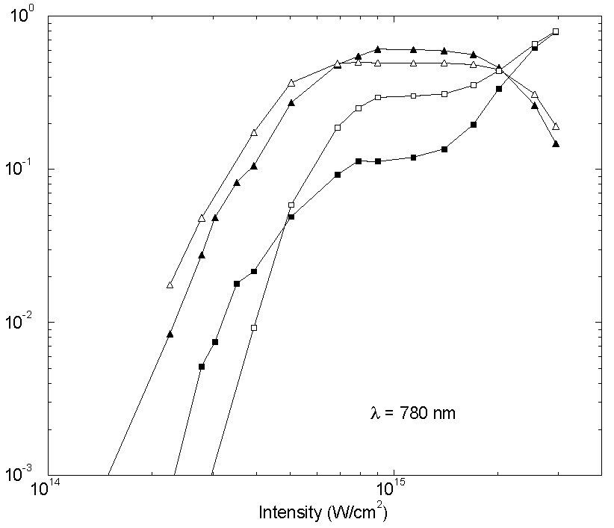
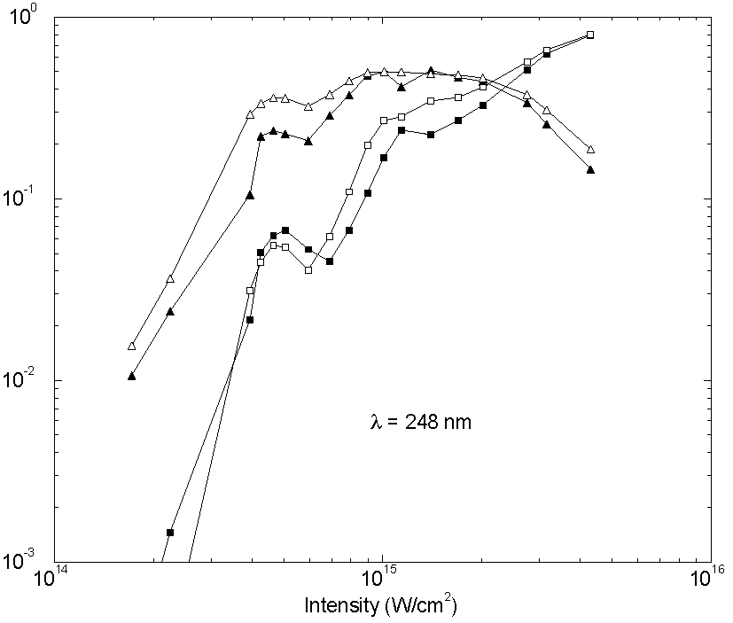
Double ionization of He
D. Lappas and R. van Leeuwen, J. Phys. B. 31, L249 (1998)
exact
exact KS
● KS ion probabilities are wrong, even with exact density.
● Worst-case scenario for TDDFT: highly correlated 2-electron
dynamics described via 1-particle density

Slide 32
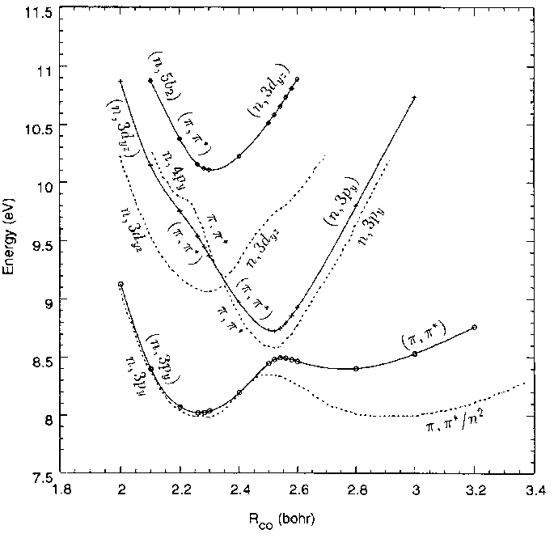
Nuclear Dynamics: potential-energy surfaces
CO
● TDDFT widely used to
calculate excited-state BO
potential-energy surfaces
● Performance depends on
xc functional
● Challenges:
► Stretched systems
► PES for charge-transfer
excitations
► Conical intersections
Casida et al. (1998)
(asymptotically corrected ALDA)

Slide 33
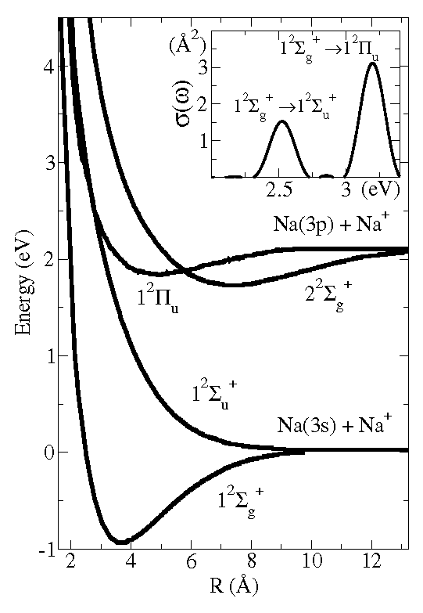
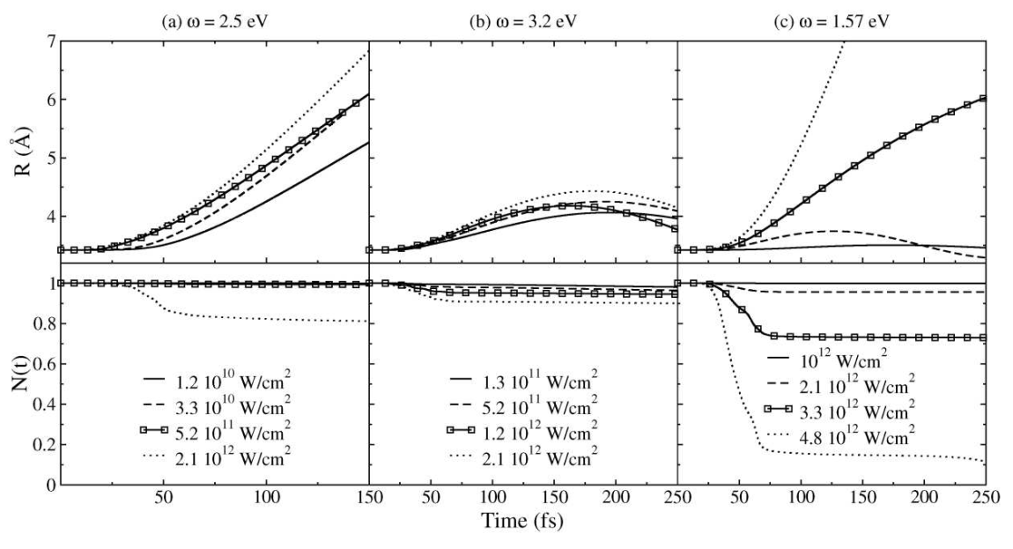
Nuclear Dynamics: TDDFT-Ehrenfest
Castro et al. (2004)
Dissociation of Na2+ dimer
Calculation done with Octopus

Slide 34
Nuclear Dynamics: TDDFT-Ehrenfest
►TDDFT-Ehrenfest dynamics: mean-field approach
● mixed quantum-classical treatment of electrons and nuclei
● classical nuclear dynamics in average force field caused by
the electrons
►Works well
● if a single nuclear path is dominant
● for ultrafast processes, and at the initial states of an excitation,
before significant level crossing can occur
● when a large number of electronic excitations are involved,
so that the nuclear dynamics is governed by average force
(in metals, and when a large amount of energy is absorbed)
►Nonadiabatic nuclear dynamics, e.g. via surface hopping schemes,
is difficult for large molecules.

Slide 35
Outline
● Introduction: strong-field phenomena
● TDDFT in a nutshell
● What TDDFT can do well, and where
it faces challenges
● TDDFT and dissipation

Slide 36
TDDFT and dissipation
One can treat two kinds of dissipation mechanisms within TDDFT:
Extrinsic: disorder, impurities, (phonons)
C. A. Ullrich and G. Vignale, Phys. Rev. B 65, 245102 (2002)
F. V. Kyrychenko and C. A. Ullrich, J. Phys.: Condens. Matter 21, 084202 (2009)
Intrinsic: electronic many-body effects
J.F. Dobson, M.J. Bünner, E.K.U. Gross, PRL 79, 1905 (1997)
G. Vignale and W. Kohn, PRL 77, 2037 (1996)
G. Vignale, C.A. Ullrich, and S. Conti, PRL 79, 4878 (1997)
I.V. Tokatly, PRB 71, 165105 (2005)

Slide 37
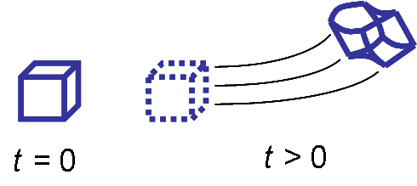
Time-dependent current-DFT
XC functionals using the language of hydrodynamics/elasticity
●Extension of LDA to dynamical regime:
local in space, but nonlocal in time
current is more natural variable.
●Dynamical xc effects: viscoelastic
stresses in the electron liquid
●Frequency-dependent viscosity
coefficients / elastic moduli

Slide 38
TDKS equation in TDCDFT
XC vector potential:
G. Vignale, C.A.U., and S. Conti,
PRL 79, 4878 (1997)
● Valid up to second order in the spatial derivatives
● The gradients need to be small, but the velocities themselves can be large

Slide 39
The xc viscoelastic stress tensor
time-dependent velocity field:
where the xc viscosity coefficients and are obtained
from the homogeneous electron liquid.

Slide 40
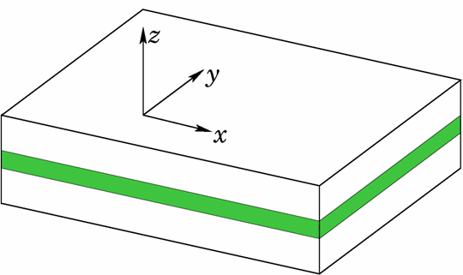
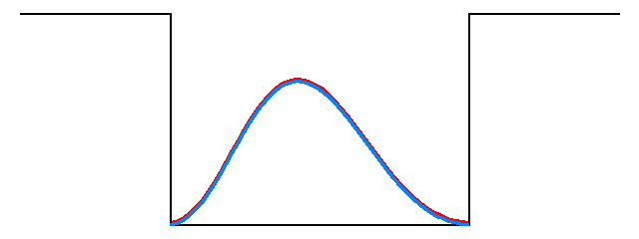
Nonlinear TDCDFT: “1D” systems
z
Consider a 3D system which is uniform along two directions
can transform xc vector potential into scalar potential:
with the memory-dependent xc potential
H.O. Wijewardane and C.A.Ullrich, PRL 95, 086401 (2005)

Slide 41
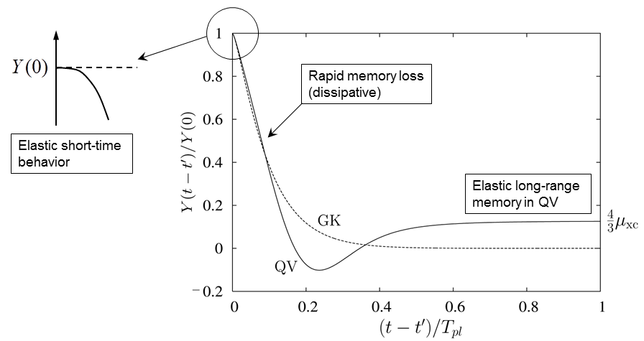
The xc memory kernel
Period of plasma oscillations

Slide 42
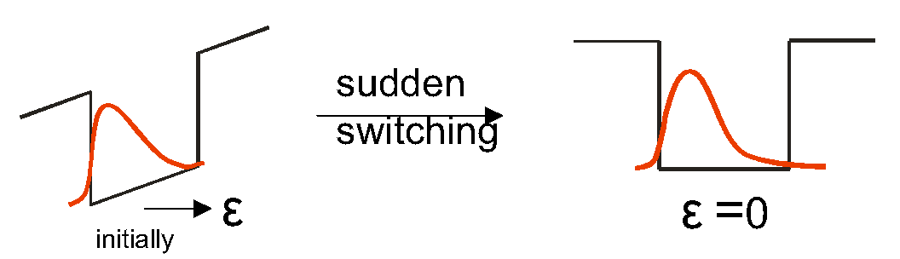
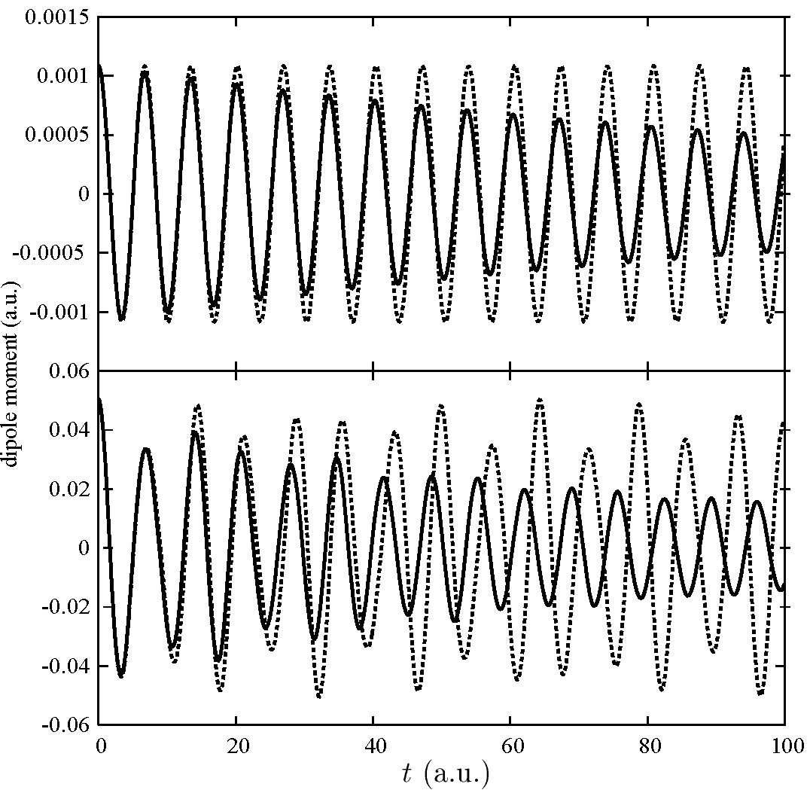
xc potential with memory: full TDKS calculation
40 nm
GaAs/AlGaAs
Weak excitation
(initial field 0.01)
ALDA
ALDA+M
Strong excitation
(initial field 0.5)
H.O. Wijewardane and C.A. Ullrich, PRL 95, 086401 (2005)

Slide 43
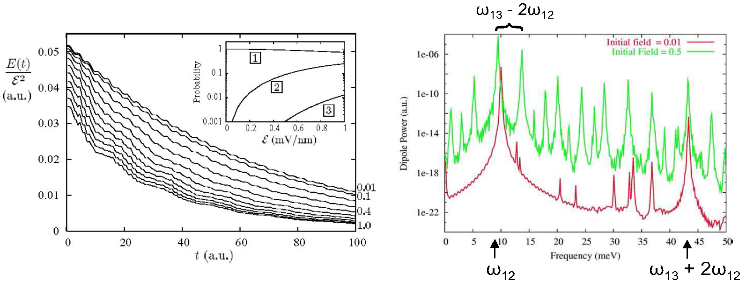
XC potential with memory: energy dissipation
Gradual loss of excitation energy
dipole power spectrum
Weak excitation:
T_{s}, T_{f}: slow
and fast ISB
relaxation times
(hot electrons)
Strong excitation:
+ sideband modulation

Slide 44
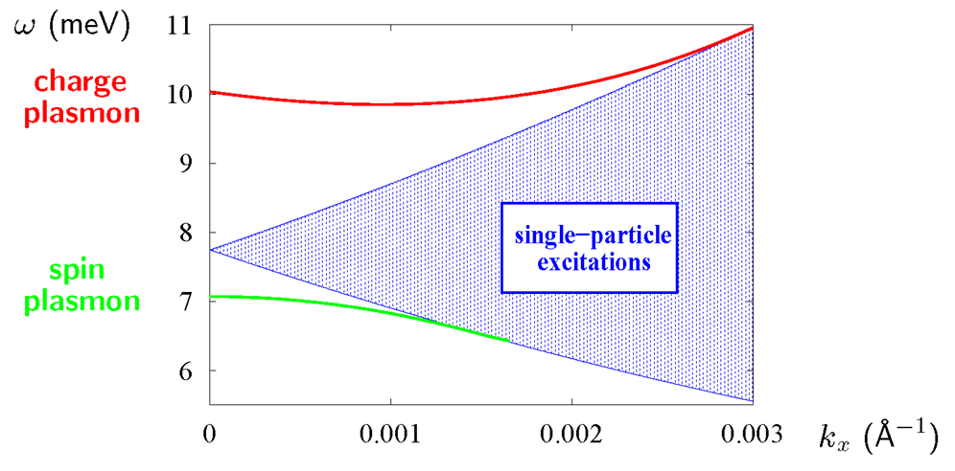
...but where does the energy go?
● collective motion along z is coupled to the in-plane degrees of freedom
● the x-y degrees of freedom act like a reservoir
● decay into multiple particle-hole excitations

Slide 45
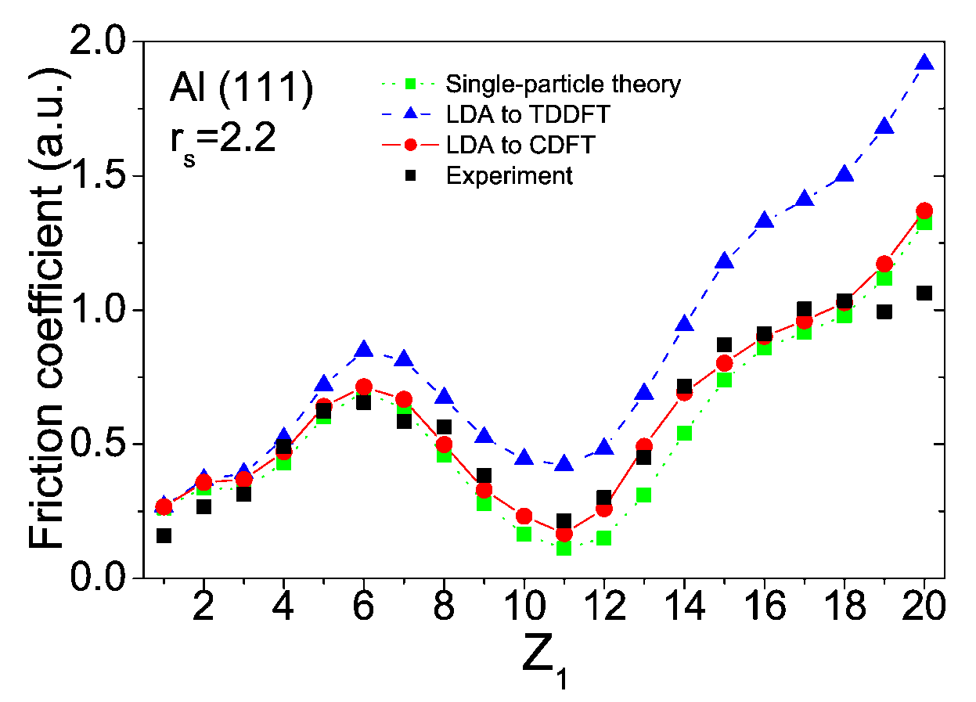
Stopping power of electron liquids
Nazarov, Pitarke, Takada, Vignale, and Chang, PRB 76, 205103 (2007)
friction coefficient:
(ALDA)
(VK)
(Winter et al.)
► Stopping power measures friction experienced by a slow ion
moving in a metal due to interaction with conduction electrons
► ALDA underestimates friction (only single-particle excitations)
► TDCDFT gives better agreement with experiment: additional
contribution due to viscosity

Slide 46

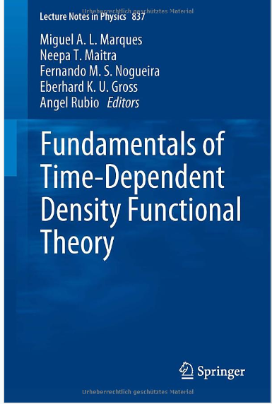
Literature

Slide 47
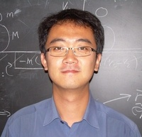



Acknowledgments
Current group members: Yonghui Li Zeng-hui Yang
Former group members: Volodymyr Turkowski
Aritz Leonardo
Fedir Kyrychenko
Harshani Wijewardane

