Slide 1
Exploiting Graphical Models for Enhancing Functionality and Uniformity in Cognitive Architectures
Paul Rosenbloom | 9/21/2010
University of Southern California
Notes:
I am not really an applied mathematician nor do I work on data analysis
My background is in symbolic AI and cognitive science
What I do is try to build cognitive architectures that integrate across the capabilities required for intelligent behavior
I’m currently looking at a new approach towards architectures that span the processing of symbols, probabilities, and signals
The goal is systems that are simpler yet more broadly functional than today’s best

Slide 2
Outline
Cognitive architecture
  The Soar architecture
  The diversity dilemma
  The promise of graphical models
    Combining broad mixed/hybrid capabilities with uniformity
A graphical architecture
  An integrative memory architecture
    Procedural (rule), declarative (semantic, episodic, constraint)
  Towards imagery and learning
Notes:
Introduce cognitive architectures
Introduce the Soar architecture as a takeoff point
Mixed is statistical-relational
Integrative memory architecture is where get to an aspect of data integration

Slide 3
Cognitive Architecture
Hypothesis about the fixed structure underlying cognition
  Defines core memories, reasoning processes, learning mechanisms, external interfaces, etc.
Yields intelligent behavior when combined with knowledge in memories
  Including more advanced reasoning, learning, etc.
May model human cognition and/or act as core of a virtual human or intelligent agent
  Strong overlap with intelligent agent architecture
Notes:
Agent -> Interaction; Cognitive -> Intelligence; Blur when emphasize both

Slide 4
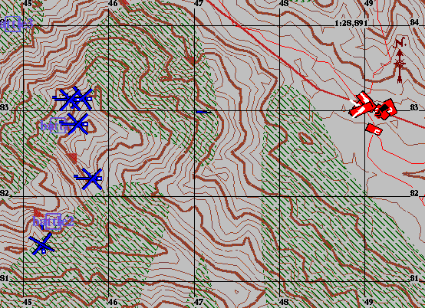
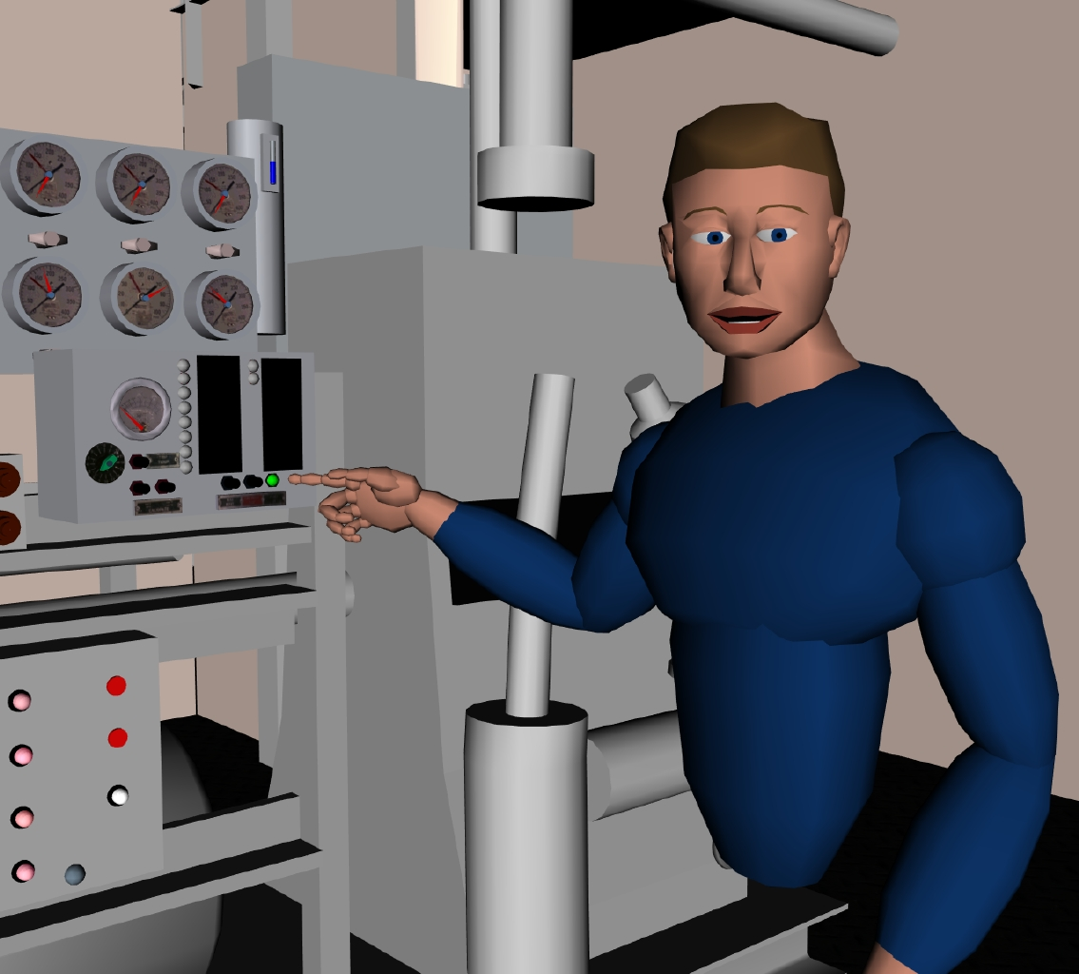

Some Cognitive-Architecture-Based Virtual Humans
Improving in mind and body over the years
These all based on Soar architecture
1997
2000
2009

Slide 5
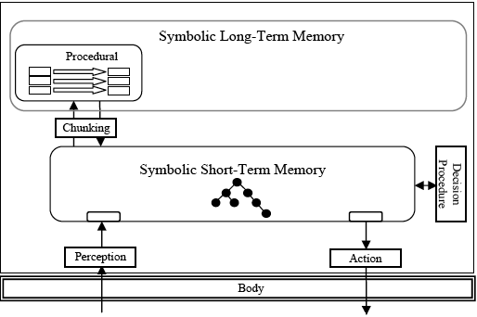
Soar Architecture (Versions 3-8)
Symbolic working memory
Long-term memory of rules
Decide what to do next based on preferences generated by rules
Reflect when can’t decide
Learn results of reflection
Interact with world

Slide 6
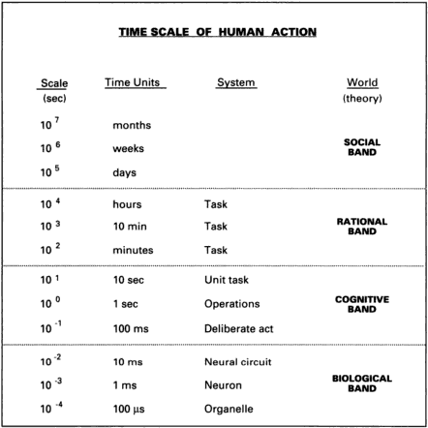
Systems Levels in Cognition
In the large, architecture is a theory about one or more systems levels in an intelligent entity
  Usually part of Cognitive Band
At each level, a combination of structures and processes implements basic elements at the next higher level
(Newell, 1990)

Slide 7
Hierarchical View of Soar (Versions 3-8)
Scale | Functionality | Mechanism | Details
1 sec | Reflective | Problem Space Search | Impasse/Subgoal If Can’t Decide
100 ms | Deliberative | Decision Cycle | Preference-based Decisions upon Quiescence
10 ms | Reactive | Elaboration Cycle | Parallel Rule Match & Firing
Learning by Chunking

Slide 8
Comments on Soar
Pursued for ~30 years as both
  A unified theory of (human) cognition
  An architecture for virtual humans and intelligent agents
Demonstrated a wide range of intelligent behaviors from interactions among a small set of mechanisms
  Problem solving and planning methods
  Varieties of knowledge and learning
  Reflection and interaction
Applied to a wide range of tasks
  Search-intensive and knowledge-intensive (expert systems)
  Cognitive and real-time situated agents/robots
I was co-PI 1983-1998
  John Laird (Michigan) has continued as sole PI since then
Notes:
More the latter than the former though, particularly more recently
Interaction included perception, action, language, and collaboration

Slide 9
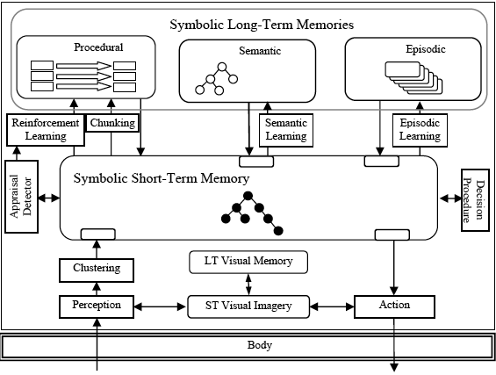
Key Conundrum with Soar (Versions <9)
Could demonstrate how the combination of a small set of general mechanisms produced a wide variety of intelligent capabilities and behaviors
But were not able to leverage this for integration at the next level, where these intelligent capabilities and behaviors were themselves routinely integrated and used
This led to creation of Soar 9
Soar 9
But this in turn raised the diversity dilemma

Slide 10
Diversity Dilemma
The girth at a level is its range of structures & processes
Key issue: uniformity versus diversity
Uniformity: Minimal mechanisms combining in general ways
  Appeals to simplicity and elegance
  The “physicist’s approach”
  Challenge: Efficiency and full range of required functionality/coverage
Diversity: Large variety of specialized mechanisms
  Appeals to functionality and optimization
  The “biologist’s approach”
  Challenge: Integrability, extensibility and maintainability
Want benefits of both!
  Can this be achieved by varying girth across levels?
Across a hierarchy, level girth may stay comparable or vary
  Physicists and biologists likely assume uniform
  Network researchers assume hourglass
Notes:
An issue I have become increasing concerned about is that of architectural girth

Slide 11
The Internet hourglass
Applications
Web
Everything
on IP
FTP
Mail
News
Video
Audio
ping
napster
Transport protocols
TCP
SCTP
UDP
ICMP
IP
IP on
everything
Ethernet
802.11
Power lines
ATM
Optical
Satellite
Bluetooth
Link technologies
From Hari Balakrishnan

Slide 12
What About Cognition?
Top (applications) is clearly diverse
  Key part of what architectures try to explain
Bottom is likely diverse as well
  Physicalism: Grounded in diversity of biology
  Strong AI: Also groundable in other technologies
Is the waist uniform or diverse?
  Hourglass or rectangle
  Traditionally question about the architecture
Applications
Architecture
Implementation

Slide 13
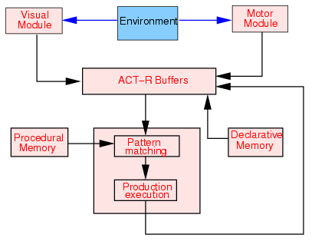
Architectural Uniformity vs. Diversity
Soar (3-8) is a traditional uniform architecture
ACT-R is a traditional diverse architecture
Soar 3-8
ACT-R

Slide 14
Examples
Soar (3-8) is a traditional uniform architecture
ACT-R is a traditional diverse architecture
Recently Soar 9 has become highly diverse
Soar 3-8
Soar 9

Slide 15
Towards Reconciling Uniformity and Diversity
Accept diversity at the architectural level
Move search for uniformity down to implementation level
  Biological Band in humans
    Locus of neural modeling
  Computational Band in AI
    Normally just Lisp, C, Java, etc.
      Impacts efficiency and robustness but usually not part of theory
Base on graphical models
  Pragmatic and theoretic impact
Applications
Architecture
Implementation
Computational Band
Similar to Domingos’s call for an AI interface layer
(Newell, 1990)
Notes:
Architecture may extend below, such as productions at 10ms level.

Slide 16
Graphical Models
Efficient marginal/MAP computation over multivariate functions by decomposing into products of subfunctions
  For constraints, probabilities, speech, etc.
  Based on independence assumptions
Come in a variety of related flavors
  Bayesian networks: Directed, variable nodes
    E.g, p(u,w,x,y,z) = p(u)p(w)p(x|u,w)p(y|x)p(z|x)
  Markov networks: Undirected, variable nodes & clique potentials
    Basis for Markov logic and Alchemy
  Factor graphs: Undirected, variable & factor nodes
    E.g., f(u,w,x,y,z) = f₁(u,w,x)f₂(x,y,z)f₃(z)
Compute via variants of
  Sum-product (message passing)
  Monte Carlo (sampling)
u
y
x
w
z
w
y
u
x
z
f₁
f₂
f₃

Slide 17
Properties of Graphical Models
Yield broad capability from a uniform base
  State of the art performance across symbols, probabilities and signals via uniform representation and reasoning algorithm
    Representation: My focus has been on factor graphs
    Reasoning: Sum-product passes messages about elements of variables’ domains
Sum-product algorithm yields
  (Loopy) belief propagation in Bayesian networks (BNs)
  Forward-backward algorithm in hidden Markov models (HMMs)
  Kalman filters, Viterbi algorithm, FFT, turbo decoding
  Arc-consistency and production match
Several neural network models map onto them
Support both mixed (symbolic & probabilistic [StarAI]) and hybrid (discrete & continuous) processing
  For uncertain reasoning & combining cognitive with perceptuomotor
Notes:
Symbolic

Slide 18
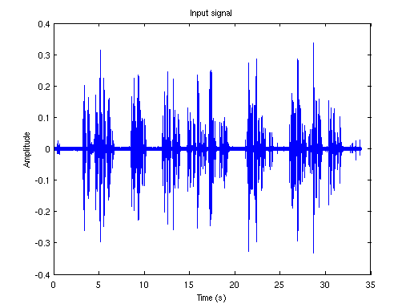
Mixed and Hybrid Processing
Symbol processing is norm in cognitive architectures
  Generally approached by rules or comparable techniques
But much knowledge is uncertain
  Architectures may use neural nets or activation-based approaches
  Bayesian networks are state of the art
    Only recently been combined effectively with general symbol processing, to yield mixed processing, and has had little impact so far on cognitive architectures
Intelligent systems also need to perceive their worlds
  Speech, vision, etc. require extended signal processing
  Also significant progress via graphical models
    Hidden Markov models for speech and Markov random fields for vision
  Architectures view this as preprocessing that creates symbols
    Need hybrid processing to use reasoning in perception and perception in reasoning

Slide 19
Scope of Sum-Product Algorithm
Message/Variable Domain
Discrete
Continuous
Symbols
Probability (Distribution) | Signal & Probability (Density)
Boolean
Message/Variable Range
Numeric
Mixed models combine Boolean and numeric ranges
Hybrid models combine discrete and continuous domains
Hybrid mixed models combine all possibilities
Dynamic hybrid mixed models add a temporal dimension

Slide 20
Research Goals
Long term
  Radically new architectures combining
    Enhanced functionality and coverage with
    Increased simplicity and uniformity
Medium term
  A uniform implementation of a mixed hybrid variant of existing architectures
Short term
  A uniform implementation of a mixed hybrid memory architecture

Slide 21
Memory Architecture
Memories (short- and long-term) used in decisions
  Soar 1-8: working memory + production memory
  ACT-R: buffers + production memory, semantic memory
  Soar 9: working memory, ST visual imagery + production memory, semantic memory, episodic memory, LT visual memory
Focus here is on representation and access
  Both procedural and declarative knowledge
  Hybrid: Continuous/signal + discrete/symbolic
  Mixed: Probabilistic/uncertain + discrete/symbolic
  Provides syntactic but not necessarily semantic integration across memories
  Not yet learning
Notes:
Haven’t yet got to learning

Slide 22
Approach
Base roughly on Soar 9 and ACT-R
  Working memory
  Procedural long-term memory
    Productions
  Declarative long-term memory
    Semantic: Predict unspecified attributes of objects based on specified ones (cues)
    Episodic: Retrieve best episode based on recency and match to cues
  Eventually imagery as well, but not yet
Implement via graphical models
  Layered approach: graph and memory layers
Notes:
SM is based on Anderson’s rational analysis of categorical prediction rather than what is implemented in Soar or ACT-R.

Slide 23
Graph Layer: Factor Graphs w/ Summary Product
Factor graphs are undirected bipartite graphs
  Decompose functions: e.g., f(u,w,x,y,z) = f₁(u,w,x)f₂(x,y,z)f₃(z)
  Map to variable & factor nodes (with functions in factor nodes)
Summary product algorithm does message passing
  Output of variable node is pointwise product of inputs
  Output of factor node is pointwise product times factor function
    And then summarize out all variables not on link (by sum or max)
    Sum: Marginals of variables (distributions over individual variable domains)
    Max: Maximum a posteriori estimation (best combination across all variables)
w
y
u
x
z
f₁
f₂
f₃

Slide 24
Representation of Functions and Messages
N dimensional continuous functions
  Approximated as piecewise linear functions over rectilinear regions
  Potentially could instead use mixtures of exponentials or Gaussians, or wavelets
Span (continuous) signals, (continuous and discrete) probability distributions, symbols
  Discretize domain for discrete distributions & symbolic
    [0,1>, [1,2>, [2,3>, …
  Booleanize range (and add symbol table) for symbolic
    E.g., [0,1>=1 ➔ RED true; [1,2>=0 ➔ GREEN false
y\x | [0,10> | [10,25> | [25,50>
[0,5> | 0 | .2y | 0
[5,15> | .5x | 1 | .1+.2x+.4y
Notes:
Biggest change is in representation used for factor functions and messages.

Slide 25
Memory Layer: Distinguish WM and LTM
Representation is predicate based
  E.g., Object(s,O1), Concept(O1,c)
  Arguments may be constants, or variables (in LTM)
Long-term memories compile into graph structures
  LTM is composed of conditionals (generalized rules)
  A conditional is a set of predicate patterns joined with a function
WM compiles to evidence at peripheral factor nodes
  It is just an N dimensional continuous function where normal symbolic wmes correspond to unit regions with Boolean values
Elaboration phase is one settling of graph
WM
Constant
Pattern
Object:
Join
Function
Concept:
Notes:
At the memory level the first thing to do is to distinguish WM from LTM. Both based on predicates with arguments.

Slide 26
Conditionals
CONDITIONAL ConceptPrior
Condition: Object(s,O1)
Condact: Concept(O1,c)
Walker | Table | Dog | Human
.1 | .3 | .5 | .1
Patterns can be conditions, actions or condacts
  Conditions and actions embody normal rule semantics
    Conditions: Messages flow from WM
    Actions: Messages flow towards WM
  Condacts embody (bidirectional) constraint/probability semantics
    Messages flow in both directions: local match + global influence
  Encoded as (generalized) linear alpha networks
Pattern networks joined via bidirectional beta network
Functions are defined over condact variables
WM
Constant
Pattern
Object:
Join
Function
Concept:

Slide 27
Additional Details
Link directionality is set independently for each link
  Determines which messages are sent
Whether to use sum or max is specified on an individual variable/node basis
  Overall algorithm thus mixes sum-product and max-product
Variables can be specified as unique or multiple
  Unique variables sum to 1 and use sum for marginals: [.1 .5 .4]
  Multiple variables can have any or all elements valued at 1 and use max for marginals: [1 1 0 0 1]
Predicates can be declared as open world or closed world with respect to matching WM
Pattern variables cause sharing of graph structure
  May be within a single conditional or across multiple conditionals
Notes:
Unique is for probabilistic random variables
Multiple is for rule variables that yield all successful matches
OW vs cW: Whether something not in WM is assumed false (0) or unknown

Slide 28
Memories
Production Memory
Semantic Memory
Just conditions and actions
  Although may also have a function
CWA and multiple variables
Just condacts (in pure form)
OWA and unique variables
Naïve Bayes (prior on concept + conditionals on attributes)
CONDITIONAL Transitive
Condition: Next(a,b)
Next(b,c)
Action: Next(a,c)
CONDITIONAL ConceptWeight
Condact: Concept(O1,c)[α1]
Weight(O1,w)
Pattern
w\c | Walker | Table | …
[1,10> | .01w | .001w | …
[10,20> | .2-.01w | “ | …
[20,50> | 0 | .025-.00025w | …
[50,100> | “ | “ | …
Join
WM
CONDITIONAL ConceptPrior
Condition: Object(s,O1)
Condact: Concept(O1,c)[α1]
Walker | Table | Dog | Human
.1 | .3 | .5 | .1
Notes:
OWA so values not specified can be determined by condacts during settling.
Anderson’s rational analysis
Pattern variable ensures sharing of information across all uses of concept condact.

Slide 29
Example Semantic Memory Graph
Concept (S)
Weight (C)
Color (S)
B: Boolean
S: Symbolic
D: Discrete
C: Continuous
Function
WM
Join/Beta
Mobile (B)
Legs (D)
Alive (B)
Just a subset of factor nodes (and no variable nodes)
Notes:
Concept function is a prior probability distribution
Attribute functions are conditional probability distribution
All but weight are discrete distributions, while weight is a density

Slide 30
Memories (cont.)
Episodic Memory
Constraint Memory
Just condacts (in pure form)
OWA and unique variables
Exponential prior on time + conditionals on episode attributes
Just condacts (in pure form)
OWA and multiple variables
CONDITIONAL TwoColorConstraint12
Condact: Color(R1,c1)[α7]
Color(R2,c2)[α8]
Conditional TimeConcept
Condact: Time(t)[α3]
Concept(O1,c)
c1\c2 | Red | Blue
Red | 0 | 1
Blue | 1 | 0
t\c | Walker | Table | Dog | Human
1 | 1 | 0 | 0 | 0
2 | 0 | 0 | 0 | 1
3 | 0 | 0 | 0 | 1
4 | 0 | 0 | 1 | 0
CONDITIONAL TimePrior
Condact: Time(t)[α3]
0 | 1 | 2 | 3 | 4
0 | .032 | .087 | .237 | .644
Notes:
Instance based with concept just another attribute; pattern variable for time
Also got a fourth form of memory essentially for free, with more possible.
Pattern variables in constraints communicate across different constraints

Slide 31
Sample Runtime Data
 | Factor Ns | Variable Ns | Messages | Time (ms)
Rule | 7 | 9 | 47 | 5/16
Semantic | 47 | 47 | 634 | 100
Episodic | 46 | 46 | 433 | 35
Constraint* | 29 | 28 | 246 | 16
* Constraint data is from a later version

Slide 32
Key Similarities and Differences
Similarities
Differences
All based on WM and LTM
All LTM based on conditionals
All conditionals map to graph
Processing by summary product
Procedural vs. declarative
  Conditions/actions vs. condacts
    Directionality of message flow
  Closed vs. open world
  Multiple vs. unique variables
Semantic vs. episodic
  Marginal/sum vs. MAP/max
  Condition on concept vs. time
  General probs. vs. instances
Constraints are actually hybrid: condacts, OWA, multiple
Other variations and hybrids are also possible

Slide 33
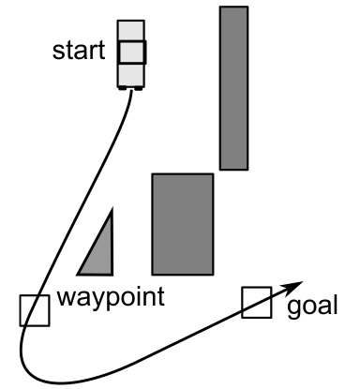
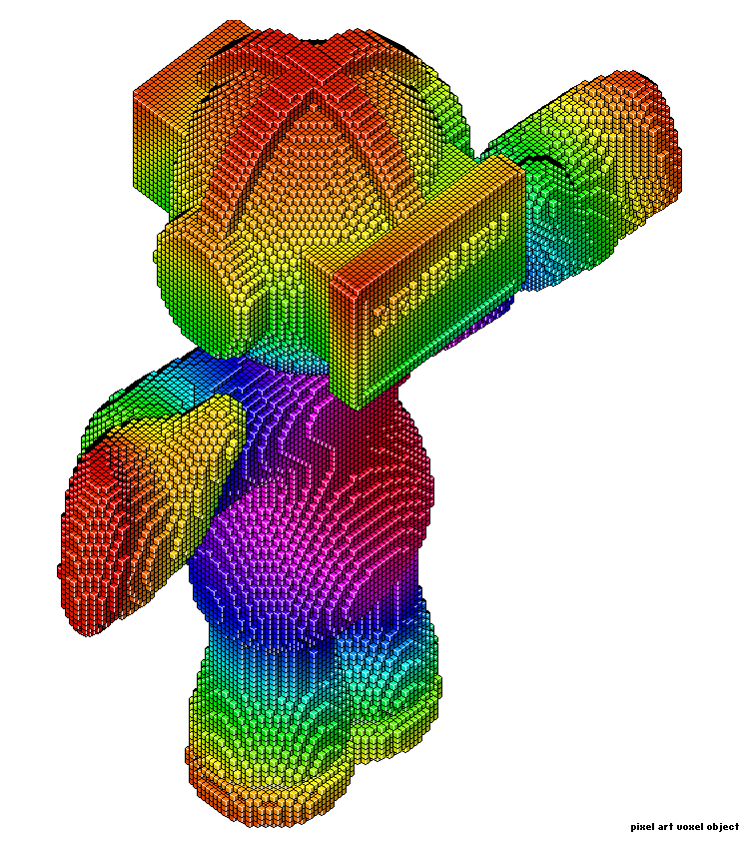
Towards Imagery
http://www.andrew.cmu.edu/user/swinterm/papers/Thesis.pdf
Represent and reason about 3D imagery
  Represent structure and location of objects
  Deal with uncertainty about location
  Implement basic transformations (translation, rotation, etc.)
Act as an intermediary between “peripheral” signal processing and “central” symbol processing
  Integrate tightly with perception and cognition
  Imagery assists perception and cognition, and vice versa
Implement uniformly with perception and cognition
  Build on piecewise continuous function/message representation
  Use graphical processing for image transformation
    Much SoA perceptual processing already based on graphical models
    Looking at techniques from stereo vision and sequence prediction
For situation assessment and prediction
Funded by AFOSR
http://www.drububu.com/tutorial/voxels.html
Notes:
Already a generalization of a voxel representation
Cognition: Theory of Mind; Perception: behavior recogniton

Slide 34
Towards Learning
Not just statistical concept formation
  Although relevant at least for semantic knowledge
  Also need to acquire procedural, episodic, skill, …
  Need to learn from all experiences, not just datasets
Looking at two complementary approaches
  Extending function scope
    Incrementally extend episodic memory as time passes
  Dependency-based graph updating
    Determine how results, and differences from expectations, depend on graph and its inputs
      Existing basis for reinforcement, backpropagation, EBL, …
    Use to drive both semantic and procedural/skill learning

Slide 35
Summary and Future
GMs show potential for resolving diversity dilemma
  A uniform approach/implementation for architectural diversity
    Combining simplicity with broad functionality (and efficiency?)
  Mixed and hybrid representation and processing
  So far yielded a graphical memory architecture and decisions
Working towards a mixed, hybrid variant of Soar 9
  Leverage mixed processing for decisions, reflection, learning, etc.
  Leverage hybrid processing for imagery (and perception)
Ultimately looking for integration across the relevant types of data/knowledge and processing mechanisms required for (at least) human-level intelligence
  From perception to cognition to motor control

