Slide 1

Bias Fields and Pattern Complexity
M.E. Glicksman
Allen S. Henry Professor of Engineering
Mechanical & Aerospace Engineering Dept.
Florida Institute of Technology, Melbourne, FL
Presentation at the UCLA Institute for Pure & Applied Mathematics
Los Angeles, CA
November 13, 2012

Slide 2
Outline
Pattern formation & microstructures
Early experiments & conventional ideas
Surprises from microgravity experiments
Conservation of energy
Capillarity, more than a boundary condition!
Bias fields: Why did we miss it?
Dynamic simulations

Slide 3
Motivation & Associated Questions
Complex pattern evolution occurs throughout nature, society, and technology.
Self-organized patterns remain important in areas as diverse as cosmology, meteorology, biology, and engineering.
Branching (ramification and splitting) allows simple starting forms to achieve increasing complexity.
Is there a causal principle responsible for branching and surface diffusion?
Where does the information driving complexity reside ?
Is pattern branching fundamentally stochastic or deterministic ?

Slide 4
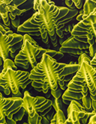
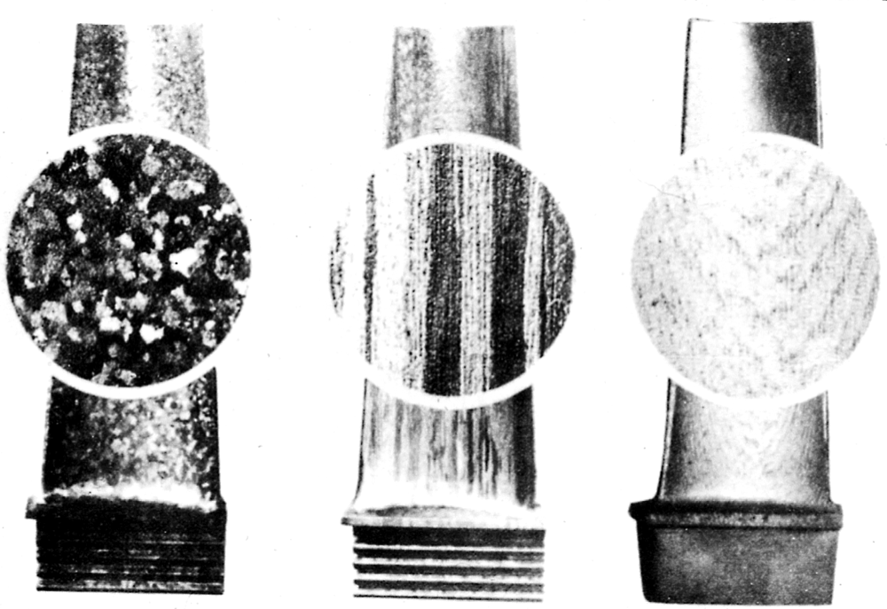
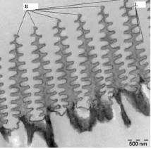
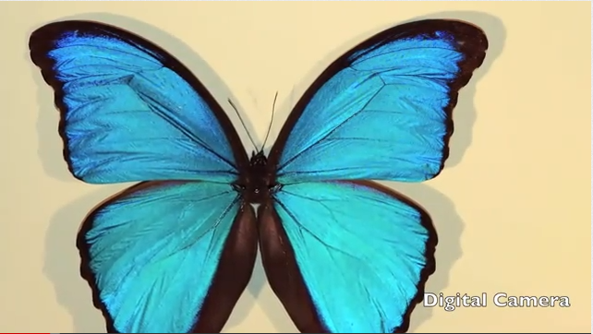
Self-Organized Branching Patterns
Dendritic Superalloy
Turbine blades
Jet engine efficiency
Microstructure control
Mechanical properties
Improved creep resistance
Polycrystal
Directional
Monocrystal
Dendritic Photonic Array
Bio-iridescence
Electro-magnetic diffraction
Photonic (chiten) dendrites
Sensitive chemical probes
Pigmentless paints & coatings
Morpho Retenor

Slide 5

Phase-Field Simulated Cu-Au Dendrite
Courtesy of J. Warren & W. Boettinger, NIST
• Sophisticated modeling—but:
• Noise is considered essential—??
• Modelers unaware of a basic mechanism
• Pattern optimization & control limited
• Missing link is the interface ‘bias field’

Slide 6
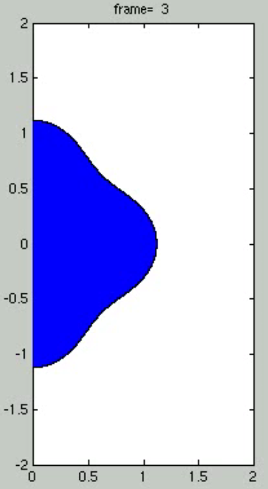
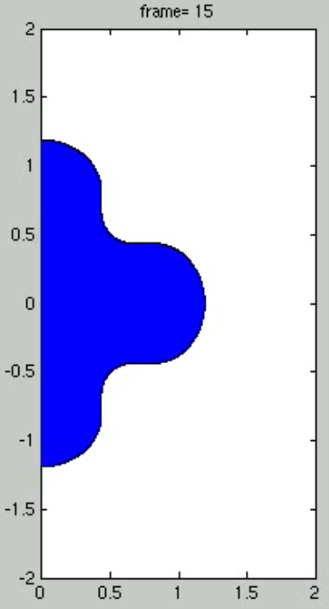
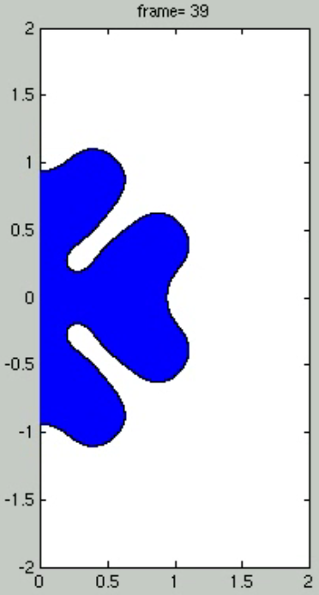
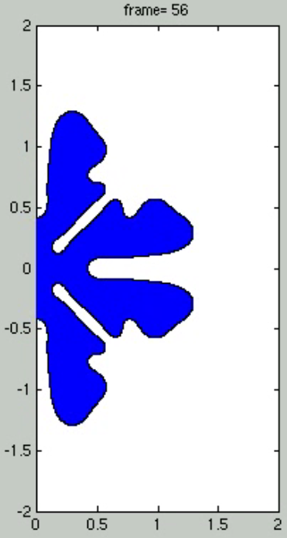
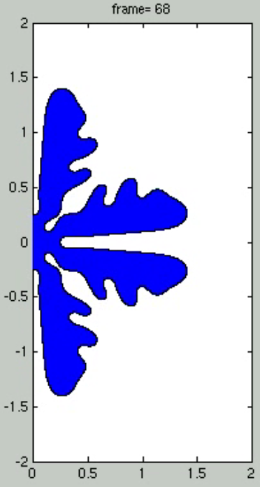
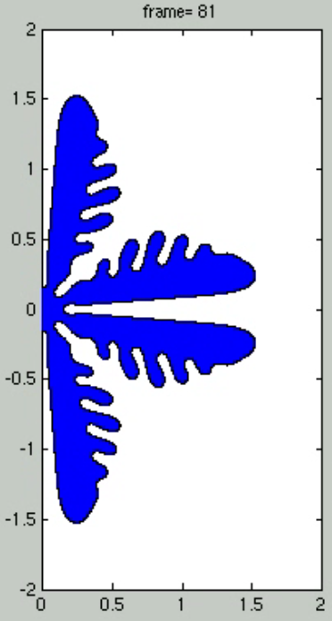
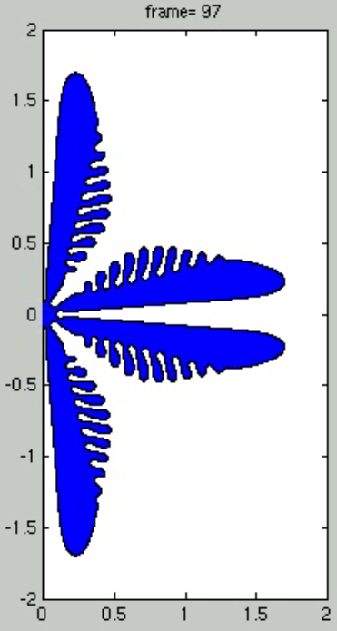
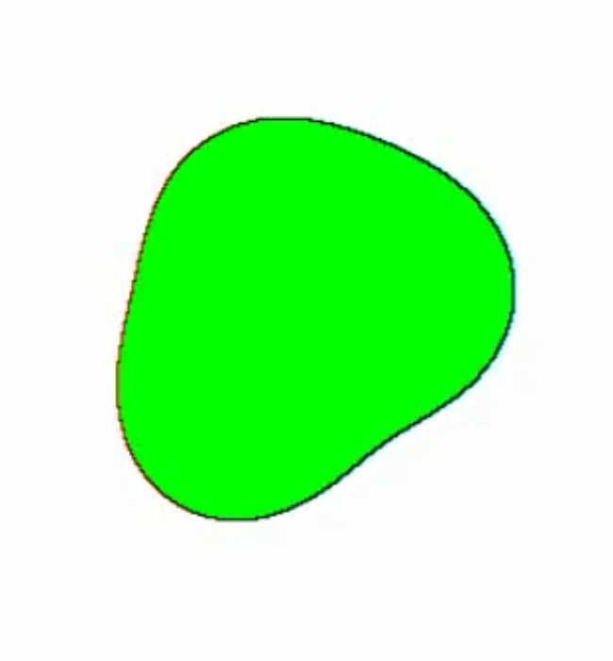
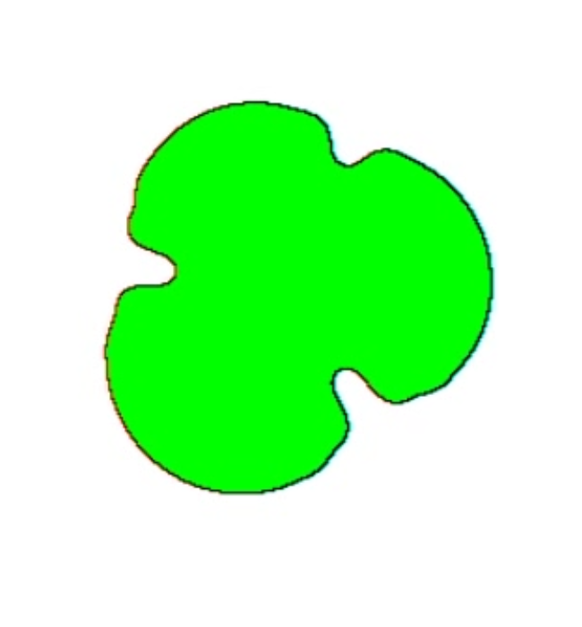
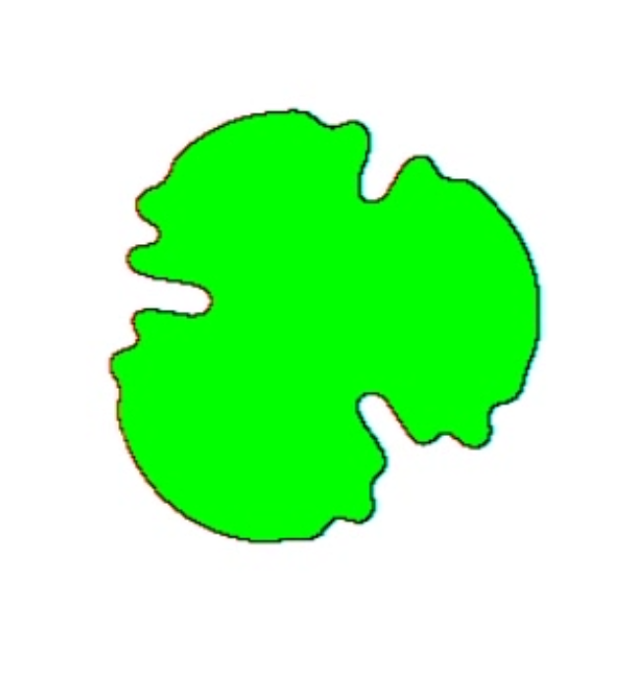



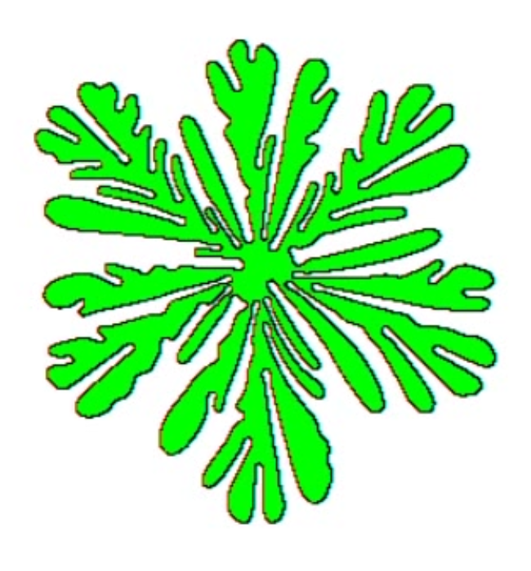
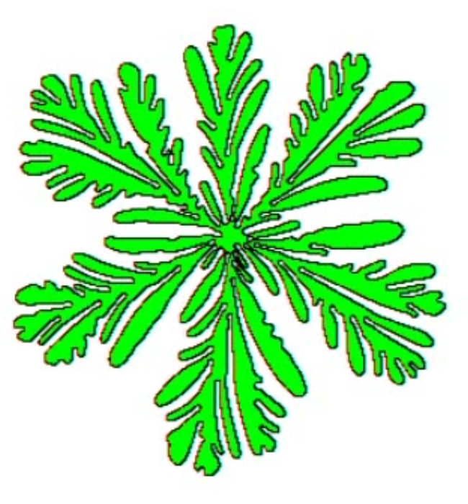
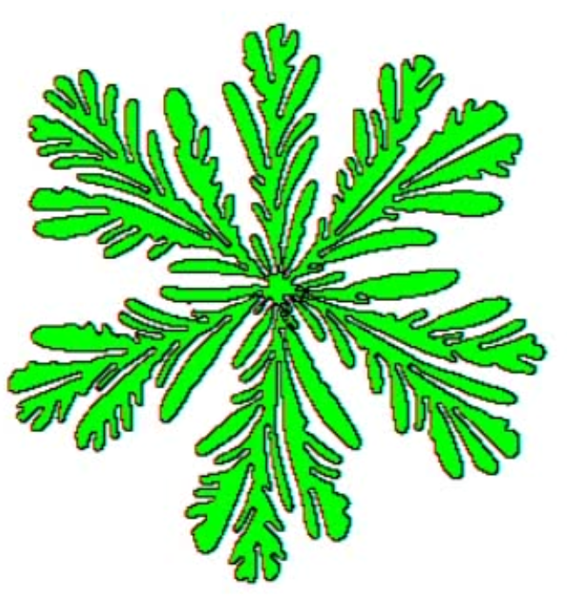
Pattern Evolution
Dendrites: Casting, welding, primary metals production, crystal growth
What’s causal?
‘Seaweed’: Fluid-fluid penetration, Hele-Shaw patterns, petroleum recovery, biogenesis

Slide 7
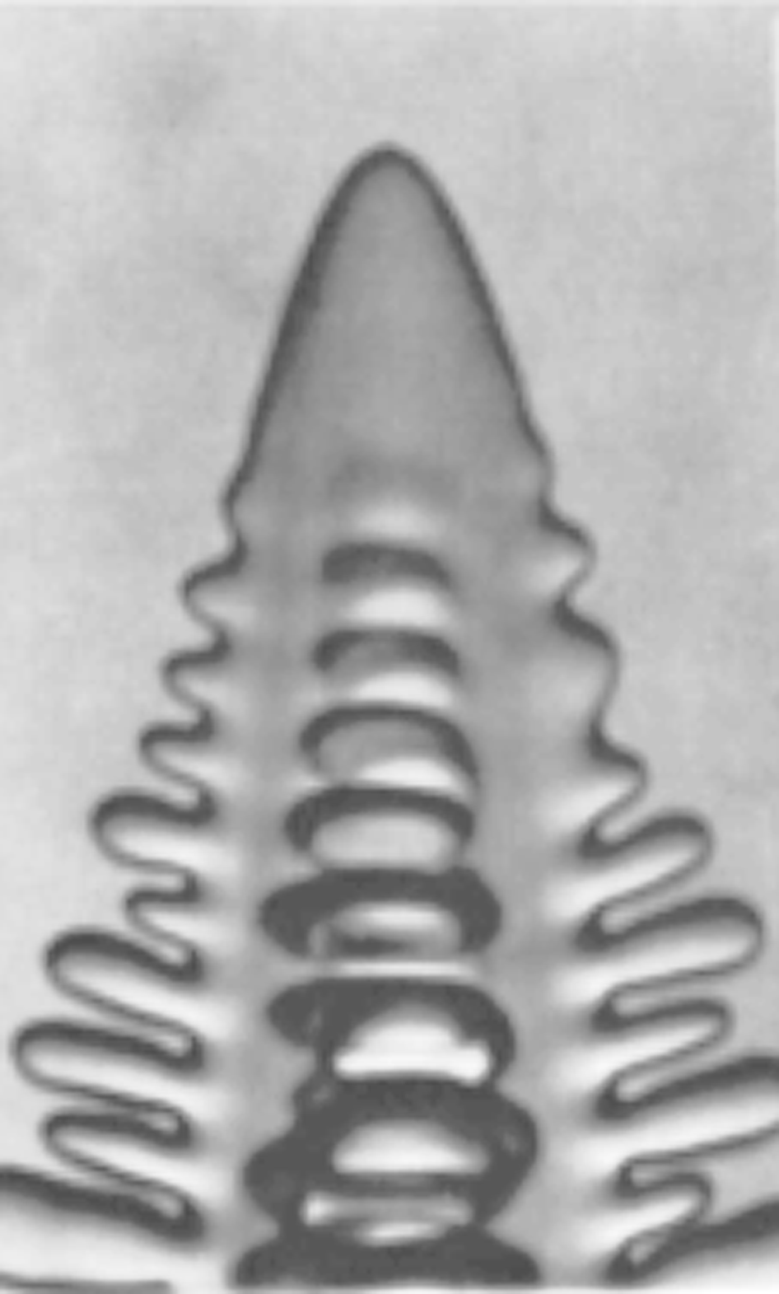
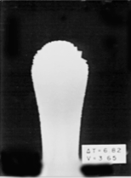
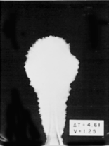
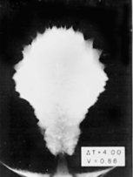
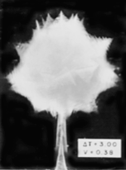
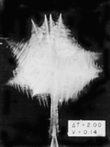
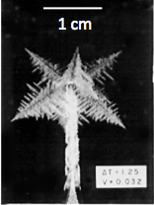
Pattern Size & Supercooling
7-9s SCN
• Solid-liquid interface is a source of heat/solute
40 micron
ΔT=6.82 K
V= 3.65 cm/s
ΔT=4.61 K
V= 1.25 cm/s
ΔT=4.00 K
V= 0.86 cm/s
• Energy/solute released must be transported away
• Boundary conditions: capillarity, kinetics, and T
• Branches appear periodically, develop irregularities
• Noise and stability responsible for pattern formation.
ΔT=3.00 K
V= 0.38 cm/s
ΔT=2.00 K
V= 0.14 cm/s
ΔT=1.25 K
V= 0.032 cm/s

Slide 8
NASA Microgravity Experiments
IDGE Experiments
Field Theory
Numerics
Bias Field Analysis
Dynamic simulation
Conclusions
Melting
Provided the big clue
on pattern formation!
Solidification

Slide 9

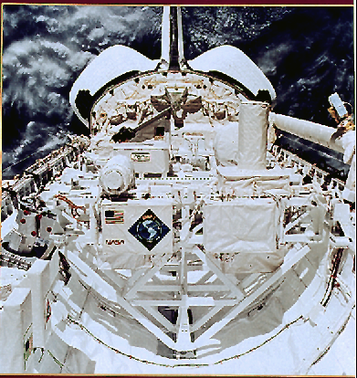
IDGE

Slide 10
USMP-4/IDGE Space Flight Instrument
Precision thermostat: (0.002 K)
35mm camera
Xenon flash
Red LED
CCD camera
Sample chamber

Slide 11

Dendritic Growth in Space
(PVA, ΔT=1.2K)

Slide 12
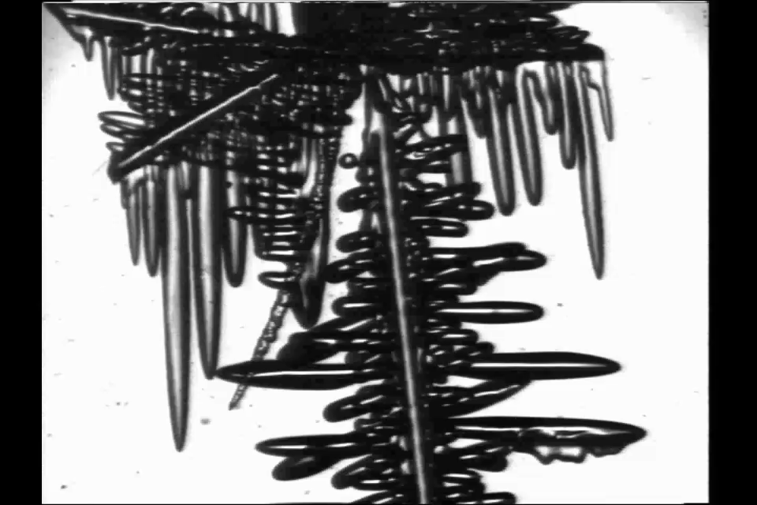
Melting PVA Dendrites (ΔT=1.8 K)

Slide 13
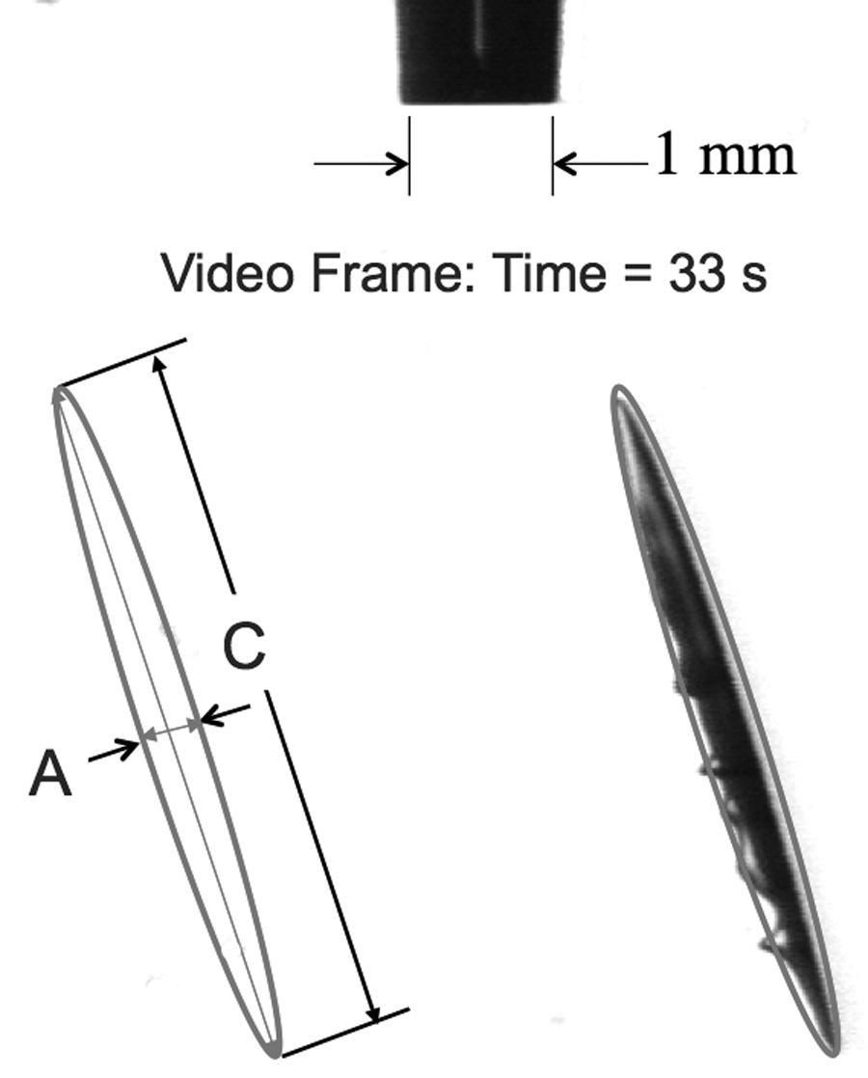
C/A Measurement

Slide 14
Analysis of Melting in Microgravity
Field Theory—a few words
  Coordinate system
  Laplace field
  Origin of self-similarity
  Melting kinetics

Slide 15
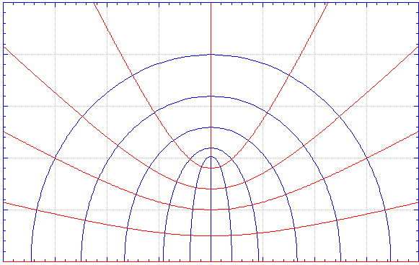
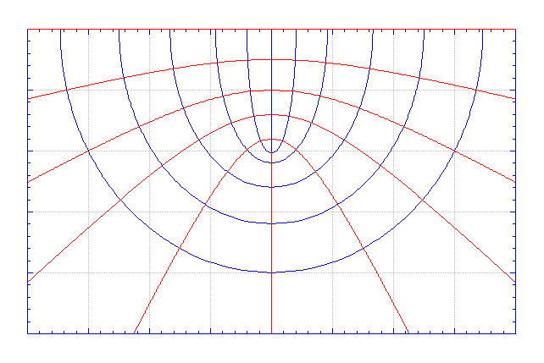
η=1
Confocal Prolate Spheroidal Coordinates
0.9
0.75
C/A=20
0.5
A. Lupulescu, M.E. Glicksman, and M.B. Koss,
J. Thermophysics and Heat Transfer, 17, (2002)
0.25
1.1
1.3
1.6
ξ=2
1
1.03
0
Exterior potential
-0.25
-0.5
-0.75
ϕ=0
Interior potential
η=-1
-0.9

Slide 16
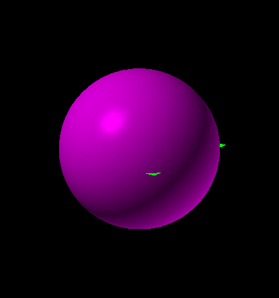
Self-Similar Melting (9:1Ellipsoid)
Self-similarity
C/A
time
Vector gradient fields: Isothermal interface

Slide 17
Melting ‘Trajectory’
(St⁺ =0.036, C/A=15, C₀ =0.76cm, Ξ=1.0026)

Slide 18
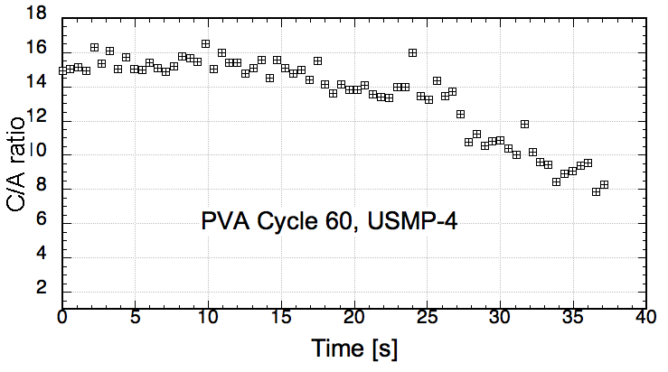
C/A versus Time: Big surprise!
Not self-similar
?
Self-similar

Slide 19
Numerical (Finite Difference)
no capillarity, Dr. S. Salon, RPI
TTTT_{int} ≠ const.
TTTT_{int} =const.
Self-similarity
≥
  Gibbs-Thomson bc imposed
  T_{int} now depends on curvature, κ
  We found:
  • Interior heat flow
  • Capillary-mediated fluxes
  • Non self-similar melting!

Slide 20
Excess Flux

Slide 21
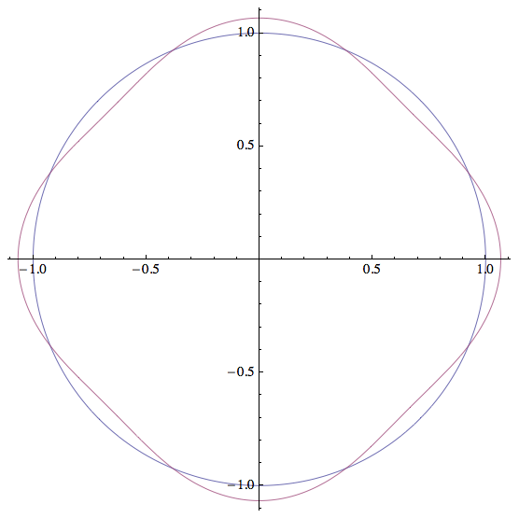
Gibbs-Thomson-Herring Potential
anisotropic
isotropic
Convex Gamma Plots
Avoids equilibrium facets

Slide 22


Global vs. Local Thermodynamic Equilibrium
Global equilibrium: Strong condition that minimizes Gibbs free energy
in closed systems
equilibrium
Initial state
equilibrium
Allow dynamics:
Local equilibrium: Weak condition that reduces free energy
in open systems
bias field
Initial state
bias field
Allow dynamics:

Slide 23
Energy Conservation
2-Phase Domain Contraction
N
n
c
S(t)
D(t)
Domain
Contraction
n
S(t)

Slide 24
Interface Energy Conservation
(Leibniz-Reynolds & Kelvin-Stokes thms)
n
N
c
S(t)
D(t)
(Domain contraction)
(Local equilibrium)
(Meso-scale)
(Fourier’s law )

Slide 25
Interface Energy Conservation
Definitions
Ref.
Mod.
Bias Field Modulation
Interface Poisson Eqn.

Slide 26
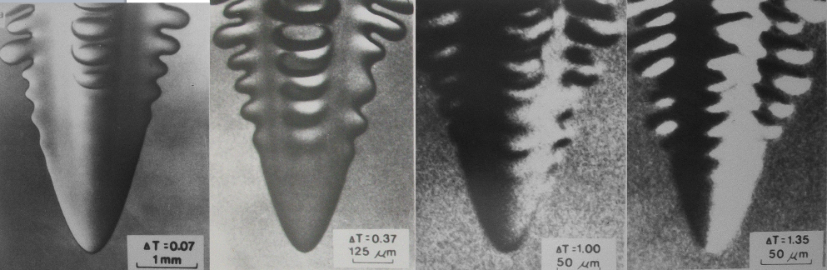
Branch Initiation: A non-self similar event, suggesting a 2nd field!
ΔT=0.07 K
-------------
1000 μm
ΔT=0.37 K
-------------
125 μm
ΔT=1.00 K
------------------
50 μm
ΔT=1.35 K
--------------------
50 μm
Red line shows last discernible branch location.

Slide 27
Capillary-mediated branching
Analysis: circle, ellipses, parabola, hyperbola, . . .
  Applied local equilibrium (GTH) on non-equilibrium analytic shapes
  Tangential interface fluxes
  Flux divergences
  Roots (sign change)
bias fields
Stefan interface balance
advance/retard, Δv_{n}
branching!
modulation

Slide 28
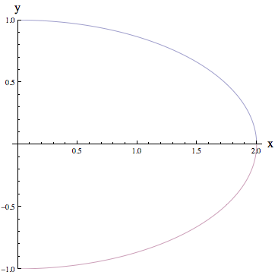
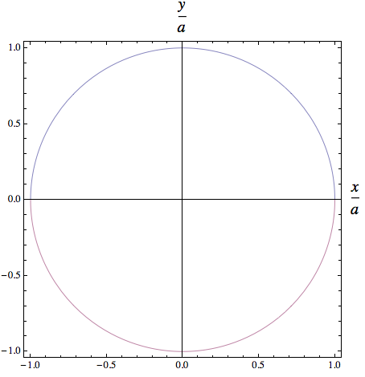
Initial Interface Shapes
(Isometric Views)
Ellipse, 2:1
Circle, R=1
a
crystal
melt
crystal
melt

Slide 29
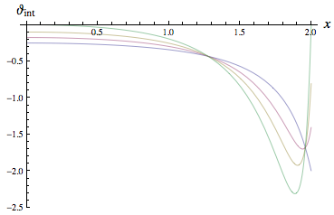
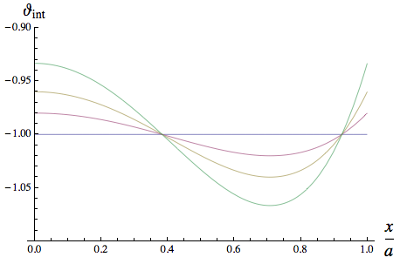
GTH Potentials
Ellipse 2:1
Circle

Slide 30
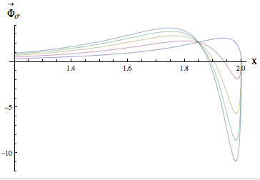
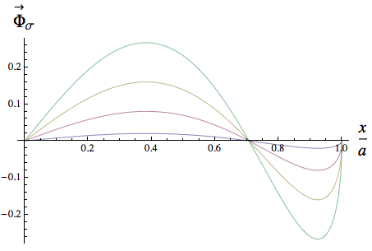
Tangential Fluxes
Ellipse 2:1
Circle

Slide 31
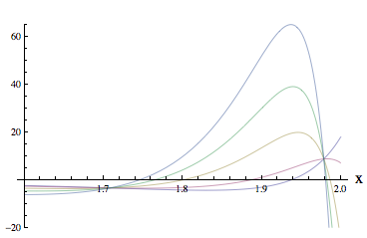
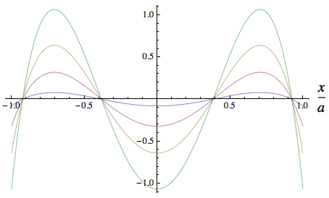
Bias Fields
Ellipse 2:1
Circle

Slide 32
Energetics & Dynamics
Simulation
  Integral eqn. solver
  Stefan interface balance
  Observed rotation points
  Pattern limit cycles

Slide 33
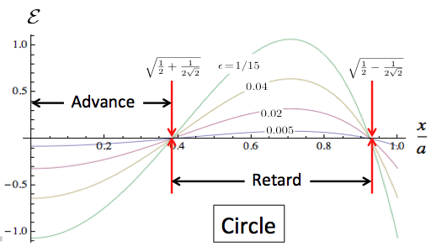
Energy Conservation: Stefan balance
Latent heat
Bias Field
Bulk energy conduction
Fast microscopic processes
Slow macroscopic processes
Interface modulation eqn:
melt
crystal

Slide 34
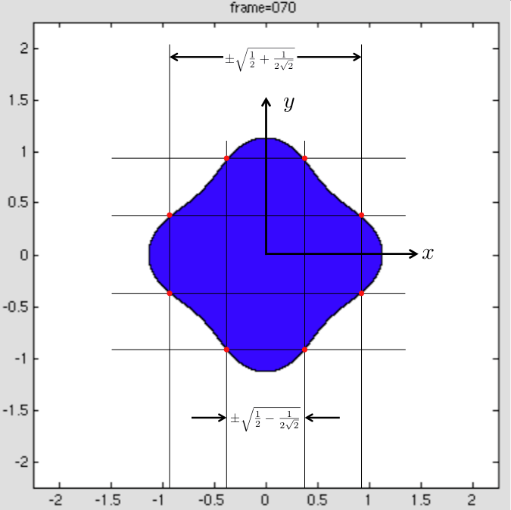
Bias Field Nodes
advance
retard
retard
advance
advance
retard
retard
advance

Slide 35
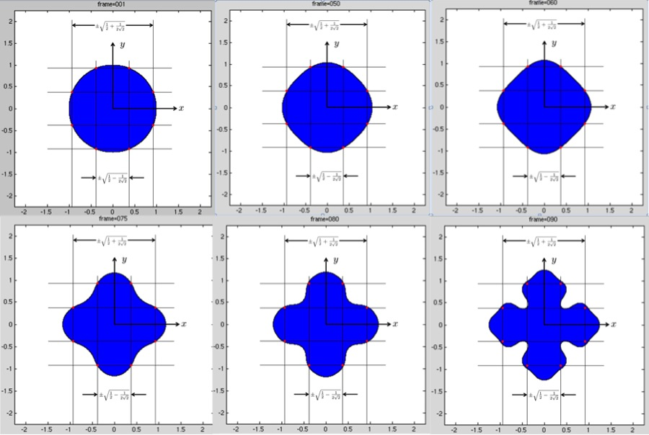
Initial Bias Field & Patterns

Slide 36
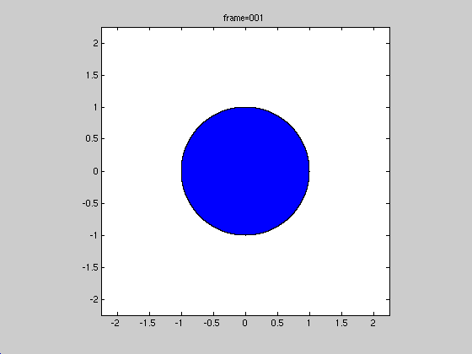
Circle Dendrite
(ε=0.005)

Slide 37
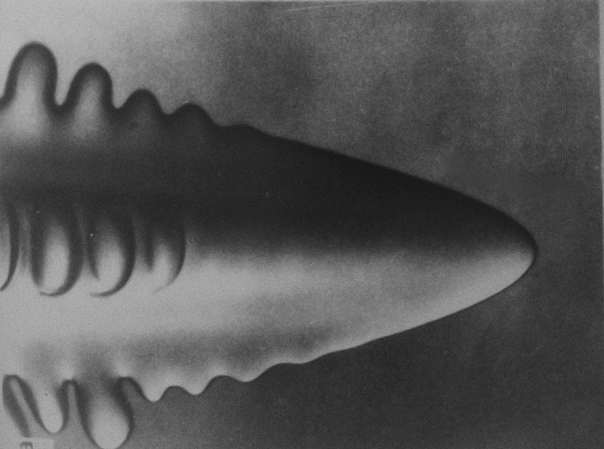
ΔT=70 mK
Last discernible branch
Branch initiation
(estimated)
1000 microns

Slide 38
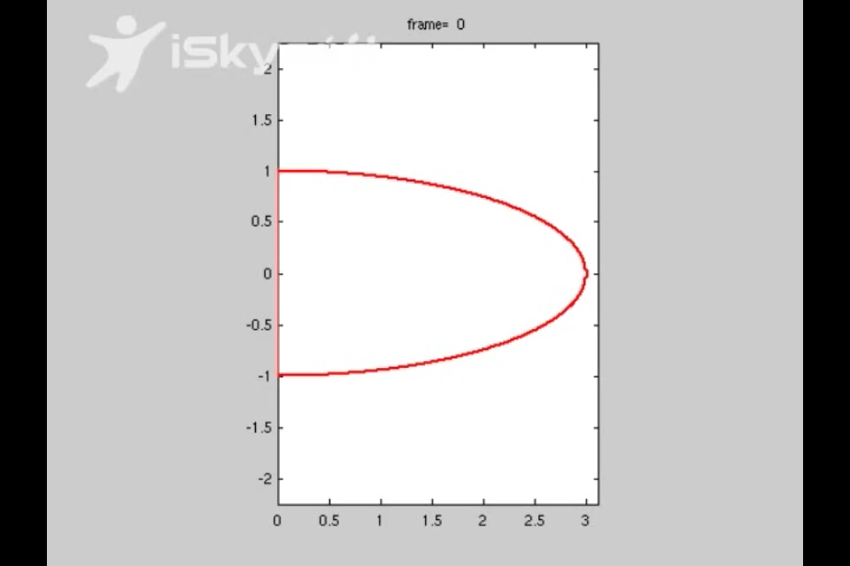
Semi-ellipse
(ε=0.005)

Slide 39
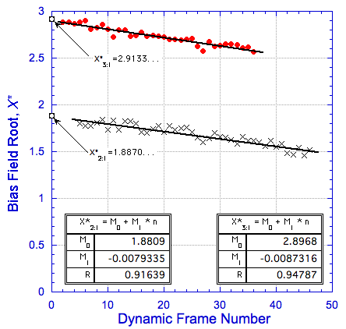
Bias Field Nodes, Ellipses (ε=0.005)

Slide 40

Deterministic Chaos, ‘Seaweed’
(ε=0)

Slide 41
Conclusions
Pattern complexities in iridescent butterfly wings and dendritic crystals are interesting and controlled branching provides technological applications.
Conventional wisdom attributes pattern branching to noise and stability.
NASA-supported microgravity experiments demonstrate that capillary potentials (local equilibria) provide weak interfacial fluxes.
Vector flux divergences imply energy release or removal (biases) on interface.
Nodes in the bias-field correspond to zeros of the surface Laplacian of the interface potential, a 4th-order function of the interface shape.
Positive bias energy retards interface speed, negative bias accelerates it.
Local changes in interface curvature couple with the external field and produce branching.
Synchronization of bias nodes with interface advance can lead to limit cycles, and dendritic growth if anisotropy is present.
Isotropic (fluid-fluid) interfaces evolve by chaotic dynamics, yielding complex ‘seaweed’ patterns.

Slide 42
Acknowledgments
Special thanks go to Professors John Lowengrub, Mathematics Dept., U. California, Irvine, CA, and Shuwang Li, Dept. of Applied Mathematics, IIT, Chicago, IL for their efforts in providing noise-free sharp interface dynamics proving the existence of local bias fields.
Thank you for listening!

