Slide 1
Brief Introduction to Geometry and Vision
A.L. Yuille (UCLA)

Slide 2
Plan of Talk
Four Topics:
(I) Basic Projection. Perspective. Vanishing Points.
(II) Camera Calibration. Stereopsis. Essential Matrix. Fundamental Matrix.
(III) Structure from Motion. Rigid. Extension to Non-Rigid.
(IV) Geometric Priors. Manhattan World.

Slide 3
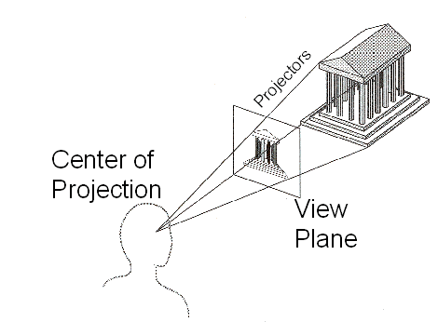
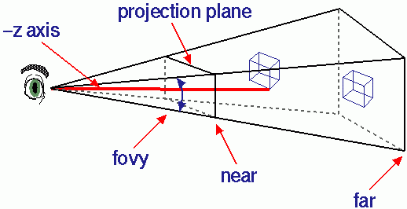
Geometry of Projection.
Most analysis is based on the Pinhole camera model.
Real cameras have lens (W. Freeman’s lectures). See Szeliski’s book for corrections to the pinhole camera model.

Slide 4
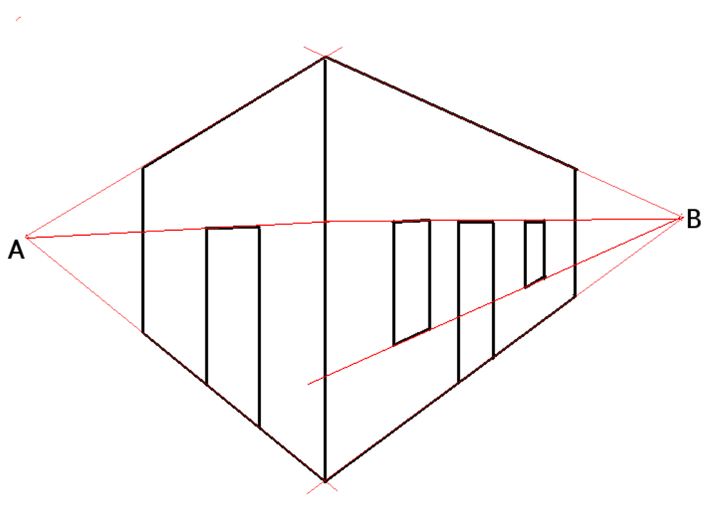
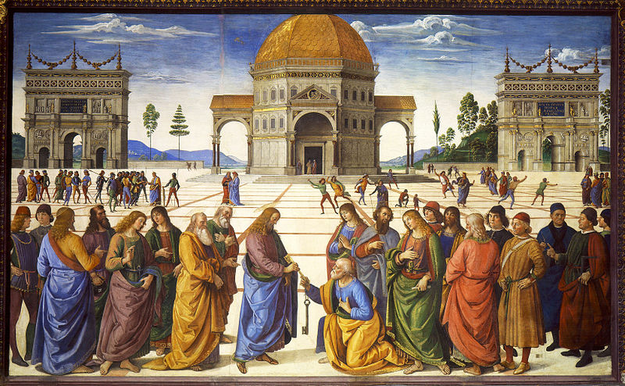
Properties of Perspective Projection
Straight lines project to straight lines.
Parallel lines in space project to lines which converge at a vanishing point.

Slide 5
Perspective 1

Slide 6
Perspective 2

Slide 7
Vanishing Points 1.

Slide 8
Vanishing points 2.

Slide 9
Linear approximations: Weak Orthographic
Perspective projection can often be approximated by scaled orthographic projection (e.g., if Z is constant).
This is a linear operation.
Parallel lines project to parallel lines (vanishing points at infinity).
This is often a good approximation which is easy to use.
Maths of weak orthographic projection.

Slide 10
Linear Projection 1

Slide 11
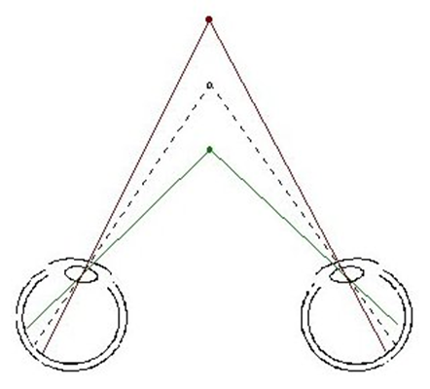
Two Cameras. Binocular Stereo.
Binocular stereo.
Estimate depth from two eyes/cameras by triangulation.
Requires solving the correspondence problem between points in the two images.
Correspondence problem is helped by the epipolar line constraint.
Camera calibration needed.

Slide 12
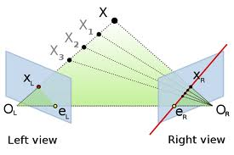
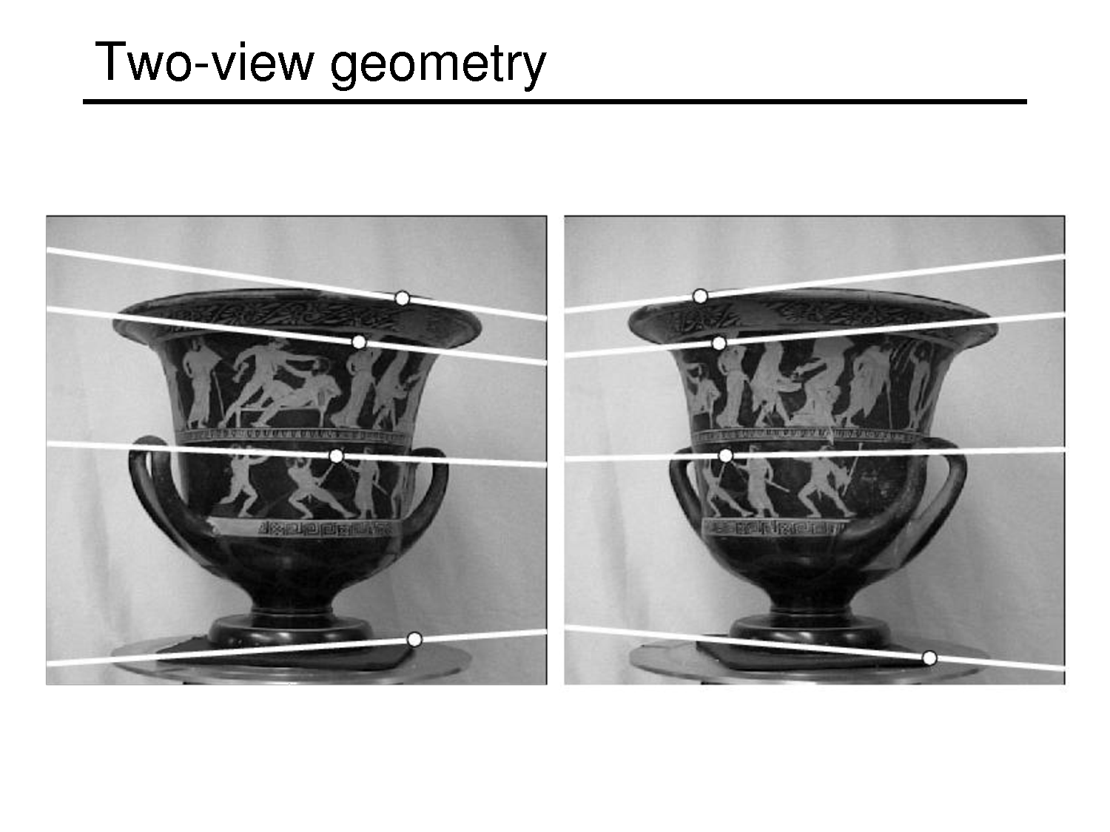
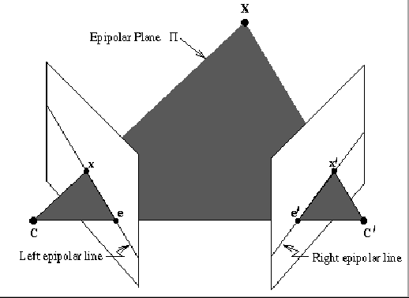
Epipolar Lines:
Points on one epipolar line can only be matched to points on the corresponding epipolar line.
Epipolar lines depend on the camera parameters.
If both cameras are parallel, then epipolar lines are horizontal.
Geometric demonstration
of epipolar line constraint.

Slide 13
Stereo Algorithms can exploit epipolar line constraints
  Simplest model: estimate the disparity d at each point (convert to depth by geometry).
  Matching unambiguous, despite epipolar line constraints.
  Regularize by smoothness (ordering),
  E.g., Marr and Poggio 1978. Arbib and Dev. 1977.
Simple Energy function: (Boykov)

Slide 14
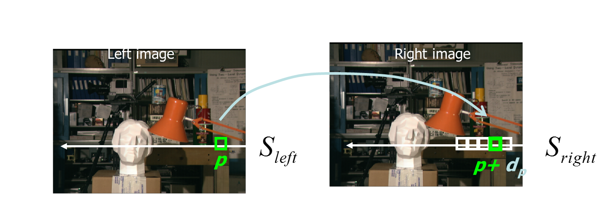
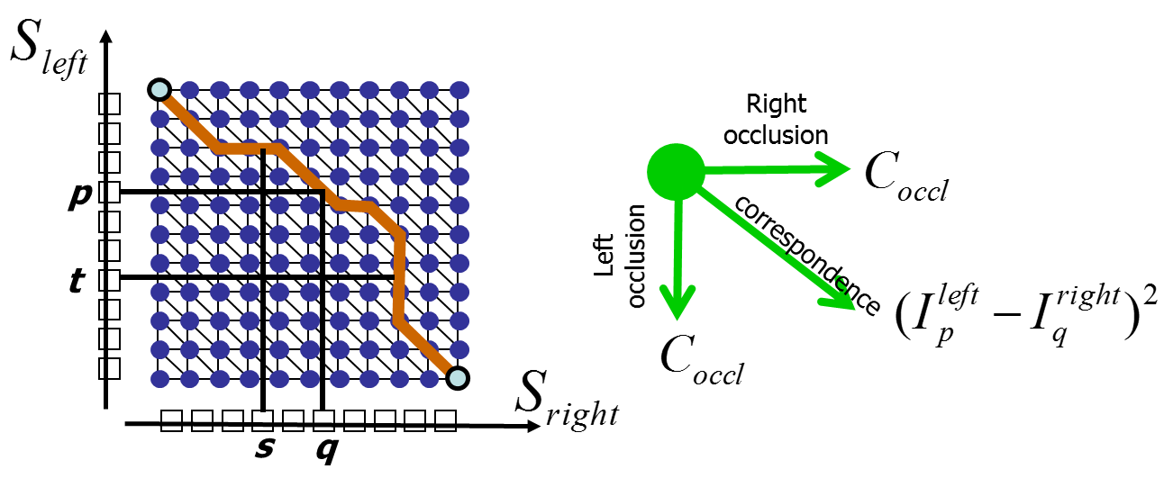
Exploit Epipolar Line constraint
The epipolar line constraint reduces correspondence to a one-dimensional problem.
Dynamic programming can be applied.

Slide 15
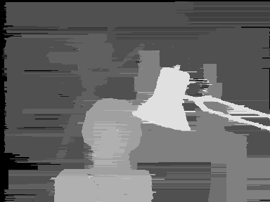
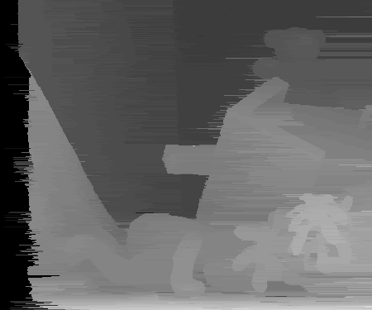
Results using Dynamic Programming

Slide 16
Half-Occlusions.
Da Vinci’s stereopsis.
Points are half-occluded:
visible to one eye/camera
but not to the other.
This gives cues for the detection of boundaries.
Geiger, Ladendorf, Yuille, 1992, Belhumeur and Mumford 1992.
H. Ishikawa and D. Geiger. 1998 (across epipolar lines).

Slide 17
Camera Callibration
Essential Matrix (Longuet-Higgins 1981). Fundamental Matrix (Q.T. Luong and O. D. Faugeras 1992, Hartley 1992).
More calibration (Z. Zhang 2000).
More reading on geometry:
R. Hartley and A. Zisserman. Multiple View Geometry in computer vision. 2003.
Y. Ma, S. Soatto, J. Kosecka, and S. Sastry. An Invitation to 3-D Vision. 2004.

Slide 18
Essential Matrix 1

Slide 19
Essential Matrix 2

Slide 20
Structure from Motion: Rigid
Linear Projection. 3D structure can be estimated by linear algebra (Singular Value Decomposition).
Camera parameters can also be estimated.
This estimation is up to an ambiguity.
Main paper:
C. Tomasi and T. Kanade. 1991.
But see also: L.L. Kontsevich, M.L. Kontsevich, A. Kh. Shen.
“Two Algorithms fro Reconstruction Shapes}. Avtometriya. 1987.

Slide 21
Structure from Motion: Rigid.
Linear projection.
Set of images is rank 3.
R. Basri and S. Ullman. Recognition by Linear Combinations of Models. 1991.
Maths of SVD.

Slide 22
Structure from Motion: Rigid 1

Slide 23
Structure from Motion: Rigid 2

Slide 24
Structure from Motion: 3

Slide 25
Structure from Motion: Rigid 4

Slide 26
Structure from Motion: 5

Slide 27
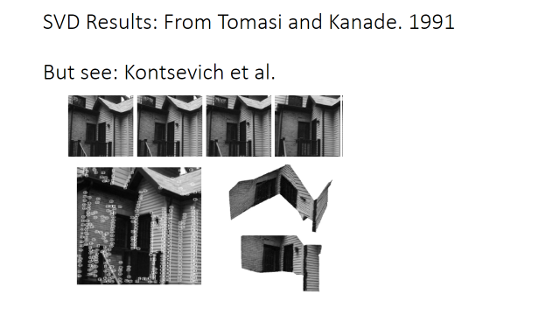
Structure From Motion: Rigid.

Slide 28
Extension to Non-Rigid Motion
This approach can be extended to a special class of non-rigid motion.
The object can be expressed as a linear sum of basis functions. The sum varies over time.
C. Bregler, A. Hertzmann, and H. Biermann. Recovering non-rigid 3D shape from image streams. CVPR. 2000.
Theory clarified by:
Y. Dai, H. Li, and M. He. A Simple Prior-free Method for Non Rigid Structure from Motion Factorization, in CVPR 2012 (ORAL). IEEE CVPR Best Paper Award-2012. (Code available).
http://users.cecs.anu.edu.au/~hongdong/

Slide 29
Non-rigid motion

Slide 30
Manhattan World
Many scenes, particularly man-made scenes, have a natural three-dimensional coordinate systems caused by the structure of the world.

Slide 31
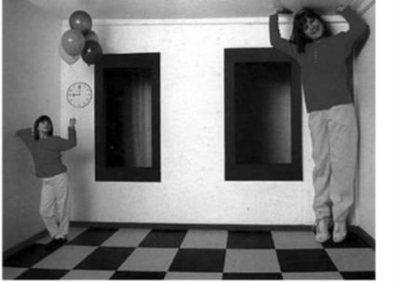
Manhattan World: 2
Back to Ames Room:
Non-Manhattan Edges:

Slide 32
Manhattan World 1

Slide 33
Manhattan World 2

Slide 34
Manhattan World 3

Slide 35
Manhattan World 4

Slide 36
Beyond Manhattan:
There are parallel lines in the scene, but they are not orthogonal.

Slide 37
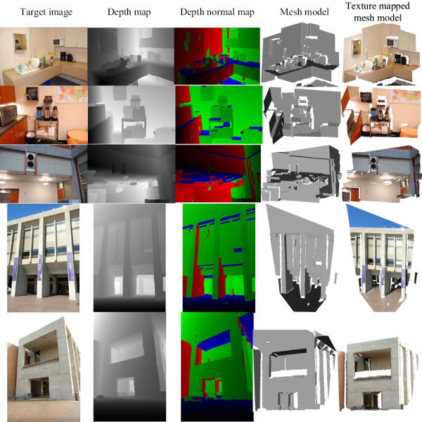
Manhattan World
Manhattan World stereo:
Piecewise planar surfaces with dominant
Directions.
Instead of assuming
Piecewise smoothness.
Video available:
http://grail.cs.washington.edu/projects/manhattan/
Y. Fuukawa, B. Curless, S. Seitz, and R. Szeliski. 2009.

Slide 38
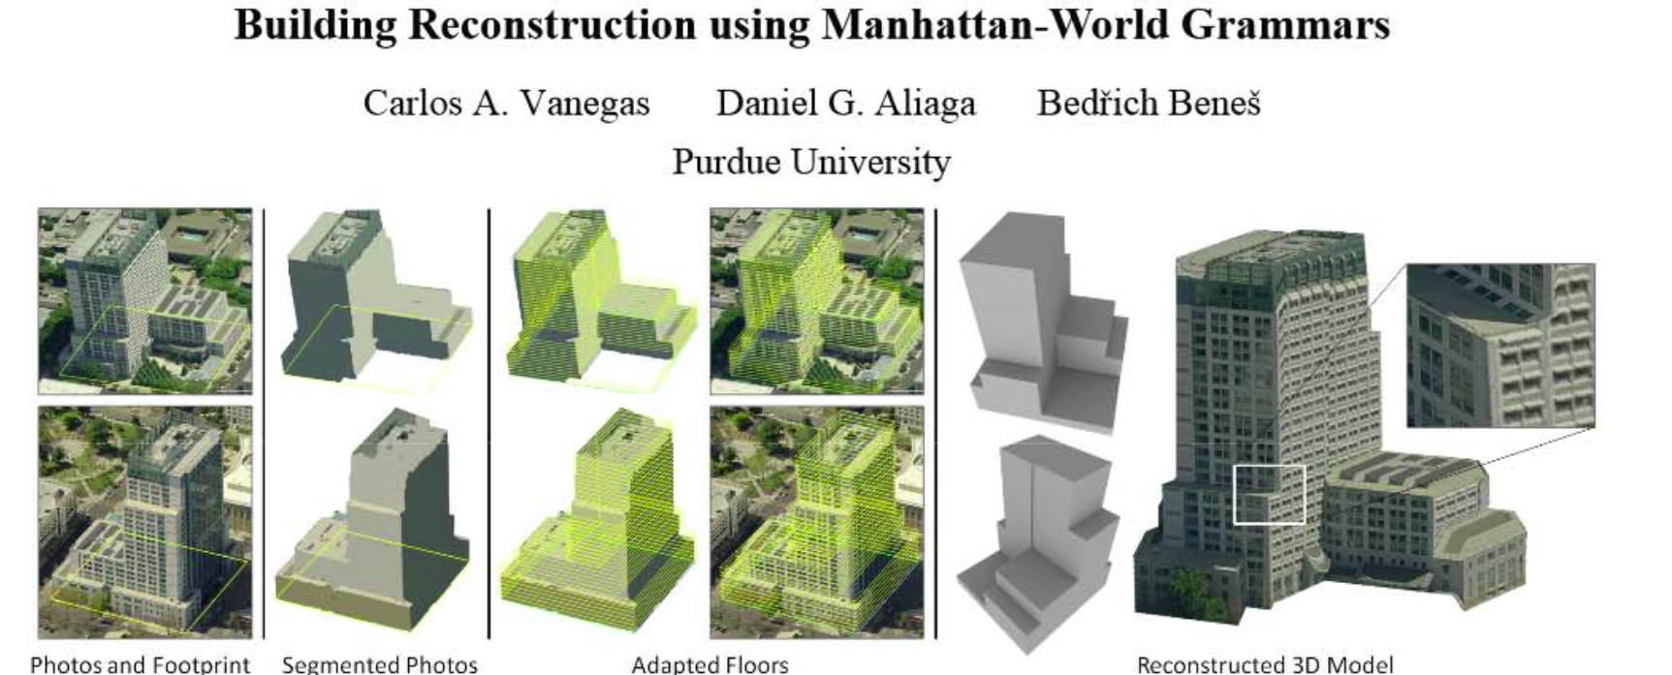
Manhattan World Grammar
Website: http://www.youtube.com/watch?v=s0mhpKFv36g

