Slide 1
Lecture IV:
A Bayesian Viewpoint on Sparse Models
Yi Ma John Wright
Microsoft Research Asia Columbia University
(Slides courtesy of David Wipf, MSRA)
IPAM Computer Vision Summer School, 2013

Slide 2
Convex Approach to Sparse Inverse Problems
Ideal (noiseless) case:
Convex relaxation (lasso):
Note: These may need to be solved in isolation, or embedded in a larger system depending on the application

Slide 3
When Might This Strategy Be Inadequate?
Two representative cases:
  The dictionary Φ has coherent columns.
  There are additional parameters to estimate, potentially embedded in Φ.
The ℓ₁ penalty favors both sparse and low-variance solutions. In general, the cause of ℓ₁ failure is always that the later influence can sometimes dominate.

Slide 4
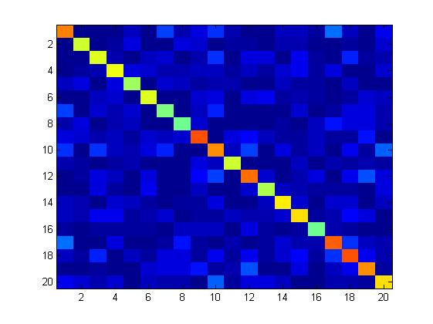
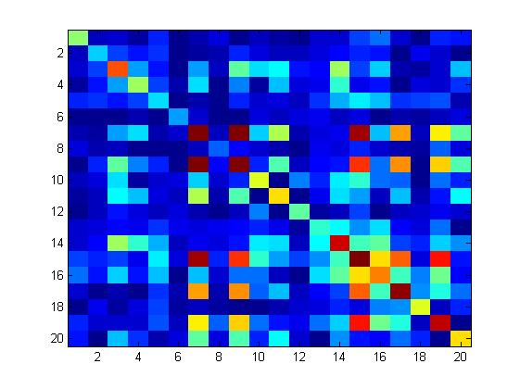


Dictionary Correlation Structure
Unstructured
Structured
Examples:
Example:
$$\sim$$
$$\sim$$
block
diagonal
arbitrary

Slide 5
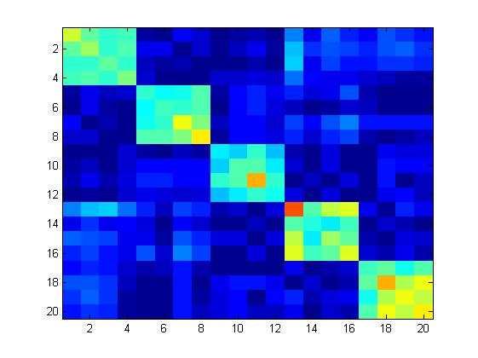
Block Diagonal Example
The ℓ₁ solution typically selects either zero or one basis vector from each cluster of correlated columns.
While the ‘cluster support’ may be partially correct, the chosen basis vectors likely will not be.
block
diagonal
Problem:

Slide 6
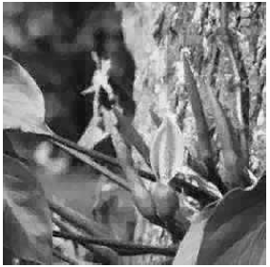
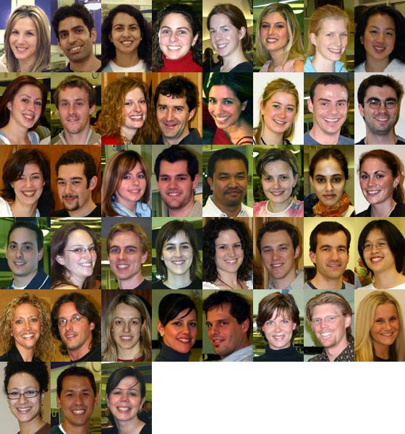
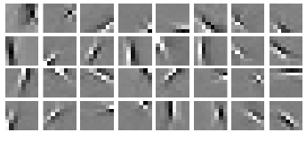
Dictionaries with Correlation Structures
Most theory applies to unstructured incoherent cases, but many (most?) practical dictionaries have significant coherent structures.
Examples:

Slide 7
MEG/EEG Example
Φ
?
source space (x)
sensor space (y)
Forward model dictionary Φ can be computed using Maxwell’s equations [Sarvas,1987].
Will be dependent on location of sensors, but always highly structured by physical constraints.

Slide 8
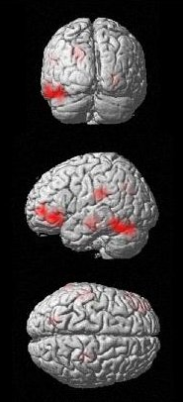
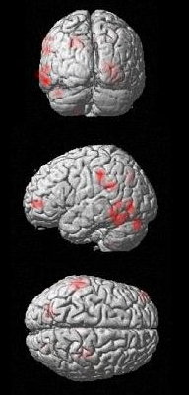
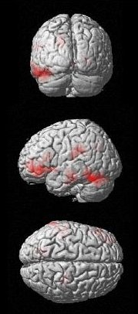
MEG Source Reconstruction Example
Ground Truth
Group Lasso
Bayesian Method

Slide 9
Bayesian Formulation
Assumptions on the distributions:
This leads to the MAP estimate:

Slide 10
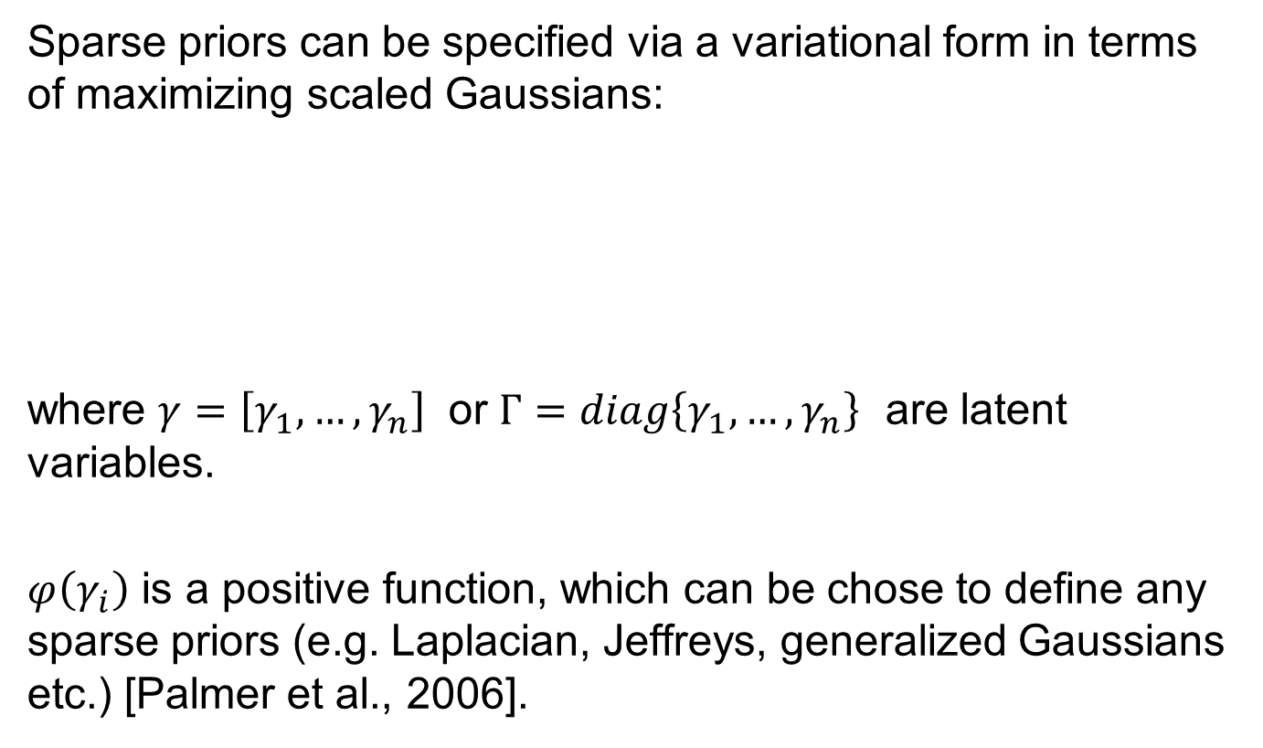
Latent Variable Bayesian Formulation
Sparse priors can be specified via a variational form in terms of maximizing scaled Gaussians:
where $γ=\left[γ_{1},…, γ_{n}\right]$ or $Γ=diag\left\{γ_{1},…, γ_{n}\right\}$ are latent variables.
$φ\left(γ_{i}\right)$ is a positive function, which can be chose to define any sparse priors (e.g. Laplacian, Jeffreys, generalized Gaussians etc.) [Palmer et al., 2006].

Slide 11
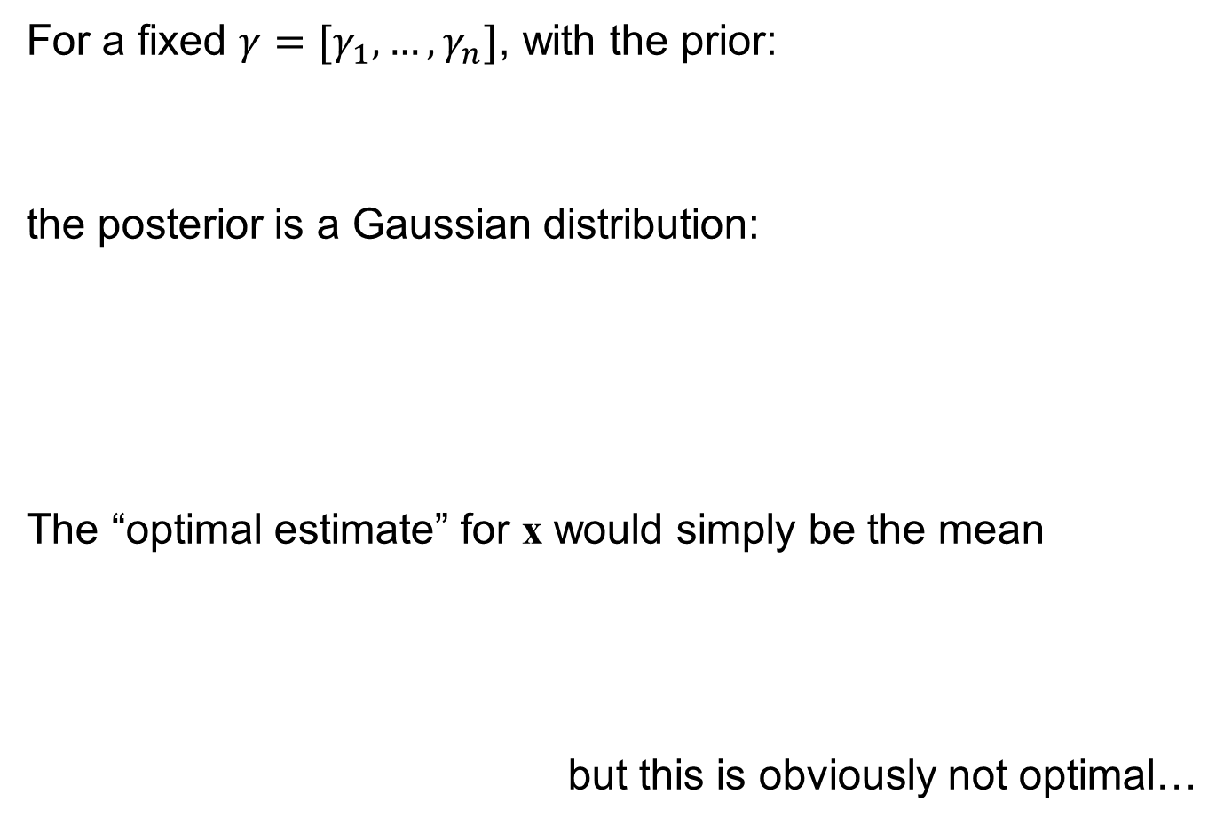
Posterior for a Gaussian Mixture
For a fixed $γ=[γ_{1},…, γ_{n}]$, with the prior:
the posterior is a Gaussian distribution:
The “optimal estimate” for x would simply be the mean
but this is obviously not optimal…

Slide 12
Approximation via Marginalization
We want to approximate
Find $γ^{∗}$ that maximizes the expected value with respect to x:

Slide 13
Latent Variable Solution
with

Slide 14
MAP-like Regularization
Very often, for simplicity, we often choose
Notice that g(x) is in general not separable:

Slide 15
Properties of the Regularizer
Theorem. When is a concave, nondecreasing
function of |x|. Also, any local solution x* has at most n nonzeros.
Theorem. When the program has no local minima. Furthermore, g(x) becomes separable and has the closed form
which is a non-descreasing strictly concave function on

Slide 16
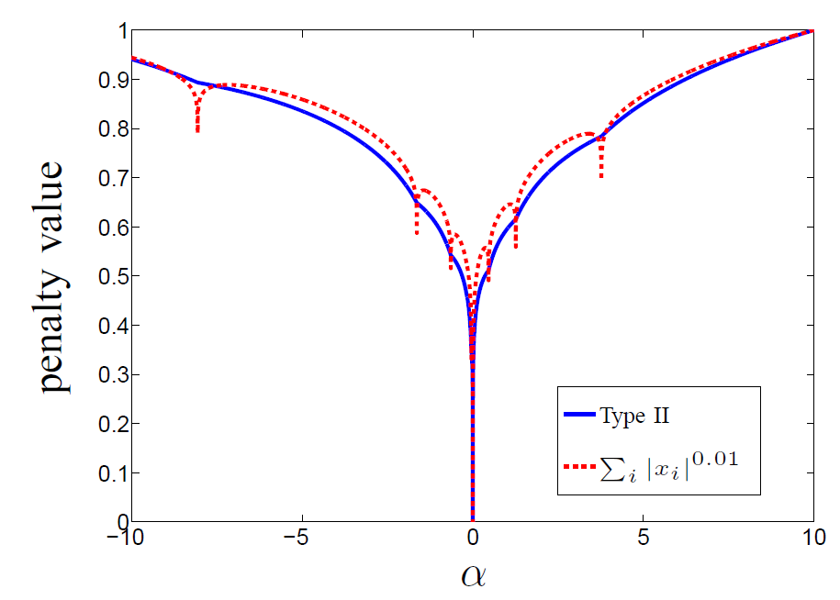

Smoothing Effect: 1D Feasible Region
penalty value

Slide 17
Noise-Aware Sparse Regularization

Slide 18
Philosophy
Literal Bayesian: Assume some prior distribution on unknown parameters and then justify a particular approach based only on the validity of these priors.
Practical Bayesian: Invoke Bayesian methodology to arrive at potentially useful cost functions. Then validate these cost functions with independent analysis.

Slide 19
Aggregate Penalty Functions
Candidate sparsity penalty:
primal
dual
NOTE: If λ → 0, both penalties have same minimum as ℓ₀ norm
    If λ → , both converge to scaled versions of the ℓ₁ norm.

Slide 20
How Might This Philosophy Help?
Consider reweighted ℓ₁ updates using primal-space penalty
Initial ℓ₁ iteration with w⁽⁰⁾ = 1:
Weight update:
Reflects the subspace of all active columns
*and* any columns of Φ that are nearby
Correlated columns will produce similar weights, small if in the active subspace, large otherwise.

Slide 21
Basic Idea
Initial iteration(s) locate appropriate groups of correlated basis vectors and prune irrelevant clusters.
Once support is sufficiently narrowed down, then regular ℓ₁ is sufficient.
Reweighed ℓ₁ iterations naturally handle this transition.
The dual-space penalty accomplishes something similar and has additional theoretical benefits …

Slide 22
Alternative Approach
What about designing an ℓ₁ reweighting function directly?
Iterate:
Note: If f satisfies relatively mild properties there will exist an associated sparsity penalty that is being minimized.
Can select f without regard to
a specific penalty function

Slide 23
Example f_{(p,q)}
Implicit penalty function can be expressed in integral form for certain selections for p and q.
For the right choice of p and q, has some guarantees for clustered dictionaries …

Slide 24
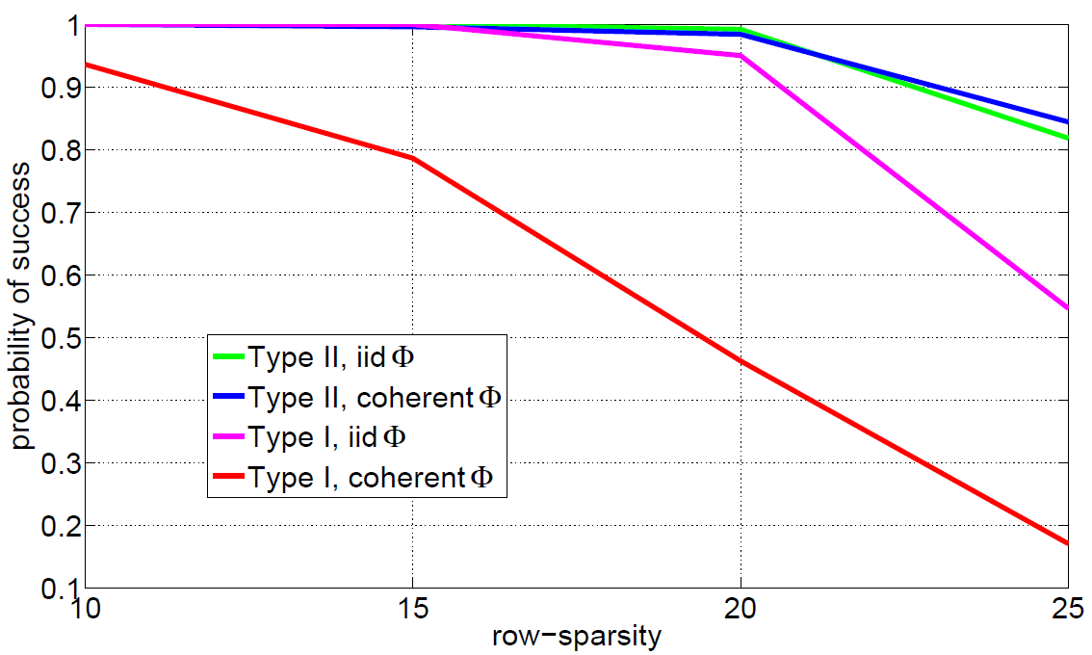

Numerical Simulations
Convenient optimization via reweighted ℓ₁ minimization [Candes 2008]
Provable performance gains in certain situations [Wipf 2013]
Toy Example:
Generate 50-by-100 dictionaries:
Generate a sparse x
Estimate x from observations
success rate
bayesian, Φ_{(unstr)}
bayesian, Φ_{(str)}
standard, Φ_{(unstr)}
standard, Φ_{(str)}
$$\sim$$
B

Slide 25
Summary
In practical situations, dictionaries are often highly structured.
But standard sparse estimation algorithms may be inadequate in this situation (existing performance guarantees do not generally apply).
We have suggested a general framework that compensates for dictionary structure via dictionary-dependent penalty functions.
Could lead to new families of sparse estimation algorithms.

Slide 26
Dictionary Has Embedded Parameters
Ideal (noiseless) :
Relaxed version:
Applications: Bilinear models, blind deconvolution, blind image deblurring, etc.

Slide 27
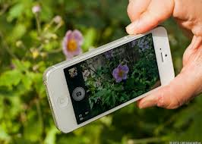
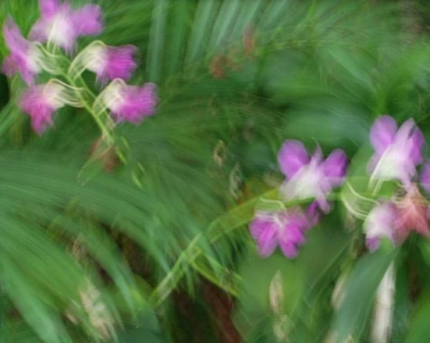

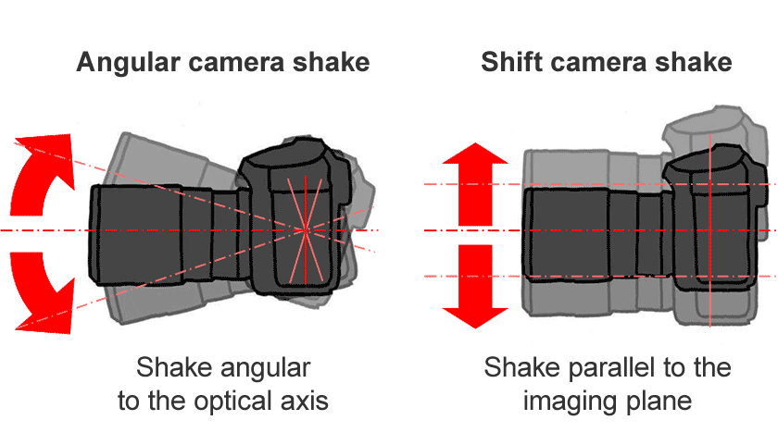
Blurry Image Formation
Relative movement between camera and scene during exposure causes blurring:
single blurry
multi-blurry
blurry-noisy
[Whyte et al., 2011]

Slide 28

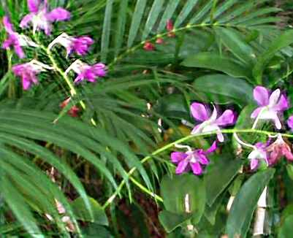
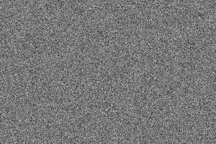
Blurry Image Formation
Basic observation model (can be generalized):
blurry
image
blur
kernel
sharp
image
noise

Slide 29
Blurry Image Formation
Basic observation model (can be generalized):
blurry
image
blur
kernel
sharp
image
√
?
?
noise
Unknown quantities we would like to estimate

Slide 30
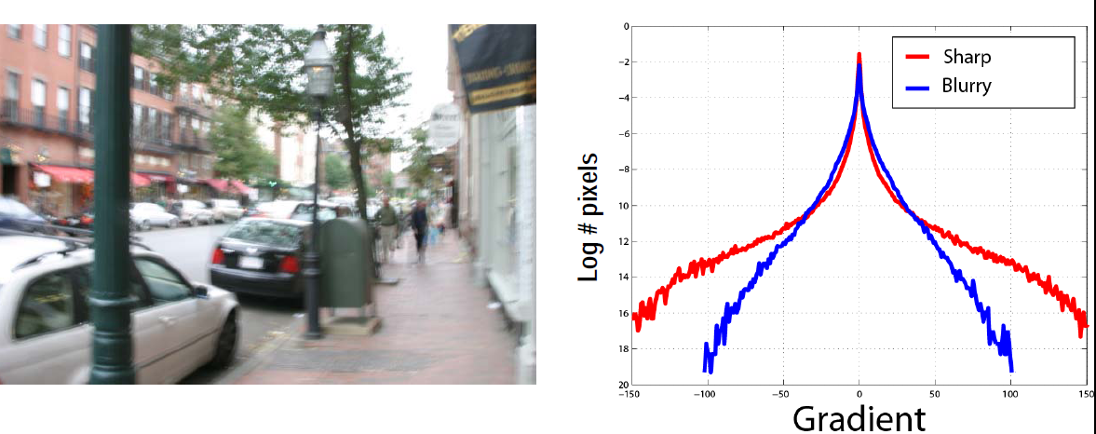
Gradients of Natural Images are Sparse
Hence we work in gradient domain
: vectorized derivatives of the sharp image
: vectorized derivatives of the blurry image
Notes:
Change the figures
Start from the common assumption everybody used ”sharp img is sparse in derivative domain”

Slide 31
Blind Deconvolution
Observation model:
Would like to estimate the unknown x blindly since k is also unknown.
Will assume unknown x is sparse.
convolution operator
toeplitz matrix

Slide 32
Attempt via Convex Relaxation
Solve:
Problem:
So the degenerate, non-deblurred solution is favored:
translated image superimposed

Slide 33
Bayesian Inference
Assume priors p(x) and p(k) and likelihood p(y|x,k).
Compute the posterior distribution via Bayes Rule:
Then infer x and or k using estimators derived from p(x,k|y), e.g., the posterior means, or marginalized means.

Slide 34
Bayesian Inference: MAP Estimation
Assumptions:
Solve:
This is just regularized regression with a sparse penalty that reflects natural image statistics.

Slide 35
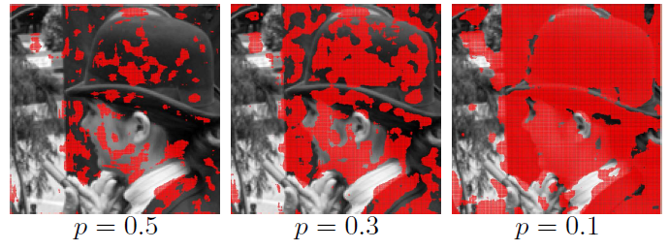
Failure of Natural Image Statistics
Shown in red are 15 X 15 patches where
(Standardized) natural image gradient statistics suggest
[Simoncelli, 1999]

Slide 36
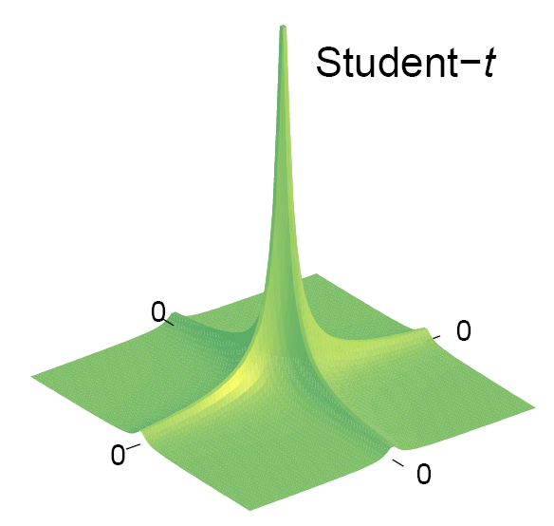
The Crux of the Problem
Natural image statistics are not the best choice with MAP, they favor blurry images more than sharp ones!
MAP only considers the mode, not the entire location of prominent posterior mass.
Blurry images are closer to the origin in image gradient space; they have higher probability but lie in a restricted region of relatively low overall mass which ignores the heavy tails.
blurry: non-sparse, low variance
sharp: sparse, high variance
feasible set

Slide 37
An “Ideal” Deblurring Cost Function
Rather than accurately reflecting natural image statistics, for MAP to work we need a prior/penalty such that
Theoretically ideal … but now we have a combinatorial optimization problem, and the convex relaxation provably fails.
Lemma: Under very mild conditions, the ℓ₀ norm (invariant to changes in variance) satisfies:
with equality iff k = δ. (Similar concept holds when x is not exactly sparse.)

Slide 38
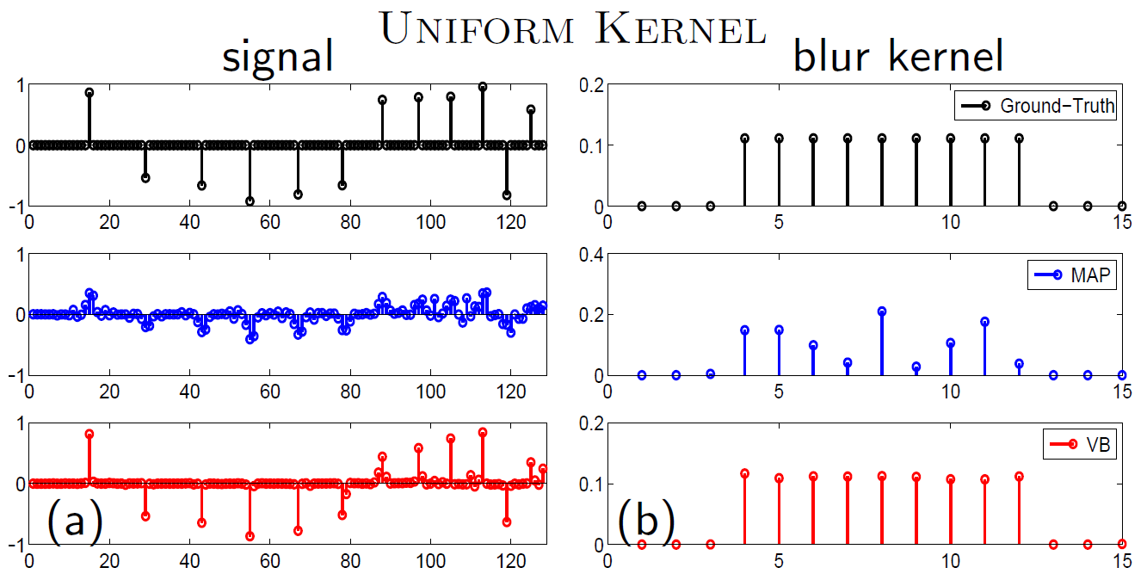
Local Minima Example
1D signal is convolved with a 1D rectangular kernel
MAP estimation using ℓ₀ norm implemented with IRLS minimization technique.
Provable failure because of convergence to local minima

Slide 39
Motivation for Alternative Estimators
With the ℓ₀ norm we get stuck in local minima.
With natural image statistics (or the ℓ₁ norm) we favor the degenerate, blurry solution.
But perhaps natural image statistics can still be valuable if we use an estimator that is sensitive to the entire posterior distribution (not just its mode).

Slide 40
Latent Variable Bayesian Formulation
Assumptions:
Follow the same process as the general case, we have:

Slide 41
Choosing an Image Prior to Use
Choosing p(x) is equivalent to choosing function f embedded in g_{VB}.
Natural image statistics seem like the obvious choice [Fergus et al., 2006; Levin et al., 2009].
Let f_{nat} denote the f function associated with such a prior (it can be computed using tools from convex analysis [Palmer et al., 2006]).
So the implicit VB image penalty actually favors the blur solution even more than the original natural image statistics!
(Di)Lemma:
is less concave in |x| than the original image prior [Wipf and Zhang, 2013].

Slide 42
Practical Strategy
Analyze the reformulated cost function independently of its Bayesian origins.
The best prior (or equivalently f ) can then be selected based on properties directly beneficial to deblurring.
This is just like the Lasso: We do not use such an ℓ₁ model because we believe the data actually come from a Laplacian distribution.
Theorem. When has the closed form
with

Slide 43
Sparsity-Promoting Properties
If and only if f is constant, then g_{VB} satisfies the following:
  Sparsity: Jointly concave, non-decreasing function of |x_{i}| for all i.
  Scale-invariance: Constraint set Ω_{k} on k does not affect solution.
  Limiting cases:
  General case:
[Wipf and Zhang, 2013]

Slide 44
Why Does This Help?
g_{VB} is a scale-invariant sparsity penalty that interpolates between the ℓ₁ and ℓ₀ norms
More concave (sparse) if
  λ is small (low noise, modeling error)
  k norm is big (meaning the kernel is sparse)
  These are the easy cases
Less concave if
  λ is big (large noise or kernel errors near the beginning of estimation)
  k norm is small (kernel is diffuse, before fine scale details are resolved)
This shape modulation allows VB to avoid local minima initially while automatically introducing additional non-convexity to resolve fine details as estimation progresses.

Slide 45
Local Minima Example Revisited
1D signal is convolved with a 1D rectangular kernel
MAP using ℓ₀ norm versus VB with adaptive shape

Slide 46
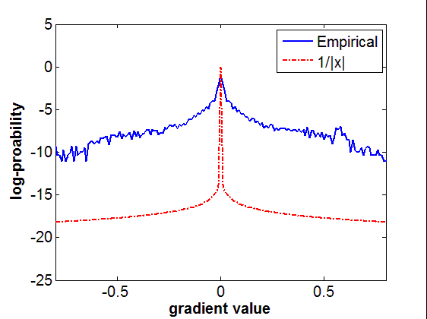
Remarks
The original Bayesian model, with f constant, results from the image prior (Jeffreys prior)
This prior does not resemble natural images statistics at all!
Ultimately, the type of estimator may completely determine which prior should be chosen.
Thus we cannot use the true statistics to justify the validity of our model.

Slide 47
Variational Bayesian Approach
Instead of MAP:
Solve
Here we are first averaging over all possible sharp images, and natural image statistics now play a vital role
[Levin et al., 2011]
Lemma: Under mild conditions, in the limit of large images, maximizing p(k|y) will recover the true blur kernel k if p(x) reflects the true statistics.

Slide 48
Approximate Inference
The integral required for computing p(k|y) is intractable.
Variational Bayes (VB) provides a convenient family of upper bounds for maximizing p(k|y) approximately.
Technique can be applied whenever p(x) is expressible in a particular variational form.

Slide 49
Maximizing Free Energy Bound
Assume p(k) is flat within constraint set, so we want to solve:
Useful bound [Bishop 2006]:
Minimization strategy (equivalent to EM algorithm):
Unfortunately, updates are still not tractable.
with equality iff

Slide 50
Practical Algorithm
New looser bound:
Iteratively solve:
Efficient, closed-form updates are now possible because the factorization decouples intractable terms.
[Palmer et al., 2006; Levin et al., 2011]

Slide 51
Questions
The above VB has been motivated as a way of approximating the marginal likelihood p(y|k).
However, several things remain unclear:
  What is the nature of this approximation, and how good is it?
  Are natural image statistics a good choice for p(x) when using VB?
  How is the underlying cost function intrinsically different from MAP?
A reformulation of VB can help here …

Slide 52
Equivalence
Solving the VB problem
is equivalent to solving the MAP-like problem
where
function that depends only on p(x)
[Wipf and Zhang, 2013]

Slide 53
Remarks
VB (via averaging out x) looks just like standard penalized regression (MAP), but with a non-standard image penalty g_{VB} whose shape is dependent on both the noise variance lambda and the kernel norm.
Ultimately, it is this unique dependency which contributes to VB’s success.

Slide 55
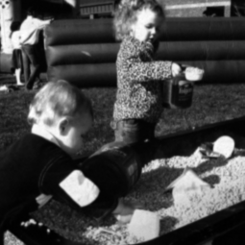
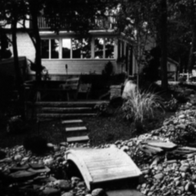
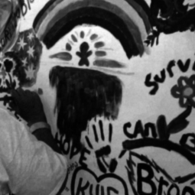
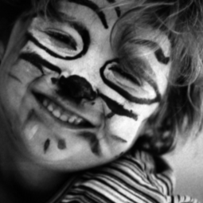
Blind Deblurring Results
Levin et al. dataset [CVPR, 2009]
  4 images of size 255 × 255 and 8 different empirically measured ground-truth blur kernels, giving in total 32 blurry images
K1-K4
Blur Kernels
Images
x1
x2
x3
x4
K5-K8

Slide 56
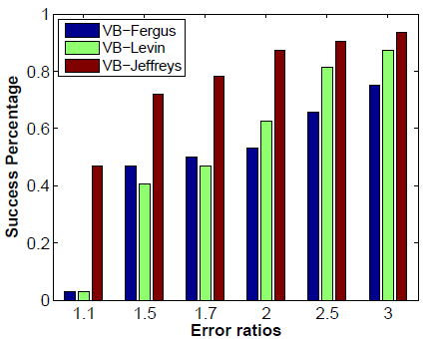
Comparison of VB Methods
Note: VB-Levin and VB-Fergus are based on natural image statistics [Levin et al., 2011; Fergus et al., 2006]; VB-Jeffreys is based on the theoretically motivated image prior.

Slide 57
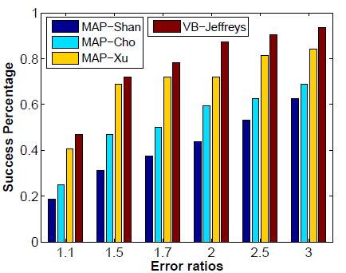
Comparison with MAP Methods
Note: MAP methods [Shan et al., 2008; Cho and Lee, 2009; Xu and Jia, 2010] rely on carefully-defined structure selection heuristics to local salient edges, etc., to avoid the no-blur (delta) solution. VB requires no such added complexity.

Slide 58
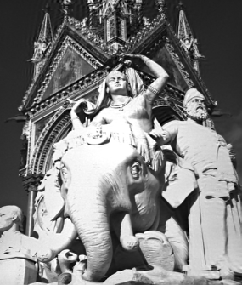

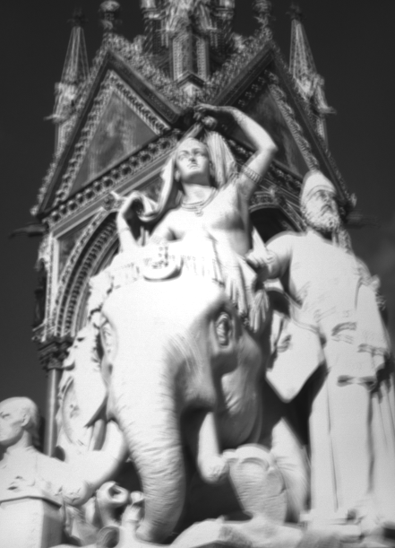
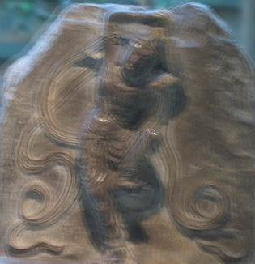
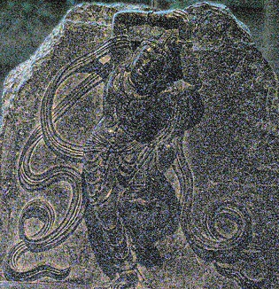
Extensions
Can easily adapt the VB model to more general scenarios:
  Non-uniform convolution models
  Multiple images for simultaneous denoising and deblurring
Blurry image is a superposition of translated and rotated sharp images
Blurry
Noisy
[Yuan, et al., SIGGRAPH, 2007]

Slide 59
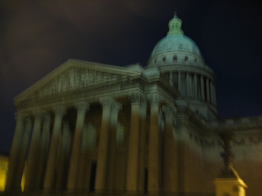
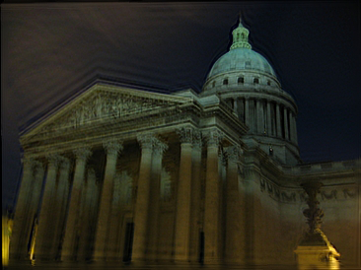
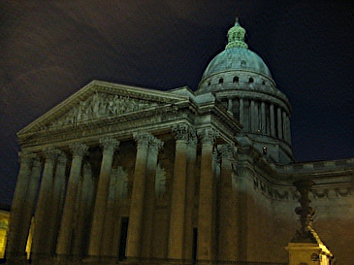
Non-Uniform Real-World Deblurring
Blurry
Whyte et al.
Zhang and Wipf
O. Whyte et al. , Non-uniform deblurring for shaken images, CVPR, 2010.
Notes:
X and gamme are shared, to effectively fuse the information from different observations together

Slide 60
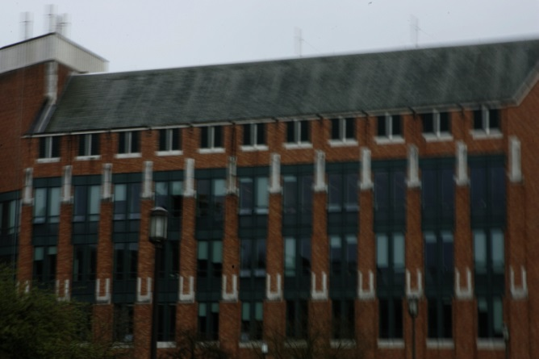
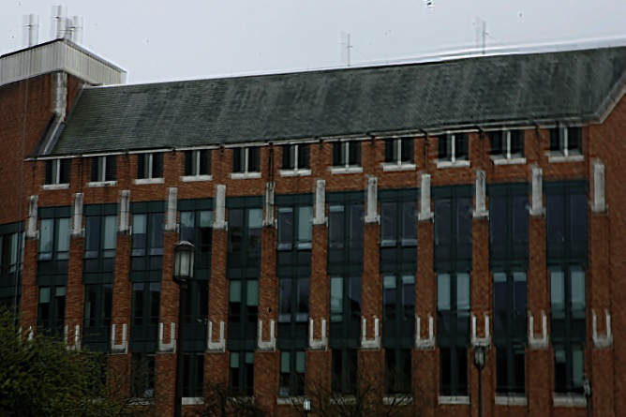
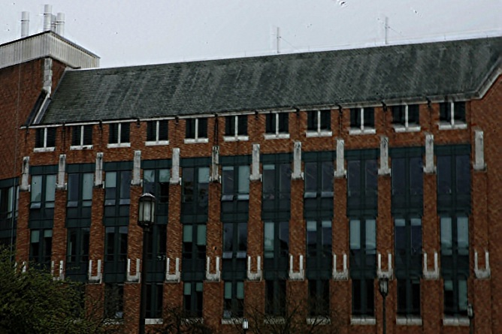
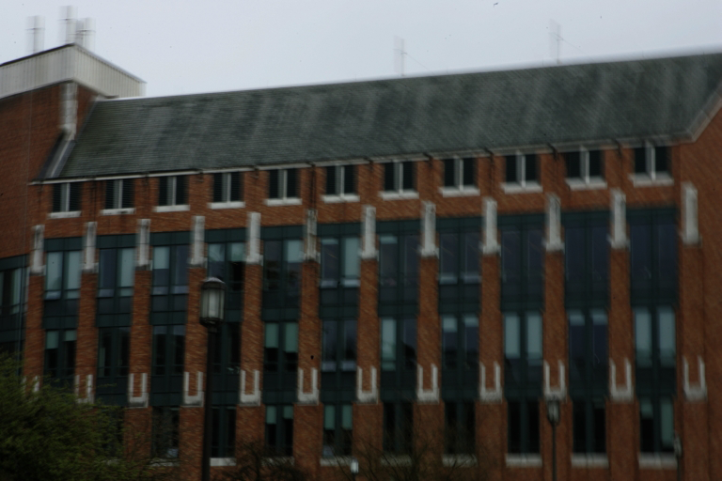


Non-Uniform Real-World Deblurring
Blurry
Gupta et al.
Zhang and Wipf
S. Hirsch et al. , Single image deblurring using motion density functions, ECCV, 2010.
Notes:
X and gamme are shared, to effectively fuse the information from different observations together

Slide 61
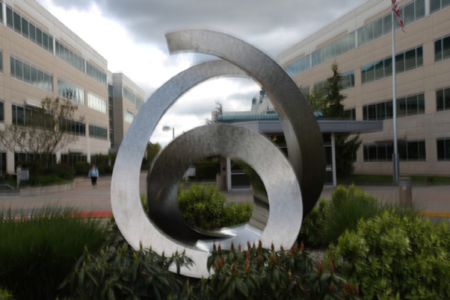
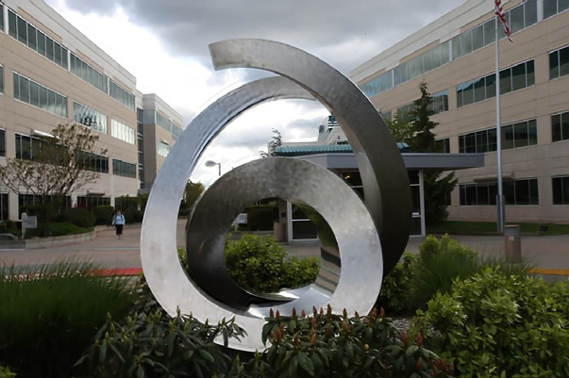

Non-Uniform Real-World Deblurring
Blurry
Joshi et al.
Zhang and Wipf
N. Joshi et al. , Image deblurring using inertial measurement sensors, SIGGRAPH, 2010.
Notes:
X and gamme are shared, to effectively fuse the information from different observations together

Slide 62
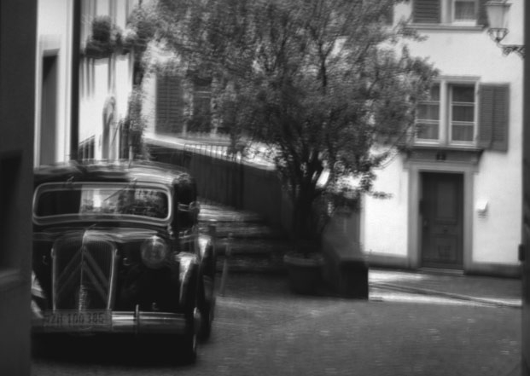
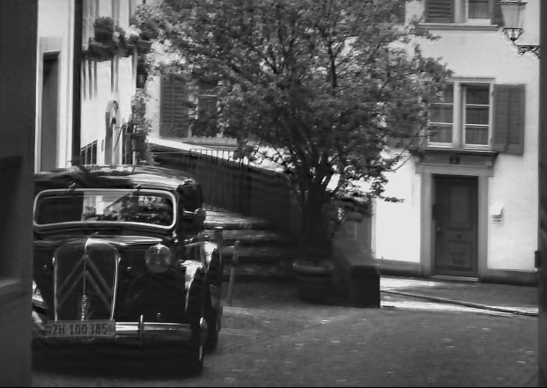
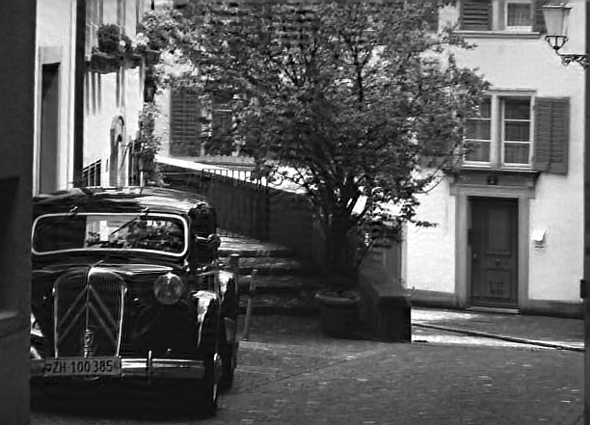
Non-Uniform Real-World Deblurring
Blurry
Hirsch et al.
Zhang and Wipf
S. Hirsch et al. , Fast removal of non-uniform camera shake, ICCV, 2011.
Notes:
X and gamme are shared, to effectively fuse the information from different observations together

Slide 63

Dual Motion Blind Deblurring
Real-world Image
Blurry I
Test images from: J.-F. Cai, H. Ji, C. Liu, and Z. Shen. Blind motion deblurring using
multiple images. J. Comput. Physics, 228(14):5057–5071, 2009.

Slide 64
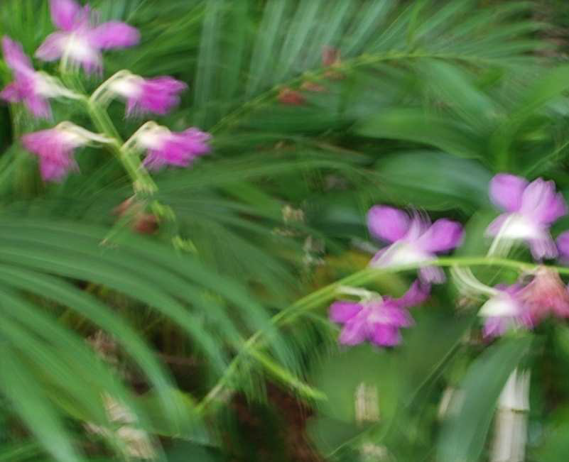
Dual Motion Blind Deblurring
Real-world Image
Blurry II
Test images from: J.-F. Cai, H. Ji, C. Liu, and Z. Shen. Blind motion deblurring using
multiple images. J. Comput. Physics, 228(14):5057–5071, 2009.

Slide 65
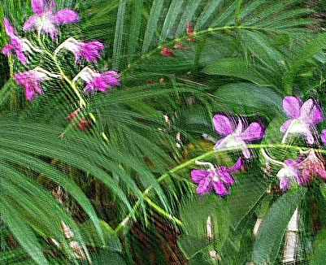
Dual Motion Blind Deblurring
Real-world Image
Cai et al.
J.-F. Cai, H. Ji, C. Liu, and Z. Shen. Blind motion deblurring using multiple images. J. Comput. Physics, 228(14):5057–5071, 2009.

Slide 66

Dual Motion Blind Deblurring
Real-world Image
Sroubek et al.
F.Sroubek and P. Milanfar. Robust multichannel blind deconvolution via fast alternating minimization. IEEE Trans. on Image Processing, 21(4):1687–1700, 2012.

Slide 67

Dual Motion Blind Deblurring
Real-world Image
Zhang et al.
H. Zhang, D.P. Wipf and Y. Zhang, Multi-Image Blind Deblurring Using a Coupled Adaptive Sparse Prior, CVPR, 2013.

Slide 68
Dual Motion Blind Deblurring
Real-world Image
Cai et al.
Sroubek et al.
Zhang et al.

Slide 69
Dual Motion Blind Deblurring
Real-world Image
Cai et al.
Sroubek et al.
Zhang et al.

Slide 70
Take-away Messages
In a wide range of applications, convex relaxations are extremely effective and efficient.
However, there remain interesting cases where non-convexity still plays a critical role.
Bayesian methodology provides one source of inspiration for useful non-convex algorithms.
These algorithms can then often be independently justified without reliance on the original Bayesian statistical assumptions.

Slide 71
References
D. Wipf and H. Zhang, “Revisiting Bayesian Blind Deconvolution,” arXiv:1305.2362, 2013.
D. Wipf, “Sparse Estimation Algorithms that Compensate for Coherent Dictionaries,” MSRA Tech Report, 2013.
D. Wipf, B. Rao, S. Nagarajan, “Latent Variable Bayesian Models for Promoting Sparsity,” IEEE Trans. Info Theory, 2011.
A. Levin, Y. Weiss, F. Durand, and W.T. Freeman, “Understanding and evaluating blind deconvolution algorithms,” Computer Vision and Pattern Recognition (CVPR), 2009.
Thank you, questions?

