Slide 1
Online Optimization for Power Networks
Changhong Zhao
Lingwen Gan
Steven Low
EE, CMS, Caltech
Enrique Mallada
ME, Johns Hopkins
January 2016
Notes:
May 2012: Santa Fe Institute Workshop on Smart Grid, Santa Fe, NM
July 2012: Network Science Workshop, Chinese University of Hong Kong, HK (Raymond Yeung)
Sept 2012: Melbourne University, EEE Department (Pascal van Hentenryck)
February 13, 2013: ITA Workshop, San Diego
May 20, 2013: IEEE Workshop on Modeling and Simulation of Cyber-Physical Energy Systems, Berkeley, CA (Peter Palensky, Edward A. Lee)
Oct 31, 2013: Google, Mountain View, CA (Arun Mazumdar)
Nov 5, 2013: Asilomar Conference, invited session on Power Networks (Edmund Yeh)
Nov 15, 2013: NSF Workshop on Smart Grid, Washington DC (Giannakis, Sairaj, SL)
Dec 2, 2013: UCLA EE (Mani Srivastava)
Dec 5, 2013: Keynote, GlobalSIP (Global Conf on Signal & Info Processing) Symposium on Signal Processing in Smart Grid (Shalinee Kishore, Lalitha Sankar)
Jan 16, 2014: Stanford Smart Grid seminar (Ram Rajagopal, Baosen Zhang)
Feb 4, 2014: 9th Annual CARNEGIE MELLON CONFERENCE ON THE ELECTRICITY INDUSTRY, (Marija Ilic, Krishnan Kant)
May 22, 2014: UC Berkeley (Kameshwar)
Oct 3, 2014: ASU (Junshan Zhang)
Nov 3, 2014: Asilomar Conference, invited session on Smart Grid: learning and optimization, Pacific Grove, CA
Nov 10, 2014: EE Control Group, Berkeley (Claire Tomlin)
Jan 16, 2015, Grid Science Winter School and Conference (Scott Backhaus, Misha Chertkov)
June 9, 2015: Advanced Mathematical Methods For Energy Systems: from Theory to Practice, Moscow, Russia (Janusz Bialek, Skoltech)
July 7, 2015, Tsinghua power systems group (Prof Song Yonghua)
July 21, 2015: Hong Kong University, EEE (David Hill, Victor Li)
Online algorithms
=============
Jan 14, 2016: IPAM Workshop on Optimization and Equilibrium of Energy Economics, UCLA, CA (Mike Ferris)
Jan 28, 2016: ESIF Workshop on Frontiers in Distributed Optimization and Control of Sustainable Power Systems, NREL, Golden, CO

Slide 2
Key message
Large network of DERs
  Real-time optimization at scale
Online optimization
  Network solves hard problems in real time for free
  Exploit it for our optimization/control
  Naturally adapts to evolving network conditions
Examples
  Slow timescale: OPF
  Fast timescale: frequency control

Slide 3
Outline
Optimal power flow
  DistFlow model and ACOPF
  Online algorithm
  Analysis and simulations
Load-side frequency control
  Dynamic model & design approach
  Distributed online algorithm
  Analysis and simulations
  Details
Main references (frequency control):
Zhao, Topcu, Li, Low, TAC 2014
Mallada, Zhao, Low, Allerton 2014
Zhao, Low, CDC 2014, Zhao et al CISS 2015

Slide 4
Bus injection model
Power flow equations
OPF = QCQP ➔ SDP relaxation

Slide 5
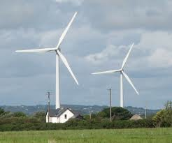

Branch flow model
j
k
directed graph G

Slide 6
Branch flow model
linear
quadratic
DistFlow equations (radial nk)
Baran & Wu, 1989

Slide 7
Branch flow model
Bus injection model
Branch flow model
DistFlow equations (radial nk)
Baran & Wu, 1989

Slide 8
Branch flow model
Bus injection model
Branch flow model
+ cycle condition on

Slide 9
Cycle condition
A relaxed solution satisfies the cycle condition if
incidence matrix;
depends on topology

Slide 10
Branch flow model
Bus injection model
Branch flow model
+ cycle condition on
Theorem: BIM = BFM
[Farivar & Low 2013 TPS
Bose et al 2012 Allerton]

Slide 11
Branch flow model
BFM and BIM are equivalent (nonlinear bijection)
… but some results are easier to formulate or
prove in one than the other
BFM is much more numerically stable
BFM is useful for radial networks
  Extremely efficient computation (BFS)
  Much better linearization
  Compact extension to multiphase unbalanced nk

Slide 12
SOCP relaxation
Bus injection model
SOC relaxation of BFM

Slide 13
SOCP relaxation of OPF

Slide 14
Sufficient conds for exact relaxation
For mesh networks, see recent works of Andy Sun, Pascal van Hentenryck on
relaxation of cycle condition
Tutorial: Convex relaxation of OPF, IEEE Trans. Control of Network Systems, 2014

Slide 15
Sufficient conds for exact relaxation
For mesh networks, see recent works of Andy Sun, Pascal van Hentenryck on
relaxation of cycle condition
Tutorial: Convex relaxation of OPF, IEEE Trans. Control of Network Systems, 2014

Slide 16
SOCP relaxation of OPF
But all these algorithms are offline …
… unsuitable for real-time optimization
network of distributed energy resources

Slide 17
OPF
controllable devices
F(x, y) = 0
BFM

Slide 18
OPF
controllable devices
F(x, y) = 0
BFM (DistFlow, radial network)

Slide 19
Approximate OPF
Recap
Reduce to x only
Add barrier function
on v(x)
L: nonconvex

Slide 20
Online gradient algorithm
gradient projection algorithm:
active control
law of physics
Explicitly exploits network to carry out part of algorithm
Naturally tracks changing network conditions

Slide 21
Online gradient algorithm
gradient projection algorithm:
active control
law of physics
Results
Local optimality
Global optimality
Suboptimality bound
[Gan & Low 2016 JSAC]

Slide 22
Local optimality
  x(t) converges to set of local optima
  if #local optima is finite, x(t) converges

Slide 23
Global optimality
Theorem
If all local optima are in A then
  x(t) converges to the set of global optima
  x(t) itself converges a global optimum

Slide 24
Global optimality
Theorem
  If SOCP is exact over X, then assumption holds

Slide 25
Suboptimality gap
any original
feasible pt
slightly away
from boundary
local
optimum
  Informally, a local minimum is almost as good
  as any strictly interior feasible point

Slide 26
Simulations

Slide 27
Outline
Optimal power flow
  DistFlow model and ACOPF
  Online algorithm
  Analysis and simulations
Load-side frequency control
  Dynamic model & design approach
  Distributed online algorithm
  Analysis and simulations
  Details
Main references (frequency control):
Zhao, Topcu, Li, Low, TAC 2014
Mallada, Zhao, Low, Allerton 2014
Zhao, Low, CDC 2014, Zhao et al CISS 2015

Slide 28
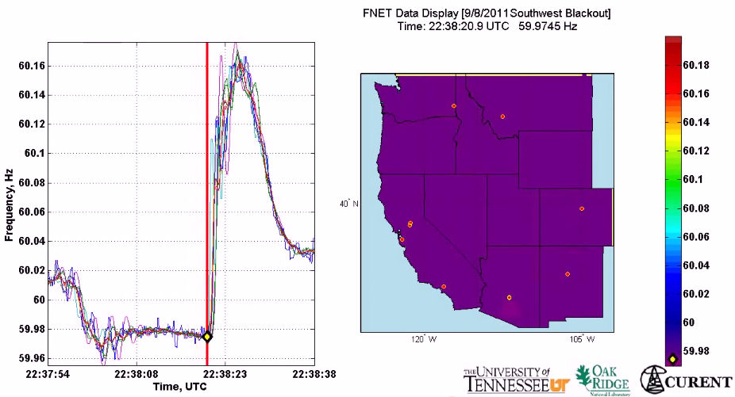
Motivation
  All buses synchronized to same nominal frequency (US: 60 Hz; Europe/China: 50 Hz)
  Supply-demand imbalance ➔ frequency fluctuation
(1 min)
2011 Southwest blackout

Slide 29
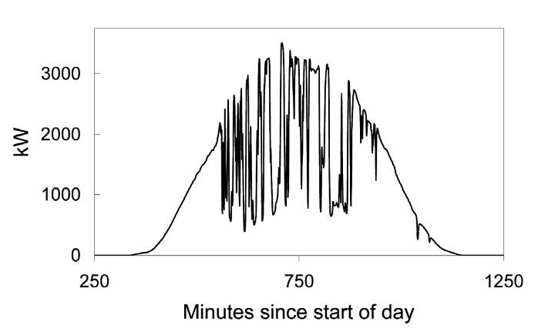
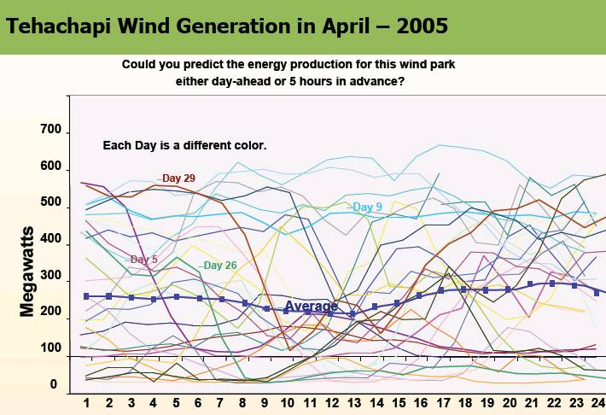
Motivation
Imagine when we have 50%+ renewable generation …
(10 min)
(1 min)

Slide 30
Why load-side participation
Ubiquitous continuous load-side control can supplement generator-side control
  faster (no/low inertia)
  no extra waste or emission
  more reliable (large #)
  better localize disturbances
  reducing generator-side control capacity
secondary freq control
economic
dispatch
primary
freq control
sec
min
5 min
60 min

Slide 31
What is the potential
Residential load accounts
for ~1/3 of peak demand
61% residential appliances
are Grid Friendly
US:
operating reserve: 13% of peak
total GFA capacity: 18%
Lu & Hammerstrom (2006), PNNL

Slide 32
How
How to design load-side frequency control ?
How does it interact with generator-side control ?

Slide 33
Literature: load-side control
Original idea & early analytical work
  Schweppe et al 1980; Bergin, Hill, Qu, Dorsey, Wang, Varaiya …
Small scale trials around the world
  D.Hammerstrom et al 2007, UK Market Transform Programme 2008
Early simulation studies
  Trudnowski et al 2006, Lu and Hammerstrom 2006, Short et al 2007, Donnelly et al 2010, Brooks et al 2010, Callaway and I. A. Hiskens, 2011, Molina-Garcia et al 2011
Analytical work – load-side control
  Zhao et al (2012/2014), Mallada and Low (2014), Mallada et al (2014), Zhao and Low (2014), Zhao et al (2015)
  Simpson-Porco et al 2013, You and Chen 2014, Zhang and Papachristodoulou (2014), Ma et al (2014), Zhao, et al (2014),
Recent analysis – generator-side/microgrid control:
  Andreasson et al (2013), Zhang and Papachristodoulou (2013), Li et al (2014), Burger et al (2014), You and Chen (2014), Simpson-Porco et al (2013), Hill et al (2014), Dorfler et al (2014)

Slide 34
Network model
branch power
generation
Will include generator-side
control later
loads:
controllable + freq-sensitive
i : region/control area/balancing authority

Slide 35
Network model
Generator bus: M_{i} > 0
Load bus: M_{i} = 0
Damping/uncontr loads:
Controllable loads:

Slide 36
Network model
swing dynamics
all variables are deviations
from nominal
extends to nonlinear power flow

Slide 37
Frequency control
Suppose the system is in steady state
Then: disturbance in gen/load …

Slide 38
Frequency control
current
approach
load-side
control

Slide 39
Outline
Network model
Distributed online algorithm
Simulations
Details
Main references:
Zhao, Topcu, Li, Low, TAC 2014
Mallada, Zhao, Low, Allerton 2014
Zhao, Low, CDC 2014, Zhao et al CISS 2015

Slide 40
Load-side controller design
Control goals (while min disutility)
  Rebalance power & stabilize frequency
  Restore nominal frequency
  Restore scheduled inter-area flows
  Respect line limits
Zhao, Topcu, Li, Low
TAC 2014
Mallada, Zhao, Low
Allerton, 2014

Slide 41
Load-side controller design
Control goals (while min disutility)
  Rebalance power & stabilize frequency
  Restore nominal frequency
  Restore scheduled inter-area flows
  Respect line limits
Zhao, Topcu, Li, Low
TAC 2014
Mallada, Zhao, Low
Allerton, 2014

Slide 42
Load-side controller design
Design control law
whose equilibrium
solves:
load disutility
power balance
inter-area flows
line limits
Control goals (while min disutility)
  Rebalance power & stabilize frequency
  Restore nominal frequency
  Restore scheduled inter-area flows
  Respect line limits
freq will emerge as
Lagrange multiplier
for power imbalance

Slide 43
Load-side controller design
Design control (G, F) s.t. closed-loop system
  is stable
  has equilibrium that is optimal
power network
load control

Slide 44
Load-side controller design
Idea: exploit system dynamic as part of primal-dual algorithm for modified opt
  Distributed algorithm
  Stability analysis
  Control goals in equilibrium
power network
load control

Slide 45
Summary: control architecture
physical network
Primary load-side frequency control
completely decentralized
Theorem: stable dynamic, optimal equilibrium
Zhao, Topcu, Li, Low. TAC 2014

Slide 46
Summary: control architecture
physical network
cyber network
Secondary load-side frequency control
communication with neighbors
Theorem: stable dynamic, optimal equilibrium
Mallada, Zhao, Low. Allerton 2014

Slide 47
Summary: control architecture
physical network
cyber network
With generator-side control, nonlinear power flow
load-side improves both transient & eq
Theorem: stable dynamic, optimal equilibrium
Zhao, Mallada, Low. CISS 2015

Slide 48
Outline
Network model
Load-side frequency control
Simulations
Details
Main references:
Zhao, Topcu, Li, Low, TAC 2014
Mallada, Zhao, Low, Allerton 2014
Zhao, Low, CDC 2014, Zhao et al CISS 2015

Slide 49
Local frequencies
[Tom Overbye, 2015 Cornell]

Slide 50
Simulations
Dynamic simulation of IEEE 39-bus system
Power System Toolbox (RPI)
Detailed generation model
Exciter model, power system
stabilizer model
Nonzero resistance lines

Slide 51
Primary control

Slide 52
Secondary control
swing dynamics
with OLC
area 1

Slide 53
Secondary control
line limit
no line limits
Total inter-area flow is
the same in both cases
line limit
with line limits

Slide 54
Key message
Large network of DERs
  Real-time optimization at scale
Online optimization
  Network solves hard problems in real time for free
  Exploit it for our optimization/control
  Naturally adapts to evolving network conditions
Examples
  Slow timescale: OPF
  Fast timescale: frequency control

Slide 55
more details
(backup)

Slide 56
Outline
Network model
Load-side frequency control
Simulations
Details
Main references:
Zhao, Topcu, Li, Low, TAC 2014
Mallada, Zhao, Low, Allerton 2014
Zhao, Low, CDC 2014, Zhao et al CISS 2015

Slide 57
Recall: design approach
Idea: exploit system dynamic as part of primal-dual algorithm for modified opt
  closed-loop system is stable
  its equilibria are optimal
power network
load control

Slide 58
Outline
Load-side frequency control
  Primary control
  Secondary control
  Interaction with generator-side control
Zhao et al SGC2012, Zhao et al TAC2014

Slide 59
Optimal load control (OLC)
demand = supply
disturbances
controllable
loads

Slide 60
system dynamics + load control
= primal dual alg
swing dynamics
implicit
load control
active control

Slide 61
Control architecture

Slide 62
Load-side primary control works
Theorem
Starting from any
system trajectory
converges to
  is unique optimal of OLC
  is unique optimal for dual
completely decentralized
frequency deviations contain right info for local decisions that are globally optimal

Slide 63
Recap: control goals
  Rebalance power
  Stabilize frequencies
  Restore nominal frequency
  Restore scheduled inter-area flows
  Respect line limits
Yes
Yes
No
No
No

Slide 64
Outline
Load-side frequency control
  Primary control
  Secondary control
  Interaction with generator-side control
Mallada, Low, IFAC 2014
Mallada et al, Allerton 2014

Slide 65
OLC for secondary control
demand = supply
restore nominal freq

Slide 66
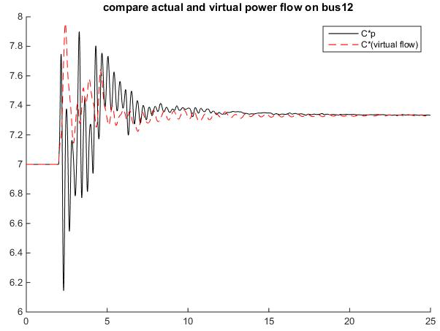
OLC for secondary control
demand = supply
restore nominal freq
key idea: “virtual flows”
in steady state:
virtual flow = real flows

Slide 67
OLC for secondary control
demand = supply
restore nominal freq
restore inter-area flow
respect line limit
in steady state:
virtual flow = real flows

Slide 68
Recall: primary control
swing dynamics:
implicit
active
control
load control:

Slide 69
Control architecture
physical network
cyber network

Slide 70
Secondary frequency control
load control:
computation & communication:
primal var:
dual vars:

Slide 71
Secondary control works
Theorem
starting from any initial point, system
trajectory converges s. t.
  is unique optimal of OLC
  nominal frequency is restored
  inter-area flows are restored
  line limits are respected

Slide 72
Recap: key ideas
Design optimal load control (OLC) problem
  Objective function, constraints
Derive control law as primal-dual algorithms
  Lyapunov stability
  Achieve original control goals in equilibrium
Distributed algorithms
primary control:
secondary control:

Slide 73
Recap: key ideas
Design optimal load control (OLC) problem
  Objective function, constraints
Derive control law as primal-dual algorithms
  Lyapunov stability
  Achieve original control goals in equilibrium
Distributed algorithms
Virtual flows
  Enforce desired properties on line flows
in steady state: virtual flow = real flows

Slide 74
Recap: control goals
  Rebalance power
  Resynchronize/stabilize frequency
  Restore nominal frequency
  Restore scheduled inter-area flows
  Respect line limits
Yes
Yes
Zhao, et al TAC2014
Yes
Yes
Yes
Mallada, et al Allerton2014
Secondary control restores nominal
frequency but requires local communication

Slide 75
Outline
Load-side frequency control
  Primary control
  Secondary control
  Interaction with generator-side control
Zhao and Low, CDC2014
Zhao, Mallada, Low, CISS 2015

Slide 76
Generator-side control
New model: nonlinear PF, with generator control
Recall model: linearized PF, no generator control

Slide 77
Generator-side control
New model: nonlinear PF, with generator control
generator bus: real power injection
load bus: controllable load

Slide 78
Generator-side control
New model: nonlinear PF, with generator control
generator buses:

Slide 79
Load-side control
physical network
cyber network

Slide 80
Load-side primary control works
Theorem
Every closed-loop equilibrium solves OLC and its dual
Suppose
Any closed-loop equilibrium is (locally) asymptotically stable provided

Slide 81
Conclusion
Forward-engineering design facilitates
  explicit control goals
  distributed algorithms
  stability analysis
Load-side frequency regulation
  primary & secondary control works
  helps generator-side control

