Slide 1
An Elliptical Form for the Power Flow Problem
Bernie Lesieutre (UW-Madison, LBNL)
Optimization and Equilibrium in Energy Economics,
IPAM, Los Angeles, January 15, 2016.
Support from MACS2

Slide 2
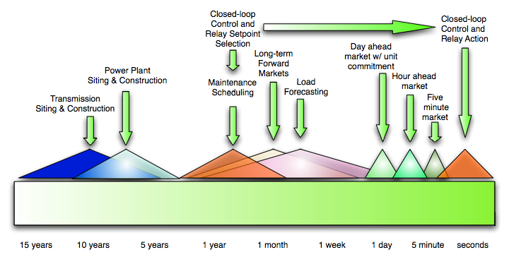
Power System Decision Timescales

Slide 3
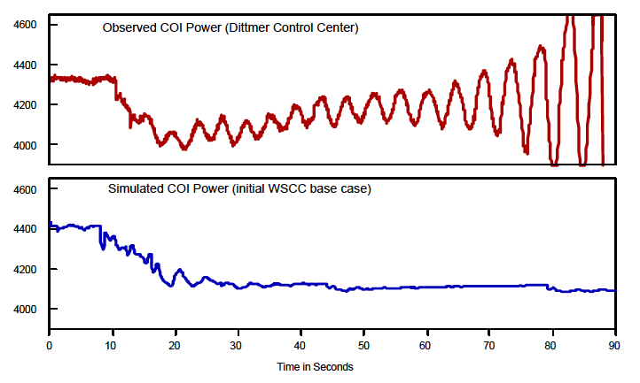
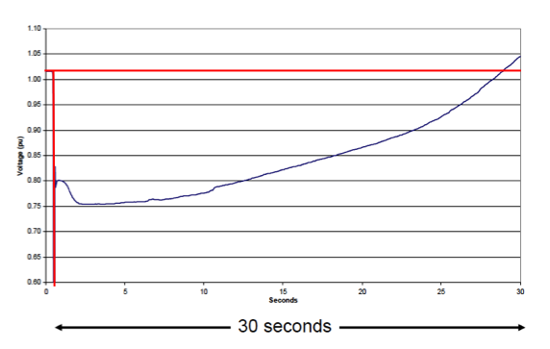
Life at the Physical Layer
“Angle” stability problems
Voltage Stability Problems

Slide 4
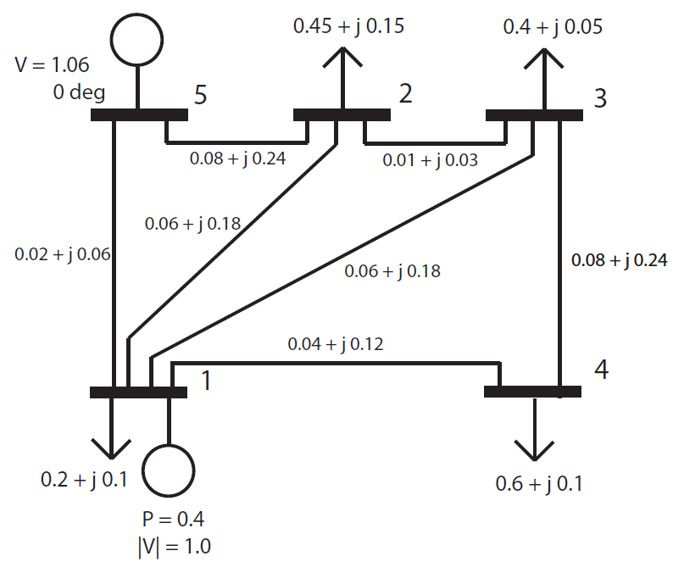
Power Flow Equations
In terms of elements of the bus admittance matrix, the power flow equations relating injected powers to voltages are
(Polar Coordinates)

Slide 5
Traditional Power Flow Problem
Textbook approach
Specify
Load Active Power and Load Reactive Power
Generator Voltage Magnitude and Active Power
One “slack bus” with Voltage Magnitude and Angle
Solve for
Load Voltage Magnitude and Angle
Generator Reactive Power and Angle
Slack bus Active and Reactive Power
Observation:
Tight constraints on
load bus powers, gen bus active power and voltage, and slack bus voltage and angle.
Loose constraints on
load bus voltages, gen bus reactive power, slack bus active and reactive power, and line flows.

Slide 6
Power Flow Extras!
Other Components:
  LTCs ( network voltage control)
  SVDs (network voltage control)
  DC lines ( a few dedicated controllable lines)
  PARs ( ~ network angle control)
Other Problems
  Multiple solutions ( ~ stability margins)
  Multiple solutions ( bifurcation analysis)
  and, most commonly,
    Optimal Power Flow

Slide 7
Basic Optimal Power Flow
Adjust the power flow problem by
Adding an objective function:
  minimize dispatch cost
Change Constraints:
  Tighten voltage constraints at loads
  Tighten power flow constraints
  Loosen Power injection constraints at generators

Slide 8


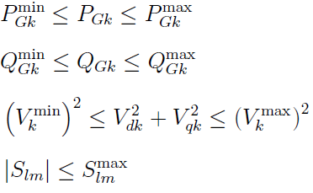
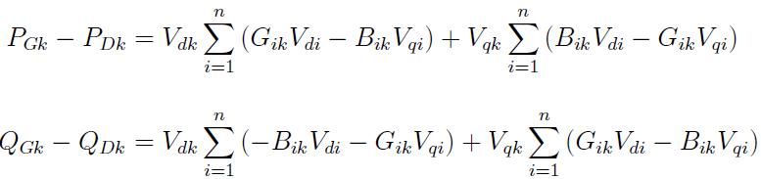
Classical OPF Problem
Cost
Engineering
Constraints
+
Physical Laws

Slide 9
OPF Variations . are . numerous
Different Objectives:
Traditional variants include
  minimize losses (maximize energy efficiency)
  achieve a target voltage profile
  include security constraints
Modern Objectives focus on Electricity Markets
Short term -
  Minimize cost for procuring energy
  Minimize cost for procuring emergency reserves
  Minimize cost for procuring regulation reserves
Long term –
  Market for ensuring future generation capacity
  Market for allocation of Financial Transmission Rights

Slide 10
Market OPFs … get complicated quickly
Multiple short-term timeframes
  day-ahead, hourly schedule
  real-time adjustments
  account for transitions
Multiple uses for a resources capacity:
  energy
  reserves
  regulation
With separate market offers, these markets are “co-optimized,” accounting for resource capacity and transition limits, and sometimes with a restriction on simultaneous allocation (disjunctive constraint).

Slide 11
Market OPFs … get complicated quickly
Ramp Rates
Co-optimization
Real-Time Dispatch
YIKES!
Offers
Disjunctive constraint
Day Ahead Schedule
Reserves
Regulation
Bids
Opportunity Cost
OOM
DG
Hourly Schedule
Energy
Demand Response
Capacity

Slide 12
Math Problem du jour
Solve the Power Flow Equations… completely.
This has been studied for a long time.
It turns out to be a hard problem…

Slide 13
Previous Work
18th Century Bezout (1779): Applied to Power Systems
In rectangular coordinates the power flow equations form coupled quadratic equations. The number of possible complex solutions are given by Bezout:
That’s a lot of solutions!

Slide 14
Previous Work
20th Century
Tavora & Smith (1972): 3-bus example admits 0, 2, 4 & 6 solutions.
Note: All three buses are “PV” buses.
Voltage Magnitudes are fixed, voltage angle are unknown except for reference bus.
For lossless system, unloaded conditions, there are 6 solutions

Slide 15
Previous Work
20th Century
Tavora & Smith (1972): 3-bus example admits 0, 2, 4 & 6 solutions.
Note: All three buses are “PV” buses.
Voltage Magnitudes are fixed, voltage angle are unknown except for reference bus.
For lossless system, unloaded conditions, there are 6 solutions

Slide 16
Previous Work
20th Century
Similar for PQ buses
Example: Capacitive reactive power support at load buses.
Inefficient power loop for two solutions.
For lossless system, unloaded conditions, reactive power support, there are 6 solutions
A solution is any vector with

Slide 17
Previous Work
20th Century
Similar for PQ buses
Example: Fixed reactive power support at load buses. Zero active power load.
Inefficient power loop for two solutions.
For lossless system, unloaded conditions, reactive power support, there are 6 solutions

Slide 18
Previous Work
20th Century
Baillieul & Byrnes (1982): bound the number of solutions by
This is consistent with number of solutions found by Tavora and Smith.
Still a large number.
However… these are the number of complex solutions.
Empirically for N>3, the number of real-valued solutions is much, much lower.
Knowledge of a bound, doesn’t find the solutions.

Slide 19
Previous Work
20th Century
Salam (1989): Globally convergent probability– one homotopy method:
Trace solutions as a function λ.
A trace is required for each complex solution. Sift for real-valued solutions.
(This must be done carefully, but it does work.)

Slide 20
Previous Work
20th Century
Salam (1989): Examples:
5 Bus system: 70 traces, 10 real-valued solutions.
7 Bus system: 917 traces, 4 real-valued solutions.
Empirically, the number of real-valued solutions appears to be much smaller than the bound.

Slide 21
Previous Work
20th Century
Ma & Thorp (1993): Efficient method, S*N continuation traces to find all the real-valued solutions.

Slide 22
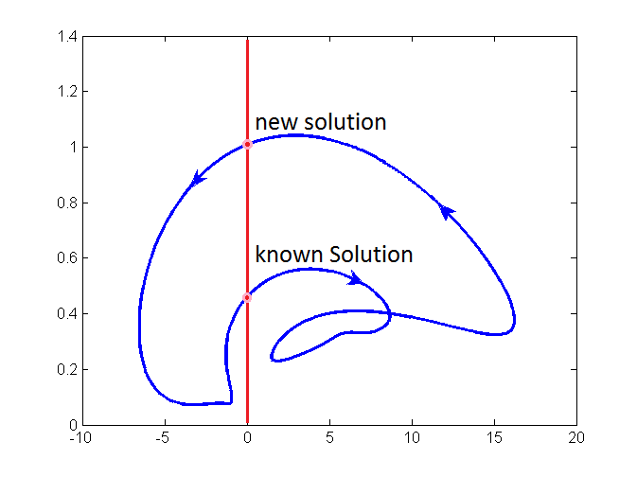
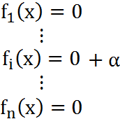
Revisit Ma-Thorp Method
Form traces using power flow active power equations (and possibly reactive power equations)
x
continuously change α
Every Point at which α = 0 is a solution to the power flow equations.
They prove that these particular traces are bounded and must form loops.
They prove that all the solutions are connected by these loops.
α

Slide 23
Revisit Ma-Thorp Method
Form traces using power flow active power equations (and possibly reactive power equations)
x
This is spectacularly efficient!
α

Slide 24
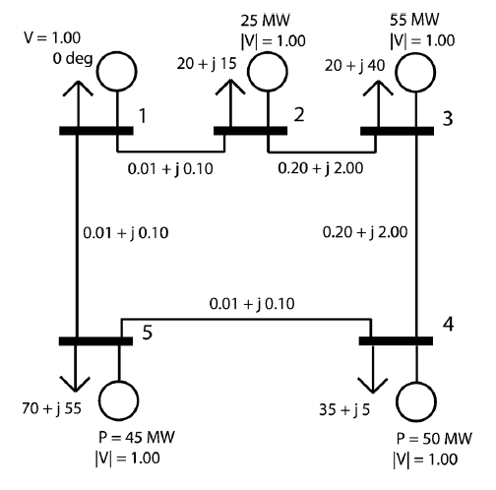
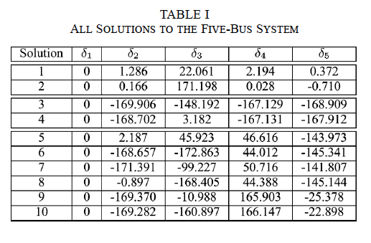
Some Previous Work
21th Century
Molzahn & Lesieutre (2013): 5-bus counter example to Ma-Thorp method

Slide 25
FIDVR Cascade: Do All Motors Stall?
Grid Voltage
V
Loads denoted by arrows.
25 Buses, 13 loads, tree distribution network, single connection to the grid.
Is it possible for a fraction of motors to stall in this network without stalling them all?

Slide 26
Bifurcation Diagrams: slip vs. voltage
Conclusions require confidently knowing that we have tracked all possible solutions

Slide 27
Some Previous Work
21th Century
Molzahn & Lesieutre (2013): 5-bus counter example to Ma-Thorp method
Mehta, Nguyen & Turitsyn (2014): trace 49 Million homotopies on IEEE 14-bus to find 30 real solutions
Molzahn, Mehta, & Niemerg (2016): topological influence on number of solutions
Lesieutre and Wu (2015) locate all the 30 solutions of IEEE 14-bus system with 299 traces

Slide 28
Extend Ma-Thorp Method
Increase the number of paths to be traveled:
Include Voltage Magnitude Equations
Represent the Power Flow Equations at Ellipses
Repeat tracing method
Main Result: the Power Flow Equations can be expressed as high dimensional ellipses.

Slide 29
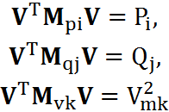


The Power Flow Equations in Rectangular Coordinates
where ; i is the index for all the buses excluding the slack bus; j is the index for PQ bus; k is the index for PV bus.
are symmetric rank-4 matrices with two repeated positive eigenvalues and two repeated negative eigenvalues. [James Foster‘13] NOT ellipses.

Slide 30
Ellipses!
Linear Combinations of these equations are Ellipses. In particular,
Define the positive definite matrix T for a base ellipse:
and form power system equations as perturbations of a base ellipse
Small Print: may not work for all systems. When in doubt, set up SDP:

Slide 31
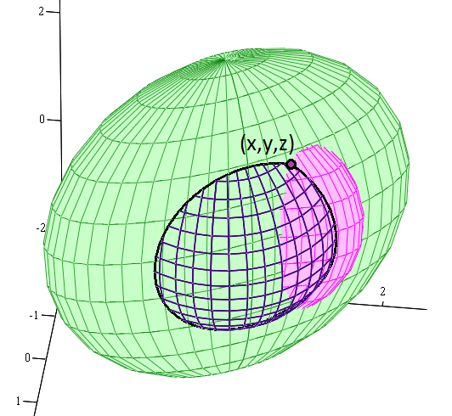
Power Flow Ellipses
Now apply tracing algorithm as used in
Ma-Thorp Paper

Slide 32
Results
Apply the High-Dimensional Elliptical structure to systems whose solution sets are known.
Cases | # real solutions | # paths traced | Baillieul Bound | Bezout Bound
Tavora & Smith 3 bus | 6 | 8 | 6 | 16
Baillieul & Byrnes 4 bus | 12 | 18 | 20 | 64
Wisconsin 5 bus | 10 | 38 | 70 | 256
Salam 5 bus | 10 | 28 | 70 | 256
Salam 7 bus | 4 | 21 | 924 | 4096
IEEE 14 bus | 30 | 299 | 10400600 | 67108864

Slide 33
Applications for Optimal Power Flow
1. Include “angle” stability in OPF
How is that done now?
By proxy, using nomograms.

Slide 34
SCIT Nomogram
The total import capabililty into Soutern California limited by flow from “East of River”, and system inertia.
Bounds reflect thermal, voltage, and stability constraints.
These are determined by numerous off-line studies.
Total Southern California Imports
“East of River” Flow

Slide 35
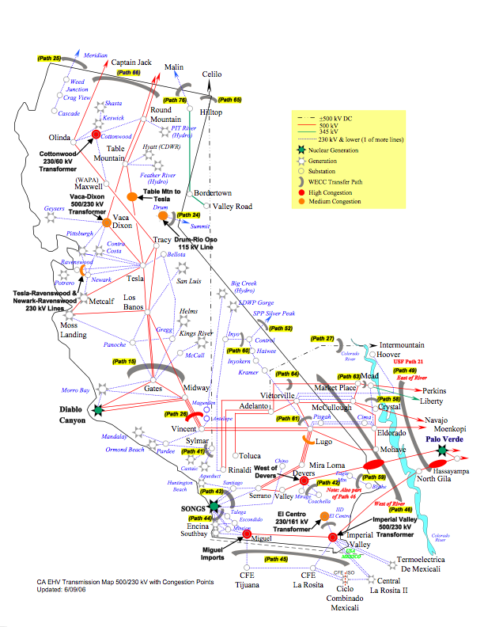
California High Voltage Grid

Slide 36
OPF Problem with stability constraint
Cost
Engineering
Constraints
+
Physical Laws

Slide 37
OPF Problem with stability constraint
Cost
Engineering
Constraints
Dynamic Security Assessment
Is a “Grand Challenge”
+
Physical Laws

Slide 38
Power Flow Solutions are Dynamic Equilibria
The Power Flow solutions are the dynamic equilibriums: Needed for energy function analysis.
Power Flow Solutions
Stability Margin
Depends on multiple equilibria
The boundary of the region of attraction is the union of stable manifolds of certain
type-1 unstable equilibrium points.

Slide 39
Applications for Optimal Power Flow
Include “angle” stability in OPF
Other. Further research into exploiting this form to analyze optimal power flow characteristics.
    Optimally solve OPF. (skeptical)
    Use to identify Redundant constraints. (maybe)
    Use this approach to find multiple local minima. (probable)

Slide 40
Conclusions
The power flow equations can be written as ellipses.
This form appears to facilitate finding all the solutions… perhaps. No proof.
The elliptical form of the equations may have other applications. Various flavors of optimal power flow.
This is a fun problem.

