Slide 1
Differential Privacy Tutorial
Part 1: Motivating the Definition
Cynthia Dwork, Microsoft Research
TexPoint fonts used in EMF.
Read the TexPoint manual before you delete this box.: AAAAAAAA

Slide 2
A Dream?
C
?
Original Database
Sanitization
Very Vague
And Very Ambitious
Census, medical, educational, financial data, commuting patterns,
web traffic; OTC drug purchases, query logs, social networking, …

Slide 3
Reality: Sanitization Can’t be Too Accurate
Dinur, Nissim [2003]
  Assume each record has highly private bi (Sickle cell trait, BC1, etc.)
    Query: Q µ [n]
    Answer = ∑_{i 2 Q} d_{i} Response = Answer + noise
  Blatant Non-Privacy: Adversary Guesses 99% bits
  Theorem: If all responses are within o(n) of the true answer, then the algorithm is blatantly non-private.
  Theorem: If all responses are within o(√n) of the true answer, then the algorithm is blatantly non-private even against a polynomial time adversary making n log² n queries at random.

Slide 4
Proof: Exponential Adversary
Focus on Column Containing Super Private Bit
Assume all answers are within error bound E.
1
0
0
“The database”
1
0
1
1
d

Slide 5
Proof: Exponential Adversary
Estimate #1’s in All Possible Sets
  8 S µ [n]: |K (S) – Σ_{i 2 S} d_{i} | ≤ E
Weed Out “Distant” DBs
  For each possible candidate database c:
    If, for any S, |∑_{i 2 S} c_{i} – K (S)| > E, then rule out c.
    If c not ruled out, halt and output c
  Real database, d, won’t be ruled out

Slide 6
Proof: Exponential Adversary
8 S, |∑_{i} _{2 S} c_{i} – K (S)| ≤ E.
Claim: Hamming distance (c,d) ≤ 4E
0
|K(S₀) - ∑_{i 2 S0} c_{i} | ≤ E (c not ruled out)
|K(S₀) - ∑_{i 2 S0} d_{i} | ≤ E
|K(S₁) - ∑_{i 2 S1} c_{i} | ≤ E (c not ruled out)
|K(S₁) - ∑_{i 2 S1} d_{i} | ≤ E
S₀
0
0
0
1
1
0
S₁
1
1
1
1
d
c

Slide 7
Reality: Sanitization Can’t be Too Accurate
1
0
  Extensions of [DiNi03]
0
1
  Blatant non-privacy if:
  all / 0.761cn / (1/2 + ε) c’n
  answers are within o(√n) of the true answer,
  even against an adversary restricted to
  queries n / cn / c’n
  comp poly(n) / poly(n) / exp(n)
  [DY08] / [DMT07] / [DMT07]
  Results are independent of how noise is distributed.
  A variant model permits poly(n) computation in the final case [DY08].
0
1
1

Slide 8
What if We Restrict the Total # of Sum Queries?
This Works.
Sufficient: noise depends on number of queries
  Independent of database, its size, the actual query
  MSN daily user logs: millions of records, <300 queries
  Privacy Noise << sampling error
Sums are Powerful!
  Principal component analysis, singular value decomposition, perceptron, k-means clustering, ID3, association rules, and STAT learning
  Provably private, high quality approximations (for large n)
Notes:
Principal component analysis, singular value decomposition, perceptron, k-means clustering, ID3, association rules, and STAT learning

Slide 9
Limiting the Number of Sum Queries [DwNi04]
C
?
Multiple Queries, Adaptively Chosen
e.g. n/polylog(n), noise o(√n)
Accuracy eventually deteriorates as # queries grows
Has also led to intriguing non-interactive results
Sums are Powerful [BDMN05]
(Pre-DP. Now know achieved a version of Differential Privacy)
Notes:
The distinction between the models is somewhat artificial.
All this was before the definition of DP

Slide 10
Auxiliary Information
Information from any source other than the statistical database
  Other databases, including old releases of this one
  Newspapers
  General comments from insiders
  Government reports, census website
  Inside information from a different organization
    Eg, Google’s view, if the attacker/user is a Google employee

Slide 11
Linkage Attacks: Malicious Use of Aux Info
Using “innocuous” data in one dataset to identify a record in a different dataset containing both innocuous and sensitive data
Motivated the voluminous research on hiding small cell counts in tabular data release

Slide 12
AOL Search History Release (2006)
650,000 users, 20 Million queries, 3 months
AOL’s goal:
  provide real query logs from real users
Privacy?
  “Identifying information” replaced with random identifiers
  But: different searches by the same user still linked

Slide 13
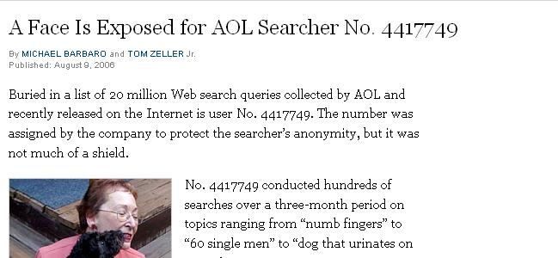
AOL Search History Release (2006)
Name: Thelma Arnold
Age: 62
Widow
Residence: Lilburn, GA

Slide 14
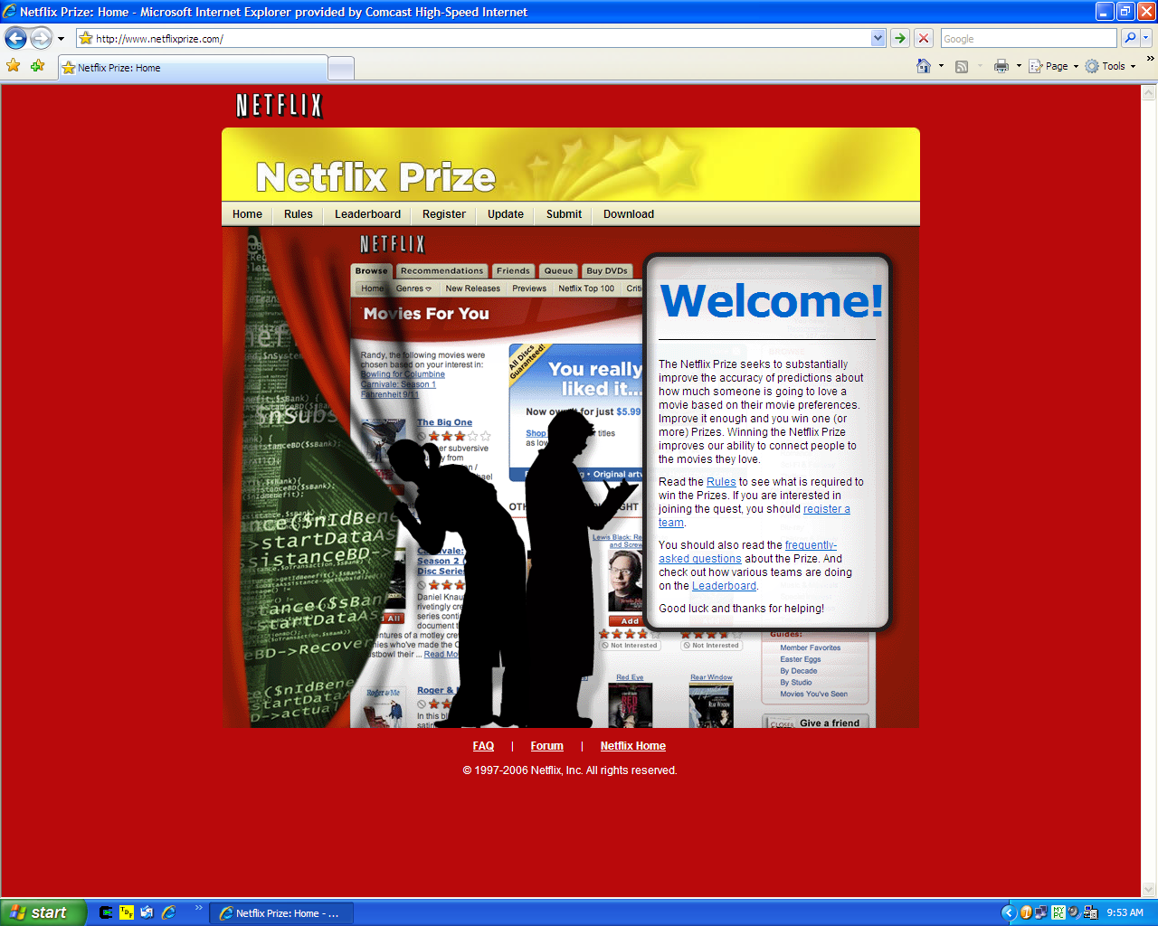

Slide 15
The Netflix Prize
Netflix Recommends Movies to its Subscribers
  Seeks improved recommendation system
  Offers $1,000,000 for 10% improvement
    Not concerned here with how this is measured
  Publishes training data

Slide 16
From the Netflix Prize Rules Page…
“The training data set consists of more than 100 million ratings from over 480 thousand randomly-chosen, anonymous customers on nearly 18 thousand movie titles.”
“The ratings are on a scale from 1 to 5 (integral) stars. To protect customer privacy, all personal information identifying individual customers has been removed and all customer ids have been replaced by randomly-assigned ids. The date of each rating and the title and year of release for each movie are provided.”

Slide 17
From the Netflix Prize Rules Page…
“The training data set consists of more than 100 million ratings from over 480 thousand randomly-chosen, anonymous customers on nearly 18 thousand movie titles.”
“The ratings are on a scale from 1 to 5 (integral) stars. To protect customer privacy, all personal information identifying individual customers has been removed and all customer ids have been replaced by randomly-assigned ids. The date of each rating and the title and year of release for each movie are provided.”

Slide 18
A Source of Auxiliary Information
Internet Movie Database (IMDb)
  Individuals may register for an account and rate movies
  Need not be anonymous
  Visible material includes ratings, dates, comments

Slide 19
A Linkage Attack on the Netflix Prize Dataset [NS06]
“With 8 movie ratings (of which we allow 2 to be completely wrong) and dates that may have a 3-day error, 96% of Netflix subscribers whose records have been released can be uniquely identified in the dataset.”
“For 89%, 2 ratings and dates are enough to reduce the set of plausible records to 8 out of almost 500,000, which can then be inspected by a human for further deanonymization.”
Attack prosecuted successfully using the IMDb.
  NS draw conclusions about user.
  May be wrong, may be right. User harmed either way.
    Gavison: Protection from being brought to the attention of others

Slide 20
Other Successful Attacks
Against anonymized HMO records [S98]
  Proposed K-anonymity
Against K-anonymity [MGK06]
  Proposed L-diversity
Against L-diversity [XT07]
  Proposed M-Invariance
Against all of the above [GKS08]
Notes:
Backstrom Dwork Kleinberg www2007
Kumar, Novak, Pang, Tomkins www2007
Machanavajjhala Gehrke Kifer icde 2006 L-diversity: at most 1/L in each group can share the same value of the sensitive attribute – so within each group there are L possible values
Xiao Tao Sigmod 2007
Ganta-Kasiviswanathan-Smith, KDD 2008

Slide 21
“Composition” Attacks [Ganta-Kasiviswanathan-Smith, KDD 2008]
Individuals
Curators
Hospital A
statsA
Attacker
sensitive information
Hospital B
statsB
Example: two hospitals serve overlapping populations
  What if they independently release “anonymized” statistics?
Composition attack: Combine independent releases

Slide 22
“Composition” Attacks [Ganta-Kasiviswanathan-Smith, KDD 2008]
Individuals
Curators
“Adam has either diabetes
or high blood pressure”
Hospital A
statsA
Attacker
sensitive information
Hospital B
statsB
“Adam has either diabetes
or emphyzema”
Example: two hospitals serve overlapping populations
  What if they independently release “anonymized” statistics?
Composition attack: Combine independent releases

Slide 23
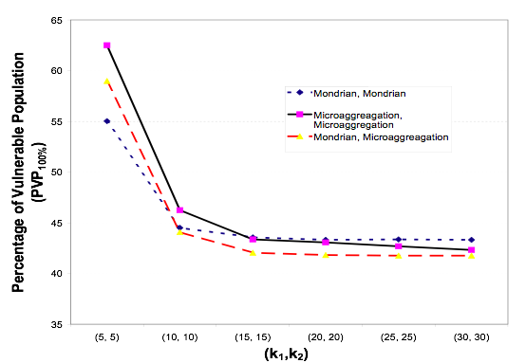
“Composition” Attacks [Ganta-Kasiviswanathan-Smith, KDD 2008]
“IPUMS” census data set. 70,000 people, randomly split into 2 pieces with overlap 5,000.
With popular technique
(k-anonymity, k=30)
for each database,
can learn “sensitive” variable for 40% of individuals

Slide 24
Analysis of Social Network Graphs
“Friendship” Graph
  Nodes correspond to users
  Users may list others as “friend,” creating an edge
    Edges are annotated with directional information
Hypothetical Research Question
  How frequently is the “friend” designation reciprocated?

Slide 25
Anonymization of Social Networks
Replace node names/labels with random identifiers
Permits analysis of the structure of the graph
Privacy hope: randomized identifiers make it hard/impossible to identify nodes with specific individuals, thereby hiding the privacy of who is connected to whom
Disastrous! [BDK07]
  Vulnerable to active and passive attacks

Slide 26
Flavor of Active Attack
Prior to release, create subgraph of special structure
  Very small: circa √(log n) nodes
  Highly internally connected
  Lightly connected to the rest of the graph
Notes:
12 on gaph of 100 million nodes

Slide 27
Flavor of Active Attack
Connections:
  Victims: Steve and Jerry
  Attack Contacts: A and B
  Finding A and B allows finding Steve and Jerry
A
S
B
J

Slide 28
Flavor of Active Attack
Magic Step
  Isolate lightly linked-in subgraphs from rest of graph
Special structure of subgraph permits finding A, B
A
S
B
J
Notes:
The algorithm finds the minimal cuts between any pairs in graph. At the start The algorithm chooses two nodes and calculates the minimal cut between them and the min cut groups. These groupes are beeing separating into two graphs and the algorithm remembers the minimal cut between them. Now in every iteration the algorithm chooses two nodes from the same group and calculates the minimal cut between them, taking in acount the other groups as a single dot (node), which the maximal flow to and from it (dot) is the maximal flow that was found in one of the previous iterations. At the end of the algorithm The Gomory - HU tree is built. That tree represent the maximal flow between all two pairs in the graph, which is the minimal edge capacity of the path between those to edges.

Slide 29
Anonymizing Query Logs via Token-Based Hashing
Proposal: token-based hashing
  Search string tokenized; tokens hashed to identifiers
Successfully attacked [KNPT07]
  Requires as auxiliary information some reference query log, eg, the published AOL query log
  Exploits co-occurrence information in the reference log to guess hash pre-images
  Finds non-star names, companies, places, “revealing” terms
  Finds non-star name + {company, place, revealing term}
  Fact: frequency statistics alone don’t work
Notes:
Kumar, Novak, Pang, Tomkins www2007

Slide 30
Definitional Failures
Guarantees are Syntactic, not Semantic
  k, l, m
  Names, terms replaced with random strings
Ad Hoc!
  Privacy compromise defined to be a certain set of undesirable outcomes
  No argument that this set is exhaustive or completely captures privacy
Auxiliary information not reckoned with
  In vitro vs in vivo

Slide 31
Why Settle for Ad Hoc Notions of Privacy?
Dalenius, 1977
  Anything that can be learned about a respondent from the statistical database can be learned without access to the database
  An ad omnia guarantee
Popular Intuition: prior and posterior views about an individual shouldn’t change “too much”.
  Clearly Silly
    My (incorrect) prior is that everyone has 2 left feet.
Unachievable [DN06]

Slide 32
Why is Daelnius’ Goal Unachievable?
The Proof Told as a Parable
  Database teaches smoking causes cancer
  I smoke in public
  Access to DB teaches that I am at increased risk for cancer
Proof extends to “any” notion of privacy breach.
Attack Works Even if I am Not in DB!
  Suggests new notion of privacy: risk incurred by joining DB
    “Differential Privacy”
  Before/After interacting vs Risk when in/not in DB
Notes:
Etymology: Middle English, from Anglo-French, from Late Latin parabola, from Greek parabolē comparison, from paraballein to compare, from para- + ballein to throw — more at devil Date: 14th century : example; specifically : a usually short fictitious story that illustrates a moral attitude or a religious principle

Slide 33
Differential Privacy is …
… a guarantee intended to encourage individuals to permit their data to be included in socially useful statistical studies
  The behavior of the system -- probability distribution on outputs -- is essentially unchanged, independent of whether any individual opts in or opts out of the dataset.
… a type of indistinguishability of behavior on neighboring inputs
  Suggests other applications:
    Approximate truthfulness as an economics solution concept [MT07, GLMRT]
    As alternative to functional privacy [GLMRT]
… useless without utility guarantees
  Typically, “one size fits all” measure of utility
  Simultaneously optimal for different priors, loss functions [GRS09]

Slide 34
Differential Privacy [DMNS06]
K gives ε - differential privacy if for all neighboring D1 and D2, and all C µ range(K ): Pr[ K (D1) 2 C] ≤ e^{ε} Pr[ K (D2) 2 C]
Neutralizes all linkage attacks.
Composes unconditionally and automatically: Σ_{i} ε _{i}
ratio bounded
Pr [response]
Bad Responses:
X
X
X

