Slide 1

Privacy of Dynamic Data: Continual Observation and Pan Privacy
Moni Naor
Weizmann Institute of Science
(visiting Princeton)
Based on joint papers with: Cynthia Dwork, Toni Pitassi, Guy Rothblum and Sergey Yekhanin

Slide 2
Sources
Based on
Cynthia Dwork, Moni Naor, Toni Pitassi, Guy Rothblum and Sergey Yekhanin, Pan-private streaming algorithms, ICS 2010
Cynthia Dwork, Moni Naor, Toni Pitassi and Guy Rothblum, Differential Privacy Under Continual Observation, STOC 2010.

Slide 3
Talk Plan
Dealing with dynamic data
Three new issues/concepts:
  Continual Observation
  Pan Privacy
  User vs. Event Level Protection
Continual Output: Counter
  Algorithm
  Lower bound
  Applications of Counters: Combining Expert Advice
Pan Privacy
  Pan Private Density Estimation
  Pan Private Incidence Counter
General Transformation

Slide 4
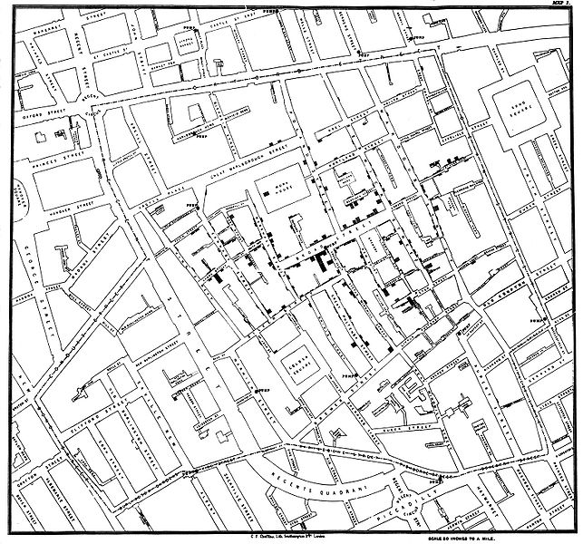
Useful Data
Cholera cases
Suspected
pump
John Snow’s map
  Cholera cases in London 1854 epidemic

Slide 5
Differential Privacy
Dwork, McSherry Nissim & Smith 2006
Protect individual participants:
Curator/
Sanitizer
+
Curator/
Sanitizer

Slide 6
Differential Privacy [DwMcNiSm06]
Protect individual participants:
  Probability of every bad event - or any event - increases only by small multiplicative factor when I enter the DB.
  May as well participate in DB…
ε-differentially private sanitizer A
For all DBs D, all Me and all events T
Adjacency: D+Me and D-Me
Handles aux input
Pr_{A}[A(D+Me)T]
e^{-ε} ≤
≤ e^{ε} ≈ 1+ε
Pr_{A}[A(D-Me)T]

Slide 7
What if the data is dynamic?
Want to handle situations where the data keeps changing
  Not all data is available at the time of sanitization
Curator/
Sanitizer

Slide 8
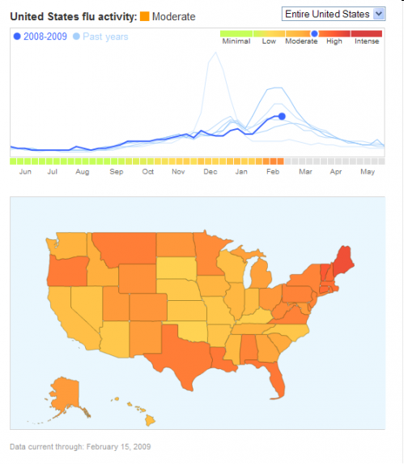
Google Flu Trends
“We've found that certain search terms are good indicators of flu activity.
Google Flu Trends uses aggregated Google search data to estimate current flu activity around the world in near real-time.”

Slide 9
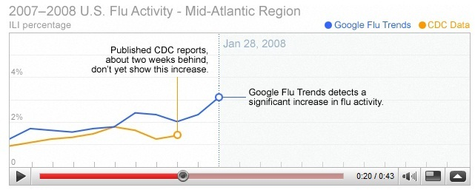
Example of Utility: Google Flu Trends

Slide 10
What if the data is dynamic?
Want to handle situations where the data keeps changing
  Not all data is available at the time of sanitization
Issues
When does the algorithm make an output?
What does the adversary get to examine?
How do we define an individual which we should protect? D+Me
Efficiency measures of the sanitizer

Slide 11
Data Streams
Data is a stream of items
  Sanitizer sees each item and updates internal state.
  Produces output: either on-the-fly or at the end
output
state
Sanitizer
Data Stream
Notes:
Generally think of these are one-pass streaming algorithms (and mention that there is a literature on these, in the non-private world).

Slide 12
Three new issues/concepts
Continual Observation
  The adversary gets to examine the output of the sanitizer all the time
Pan Privacy
  The adversary gets to examine the internal state of the sanitizer. Once? Several times? All the time?
“User” vs. “Event” Level Protection
  Are the items “singletons” or are they related

Slide 13
Randomized Response
Randomized Response Technique [Warner 1965]
  Method for polling stigmatizing questions
  Idea: Lie with known probability.
    Specific answers are deniable
    Aggregate results are still valid
The data is never stored “in the plain”
“trust no-one”
1
0
Popular in DB literature
Mishra and Sandler.
1
+
+
+
noise
noise
…
noise

Slide 14
The Dynamic Privacy Zoo
Petting
User-Level Continual Observation Pan Private
Differentially Private
Continual Observation
Pan Private
Randomized Response
User level Private

Slide 15
Continual Output Observation
Data is a stream of items
  Sanitizer sees each item, updates internal state.
  Produces an output observable to the adversary
Output
state
Sanitizer

Slide 16
Continual Observation
Alg - algorithm working on a stream of data
  Mapping prefixes of data streams to outputs
  Step i output σ_{i}
Alg is ε-differentially private against continual observation if for all
  adjacent data streams S and S’
  for all prefixes t outputs σ₁ σ₂ … σ_{t}
Adjacent data streams: can get from one to the other by changing one element
S= acgtbxcde
S’= acgtbycde
Pr[Alg(S)=σ₁ σ₂ … σ_{t}]
e^{-ε} ≤
≤ e^{ε} ≈ 1+ε
Pr[Alg(S’)=σ₁ σ₂ … σ_{t}]

Slide 17
The Counter Problem
0/1 input stream
011001000100000011000000100101
Goal :a publicly observable counter, approximating the total number of 1’s so far
Continual output: each time period, output total number of 1’s
Want to hide individual increments while providing reasonable accuracy

Slide 18
Counters w. Continual Output Observation
Data is a stream of 0/1
  Sanitizer sees each x_{i}, updates internal state.
  Produces a counter observable to the adversary
1
1
1
2
Output
state
Sanitizer
1
0
0
1
0
0
1
1
0
0
0
1
Notes:
.

Slide 19
Counters w. Continual Output Observation
Continual output: each time period, output total 1’s
Initial idea: at each time period , on input x_{i} 2 {0, 1}
  Update counter by input x_{i}
  Add independent Laplace noise with magnitude 1/ε
Privacy: since each increment protected by Laplace noise – differentially private whether x_{i} is 0 or 1
Accuracy: noise cancels out, error Õ(√T)
For sparse streams: this error too high.
-4
-3
-2
-1
0
1
2
3
4
5
T – total number of time periods

Slide 20
Why So Inaccurate?
Operate essentially as in randomized response
  No utilization of the state
Problem: we do the same operations when the stream is sparse as when it is dense
  Want to act differently when the stream is dense
The times where the counter is updated are potential leakage

Slide 21
Delayed Updates
Main idea: update output value only when large gap between actual count and output
Have a good way of outputting value of counter once: the actual counter + noise.
Maintain
Actual count A_{t} (+ noise )
Current output out_{t} (+ noise)
D – update threshold
Notes:
Main idea: only a few events where input items effect output, so don’t need to worry about too many instances where input effects output

Slide 22
Delayed Output Counter
Out_{t} - current output
A_{t} - count since last update.
D_{t} - noisy threshold
If A_{t} – D_{t} > fresh noise then
Out_{t+1} ← Out_{t} + A_{t} + fresh noise
A_{t+1} ← 0
D_{t+1} ← D + fresh noise
Noise: independent Laplace noise with magnitude 1/ε
Accuracy:
For threshold D: w.h.p update about N/D times
Total error: (N/D)^{1/2} noise + D + noise + noise
Set D = N^{1/3}  accuracy ~ N^{1/3}
delay

Slide 23
Privacy of Delayed Output
A_{t} – D_{t} > fresh noise, D_{t+1} ← D + fresh noise
Out_{t+1}←Out_{t} +A_{t}+ fresh noise
Protect: update time and update value
For any two adjacent sequences
101101110001
101101010001
Can pair up noise vectors
μ₁μ₂μ_{k-1} μ_{k} μ_{k+1}
μ₁μ₂μ_{k-1} μ’_{k} μ_{k+1}
Identical in all locations except one
μ’_{k} = μ_{k} +1
Where first update after difference occurred
D_{t} D’_{t}
Prob ≈ e^{ε}

Slide 24
Dynamic from Static
Accumulator measured when stream is in the time frame
Run many accumulators in parallel:
  each accumulator: counts number of 1's in a fixed segment of time plus noise.
  Value of the output counter at any point in time: sum of the accumulators of few segments
Accuracy: depends on number of segments in summation and the accuracy of accumulators
Privacy: depends on the number of accumulators that a point influences
Idea: apply conversion of static algorithms into dynamic ones
Bentley-Saxe 1980
Only finished segments used
With a little help from my friends
Ilya Mironov
Kobbi Nissim
Adam Smith
x_{t}

Slide 25
The Segment Construction
Based on bit representation:
Each point t is in dlog te segments
Σ_{i=1}^{t} x_{i} - Sum of at most log t accumulators
By setting ε’ ¼ ε / log T can get the desired privacy
Accuracy: With all but negligible in T probability the error at every step t is at most O((log^{1.5} T)/ε)).
canceling

Slide 26
Synthetic Counter
Can make the counter synthetic
Monotone
Each round counter goes up by at most 1
Apply to any monotone function

Slide 27
Lower Bound on Accuracy
Theorem: additive inaccuracy of log T is essential for ε-differential privacy, even for ε=1
Consider: the stream 0^{T} compared to collection of T/b streams of the form 0^{jb}1^{b}0^{T-(j+1)b}
S_{j} = 000000001111000000000000
b
Call output sequence correct: if a b/3 approximation for all points in time

Slide 28
…Lower Bound on Accuracy
S_{j}=000000001111000000000000
Important properties
For any output, ratio of probabilities under stream S_{j} and 0^{T} should be at least e^{-εb}
  Hybrid argument from differential privacy
Any output sequence correct for at most one S_{j} or 0^{T}
  Say probability of a good output sequence is at least α
b/3 approximation for all points in time
Good for S_{j}
Prob under 0^{T}: at least αe^{-εb}
b=1/2log T, α =1/2
T/b αe^{-εb} · α
contradiction

Slide 29
Hybrid Proof
Want to show that for any event B
Pr[A(0^{T})2 B]
Let
S_{ji}=0^{jb}1^{i}0^{T-jb-i}
S_{j0}=0^{T}
S_{jb}=S_{j}
e^{-εb} ≤
Pr[A(S_{j}) 2 B]
Pr[A(S_{ji}) 2 B]
e^{-ε} ≤
Pr[A(S_{ji+1})2B]
Pr[A(S_{j0})2B]
Pr[A(S_{j0})2B]
Pr[A(S_{jb-1})2B]
.
…
.
=
¸ e^{-εb}
Pr[A(S_{jb})2B]
Pr[A(S_{j1})2B]
Pr[A(S_{jb})2B]

Slide 30
What shall we do with the counter?
Privacy-preserving counting is a basic building block in more complex environments
General characterizations and transformations
Event-level pan-private continual-output algorithm for any low sensitivity function
Following expert advice privately
Track experts over time, choose who to follow
Need to track how many times each expert was correct

Slide 31
Following Expert Advice
Hannan 1957
Littlestone Warmuth 1989
n experts, in every time period each gives 0/1 advice
pick which expert to follow
then learn correct answer, say in 0/1
Goal: over time, competitive with best expert in hindsight
Expert 1
1
1
1
0
1
Expert 2
0
1
1
0
0
Expert 3
0
0
1
1
1
0
1
1
0
0
Correct
Notes:
Hannan in the 50’s, Littlestone and Warmuth in CS

Slide 32
Following Expert Advice
Goal:
#mistakes of chosen experts ≈
#mistakes made by best expert in hindsight
Want 1+o(1) approximation
n experts, in every time period each gives 0/1 advice
pick which expert to follow
then learn correct answer, say in 0/1
Goal: over time, competitive with best expert in hindsight
Expert 1
1
1
1
0
1
Expert 2
0
1
1
0
0
Expert 3
0
0
1
1
1
0
1
1
0
0
Correct

Slide 33
Following Expert Advice, Privately
n experts, in every time period each gives 0/1 advice
pick which expert to follow
then learn correct answer, say in 0/1
Goal: over time, competitive with best expert in hindsight
New concern:
  protect privacy of experts’ opinions and outcomes
User-level privacy
Lower bound, no non-trivial algorithm
Event-level privacy
counting gives 1+o(1)-competitive
Was the expert consulted at all?

Slide 34
Algorithm for Following Expert Advice
Follow perturbed leader [Kalai Vempala]
For each expert: keep perturbed #mistakes
follow expert with lowest perturbed count
Idea: use counter, count privacy-preserving #mistakes
Problem: not every perturbation works
need counter with well-behaved noise distribution
Theorem [Follow the Privacy-Perturbed Leader]
For n experts, over T time periods, # mistakes is within ≈ poly(log n,log T,1/ε) of best expert

Slide 35
Pan-Privacy
“think of the children”
In privacy literature: data curator trusted
In reality:
  even well-intentioned curator subject to mission creep, subpoena, security breach…
  Pro baseball anonymous drug tests
  Facebook policies to protect users from application developers
  Google accounts hacked
Goal: curator accumulates statistical information,
but never stores sensitive data about individuals
Pan-privacy: algorithm private inside and out
internal state is privacy-preserving.
Notes:
Usually privacy literature considers static DBs
subpoenas

Slide 36
Randomized Response [Warner 1965]
Strong guarantee: no trust in curator
Makes sense when each user’s data appears only once,
otherwise limited utility
New idea: curator aggregates statistical information,
but never stores sensitive data about individuals
Method for polling stigmatizing questions
Idea: participants lie with known probability.
  Specific answers are deniable
  Aggregate results are still valid
Data never stored “in the clear”
popular in DB literature [MiSa06]
User Response
noise
noise
…
noise
+
+
+
1
0
1
User Data

Slide 37
Aggregation Without Storing Sensitive Data?
Streaming algorithms: small storage
  Information stored can still be sensitive
  “My data”: many appearances, arbitrarily interleaved with those of others
Pan-Private Algorithm
  Private “inside and out”
  Even internal state completely hides the appearance pattern of any individual:
  presence, absence, frequency, etc.
“User level”

Slide 38
Pan-Privacy Model
Data is stream of items, each item belongs to a user
Data of different users interleaved arbitrarily
Curator sees items, updates internal state, output at stream end
state
output
Can also consider multiple intrusions
Pan-Privacy
For every possible behavior of user in stream, joint distribution of the internal state at any single point in time and the final output is differentially private

Slide 39
Adjacency: User Level
Universe U of users whose data in the stream; x 2 U
Streams x-adjacent if same projections of users onto U\{x}
Example: axbxcxdxxxex and abcdxe are x-adjacent
    Both project to abcde
    Notion of “corresponding locations” in x-adjacent streams
U -adjacent: 9 x 2 U for which they are x-adjacent
  Simply “adjacent,” if U is understood
Note: Streams of different lengths can be adjacent

Slide 40
Example: Stream Density or # Distinct Elements
Universe U of users, estimate how many distinct users in U appear in data stream
Application: # distinct users who searched for “flu”
Ideas that don’t work:
Naïve
Keep list of users that appeared (bad privacy and space)
Streaming
  Track random sub-sample of users (bad privacy)
  Hash each user, track minimal hash (bad privacy)
Notes:
Talk about difficulty:
can’t keep track of whether user appeared or not. But first appearance has effect, second and on do not.

Slide 41
Pan-Private Density Estimator
Inspired by randomized response.
Store for each user xU a single bit b_{x}
Initially all b_{x} 0 w.p. ½
1 w.p. ½
When encountering x redraw b_{x} 0 w.p. ½-ε
1 w.p. ½+ε
Final output: [(fraction of 1’s in table - ½)/ε] + noise
Distribution D₀
Distribution D₁
Pan-Privacy
If user never appeared: entry drawn from D₀
If user appeared any # of times: entry drawn from D₁
D₀ and D₁ are 4ε-differentially private

Slide 42
Pan-Private Density Estimator
Inspired by randomized response.
Store for each user xU a single bit b_{x}
Initially all b_{x} 0 w.p. ½
1 w.p. ½
When encountering x redraw b_{x} 0 w.p. ½-ε
1 w.p. ½+ε
Final output: [(fraction of 1’s in table - ½)/ε] + noise
Improved accuracy and Storage
Multiplicative accuracy using hashing
Small storage using sub-sampling

Slide 43
Pan-Private Density Estimator
Theorem [density estimation streaming algorithm]
ε pan-privacy, multiplicative error α
space is poly(1/α,1/ε)

Slide 44
Density Estimation with Multiple Intrusions
If intrusions are announced, can handle multiple intrusions
accuracy degrades exponentially in # of intrusions
Can we do better?
Theorem [multiple intrusion lower bounds]
If there are either:
Two unannounced intrusions (for finite-state algorithms)
Non-stop intrusions (for any algorithm)
then additive accuracy cannot be better than Ω(n)
Notes:
one intrusion doable, two are impossible.

Slide 45
What other statistics have pan-private algorithms?
Density: # of users appeared at least once
Incidence counts: # of users appearing k times exactly
Cropped means: mean, over users, of min(t,#appearances)
Heavy-hitters: users appearing at least k times

Slide 46
Counters and Pan Privacy
Is the counter algorithm pan private?
No: the internal counts accurately reflect what happened since last update
Easy to correct: store them together with noise:
Add (1/ε)-Laplacian noise to all accumulators
  Both at storage and when added
  At most doubles the noise
count
accumulator
noise

Slide 47
Continual Intrusion
Consider multiple intrusions
Most desirable: resistance to continual intrusion
Adversary can continually examine the internal state of the algorithm
  Implies also continual observation
  Something can be done: randomized response
  But:
Theorem: any counter that is ε-pan-private under continual observation and with m intrusions must have additive error Ω(√m) with constant probability.

Slide 48
Pan Privacy under Continual Observation
Definition
 U-adjacent streams S and S’, joint distribution on internal state at any single location and sequence of all outputs is differentially private.
Output
state
Internal state
Notes:
CHALLENGE: each data item effects many of the outputs, even if each output individually is private, the collection might not be

Slide 49
A General Transformation
Transform any static algorithm A to continual output, maintain:
Pan-privacy
Storage size
Hit in accuracy low for large classes of algorithms
Main idea: delayed updates
Update output value only rarely, when large gap between A’s current estimate and output
Notes:
Main idea: only a few events where input items effect output, so don’t need to worry about too many instances where input effects output

Slide 50
Theorem [General Transformation]
Max output difference on adjacent streams
Transform any algorithm A for monotone function f with error α, sensitivity sens_{A}, maximum value N
New algorithm has ε-privacy under continual observation, maintains A’s pan-privacy and storage
Error is Õ(α+√N*sens_{A}/ε)

Slide 51
General Transformation: Main Idea
input: a0bcbbde
D
A
out
Assume A is a pan-private estimator for monotone f ≤ N
If |A_{t} – out_{t-1}| > D then out_{t} ← A_{t}
For threshold D: w.h.p update about N/D times

Slide 52
General Transformation: Main Idea
input: a0bcbbde
A
out
Assume A is a pan-private estimator for monotone f ≤ N
A’s output may not be monotonic
If |A_{t} – out_{t-1}| > D then out_{t} ← A_{t}
What about privacy? Update times, update values
For threshold D: w.h.p update about N/D times
Quit if #updates exceeds Bound ≈ N/D

Slide 53
General Transformation: Privacy
If |A_{t} – out_{t-1}| > D then out_{t} ← A_{t}
What about privacy? Update times, update values
Add noise
Noisy threshold test 
privacy-preserving update times
Noisy update 
privacy preserving update values

Slide 54
Error:
Õ[D+(s_{A}*N)/(D*ε)]
General Transformation: Privacy
If |A_{t} – out_{t-1} +noise | > D
then out_{t} ← A_{t}+ noise
Scale noise(s) to [ Bound·sens_{A}/ε ]
Yields (ε,δ)-diff. privacy:
Pr[z|S] ≤ e^{ε}·Pr[z|S’]+δ
  Proof pairs noise vectors that are “far” from causing quitting on S, with noise vectors for which S’ has exact same update times
  Few noise vectors bad; paired vectors “ε-private”

Slide 55
Theorem [General Transformation]
Transform any algorithm A for monotone function f with error α, sensitivity sens_{A}, maximum value N
New algorithm has ε-privacy under continual observation, maintains A’s pan-privacy and storage
Error is Õ(α+√N*sens_{A}/ε)
Extends from monotone to “stable” functions
Loose characterization of functions that can be computed privately under continual observation without pan-privacy

Slide 56
Pan-private Algorithms
Continual Observation
Density: # of users appeared at least once
Incidence counts: # of users appearing k times exactly
Cropped means: mean, over users, of min(t,#appearances)
Heavy-hitters: users appearing at least k times

Slide 57
The Dynamic Privacy Zoo
Petting
Continual Pan Privacy
Differentially Private Outputs
Privacy under Continual Observation
Pan Privacy
Sketch vs. Stream
User level Privacy

Slide 58
Future Work
Map-Reduce style computation?
Connection to Competitive Analysis of Online Computation
General characterization of Pan Privacy?
  Multiple intrusions?
Connection between secure computation and pan privacy
  A pan private algorithm is also a secure computation on a line
    Immune to a single fault

