Slide 1
Privacy-Preserving Classification
Kamalika Chaudhuri UC San Diego
Claire Monteleoni CCLS, Columbia
Anand Sarwate ITA, UC San Diego

Slide 2




Sensitive Data
Medical Records
Genetic Data
Financial Data
Search Logs

Slide 3
How to learn from sensitive data
While preserving privacy?

Slide 4
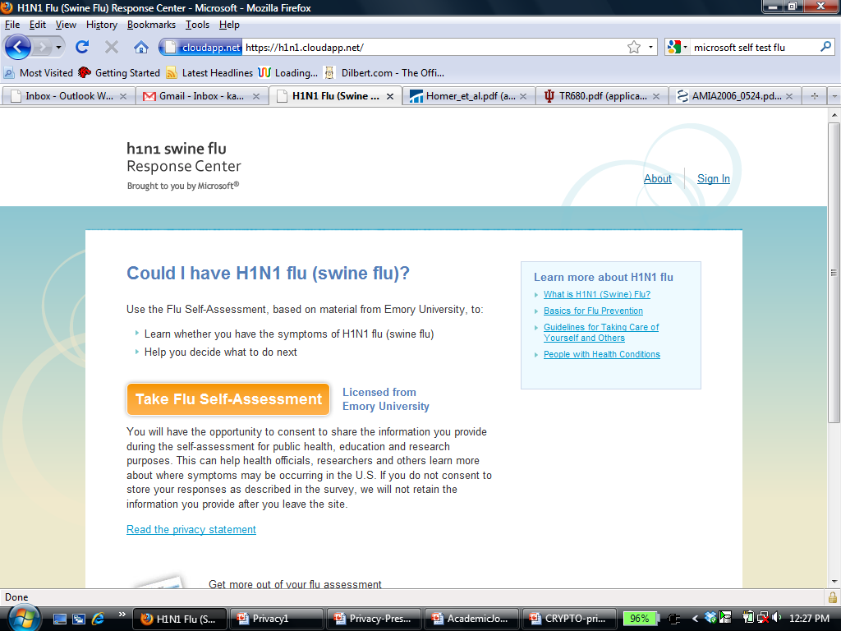
A Learning Problem: Flu Test
Predicts flu or not, based on symptoms
Trained on sensitive patient data

Slide 5
From Attributes to Labeled Data
Yes
No
99F
No
Sore
Throat
Fever
Temperature
Flu
1
0
99
-ve
Data
Label
Notes:
Data are vectors in Euclidean space

Slide 6
Classifying Sensitive Data
+
+
-
+
-
-
+
+
+
-
-
+
+
-
-
Learner
+
+
-
+
-
Private
Data
Public
Classifier
Goals: Privacy and Accuracy

Slide 7
Linear Classification
w
+
+
-
+
-
Distribution P over
labeled examples
+
+
+
-
-
+
+
-
-
+
-
+
-
Goal: Find Vector w that separates + from –,
for points from P
Key: Find a simple model to fit samples
Notes:
We are not just interested in predicting the training points well, but there is some underlying distribution over examples. What we want is a vector that predicts well wrt the whole distribution

Slide 8
Empirical Risk Minimization (ERM)
Given: Labeled data (x_{i}, y_{i})
Find w minimizing:
½¸|w|² + ∑_{i} L(y_{i} w^{T} x_{i})
Regularizer
(Model Complexity)
Risk
(Training Error)

Slide 9
Empirical Risk Minimization (ERM)
w
+
+
-
+
-
+
+
+
-
-
+
+
-
-
+
-
+
-
Risk Hinge-Loss
Optimizer Support Vector Machines (SVM)
Given: Labeled data (x₁, y₁),…,(x_{n}, y_{n})
Find: Vector w that minimizes:
½¸|w|² + ∑_{i} L(y_{i} w^{T} x_{i})
Risk Logistic-Loss
Optimizer Logistic Regression
Regularizer
Risk
Notes:
How to mention Logistic regression and support vector machines?

Slide 10
ERM with Privacy
Given: Labeled data (x_{i}, y_{i})
Find Vector w that:
(Private)
Is private w.r.t. training data
(Accurate)
Approximately minimizes Regularizer + Risk

Slide 11
Talk Outline
Privacy-preserving Classification
How to define Privacy?

Slide 12


Differential Privacy
Randomized
Learner
Data +
“similar”
Randomized
Learner
Data +
Participation of a person doesn’t change output

Slide 13
Differential Privacy: Attacker’s View
Classifier
Conclusion on
Trained on
Prior Knowledge
+
Data &
=
Classifier
Conclusion on
Trained on
Prior Knowledge
+
Data &

Slide 14
Differential Privacy
t
D₁
D₂
h[A(D₁) = t]
h[A(D₂) = t]
For all D₁, D₂ that differ by one person’s value:
If A = ²-private randomized algorithm, h=density,
8t, h[A(D₁) = t] ≤ (1 + ²) h[A(D₂) = t]

Slide 15
Differential Privacy: Facts
1. Provably strong notion of privacy
Adversary knows all values in D except one
Cannot gain confidence on last value from A(D)
2. Good private approximations for many functions
E.g. mean, histograms, contingency tables,...

Slide 16
Talk Outline
Privacy-preserving Classification
Differential Privacy
ERM with Privacy

Slide 17
ERM with Privacy
Given: Labeled data (x_{i}, y_{i})
Find Vector w that:
(Private)
Is private w.r.t. training data
(Accurate)
Approximately minimizes Regularizer + Risk
Examples
Private Logistic Regression, Private SVM

Slide 18
Why is ERM not private for SVM?
+
+
+
+
+
+
+
-
+
+
-
-
+
-
-
-
-
SVM solution is a combination of support vectors
If a support vector moves, solution changes
Notes:
Remind ERM + SVM (one slide)
(Tell them that this is all you need to remember…)
Full thing (not acronyms)
Click – sv bold

Slide 19
How to make ERM private?
+
+
+
+
+
-
+
+
+
-
-
+
-
-
-
-
Pick w from distribution around opt solution

Slide 20
How to make ERM private?
+
+
+
+
+
-
+
+
+
-
-
+
-
-
-
-
Too concentrated implies poor privacy

Slide 21
How to make ERM private?
+
+
+
+
+
-
+
+
+
-
-
+
-
-
-
-
Too smooth implies poor accuracy
Notes:
Should I delete this one and the last slide? (if not enough time…)

Slide 22
Pick distribution that gives
privacy and accuracy

Slide 23
Talk Outline
Privacy-preserving Classification
Differential Privacy
ERM with Privacy
Algorithm

Slide 24
Properties of Real Data
Data
Opt Surface
+
+
+
+
+
-
+
-
Loss
-
-
-
-
-
Perturbation
Opt surface very convex in some directions
High loss when perturbed in such directions

Slide 25
Properties of Real Data
Data
Opt Surface
+
+
+
+
+
-
+
-
Loss
-
-
-
-
-
Perturbation
Idea 1: Uniformly Perturb Opt Solution
Idea 2: Perturb Solution Less in Convex Directions

Slide 26
Our Idea: Perturb Surface & then Optimize

Slide 27
Algorithm
Given: Labeled data (x_{i}, y_{i})
Find w minimizing:
½¸|w|² + ∑_{i} L(y_{i} w^{T} x_{i}) + (1/n)b^{T}w
Regularizer
(Model Complexity)
Risk
(Training Error)
Perturbation
(Privacy)

Slide 28
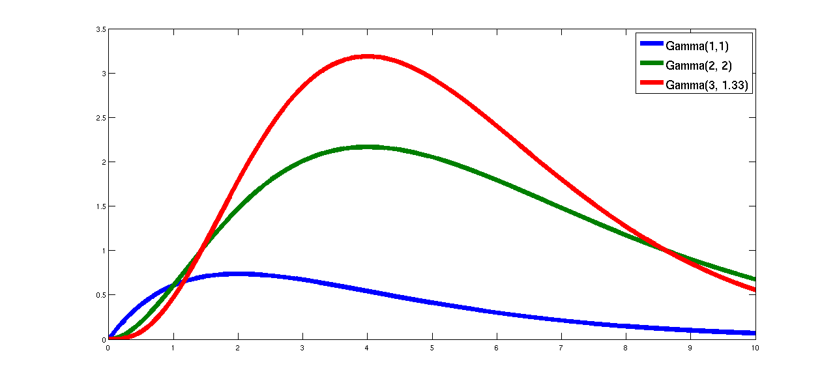
Algorithm: Perturbation
Perturbation b drawn from:
Magnitude: |b| » ¡(d, 1/²)
Direction : uniform
Notes:
Have things come in one by one
Animation – sphere. Random point

Slide 29
Talk Outline
Privacy-preserving Classification
Differential Privacy
ERM with Privacy
Algorithm: Perturb & Optimize
Analytical Results: Privacy and Accuracy

Slide 30
Privacy Guarantees
Theorem: [CM08, SCM09] If
L is convex, differentiable
For any w, any D₁, D₂ differing in one value,
|rL(D₁,w) – rL(D₂,w)| · 1/n
then, our algorithm is ²-differentially-private
L = Logistic loss
Private Logistic Regression
L = Huber loss
Private SVM
(Hinge Loss is Non-differentiable)

Slide 31
Measure of Accuracy
#Samples for Error ®
(Fewer Samples Implies More Accurate)
Notes:
How to explain what is private generalization error

Slide 32
Data Requirement (SVM)
d: # dimensions
°: margin
²: privacy
®: error
°, ², ® < 1
+
°
+
+
+
+
+
-
+
-
-
+
-
-
-
-
Normal SVM 1/°²®²
Our Algorithm 1/°²®² + d/°²®

Slide 33
Previous Work
Algorithm
Data
Running Time
[BLR08], [KL+08]
d²/®³²
Exp(d)
Recipe of [DMNS06]
d/°²²®^{1.5}
Efficient
[CM08],
[SCM09]
d/°²®
Efficient

Slide 34
Talk Outline
Privacy-preserving Classification
Differential Privacy
ERM with Privacy
Algorithm: Perturb & Optimize
Analytical Results: Privacy and Accuracy
  Proofs: Privacy

Slide 35
Privacy Guarantees
Theorem: [CM08, SCM09] If
L is convex, differentiable
For any w, any D₁, D₂ differing in one value,
|rL(D₁,w) – rL(D₂,w)| · 1/n
then, our algorithm is ²-differentially-private

Slide 36
Privacy Proof Sketch
w* : solution
D₁, D₂ : differ in one value
b₁ : perturbation if input is D₁
b₂ : perturbation if input is D₂
Goal: To show that Pr[w*|D₁] · (1 + ²)Pr[w*|D₂]

Slide 37
Privacy Proof Sketch
w* : solution
D₁, D₂ : differ in one value
b₁ : perturbation if input is D₁
b₂ : perturbation if input is D₂
Fact 1. b₁, b₂ are unique
Proof: From differentiability of L,
¸w* + rL(D_{i}, w*) + b_{i}/n = 0

Slide 38
Privacy Proof Sketch
w* : solution
D₁, D₂ : differ in one value
b₁ : perturbation if input is D₁
b₂ : perturbation if input is D₂
Fact 2. |b₁ – b₂| · 1
Proof: At w*,
¸w*+rL(D₁, w*)+b₁/n = 0 = ¸w*+rL(D₂, w*)+b₂/n
Follows from |rL(D₁, w*) - rL(D₂, w*)|· 1/n

Slide 39
Privacy Proof Sketch
w* : solution
D₁, D₂ : differ in one value
b₁ : perturbation if input is D₁
b₂ : perturbation if input is D₂
Fact 1. b₁, b₂ are unique
Fact 2. |b₁ – b₂| · 1
2 & property of ¡, Pr[b₁] · (1 + ²) Pr[b₂]
1 & uniqueness of w*, Pr[w*|D₁] · (1 +²)Pr[w*|D₂]

Slide 40
Privacy Guarantees
Theorem: [CM08, SCM09] If
L is convex, differentiable
For any w, any D₁, D₂ differing in one value,
|rL(D₁,w) – rL(D₂,w)| · 1/n
then, our algorithm is ²-differentially-private

Slide 41
Talk Outline
Privacy-preserving Classification
Differential Privacy
ERM with Privacy
Algorithm: Perturb & Optimize
Analytical Results: Privacy and Accuracy
  Proofs: Privacy
  Proofs: Accuracy

Slide 42
Accuracy: Proof Sketch
Theorem: [CM08, SCM09] #Samples
needed for error ® is 1/°²®² + d/°²®
Lemma 1: Distance of private opt solution
from opt solution is at most |b|/¸n
Lemma 2: Extra training loss due to privacy
is at most|b|²/¸n²²²

Slide 43
Accuracy: Proof Sketch
Lemma 1: Distance of private opt solution
from opt solution is at most |b|/¸n
Next: Proof sketch of Lemma 1

Slide 44
Lemma 1: Proof Sketch in 1 dimension
Slope ¸
b/n
Solution
+
=
0
b/n
0
b/¸n
rOpt Surface
rPerturbation
rPerturbed Opt
Find w minimizing:
½¸|w|² + ∑_{ι} L(y_{i} w^{T} x_{i}) + b^{T}w/n

Slide 45
Accuracy: Proof Sketch
Lemma 1: Distance of private opt solution
from opt solution is at most |b|/¸n
Lemma 2: Extra training loss due to privacy
is at most |b|²/¸n²²²
Proof: Lemma 1 + Taylor Series

Slide 46
Accuracy Guarantees
Theorem: [CM08, SCM09] #Samples
needed for error ® is 1/°²®² + d/°²®
Proof: Lemma 2 and techniques of [SSS08]

Slide 47
Talk Outline
Privacy-preserving Classification
Differential Privacy
ERM with Privacy
Algorithm: Perturb & Optimize
Analytical Results: Privacy & Accuracy
Evaluation

Slide 48
Experiments
UCI Adult: Census/Income Data
  Demographic data of size 47K
  105 dimensions (after preprocessing)
Task: Predict if income is above/below 50K

Slide 49
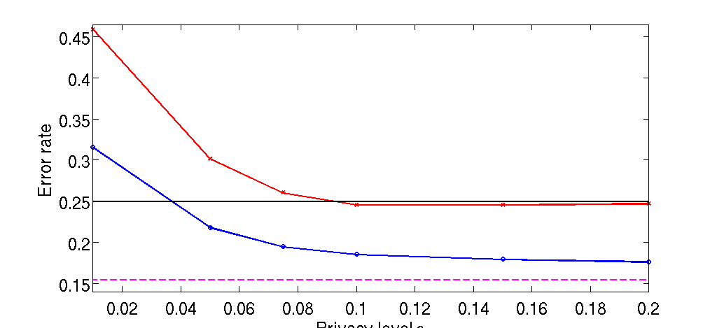
Privacy-Accuracy Tradeoff
Our Algorithm
Error
[DMNS06]
Chance
NormalSVM
Privacy Level ²
Smaller ², More privacy

Slide 50
Experiments
KDDCup99: Intrusion Detection Data
  50K network connections
  119 dimensions (after preprocessing)
Task: Predict if connection is malicious or not
Notes:
Check # for training + testing

Slide 51
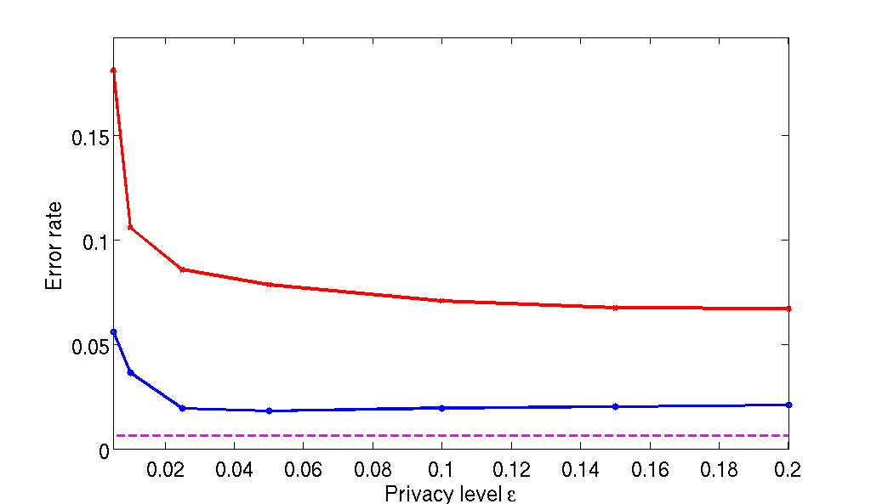
Privacy-Accuracy Tradeoff
Our Algorithm
Error
[DMNS06]
NormalSVM
Privacy Level ²
Smaller ², More privacy

Slide 52
Talk Outline
Privacy-preserving Classification
Differential Privacy
ERM with Privacy
Algorithm: Perturb & Optimize
Analytical Results: Privacy & Accuracy
Evaluation: On Adult & KDDCup datasets

Slide 53
Future Work
1. Can we reduce the price of privacy ?
Find a linear classification algorithm:
    ²-private
    Computationally efficient
    Requires fewer samples
Can we lower-bound the sample requirement for differentially private classification ?

Slide 54
References
Privacy-preserving Logistic Regression, K. Chaudhuri, C. Monteleoni, NIPS 2008
Differentially-Private Support Vector Machines, A. Sarwate, K. Chaudhuri, C. Monteleoni, In Submission, Available from Arxiv

Slide 55
Questions?

