Slide 1







Segmentation with non-linear constraints on appearance, complexity, and geometry
IPAM
February 2013
Western
Univesity
Yuri Boykov
Andrew
Delong
Lena
Gorelick
Hossam
Isack
Anton
Osokin
Frank
Schmidt
Olga
Veksler

Slide 2
Overview
Standard linear constraints on segments
  intensity log-likelihoods, volumetric ballooning, etc.
1. Basic non-linear regional constraints
  enforcing intensity distribution (KL, Bhattacharia, L₂)
  constraints on volume and shape
2. Complexity constraints (label costs)
  unsupervised and supervised image segmentation, compression
  geometric model fitting
3. Geometric constraints
  unsupervised and supervised image segmentation, compression
  geometric model fitting (lines, circles, planes, homographies, motion,…)

Slide 3
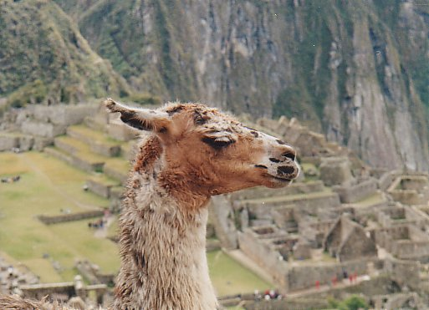
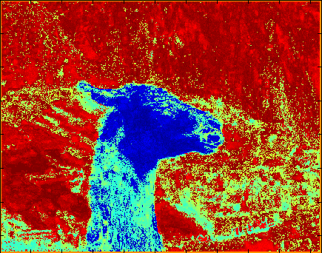
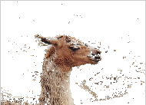
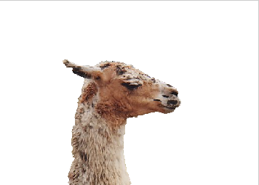
Image segmentation
Basics
S

Slide 4
Linear appearance of region S
Examples of potential functions f
  Log-likelihoods
  Chan-Vese
  Ballooning

Slide 5
Part 1
Basic non-linear regional functionals

Slide 6
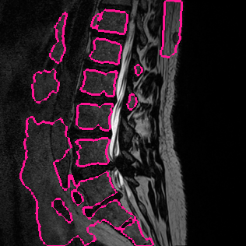
Standard Segmentation Energy
Target Appearance
Resulting Appearance
Fg
Probability
Distribution
Bg
Intensity

Slide 7
Minimize Distance to
Target Appearance Model
Non-linear
harder to optimize
regional term

Slide 8
  appearance models
  shape
non-linear regional term

Slide 9
Related Work
Can be optimized with gradient descent
  first order approximation
Ben Ayed et al. Image Processing 2008,
Foulonneau et al., PAMI 2006
Foulonneau et al., IJCV 2009
We use higher-order approximation based on trust region approach
Notes:
We are not the first to look into optimization of energies with non-linear regional terms.

Slide 10
a general class of
non-linear regional functionals

Slide 11
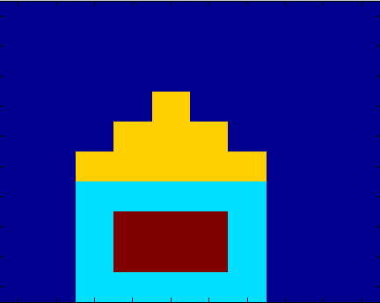

Regional Functional
Examples
Volume Constraint

Slide 12
Regional Functional
Examples
Bin Count Constraint

Slide 13
Regional Functional
Examples
Histogram Constraint

Slide 14
Regional Functional
Examples
Histogram Constraint

Slide 15
Regional Functional
Examples
Histogram Constraint

Slide 16

Shape Prior
Volume Constraint is a very crude shape prior
Can be generalized to constraints for a set of shape moments m_{pq}

Slide 17
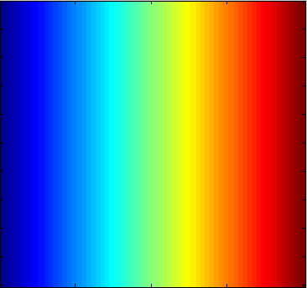
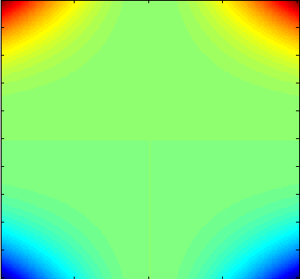
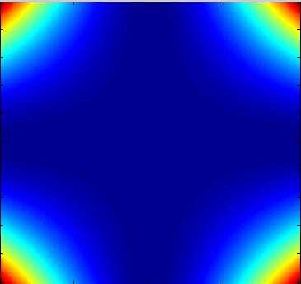
Shape Prior
Volume Constraint is a very crude shape prior

Slide 18
Shape Prior using
Shape Moments m_{pq}

Slide 19
Shape Prior using
Shape moments
Shape Prior Constraint
Dist(
,
)

Slide 20
Optimization of Energies with
Higher-order Regional Functionals

Slide 21
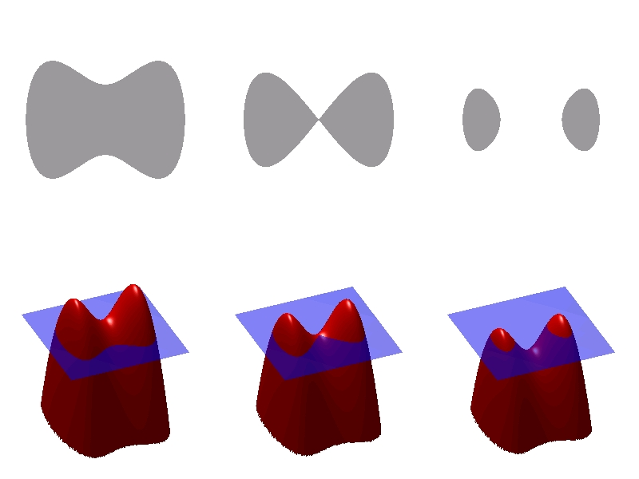
Gradient Descent (e.g. level sets)
Gradient Descent
First Order Taylor Approximation for R(S)
First Order approximation for B(S)
(“curvature flow”)
Robust with tiny steps
  Slow
  Sensitive to initialization
Ben Ayed et al. CVPR 2010,
Freedman et al. tPAMI 2004
http://en.wikipedia.org/wiki/File:Level_set_method.jpg

Slide 22
Energy Specific vs. General
Speedup via energy- specific methods
  Bhattacharyya Distance
  Volume Constraint
We propose
  trust region optimization algorithm
  for general high-order energies
  higher-order (non-linear) approximation
Ben Ayed et al. CVPR 2010,
Werner, CVPR2008
Woodford, ICCV2009

Slide 23
General Trust Region Approach
An overview
The goal is to optimize
Trust region
Trust Region Sub-Problem
First Order Taylor for R(S)
Keep quadratic B(S)
Notes:
Iterative optimization algorithm
Approximation model is constructed near current solution
The model is only “trusted” locally within a small radius around the current solution – trust region
The approximate model is globally optimized within the current trust region – trust region sub-problem.
The size of the trust region is adjusted

Slide 24
General Trust Region Approach
An overview
The goal is to optimize
Trust Region Sub-Problem
Notes:
Iterative optimization algorithm
Approximation model is constructed near current solution
The model is only “trusted” locally within a small radius around the current solution – trust region
The approximate model is globally optimized within the current trust region – trust region sub-problem.
The size of the trust region is adjusted

Slide 25
Solving Trust Region Sub-Problem
Constrained optimization
minimize
Unconstrained Lagrangian Formulation
minimize
Can be optimized globally u using graph-cut or convex continuous formulation
L₂ distance can be approximated with unary terms
[Boykov, Kolmogorov, Cremers, Delong, ECCV’06]

Slide 26
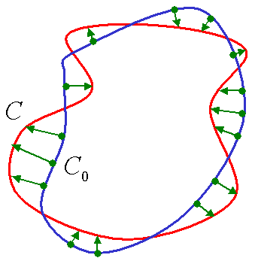
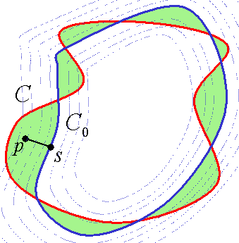
Approximating distance
[BKCD – ECCV 2006]

Slide 27
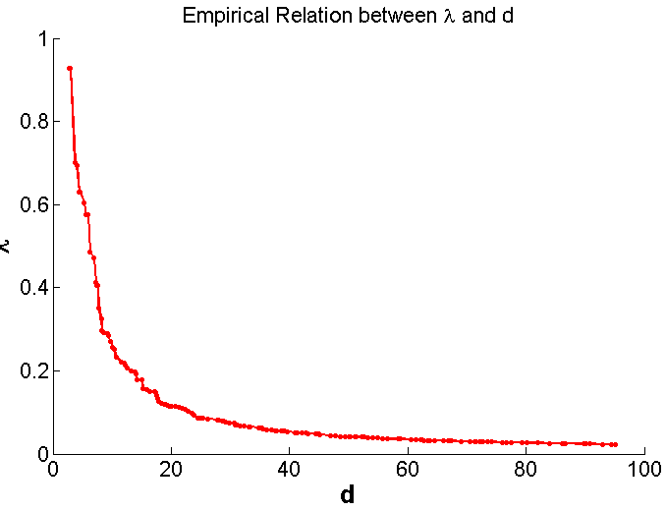
Trust Region
Standard (adaptive) Trust Region
  Control of step size d
Lagrangian Formulation
  Control of
  the Lagrange multiplier λ
λ

Slide 28
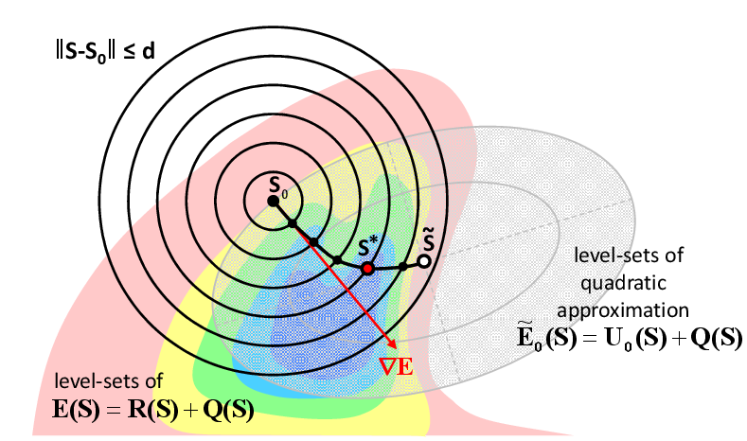
Spectrum of Solutions for different λ or d
Newton step
“Gradient Descent”
Exact Line Search (ECCV12)
Notes:
Newton
Gradient Descent
In between

Slide 29
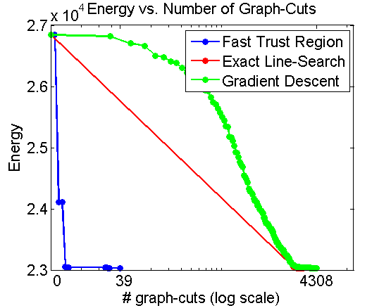
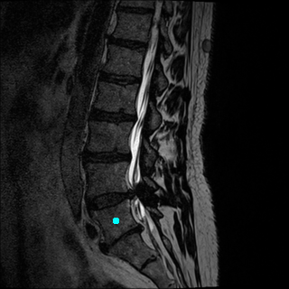
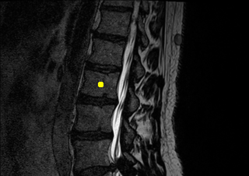
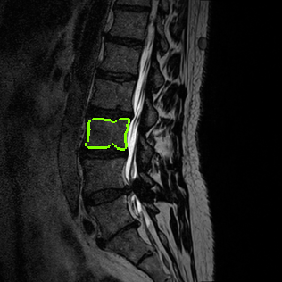
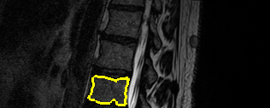
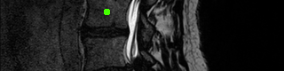
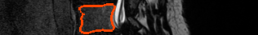
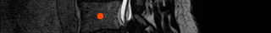
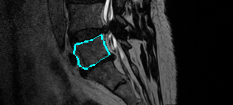
Volume Constraint for Vertebrae segmentation
Log-Lik. + length
Initializations
Log-Lik. + length + volume
Fast Trust Region

Slide 30



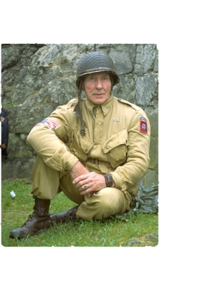

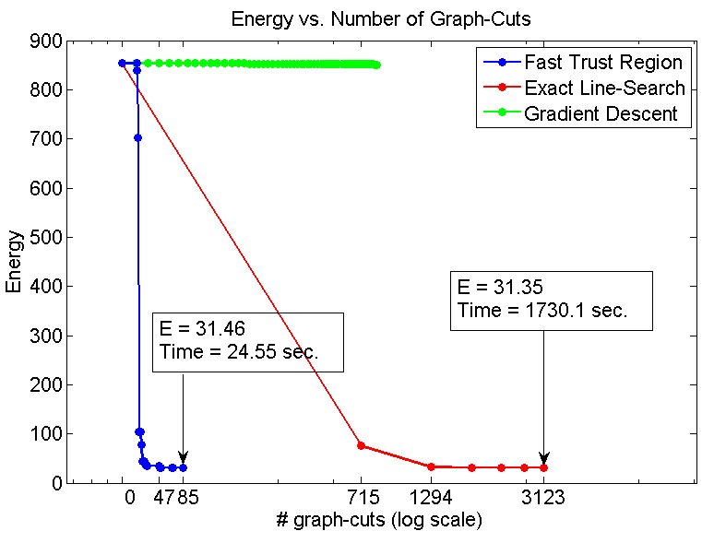
Appearance model with KL Divergence Constraint
Init
Fast
Trust Region
Exact
Line Search
“Gradient Descent”
Appearance model is obtained from the ground truth

Slide 31
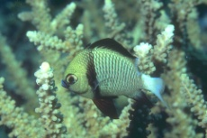
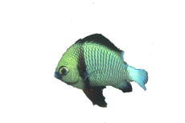

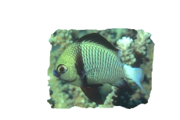
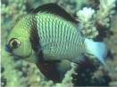
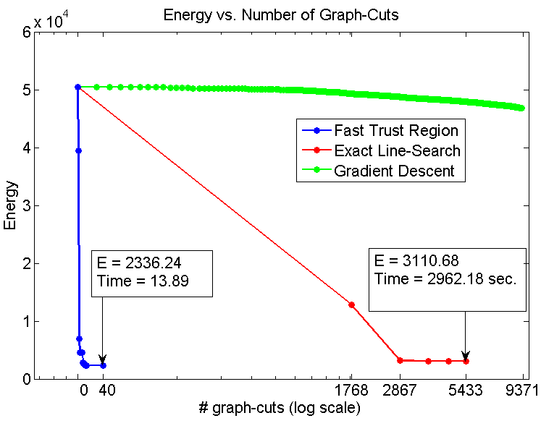
Appearance Model with Bhattacharyya Distance Constraint
“
“
Fast Trust Region
Exact Line Search
“Gradient Descent”
Appearance model is obtained from the ground truth

Slide 32
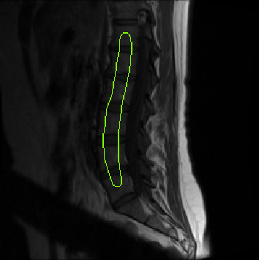
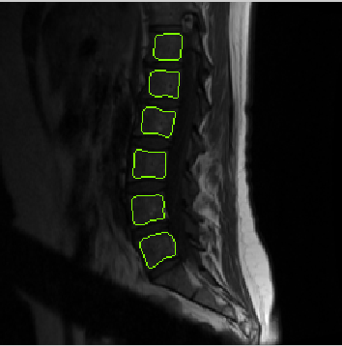
Shape prior with Tchebyshev moments for spine segmentation
Log-Lik. + length + Shape Prior
Fast Trust Region
Second order Tchebyshev moments computed
for the user scribble

Slide 33
Part 2
Complexity constraints on appearance

Slide 34
Segment appearance ?
sum of log-likelihoods (linear appearance)
  histograms
  mixture models
assumes i.i.d. pixels
now: allow sub-regions (n-labels)
with constraints
  based on information theory (MDL complexity)
  based on geometry (anatomy, scene layout)

Slide 35
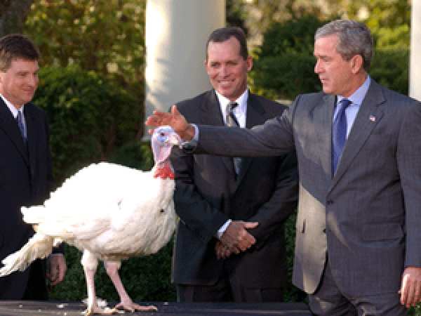
Natural Images: GMM or MRF?
are pixels in this image i.i.d.?
NO!
MRF

Slide 36

Natural Images: GMM or MRF?
GMM

Slide 37

Natural Images: GMM or MRF?
MRF

Slide 38

Natural Images: GMM or MRF?
MRF?

Slide 39
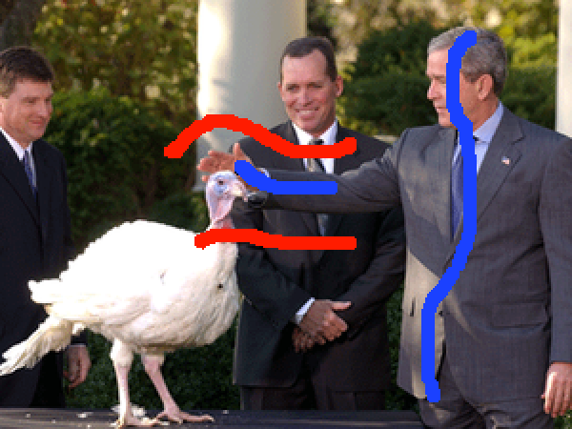
Binary graph cuts
[Boykov & Jolly, ICCV 2001]
[Rother, Kolmogorov, Blake, SIGGRAPH 2004]

Slide 40

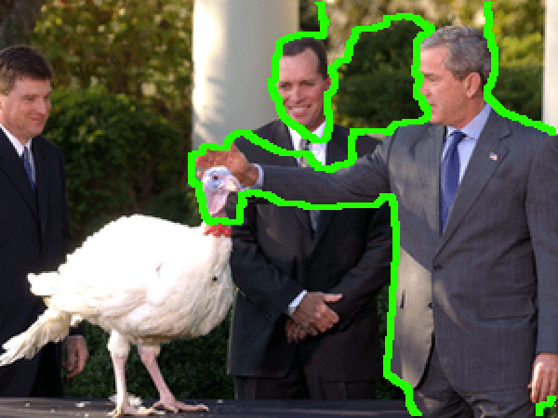
Binary graph cuts
[Boykov & Jolly, ICCV 2001]
[Rother, Kolmogorov, Blake, SIGGRAPH 2004]

Slide 41
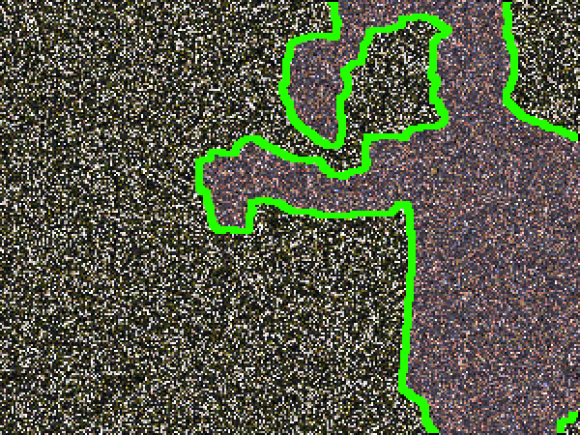
Binary graph cuts
GMM
GMM
[Boykov & Jolly, ICCV 2001]
[Rother, Kolmogorov, Blake, SIGGRAPH 2004]

Slide 42


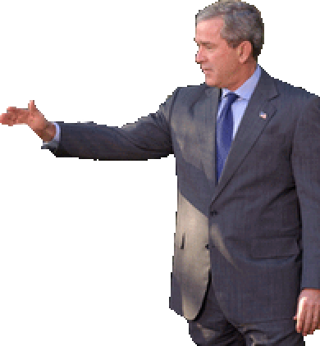
A Spectrum of Complexity
Objects within image can be as complex as image itself
Where do we draw the line?
Gaussian?
GMM?
MRF?
object recognition??

Slide 43
Single Model Per Class Label
GMM
GMM
Pixels are identically distributed inside each segment

Slide 44
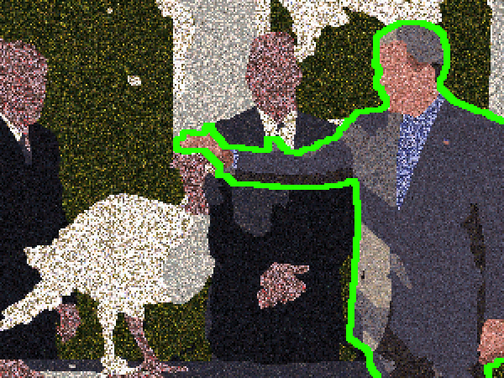
Multiple Models Per Class Label
GMM
GMM
GMM
GMM
GMM
GMM
Now pixels are not identically distributed inside each segment

Slide 45
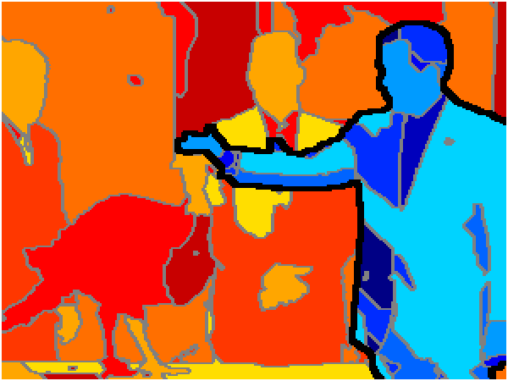
Multiple Models Per Class Label
MRF
MRF
Our Energy ≈ Supervised Zhu & Yuille!
Now pixels are not identically distributed inside each segment

Slide 46
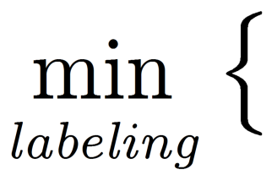


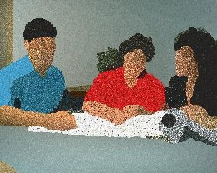
Leclerc, PAMI’92
Zhu & Yuille. PAMI’96; Tu & Zhu. PAMI’02
Unsupervised clustering of pixels
color similarity
+
boundary length
MDL regularizer
+
α-expansion (graph cuts) can handle such energies
with some optimality guarantees [IJCV’12,CVPR’10]

Slide 47
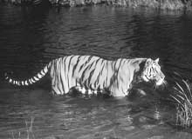

(unsupervised image segmentation)
Fitting color models
each label L represents some distribution Pr(I|L)
information theory (MDL) interpretation:
= number of bits to compress image I losslessly

Slide 48
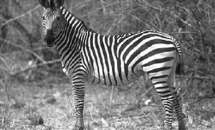
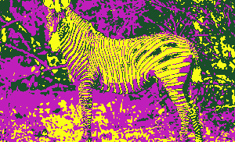
(unsupervised image segmentation)
Fitting color models
Label costs only
Delong, Osokin, Isack, Boykov, IJCV 12 (UFL-approach)

Slide 49

(unsupervised image segmentation)
Fitting color models
Spatial smoothness only [Zabih & Kolmogorov, CVPR 04]

Slide 50

(unsupervised image segmentation)
Fitting color models
Spatial smoothness + label costs
Zhu & Yuille, PAMI 1996 (gradient descent)
Delong, Osokin, Isack, Boykov, IJCV 12 (a-expansion)

Slide 51
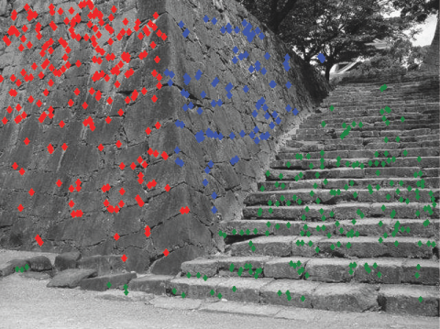
Fitting planes (homographies)
Delong, Osokin, Isack, Boykov, IJCV 12 (a-expansion)

Slide 52
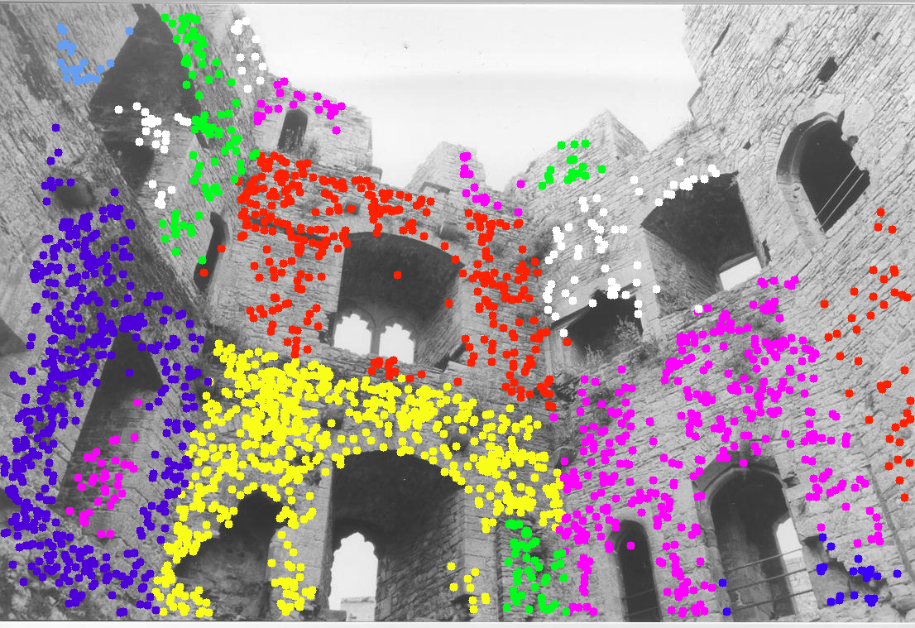
Fitting planes (homographies)
Delong, Osokin, Isack, Boykov, IJCV 12 (a-expansion)

Slide 53


Back to interactive segmentation

Slide 54

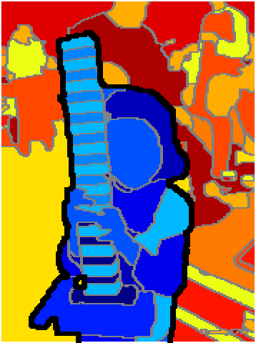

EMMCVPR 2011
segmentation
“sub-labeling”
colour models

Slide 55
Main Idea
Standard MRF:
Two-level MRF:
image-level MRF
object GMM
background GMM
image-level MRF
object MRF
background MRF
GMMs
GMMs
unknown number of labels in each group!

Slide 56
Our multi-label energy functional
data costs
smooth costs
label costs
set of labels L
Penalizes number of GMMs (labels)
  prefer fewer, simpler models
  MDL / information criterion regularize “unsupervised” aspect
Discontinuity cost c is higher between labels of different categories
GMMs
GMMs
object
labels
background
labels
two categories of labels
(respecting hard-constraints)

Slide 57
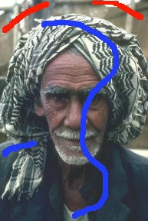
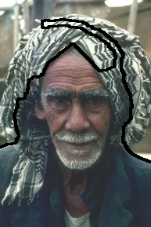
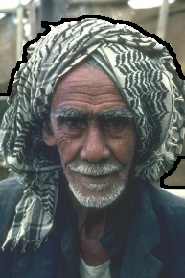
More Examples
standard 1-level MRF
2-level MRF

Slide 58


More Examples
standard 1-level MRF
2-level MRF

Slide 59




Beyond GMMs
GMMs only
GMMs + planes
GMMs
plane

Slide 60
Part 3
Geometric constraints on sub-segments

Slide 61

Towards biomedical image segmentation…
Sub-labels maybe known apriori
    known parts of organs or cells
    interactivity becomes optional
Geometric constraints should be added
- human anatomy (medical imaging)
- or known scene layout (computer vision)

Slide 62




Illustrative Example
We want to distinguish between these objects
input
what we want
what mixed model gives
mixed appearance model:
Notes:
“Here we have a synthetic example designed to show the same basic problem from the previous slide.”
“Suppose we want to segment objects that look like center object.”
“It’s a mix of light grey and dark grey.”
“If we use such a description of the center object and use binary segmentation, we’ll necessarily pick up all these other false-positives that fit the same appearance model. For interactive segmentation, this is where we start needing lots of ‘background’ strokes all over the image, to get rid of these guys.”

Slide 63

main ideas
  sub-labels with distinct appearance models (as earlier)
  basic geometric constraints between parts
    inclusion/exclusion
    expected distances
    and margins
    For some constraints
    globally optimal segmentation
    can be computed
    in polynomial time
Notes:
“Okay so that’s enough to at least motivate our energy and whatnot, but before we get to those details I’ll review the main ideas and try to give perspective on where our work fits into things.”
“Okay, problem: Mixed models lose discriminative power”
“There are ways to tackle those earlier examples with multiple deformable meshes and whatnot, but we’re specifically trying to understand what type of multi-part models we can *globally* optimize.”
“In the end, what we’re going to do is sort of like multi-label optimization, but two important differences: first, our labels are not ordered, yet we’re still trying to optimize, *globally*, using a single graph cut; second, we add explicit geometric interactions between our ‘labels’ i.e. the parts”
“People have worked on this kind of problem before, but since we’re looking for global solutions, this rules out active contours, level sets and whatnot.”

Slide 64






Illustrative Example
Model as two parts: “light X contains dark Y”
Center object the only object that fits two-part model
(no localization)
Notes:
“Before showing our construction, I just want to come back to this synthetic example one last time to show what kind of two-part model we might want to implement with our framework.”
“Remember that a mixture model for the center object just segments everything.”
“If we represent the object as two spatially coherent parts, a light grey part, and a dark grey part, and make sure that the light grey surrounds the inner part with a preferred margin of some kind, then one of these objects fits this description better than all the others so we can now distinguish between these objects.”

Slide 65




Our Energy
Let over objects L and pixels P
‘layer cake’
a-la Ishikawa’03
variables
Notes:
“Okay, our energy is defined on boolean variables that are indexed both over our set of objects L, and also over our set of pixels P.”
“The functional itself can be grouped into a data term for each pixel, surface regularization terms for each independent object, and geometric interactions between pairs of objects.”
“Now, when explaining these kinds of things, some people say ‘just show me the energy’, while other people, like Yuri, say ‘just show the graph construction’, so we’ll try to show both in parallel.”
“The construction is easy to visualize, especially for people who have worked with discrete ‘layer-cake’ constructions like Ishikawa, because the most natural way to lay out vertices is the same: in layers.”
“In fact, people who have worked with the Ishikawa construction or its continuous counterparts, will need very few ‘bits’ to understand what we’re doing.”
“The next three slides highlight each of these terms.”

Slide 66


Surface Regularization Terms
Let over objects L and pixels P
Standard regularization of each independent surface

Slide 67


Geometric Interaction Terms
Let over objects L and pixels P
Inter-surface interaction
Notes:
“And what we’re calling geometric interactions are just terms that connect neighbourhoods across layers and potentially between different pixels.”
“The few slides will detail the most obvious, concrete interaction terms that have straight-forward geometric interpretation.”

Slide 68
So What Can We Do?
Nestedness/inclusion of sub-segments
ICCV 2009 (submodular, exact solution)
Spring-like repulsion of surfaces, minimum distance
ICCV 2009 (submodular, exact solution)
Spring-like attraction of surfaces, Hausdorf distance
ECCV 2012 (approximation)
Extends Li, Wu, Chen & Sonka [PAMI’06]
  no pre-computed medial axes
  no topology constraints

Slide 69


Applications
Medical Segmentation
  Lots of complex shapes with priors between boundaries
  Better domain-specific models
Scene Layout Estimation
  Basically just regularize Hoiem-style data terms [4]
Notes:
“Lots of hard-to-predict shapes with bifurcations and hard topologies.”

Slide 70




Application: Medical
input
our result

Slide 71

Application: Medical
full body MRI
two-part model

Slide 72




Application: Medical
full body MRI

Slide 73
Conclusions
linear functionals are very limited
  be careful with i.i.d. (histograms or mixture models)
higher-order regional functionals
use sub-segments regularized by
  complexity or sparcity (MDL, information theory)
  geometry (based on anatomy)
literature: ICCV’09, EMMCVPR’11, ICCV’11, , IJCV12, ECCV’12

