Slide 1

Detecting Signal from Data with Noise
Adaptive Data Analysis and Sparsity
California, 2013
Xianyao Chen
Meng Wang, Yuanling Zhang, Ying Feng
Zhaohua Wu, Norden E. Huang
Laboratory of Data Analysis and Applications, SOA, China
The First Institute of Oceanography, State Oceanic Administration, China

Slide 2
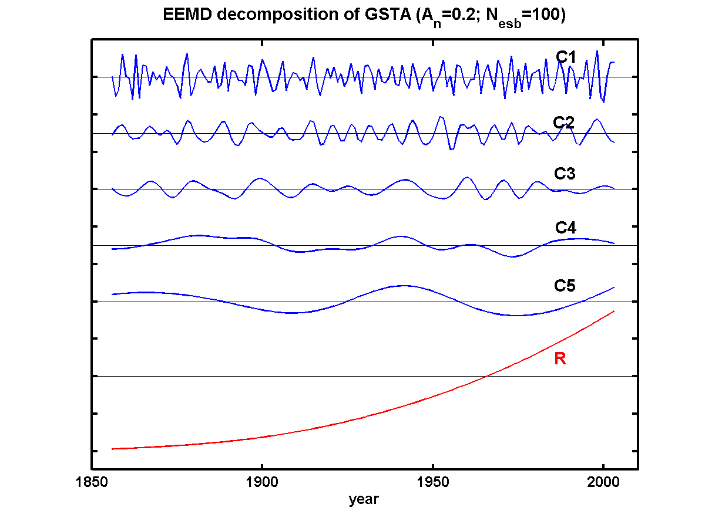
Motivation
Identify the meaning of each IMFs, whether it is noise, or signal, or when it is noise, or signal.

Slide 3
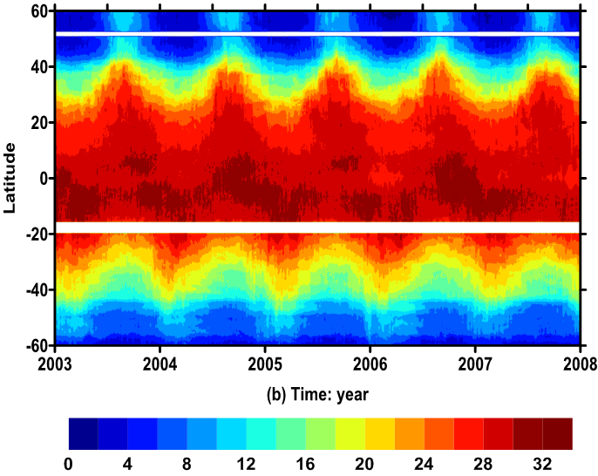
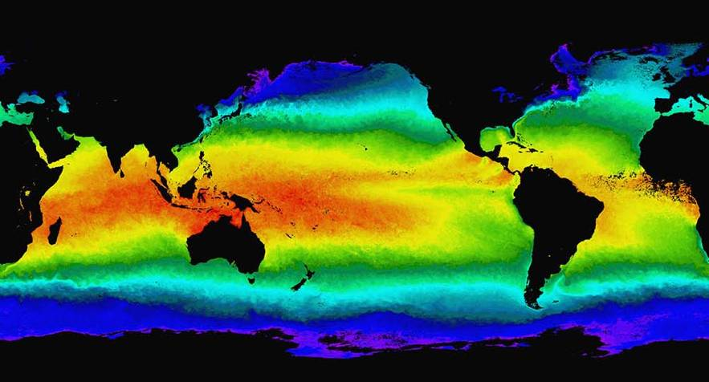
Motivation
Identify the meaning of each IMFs, whether it is noise, or signal, or when it is noise, or signal.

Slide 4
Motivation
Identify the meaning of each IMFs, whether it is noise, or signal, or when it is noise, or signal.

Slide 5
NOISE or SIGNAL?

Slide 6
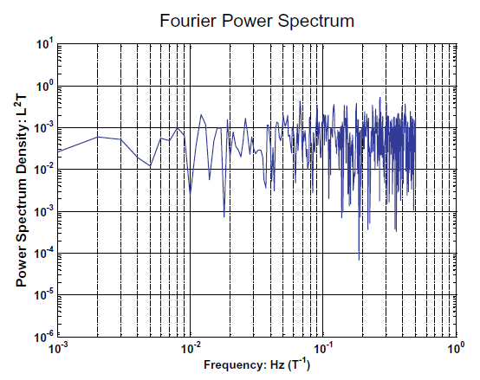
Characteristics of white noise
Two views of white noise: EMD and Fourier

Slide 7
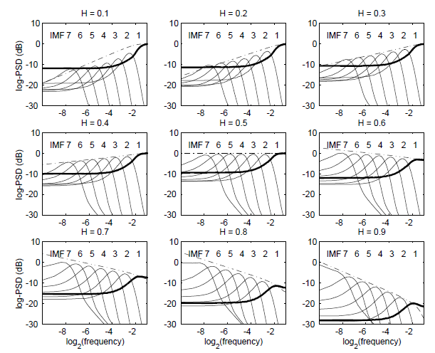
Characteristics of white noise
Two views of white noise: EMD and Fourier
Flandrin et al. 2004, IEEE.

Slide 8
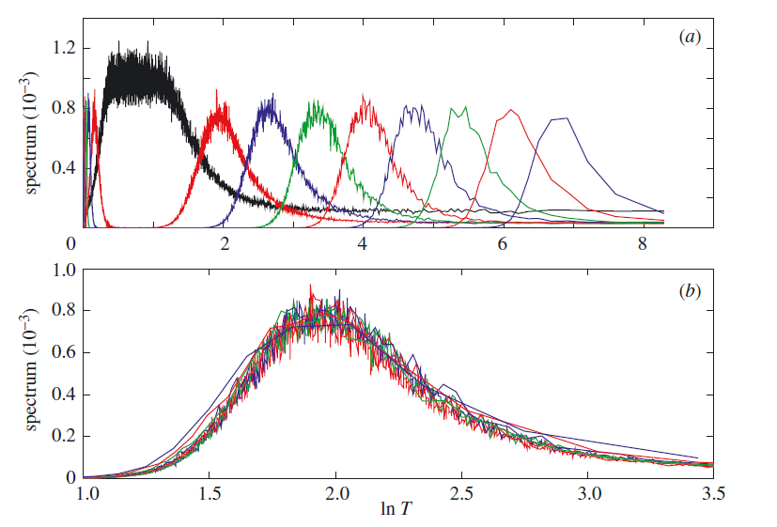
Characteristics of white noise
Two views of white noise: EMD and Fourier
Wu et al. 2004, Proc. Roy. Soc. Lon.

Slide 9
Characteristics of white noise
Two views of white noise: EMD and Fourier
Wu et al. 2004, Proc. Roy. Soc. Lon.

Slide 10
Detecting signal with white noise
The null hypothesis: The underlying noise is white.
1 mon
1 yr
10 yr
100 yr
Wu et al. 2004, Proc. Roy. Soc. Lon.

Slide 11
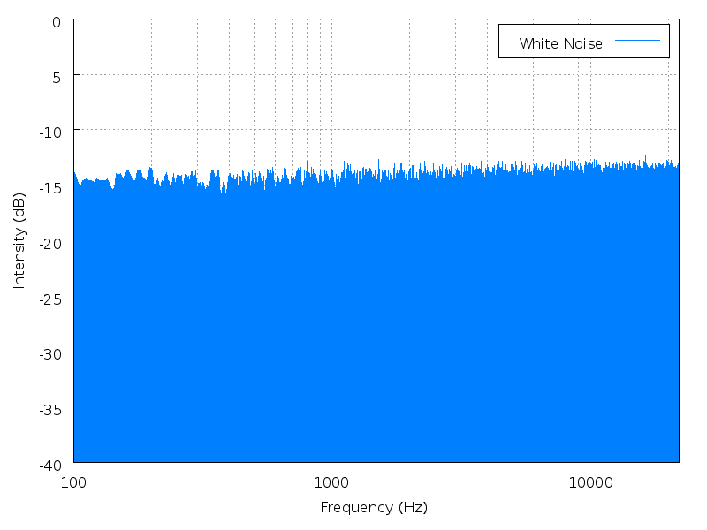
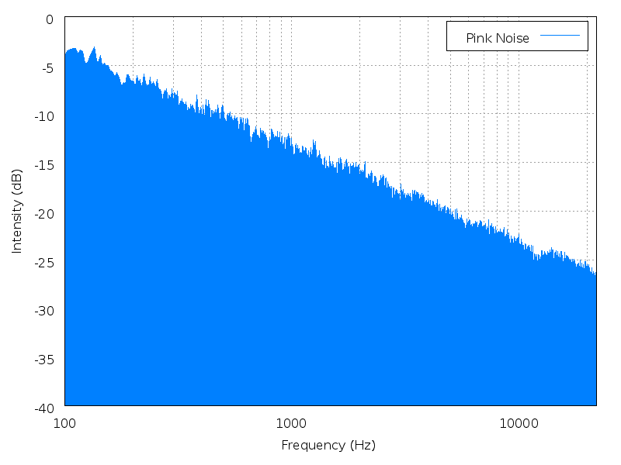
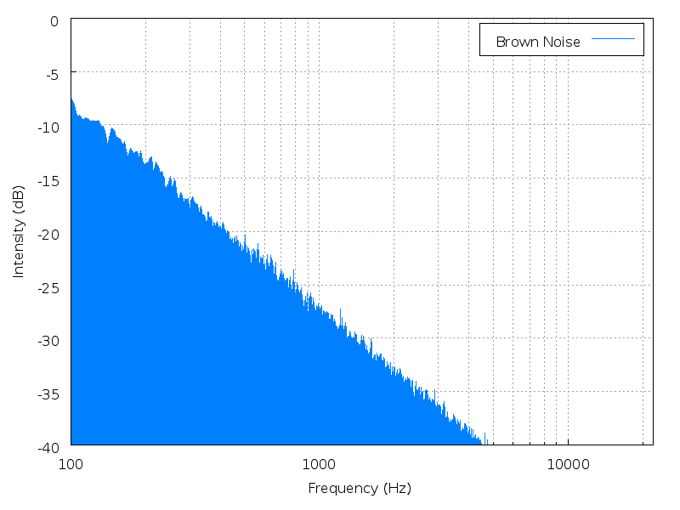
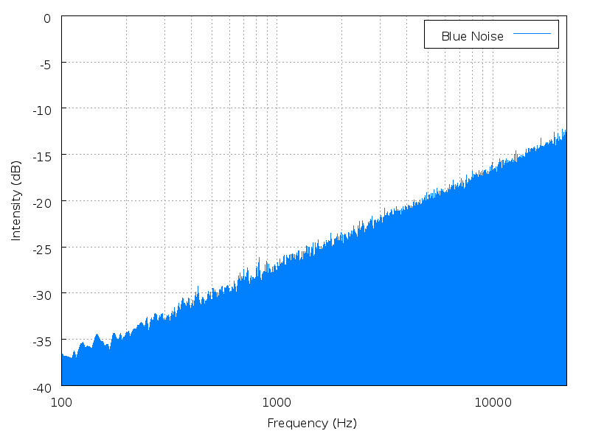
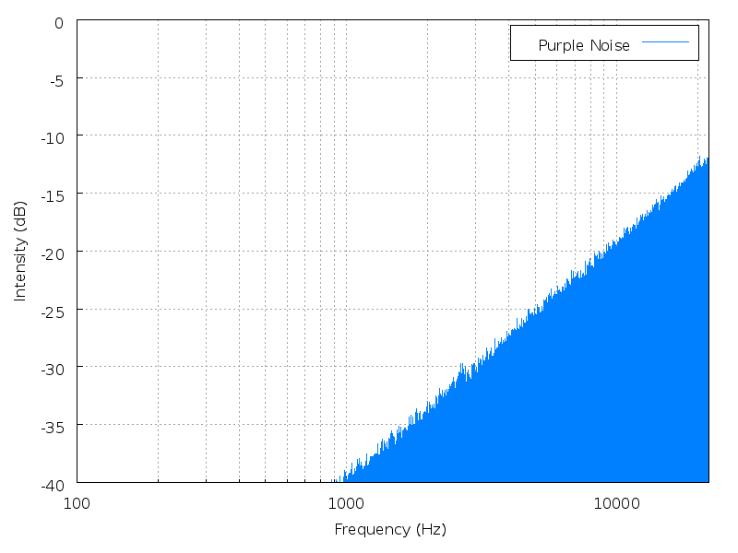
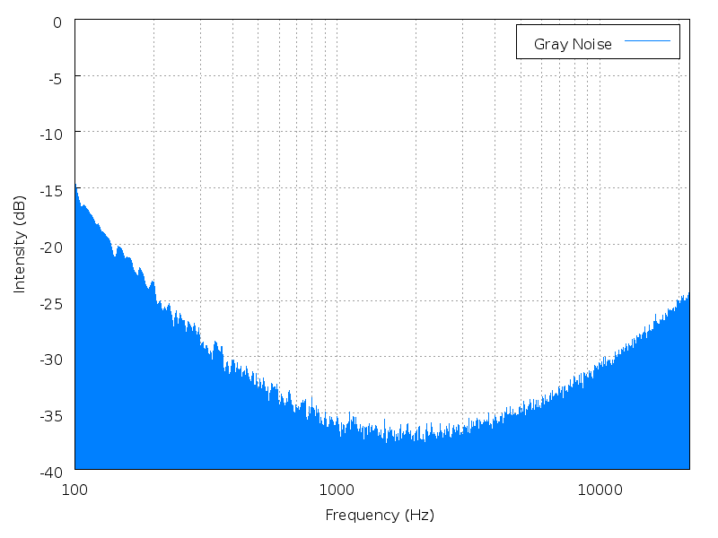
Problem: How to detect signal from color noise?
white pink red
blue purple gray
wikipedia

Slide 12
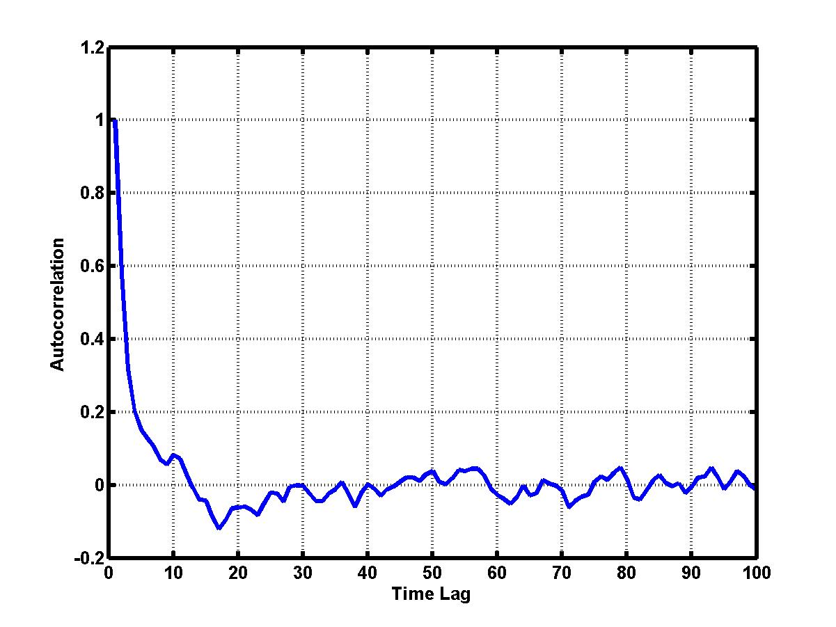
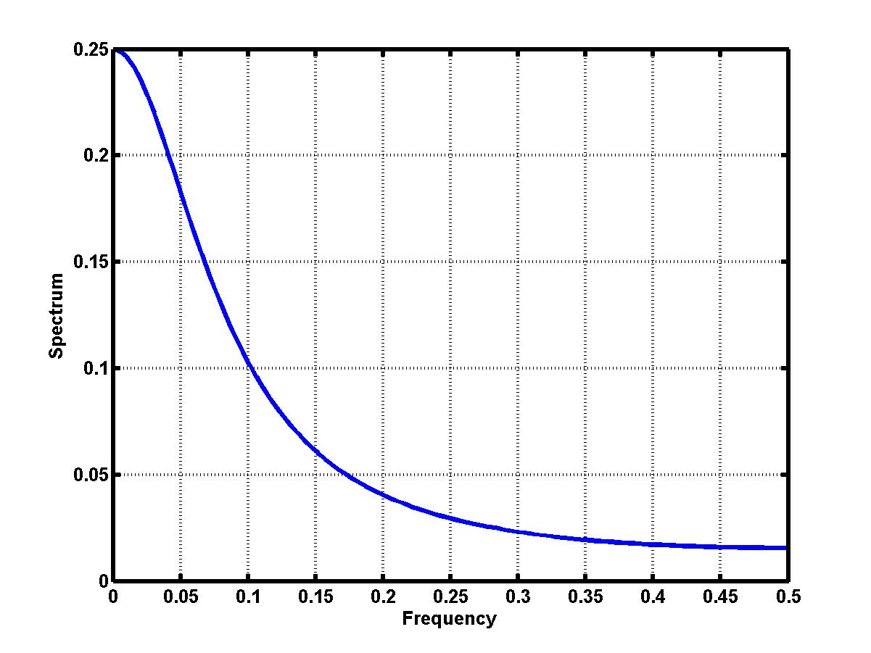
Taking red noise as an example

Slide 13
General characteristics of noise
First study the Auto-Regressive processes

Slide 15
Color noise will pass the significance test based on white noise null hypothesis.

Slide 17
AR1 - normalized spectrum

Slide 18
Changing sampling rate
AR1 - normalized spectrum [1.0 1.2]Δt

Slide 19
Changing sampling rate
AR1 - normalized spectrum [1.0 1.2 1.4] Δt

Slide 20
Changing sampling rate
AR1 - normalized spectrum [1.0 1.2 1.4 1.6] Δt

Slide 21
Changing sampling rate
AR1 - spectrum [1.0 1.2 1.4 1.6] Δt

Slide 22
Noise is a time series whose characteristics are determined by the sampling rate.

Slide 23
Noise is a time series whose characteristics are determined by the sampling rate.

Slide 25
The true signal will not be destroyed, eliminated, or distorted by re-sampling, unless the re-sampling rate is too long to identify a whole period.

Slide 26
Noise is a continuous process, whose characteristics are determined once observed by a specific sampling rate.
AR1 - normalized spectrum [1.0 1.2 1.4 1.6]

Slide 27
Can this feature be identified by Fourier analysis?

Slide 28
Can this feature be identified by Fourier analysis? - NO

Slide 29
Quantify the difference using HHT
SWMF: Spectrum-Weighted-Mean Frequency

Slide 30
Quantify the difference using HHT

Slide 31
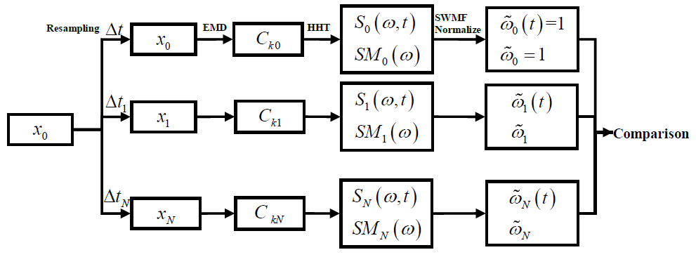
Adaptive Null Hypothesis
H₀: The time series under investigation contains nothing but random noise.
H₁: Reals signals are presented in the data.
Testing method:

Slide 32
Characteristics of the method
Valid for many different kinds of noise (not all tested)
Tested:
White
Red (AR, fGn)
Ultraviolet (fGn)

Slide 33
Characteristics of the method
Valid for nonstationary time series

Slide 34
Characteristics of the method
Valid for nonstationary time series

Slide 35
Characteristics of the method
Valid for nonstationary time series

Slide 36
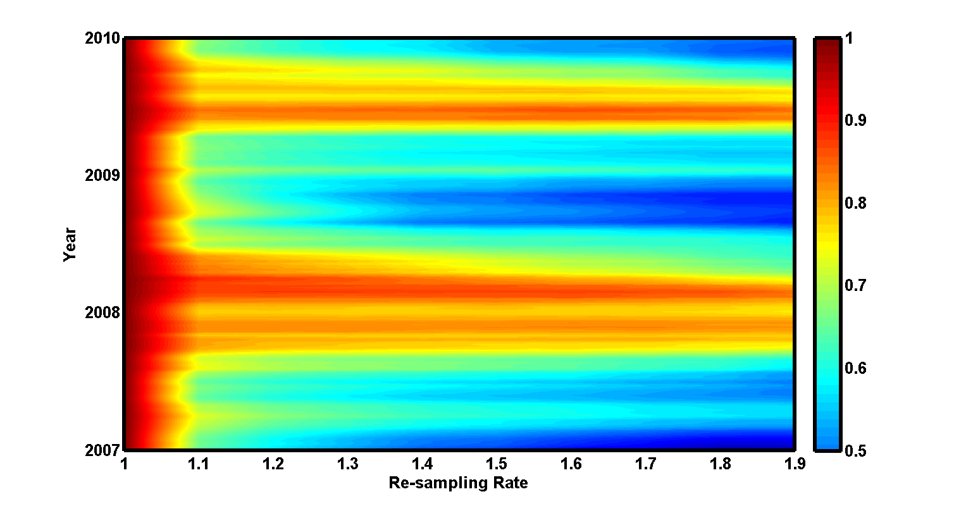
Characteristics of the method
Valid for nonstationary time series

Slide 37
Examples - I

Slide 38
Examples - I

Slide 39
Examples - II

Slide 40
Examples - II

Slide 41
Examples - III Sea Surface Temperature (SST)

Slide 42
Examples - III

Slide 43
Examples - III

Slide 44
Examples - III Sea Surface Temperature (SST)

Slide 45
Examples - III

Slide 46
Examples - III

Slide 47
Examples - III

Slide 48
Examples - III

Slide 49
Conclusion
An adaptive null hypothesis for testing the characteristics of background and further detecting the signal from data with unknown noise are proposed.
The proposed adaptive null hypothesis and fractional re-sampling technique (FRT) has several advantages for detecting signals from noisy data:
It is based on one of the general characteristics of noise processes, without pre-defined function form or a prior knowledge of background noise. This makes the method effective when dealing with many real applications, in which neither signals nor noise is known before analysis.
It is based on the EMD method, which is developed mainly for analyzing nonlinear and nonstationary time series. Notice that both the null hypothesis and the testing methods do not involved linear or stationary assumptions. Therefore, this method is valid for nonlinear and nonstationary processes, which is very often the case in real applications.

Slide 50
Thanks and Questions!

