Slide 1
Quantification of
Nonlinearity and Nonstionarity
Norden E. Huang
With collaboration of
Zhaohua Wu; Men-Tzung Lo; Wan-Hsin Hsieh;
Chung-Kang Peng; Xianyao Chen; Erdost Torun; K. K. Tung
IPAM, January 2013

Slide 2


Slide 3
The term, ‘Nonlinearity,’ has been loosely used, most of the time, simply as a fig leaf to cover our ignorance.
Can we measure it?

Slide 4
How is nonlinearity defined?
Based on Linear Algebra: nonlinearity is defined based on input vs. output.
But in reality, such an approach is not practical: natural system are not clearly defined; inputs and out puts are hard to ascertain and quantify.
Nonlinear system is not always so compliant: in the autonomous systems the results could depend on initial conditions rather than the magnitude of the ‘inputs.’
There might not be that forthcoming small perturbation parameter to guide us. Furthermore, the small parameter criteria could be totally wrong: small parameter is more nonlinear.

Slide 5
Linear Systems
Linear systems satisfy the properties of superposition and scaling. Given two valid inputs
as well as their respective outputs
then a linear system must satisfy
for any scalar values α and β.

Slide 6
How is nonlinearity defined?
Based on Linear Algebra: nonlinearity is defined based on input vs. output.
But in reality, such an approach is not practical: natural system are not clearly defined; inputs and out puts are hard to ascertain and quantify.
Nonlinear system is not always so compliant: in the autonomous systems the results could depend on initial conditions rather than the magnitude of the ‘inputs.’
There might not be that forthcoming small perturbation parameter to guide us. Furthermore, the small parameter criteria could be totally wrong: small parameter is more nonlinear.

Slide 7
Nonlinearity Tests
Based on input and outputs and probability distribution: qualitative and incomplete (Bendat, 1990)
Higher order spectral analysis, same as probability distribution: qualitative and incomplete
Nonparametric and parametric: Based on hypothesis that the data from linear processes should have near linear residue from a properly defined linear model (ARMA, …), or based on specific model: Qualitative

Slide 8
How should nonlinearity be defined?
The alternative is to define nonlinearity based on data characteristics: Intra-wave frequency modulation.
Intra-wave frequency modulation is the deviation of the instantaneous frequency from the mean frequency (based on the zero crossing period).

Slide 9
Characteristics of Data from
Nonlinear Processes

Slide 10
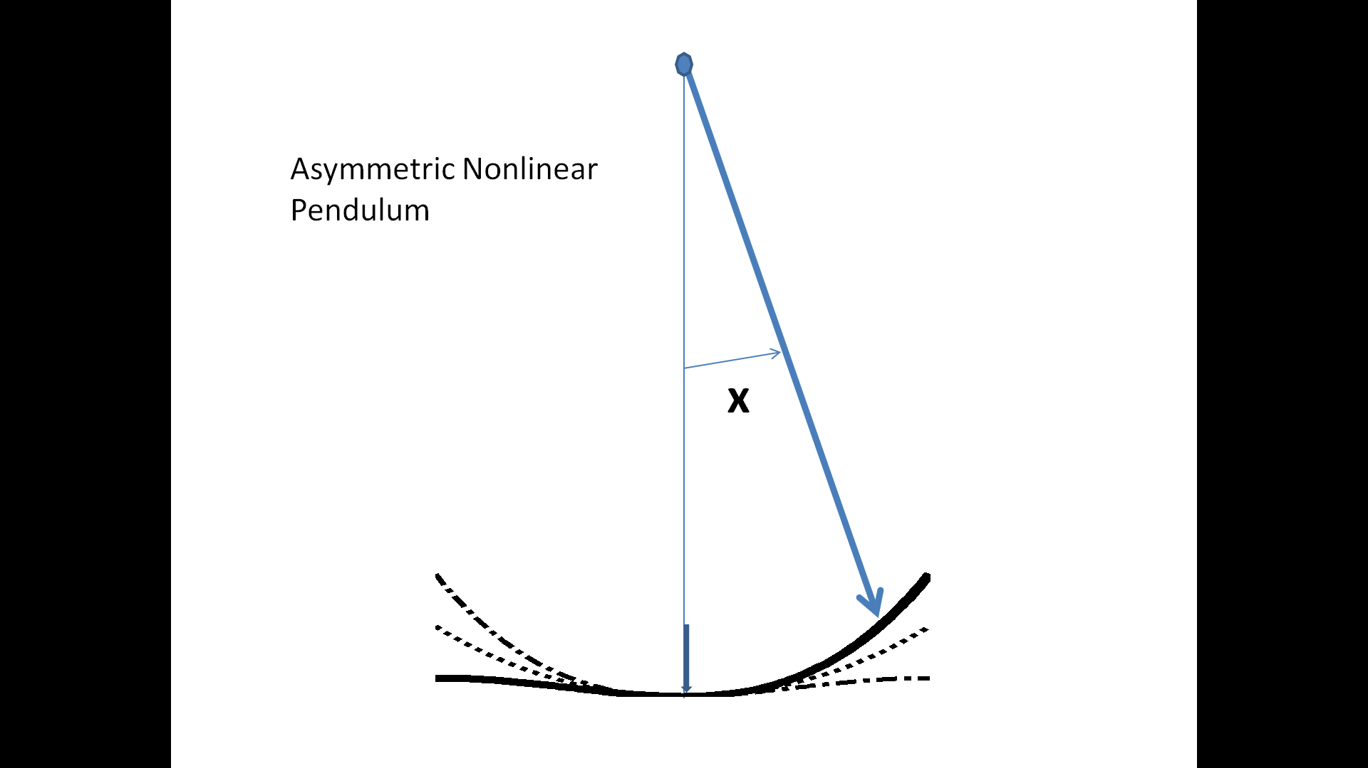
Nonlinear Pendulum : Asymmetric

Slide 11
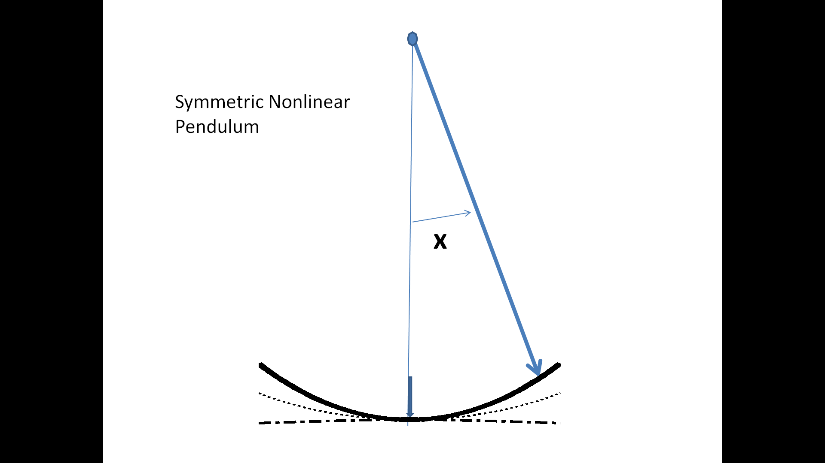
Nonlinear Pendulum : Symmetric

Slide 12
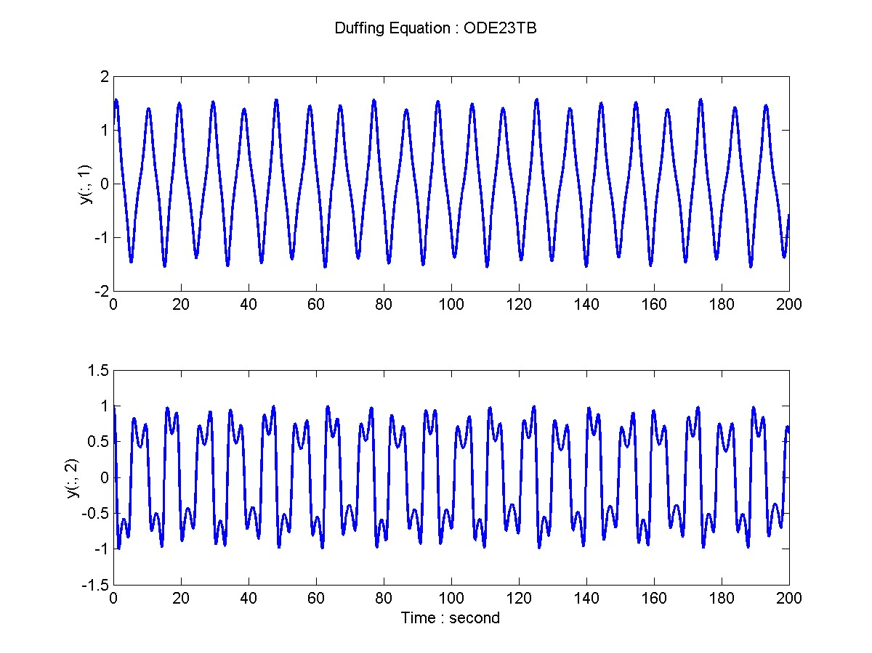
Duffing Equation : Data

Slide 13
Hilbert’s View on Nonlinear Data

Slide 14
A simple mathematical model

Slide 15
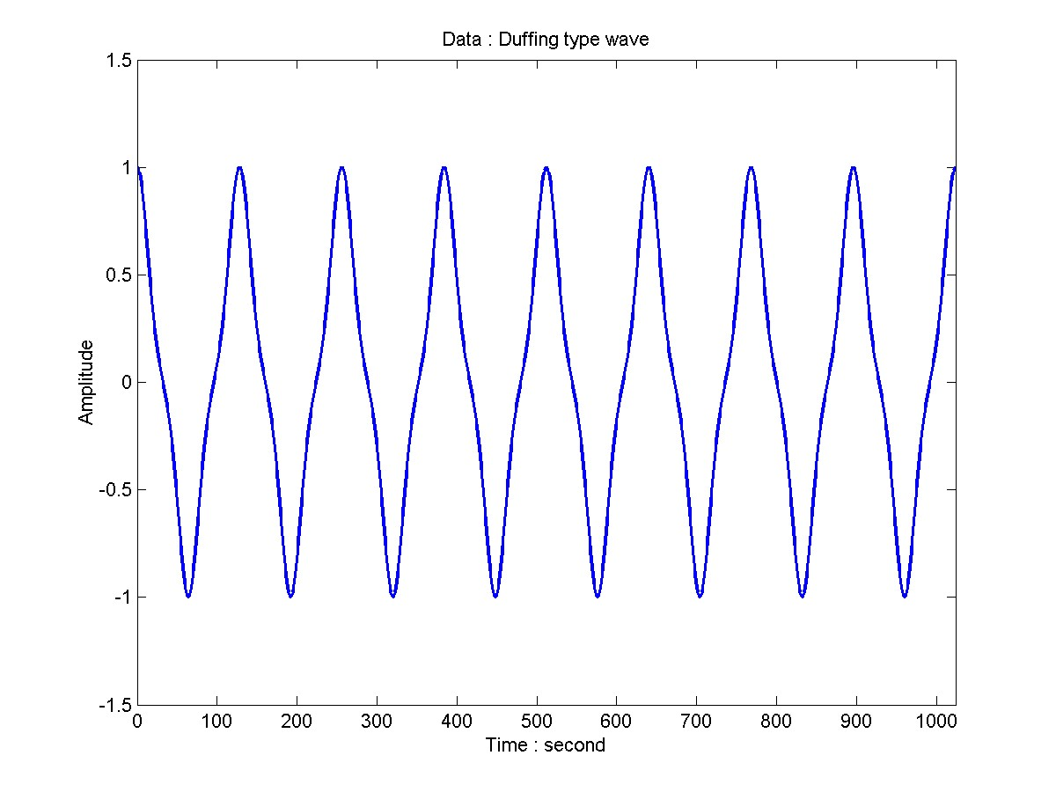
Duffing Type Wave
Data: x = cos(wt+0.3 sin2wt)

Slide 16
Duffing Type Wave
Perturbation Expansion

Slide 17
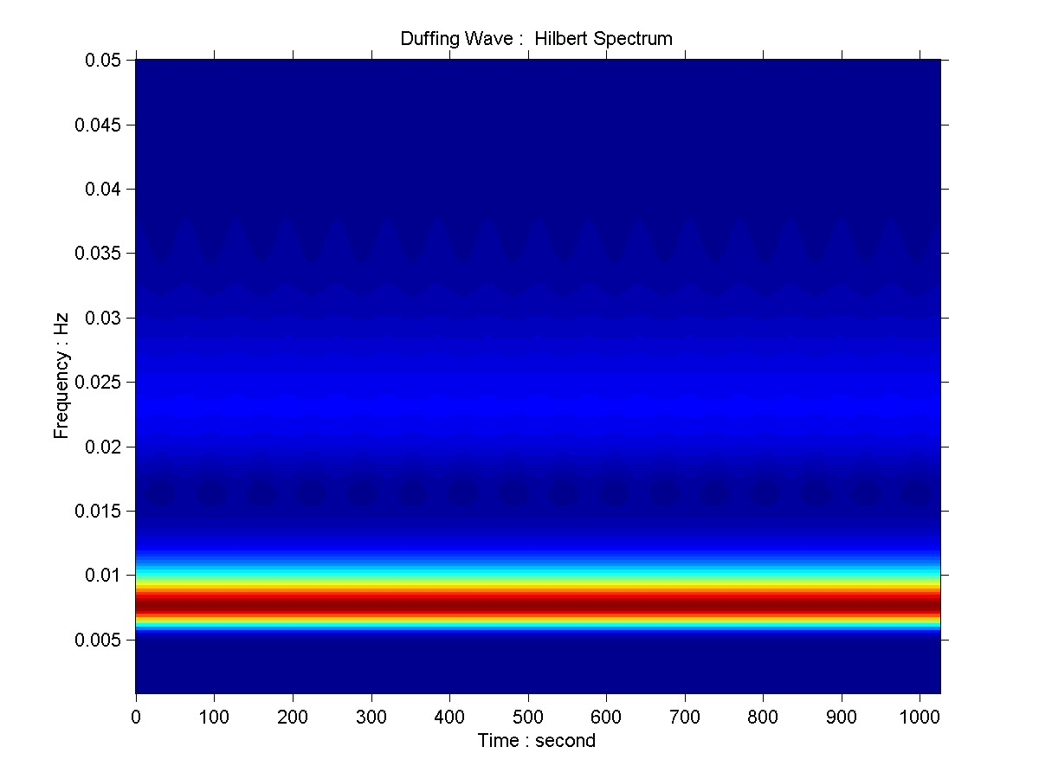
Duffing Type Wave
Wavelet Spectrum

Slide 18

Duffing Type Wave
Hilbert Spectrum

Slide 19
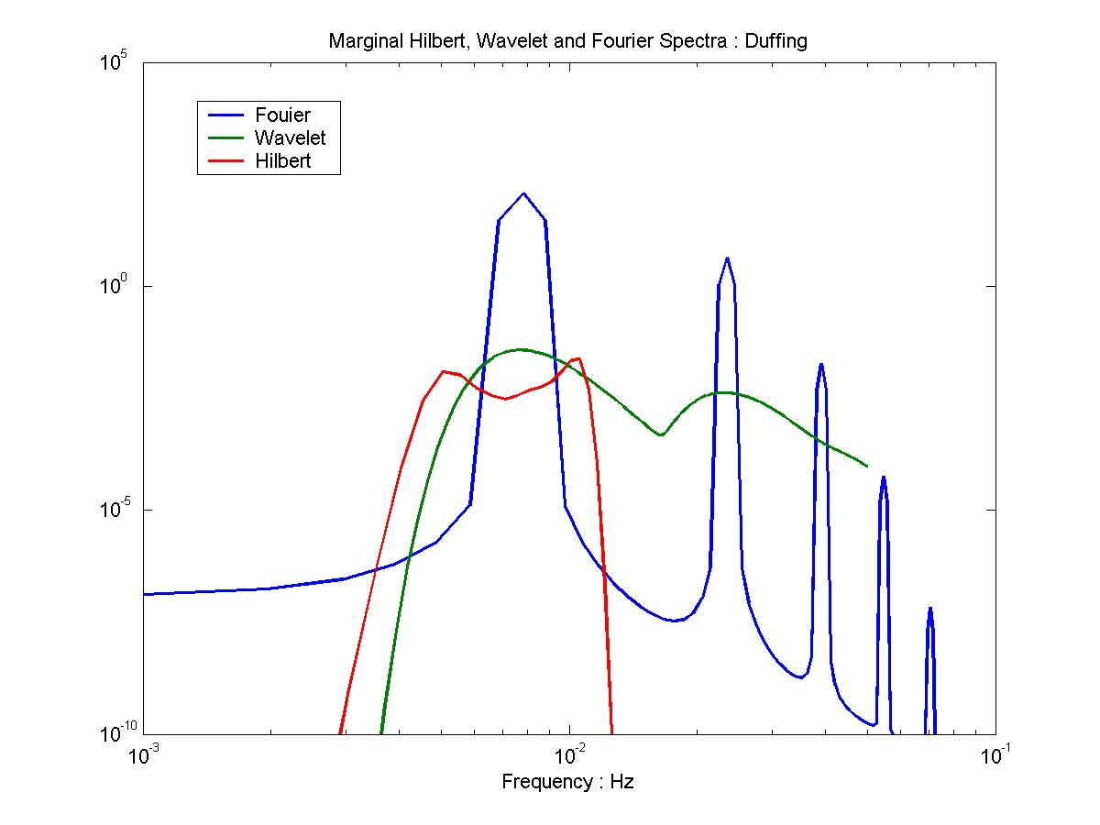
Duffing Type Wave
Marginal Spectra

Slide 20
The advantages of using HHT
In Fourier representation based on linear and stationary assumptions; intra-wave modulations result in harmonic distortions with phase locked non-physical harmonics residing in the higher frequency ranges, where noise usually dominates.
In HHT representation based on instantaneous frequency; intra-wave modulations result in the broadening of fundamental frequency peak, where signal strength is the strongest.

Slide 21
Define the degree of nonlinearity
Based on HHT for intra-wave frequency modulation

Slide 22
Characteristics of Data from
Nonlinear Processes

Slide 23
Degree of nonlinearity

Slide 24
The influence of amplitude variations
Single component
To consider the local amplitude variations, the definition of DN should also include the amplitude information; therefore the definition for a single component should be:

Slide 25
The influence of amplitude variations for signals with multiple components
To consider the case of signals with multiple components, we should assign weight to each individual component according to a normalized scheme:

Slide 26
Degree of Nonlinearity
We can determine DN precisely with Hilbert Spectral Analysis.
We can also determine δ and η separately.
η can be determined from the instantaneous frequency modulations relative to the mean frequency.
δ can be determined from DN with η determined. NB: from any IMF, the value of ηδ cannot be greater than 1.
The combination of δ and η gives us not only the Degree of Nonlinearity, but also some indications of the basic properties of the controlling Differential Equation.

Slide 27
Calibration of the Degree of Nonlinearity
Using various Nonlinear systems

Slide 28
Stokes Models

Slide 29
Stokes I

Slide 30
Phase Diagram

Slide 31
IMFs

Slide 32
Data and IFs : C1

Slide 33
Data and IFs : C2

Slide 34
Stokes II

Slide 35
Phase Diagram

Slide 36
Data and Ifs : C1

Slide 37
Data and Ifs : C1 details

Slide 38
Data and Ifs : C2

Slide 39
Combined Stokes I and II

Slide 40
Water Waves
Real Stokes waves

Slide 41
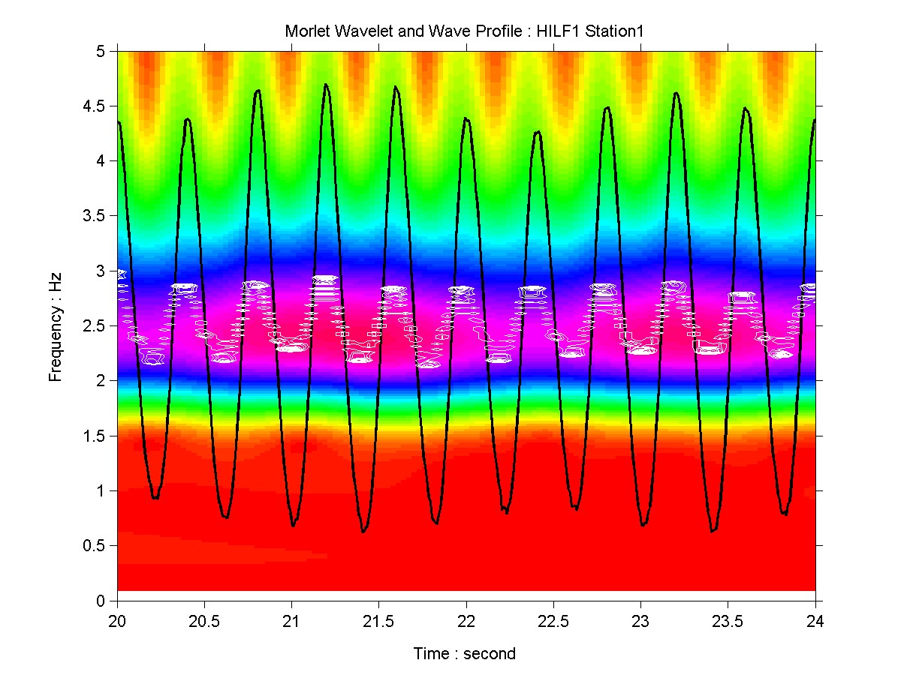
Comparison : Station #1

Slide 42
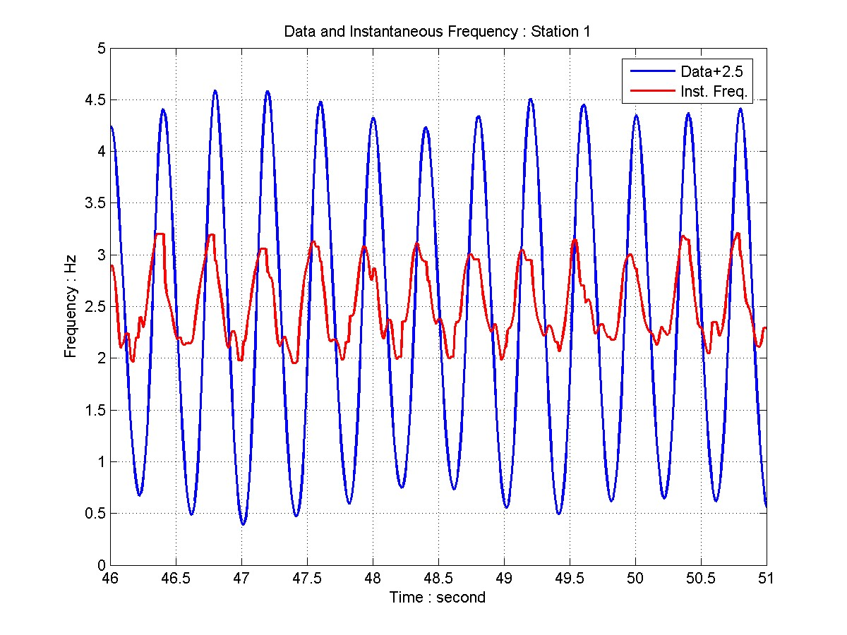
Data and IF : Station #1
DN=0.1607

Slide 43
Duffing Models

Slide 44
Duffing I

Slide 45
Phase Diagram

Slide 46
IMFs

Slide 47
Data and IFs

Slide 48
Data and Ifs Details

Slide 49
Summary Duffing I

Slide 50
Duffing II

Slide 51
Summary Duffing II

Slide 52
Summary Duffing II

Slide 53
Duffing O : Original

Slide 54
Data and IFs

Slide 55
Data and Ifs : Details

Slide 56
Phase Diagram

Slide 57
IMFs

Slide 58
Duffing 0 : Original

Slide 59
Phase : e=0.50

Slide 60
IMF e=0.50

Slide 61
Data and Ifs : e=0.50

Slide 62
Data and Ifs : details e=0.50

Slide 63
Summary : Epsilon

Slide 64
Summary All Duffing Models

Slide 65
Lorenz Model

Slide 66
Lorenz Model
Lorenz is highly nonlinear; it is the model equation that initiated chaotic studies.
Again it has three parameters. We decided to fix two and varying only one.
There is no small perturbation parameter.
We will present the results for ρ=28, the classic chaotic case.

Slide 67
Phase Diagram for ro=28

Slide 68
X-Component
DN1=0.5147
CDN=0.5027

Slide 69
Data and IF

Slide 70
Spectra data and IF

Slide 71
IMFs

Slide 72
Hilbert Spectrum

Slide 73
Degree of Nonstationarity
Quantify nonstationarity

Slide 74
Need to define the Degree Stationarity
Traditionally, stationarity is taken for granted; it is given; it is an article of faith.
All the definitions of stationarity are too restrictive and qualitative.
Good definition need to be quantitative to give a Degree of Stationarity

Slide 75
Definition : Strictly Stationary

Slide 76
Definition : Wide Sense Stationary

Slide 77
Definition : Statistically Stationary
If the stationarity definitions are satisfied with certain degree of averaging.
All averaging involves a time scale. The definition of this time scale is problematic.

Slide 78
Stationarity Tests
To test stationarity or quantify non-stationarity, we need a precise time-frequency analysis tool.
In the past, Wigner-Ville distribution had been used. But WV is Fourier based, which only make sense under stationary assumption.
We will use a more precise time-frequency representation based on EMD and Hilbert Spectral Analysis.

Slide 79
Degree of Stationarity
Huang et al (1998)

Slide 80
Problems
The instantaneous frequency used here includes both intra-wave and inter-wave frequency modulations: mixed nonlinearity with nonstationarity.
We have to define frequency here based on whole wave period, ω_{z} , to get only the inter-wave modulation.
We have also to define the degree of non-stationarity in a time dependent way.

Slide 81
Tim-dependent Degree of non-Stationarity: with a sliding window ΔT

Slide 82
Time-dependent Degree of Non-linearity
For both nonstationary and nonlinear processes

Slide 83
Time-dependent degree of nonlinearity
To consider the local frequency and amplitude variations, the definition of DN should be time- dependent as well. All values are defined within a sliding window ΔT:

Slide 84
Application to Biomedical case

Slide 85
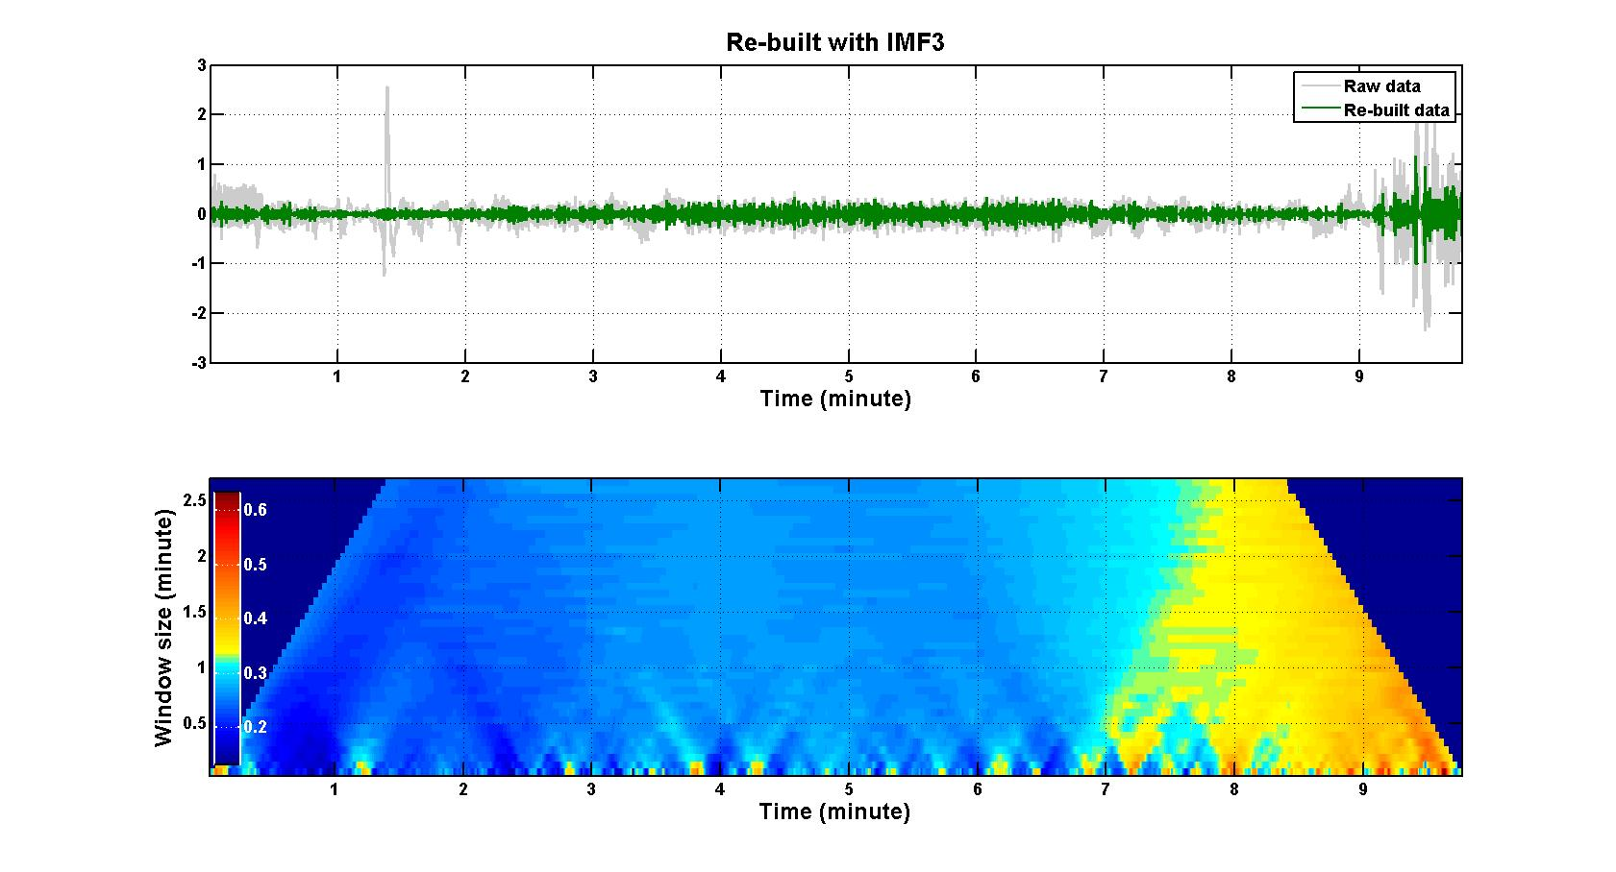
Heart Rate Variability : AF Patient

Slide 87
Conclusion
With HHT, we can have a precisely defined instantaneous frequency; therefore, we can also define nonlinearity quantitatively.
Nonlinearity should be a state of a system dynamically rather than statistically.
There are many applications for the degree of nonlinearity in system integrity monitoring in engineering, biomedical and natural phenomena.

Slide 88
Thanks

